Slide 1
Principal Component
Analysis (PCA)

Slide 2
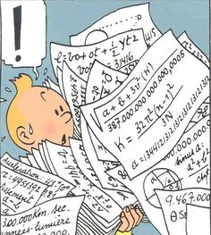
Problem… again
Someone shows up in your “data scientist” office with a new data set, throws it on your desk and says :
  “I need you to analyze these data”
  “What is it?”
  “ [insert here long explanation
  about a sample with
  way too many features] ”
And the person leaves… living you with a confusing data set on your desk.

Slide 3
Let's be smart… and a bit lazy
A high number of features (i.e. dimensions) is often a problem for analysis.
Some features are more relevant than others and it is interesting to reduce our work to the most important features/dimensions.
How do I effectively find a space of lower dimension for my study without losing relevant informations?

Slide 4
PCA is your Friend
The purpose of the Principal Component Analysis is to find how to reduce a complex data set to a lower dimension to reveal the sometimes hidden, simplified dynamics that often underlie it.
Jon Shlens 2003
A Tutorial On Principal Component Analysis
the content of this presentation is greatly inspired by the above reference

Slide 5
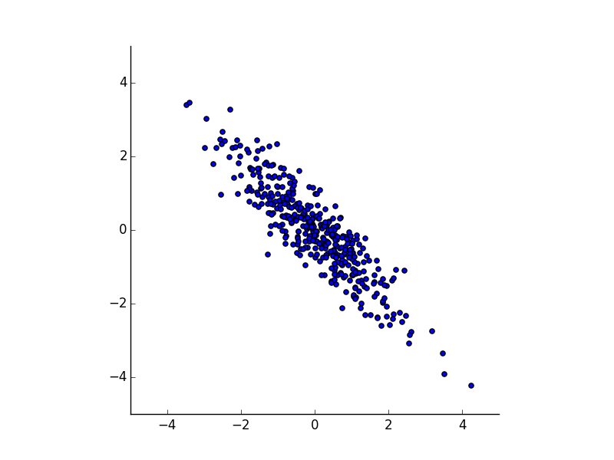
Intuitive Approach
Consider the following distribution.
We can (easily) fit an ellipse
to the distribution…
… which has a major and
a minor axis.
The Major axis is
simply the
Principal Component

Slide 6
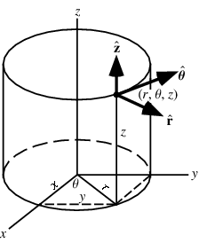
Physicist Point of View
In Physics it is one of the first step to solve a problem :
  Find the most convenient basis to express and solve our problem.
Example : For a problem with an axis of symmetry I should use the cylindrical coordinates instead of the Cartesian ones.

Slide 7
PCA Assumption
Now we want to find the best basis to express the data set, in other words :
  What is the best basis to express my data set which is a linear combination fo the original basis?
From here it is a linear algebra problem.
(Note : linearity is a strong assumption that helps simplifying our problem)

Slide 8
First Formulation
Let's X be our original data set m samples, n features
and Y its representation in a new basis, we have :
  P.X = Y
where P is a transformation matrix.
Before doing maths, let's think a bit :
What do we want Y to highlight and therefore what is a good choice for P ?
Well, Let me tell you about noise and redundancy...

Slide 9
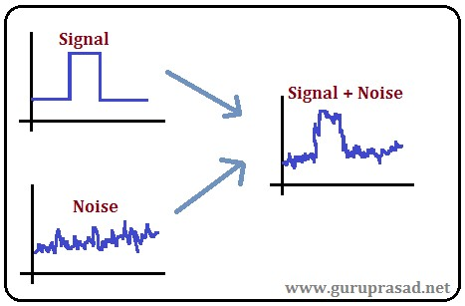
Noise
In any data set noise is present.
Instead of measuring its absolute amplitude it is very often more interesting and meaningful to compare it to the signal amplitude.
  Signal-to-Noise-Ratio :
SNR ≫ 1 : high precision
SNR∼1 : can't separate
Noise and Signal

Slide 10
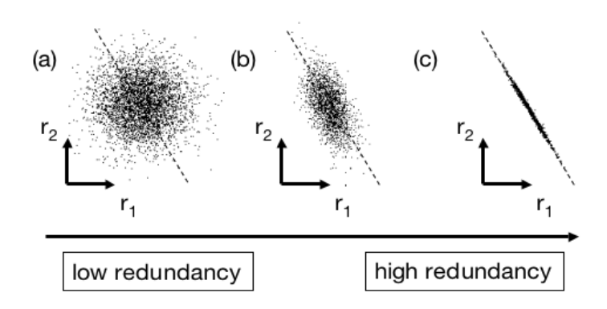
Redundancy
It is about how two measures are correlated. If they are then we have redundancy.

Slide 11
Noise and Redundancy
Dimensional reduction :
  Prevent redundancy and get rid of noise to keep the very essence of the data set.
To quantify redundancy we introduce the covariance between two vectors of measurements A and B:
  covariance is null if A and B are uncorrelated
  covariance is the variance σ²A if A=B
Note : A and B have zero mean.

Slide 12
Covariance
Covariance can also be expressed as :
We can generalize to X and define the covariance matrix :
Where n is the number of features.

Slide 13
Covariance Matrix
Properties of the covariance matrix S:
  S is a square symmetric m × m matrix
  S diagonal terms are the variance of measurements
  S off-diagonal terms are the covariance between measurements.
Computing S quantify correlations between pairs of observations.

Slide 14
Covariance Matrix
no redundancy
=
covariance equal to zero
=
S off-diagonal terms equal to zero
=
S is a diagonal matrix

Slide 15
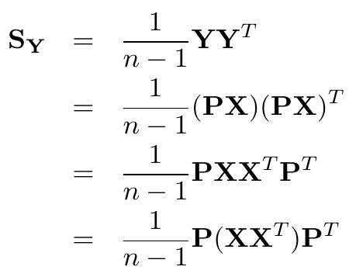
Little Calculus
We have the initial covariance matrix for X : SX
We want the covariance matrix for Y : SY to be diagonal.
We have :

Slide 16
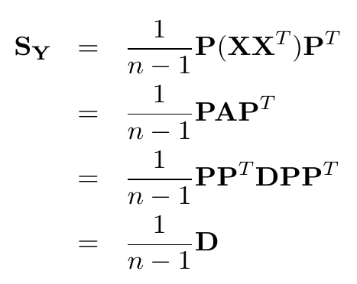
Little Calculus
Let's take A=XX^{T} it is a symmetric matrix…
… meaning that it is diagonalized by an orthogonal matrix of its eigenvectors E!

Slide 17
To Summarize
P is a matrix which rows are eigenvectors of XX^{T}
S_{Y} is a diagonal matrix where the i^{th} diagonal element is the variance of X along i^{th} row of P
Actually the eigenvector with the highest eigenvalue is the principle component.
We can then also arrange the eigenvectors based on their eigenvalues.

Slide 18
Dimensional Reduction
In order to reduce dimensionality we can simply drop eigenvectors with lowest eigenvalues.
i.e. remove rows from P
We only keep the dimension that contribute the most to the total variance and hence are more important by projecting X along P :
Y = P.X
Y is of lower dimension than X

Slide 19
PCA Recipe
Get data
Subtract the mean for each dimension
Calculate the covariance matrix
Calculate the eigenvectors and eigenvalues of the covariance matrix
Choose the main components (for dimensional reduction)
Derive the new data set
Lindsay I Smith 2002
A tutorial on Principal Component Analysis

Slide 20
To go further
More General Solution :
Singular Value Decomposition (SVD)
Independant Component Analysis (ICA)

Slide 21

Coding Time (1)
Create a new notebook to try PCA
  First on a simple distribution
  On a more complex data set of your choice once you have understood well the algorithm

