Slide 1
Bayesian Statistics
(some) Applications

Slide 2
Bayes Factor
The Bayes Factor is used to compare two models.
Let's consider two models M1 and M2 with parameters θ₁ and θ₂ and the observed data X. The Bayes Factor is given by :

Slide 3
Bayes Factor
Somehow Bayes Factor can be used to compare an hypothesis against its null-hypothesis. In that case you might find the following table in the literature :
B | 2.ln(B) | Evidence against H₀
1 to 3 | 0 to 2 | Not worth mentioning
3 to 20 | 2 to 6 | Positive
20 to 150 | 6 to 10 | Strong
> 150 | >10 | Very Strong

Slide 4
Bayesian Information Criterion
The Bayesian Information Criterion (BIC) is used for model selection.
Let's consider a model M with parameters θ and X are the observed data. The BIC is defined as
where k is the number of free parameters, n is the number of samples (must be large) and L is the maximum likelihood value.

Slide 5
BIC Properties
Independent of the prior choice
Measures the efficiency of M to predict the data
Penalizes complex models (number of parameters)
Can be used to choose the number of clusters according to the intrinsic complexity present in a data set (such as Gaussian Mixture Model).

Slide 6
Naive Bayes
It is a classification method (supervised).
Why “Naive”?
  !!! NAIVE ≠ STUPID !!!
  Because it makes the naive assumption of independence between features.
Basically it computes how likely an element belongs to a class based on its features value.

Slide 7


Naive Bayes -Simple Example
Example extracted from “Bayesian Reasoning and Machine Learning” (D. Barber 2010)
Scottish or English ?
Features (yes=1,no=0):
  Likes shortbread
  Likes lager
  Drinks whiskeys
  Eats porridge
  Watch England play football

Slide 8
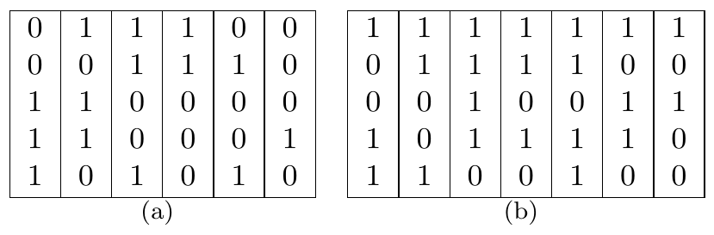
Naive Bayes -Simple Example
Observation : x = [1,0,1,1,0]
Labels : English or Scottish based on
Features
English Tastes
Scottish Tastes

Slide 9
Naive Bayes -Simple Example
Probability to be Scottish :
Priors (cf data set): P(scot) = 7/13 and P(eng) = 6/13
Likelihoods :

Slide 10
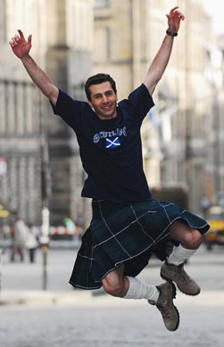
Naive Bayes -Simple Example
Substituting everything in :
We obtain
The person is very
likely Scottish.

Slide 11
Naive Bayes - Comments
If another Scottish person takes the test and does not like shortbread it would be misclassified as English (don't do that)!
Naive Bayes struggles with sparse data.
Naive Bayes techniques differ on the assumption we make for the likelihood P(x | class) (can be gaussian multinomial, etc...).
Overall appears to perform surprisingly well for many classification problems.

Slide 12

Coding Time (1)
Choose your favorite data set and try the different Naive Bayes classification methods...

Slide 13
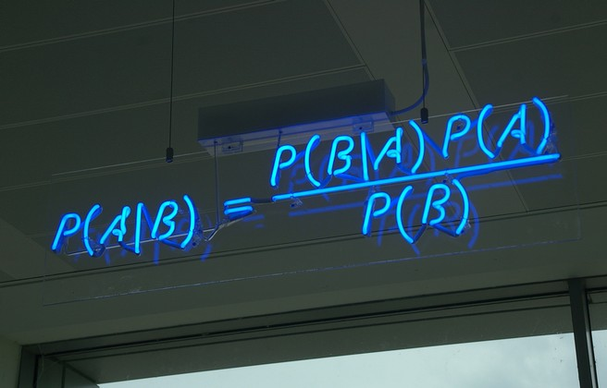
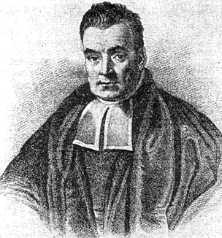
What Else ???
Well… many more applications…
… and so little time...

