Slide 1


Poise: Balancing Thread-Level Parallelism and Memory System Performance in GPUs using Machine Learning
Saumay Dublish* Vijay Nagarajan ‡ Nigel Topham‡
* Synopsys Inc.
‡ The University of Edinburgh
HPCA 2019
Washington D.C., USA
19th February, 2019

Slide 2

GPU Architecture
Overview
GPUs are throughput-oriented systems
Focus on overall system throughput
Rely on high levels of multithreading
Implemented by switching across warps
Overlap latency with useful execution
SM
SM
SM
L1
L1
L1
L2
DRAM
GPU Architecture
Overview
Notes:
GPUs are throughput oriented systems that are concerned with overall system performance and not with single threaded performance.
To achieve this goal, they allow concurrent execution of thousands of threads and use multithreading to maximize system performance.

Slide 3
GPU Architecture
Consequence of increasing TLP
Increasing TLP not always useful
Leads to cache thrashing
Leads to bandwidth bottlenecks
Results in high levels of congestion
Latencies tend to be very high!
Can such high latencies be hidden?
SM
SM
SM
L1
L1
L1
L2
DRAM
GPU Architecture
Consequence of increasing TLP
Notes:
Increasing TLP is not always useful

Slide 4
Hiding Latencies in GPUs
Harnessing concurrency
LOAD
Independent
Independent
Independent
Independent
Load latency
Instruction concurrency
(Intra-warp concurrency)
Execution
time
DEPENDENCY
LOAD
LOAD
Independent
Independent
Independent
Independent
Warp concurrency
LOAD
Load latency
Independent
Independent
Independent
Independent
LOAD
(Inter-warp concurrency)
Independent
Independent
Independent
Independent
LOAD
Independent
Independent
Independent
Independent
Execution
time
Independent
Independent
Independent
Independent
DEPENDENCY
DEPENDENCY
DEPENDENCY
DEPENDENCY
DEPENDENCY
GPU Architecture
Hiding Latencies in GPUs
Notes:
A warp typically hosts a load instruction and an instruction dependent on the load with a bunch of independent operations in between

Slide 5
Hiding Latencies in GPUs
Harnessing concurrency
LOAD
Independent
Independent
Independent
Independent
Load latency
Instruction concurrency
(Intra-warp concurrency)
Execution
stall
time
DEPENDENCY
LOAD
LOAD
Independent
Independent
Independent
Independent
Warp concurrency
LOAD
Load latency
Independent
Independent
Independent
Independent
LOAD
(Inter-warp concurrency)
Independent
Independent
Independent
Independent
LOAD
Independent
Independent
Independent
Independent
Execution
time
Independent
Independent
Independent
Independent
DEPENDENCY
DEPENDENCY
DEPENDENCY
DEPENDENCY
DEPENDENCY
GPU Architecture
Hiding Latencies in GPUs
Notes:
But a single warp does not provide enough concurrency to hide the entire memory latency

Slide 6
Hiding Latencies in GPUs
Harnessing concurrency
LOAD
Independent
Independent
Independent
Independent
Load latency
Instruction concurrency
(Intra-warp concurrency)
Execution
stall
time
DEPENDENCY
LOAD
LOAD
Independent
Independent
Independent
Independent
Warp concurrency
LOAD
Load latency
Independent
Independent
Independent
Independent
LOAD
(Inter-warp concurrency)
Independent
Independent
Independent
Independent
LOAD
Independent
Independent
Independent
Independent
Execution
time
Independent
Independent
Independent
Independent
DEPENDENCY
DEPENDENCY
DEPENDENCY
Works well in compute-intensive applications
DEPENDENCY
DEPENDENCY
GPU Architecture
Hiding Latencies in GPUs
Notes:
Load latencies get overlapped due to memory level parallelism, and busy cycles get added.
Instruction concurrency - Independent instructions within a warp
Warp concurrency - Independent instructions interleaved across warps

Slide 7
The Case of Limited Parallelism
Fewer independent operations
LOAD
Independent
Independent
Independent
Independent
Load latency
Instruction concurrency
(Intra-warp concurrency)
Execution
stall
time
DEPENDENCY
LOAD
LOAD
Independent
Independent
Independent
Independent
Warp concurrency
LOAD
Load latency
Independent
Independent
Independent
Independent
LOAD
(Inter-warp concurrency)
Independent
Independent
Independent
Independent
LOAD
Independent
Independent
Independent
Independent
Execution
time
Independent
Independent
Independent
Independent
DEPENDENCY
DEPENDENCY
DEPENDENCY
DEPENDENCY
DEPENDENCY
GPU Architecture
The Case of Limited Parallelism
Notes:
But there are a growing set of applications with very few independent operations in a warp

Slide 8
The Case of Limited Parallelism
Fewer independent operations
LOAD
Independent
Independent
Independent
Independent
Load latency
Instruction concurrency
(Intra-warp concurrency)
Execution
stall
time
DEPENDENCY
LOAD
LOAD
Independent
Independent
Independent
Independent
Warp concurrency
LOAD
Load latency
Independent
Independent
Independent
Independent
LOAD
(Inter-warp concurrency)
Independent
Independent
Independent
Independent
LOAD
Independent
Independent
Independent
Independent
Execution
stall
time
Independent
Independent
Independent
Independent
DEPENDENCY
DEPENDENCY
DEPENDENCY
DEPENDENCY
DEPENDENCY
GPU Architecture
The Case of Limited Parallelism

Slide 9
The Case of Limited Parallelism
Fewer independent operations
LOAD
Independent
Independent
Independent
Independent
Load latency
Instruction concurrency
(Intra-warp concurrency)
Execution
stall
time
DEPENDENCY
LOAD
Higher load latency due to congestion
LOAD
Independent
Independent
Independent
Independent
LOAD
LOAD
LOAD
Independent
Independent
Independent
Independent
LOAD
LOAD
Independent
Independent
Independent
Independent
Independent
Independent
Independent
Independent
LOAD
Independent
Independent
Independent
Independent
Warp concurrency
LOAD
Load latency
Independent
Independent
Independent
Independent
Independent
Independent
Independent
Independent
LOAD
LOAD
LOAD
Independent
Independent
Independent
Independent
Independent
Independent
Independent
Independent
Independent
Independent
Independent
Independent
(Inter-warp concurrency)
LOAD
LOAD
LOAD
Independent
Independent
Independent
Independent
DEPENDENCY
Independent
Independent
Independent
Independent
Execution
time
Independent
Independent
Independent
Independent
Independent
Independent
Independent
Independent
DEPENDENCY
Independent
Independent
Independent
Independent
DEPENDENCY
DEPENDENCY
DEPENDENCY
DEPENDENCY
DEPENDENCY
DEPENDENCY
DEPENDENCY
Impractically large number of warps required to completely hide latency
DEPENDENCY
DEPENDENCY
DEPENDENCY
DEPENDENCY
DEPENDENCY
DEPENDENCY
GPU Architecture
The Case of Limited Parallelism
Notes:
In order to have the same level of parallelism that we had in compute-intensive applications, one would need impractically large number of warps.
It is often not possible to have so many warps due to resource constraints and hardware limitations.
Within practical limits, it only increases the memory latency without significantly improving the parallelism

Slide 10
Need For Balance
Tension between TLP and memory system performance
Increase TLP to improve concurrency – latency worsens
Reduce TLP to reduce latency – concurrency worsens
☓
☓
✓
✓
Concurrency
Memory Performance
Optimal system throughput with balanced TLP and memory performance
GPU Architecture
Need for Balance
Notes:
Case 1: Lower system throughput due to high congestion and exposed latencies
Case 2: Lower system throughput due to restricted parallelism
Somewhere in the middle lies a balance which provides sufficient concurrency without causing cache thrashing and memory congestion

Slide 11
Outline
Problem Statement Balancing TLP and memory performance
Prior state-of-the-art CCWS and PCAL warp schedulers
Pitfalls in prior techniques Iterative search and prone to local optima
Goals Computing the best warp scheduling decisions
Proposal Poise
Results Experimental results
Conclusion Key takeaways

Slide 12
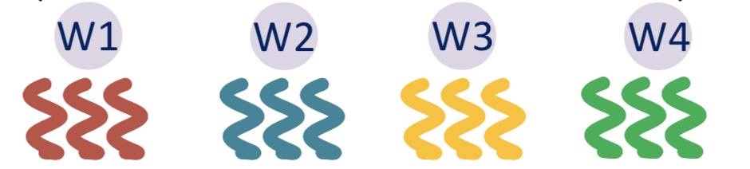
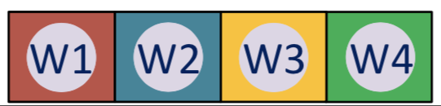
Prior state-of-the-art
Cache-conscious wavefront scheduling (CCWS)
Limits the degree of multithreading
Warps
Cache Thrashing
L1 cache
Memory Congestion
Prior state-of-the-art
CCWS
Notes:
One of the first few techniques to propose reducing TLP to improve system throughput was CCWS.
The authors recognized that high number of warps cause cache thrashing and congestion, and suggested reducing these warps

Slide 13
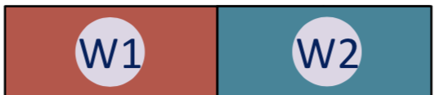
Prior state-of-the-art
Cache-conscious wavefront scheduling (CCWS)
Limits the degree of multithreading
☓
Warps
Reduces cache thrashing
Cache Thrashing
L1 cache
Memory Congestion
Relieves congestion
Shortcomings
Couples warps with cache performance
Underutilization of shared memory resources
Dynamic policy has significant performance and cost overheads
Static policy burdens the user with the task of profiling every workload
Prior state-of-the-art
CCWS

Slide 14
Prior state-of-the-art
Priority-based cache allocation (PCAL)
Alter parallelism independent of memory system performance
☓
☓
Warps
L1 cache
Prior state-of-the-art
CCWS
Notes:
PCAL continues to use lower number of warps to maintain good cache performance

Slide 15
Prior state-of-the-art
Priority-based cache allocation (PCAL)
Vital warps (W1, W2, W3)
☓
Warps
CCWS search space
Cache-polluting warps
L1 cache
PCAL search space
Cache-polluting warps
(W1, W2)
Vital warps
Prior state-of-the-art
PCAL

Slide 16
Prior state-of-the-art
Priority-based cache allocation (PCAL)
Vital warps (N)
Determine degree of multithreading
Cache-polluting warps (p)
CCWS search space
Subset of vital warps
Ability to allocate and evict the L1 cache
Reduce cache contention
Cache-polluting warps
PCAL search space
Warp-tuple { N, p }
Vital warps
Prior state-of-the-art
PCAL
Notes:
High TLP maybe counter-productive as it increases the latencies which we wanted to hide in the first place
Instruction concurrency - Independent instructions within a warp
Warp concurrency - Independent instructions interleaved across warps

Slide 17
Limitations of PCAL
Heuristic-based iterative search are slow in hardware
Prone to local optima in presence of multiple performance peaks
These two limitations lead to sub-optimal solutions
Iterative hill climbing
Cache-polluting warps
Local optimum
Vital warps
Prior state-of-the-art
Limitations of PCAL
Notes:
Heuristics based iterative search are particularly slow in hardware due to the time needed to generate the heuristics which is typically by sampling.
The impact is even more when the starting point is far from the solution.
Iterative searches can get trapped in a local optima when there are multiple performance peaks in the search space, which is in fact true for GPUs.

Slide 18
Goals
How to find the best warp-tuple?
Balance TLP and memory performance
Avoid local optima
Converge expeditiously
Low sampling and hardware overhead
Avoid burdening the user
Cache-polluting warps
Best warp-tuple?
Vital warps
Goals
Notes:
While we have described the problem before – striking a balance between TLP and memory system performance
We now define the problem statement further – through the levers defined by PCAL – how to find the best warp-tuple that best balances TLP and memory
Challenges:
Heuristics based iterative search are prone to local optima in presence of multiple performance peaks in the solution space
Iterative search is slow in hardware
It should not add profiling burden on the user like several profiling based techniques do

Slide 19
Proposal
Poise
A technique to dynamically balance TLP and memory system performance
Machine Learning Framework
Hardware Inference Engine
Supervised learning
Runtime prediction
Unseen user application
Feature Set
Runtime Input
Sample Input
Training Dataset
Regression Model
Feature weights
Prediction Stage &
Local Search
Profiled Kernels
Poise Prediction
via compiler
Sample Output
Best warp-tuple
Best warp-tuple
Poise
Poise: A System Overview
Notes:
The machine learning framework comprises a training set which is used to learn about good warp scheduling decisions
The profiled kernels feed sample input and output to the regression model which performs supervised learning
It learns a mapping from input to output and conveys that learning to the hardware throught the compiler

Slide 20
Machine Learning Framework
Analytical Model
Black-box techniques provide little insight
Analytical model uses domain knowledge to identify reliable features
Allows us to reason about the effectiveness of different features
Proposed feature vector consists of only seven features
More details about the analytical model in the paper
Poise
Machine Learning Framework
Analytical Model
Notes:
Often times, correlation techniques and other black box techniques are used to find the feature set. But they provide little insight as to why certain features are selected.
This limits their adoption is rigid systems such as architectures where one must burn the logic into the chip and does not allow changes so easily.

Slide 21
Machine Learning Framework
Regression Model
We use Negative Binomial regression to perform supervised learning
Inputs are mapped to the output using a log-linear link function
Reasons for selecting Negative Binomial regression:
Predicts discrete non-negative warp-tuple values
Lightweight in training time and dataset
Low computational demand for training and inference
Poise
Machine Learning Framework
Regression Model
Notes:
Larger models: overfitting; bulky features; black box
Larger models are prone to overfitting when the training datasets are not huge and present large requirements on training data and time
Generate bulky feature weight matrices which often run into Kilo Bytes and Mega Bytes and cannot be stored on-chip due to storage constraints,
Are black box techniques that prevents us to reason about the efficiency of these techniques and hinders adoption in architecture

Slide 22
Hardware Inference Engine
Computes runtime predictions about good warp-tuples for new workloads
Constitutes a prediction stage and local search
Unseen user application
Feature Set
Runtime Input
Sample Input
Training Dataset
Regression Model
Feature weights
Prediction Stage & Local Search
via compiler
Poise prediction
Sample Output
Best warp-tuple
Best warp-tuple
Poise
Hardware Inference Engine

Slide 23
Hardware Inference Engine
Prediction Stage
Perform predictions at runtime using new features and learned mapping
Unseen user application
Runtime Input
Feature weights
Prediction Stage
via compiler
Predicted Output
Good warp-tuple
Runtime Feature Collection
Performance Counters
Dot product
Weights ● Features
Inference
Inverse log operation
Poise
Hardware Inference Engine
Prediction Stage

Slide 24
Hardware Inference Engine
Local Search
Mitigate statistical errors in prediction with a near-neighborhood search via gradient ascent
Unseen user application
Runtime Input
Feature weights
Prediction Stage
Warp Scheduler
Local Search
via compiler
Predicted Output
Poise Prediction
Good warp-tuple
Best warp-tuple
Local search is less prone to getting trapped at local optima due to proximity to performance peaks
Poise
Hardware Inference Engine
Local Search
Notes:
It’s worth noting, that unlike PCAL, local search here is less prone …

Slide 25
Working Summary
PCAL
Poise
Feature collection
Iterative hill climbing
Cache-polluting warps
Cache-polluting warps
Local Search
Feature collection
Local optimum
Prediction
Vital warps
Vital warps
Poise
Working Summary

Slide 26
Warp Scheduler Architecture
GTO warp scheduler
Warp Scheduler Queue
W_{MAX-1}
Latest
…
…
…
…
W₂
W₁
Oldest
W₀
Warp-ID
bits
Poise
Warp Scheduler Architecture

Slide 27
Warp Scheduler Architecture
Warp Scheduler Queue
W_{MAX-1}
1
1
Latest
…
1
1
…
1
1
…
1
1
…
1
1
W₂
1
1
W₁
1
1
Oldest
W₀
1
1
Warp-ID
bits
Vital bit
Pollute bit
Poise
Warp Scheduler Architecture

Slide 28
Warp Scheduler Architecture
Compiler
Warp Scheduler Queue
Feature weights
W_{MAX-1}
W_{MAX-1}
1
1
0
Constant
Memory
Latest
…
…
1
1
0
…
…
1
1
1
…
…
1
1
Hardware Inference Engine
1
N
Vital Warps
…
…
1
1
1
W₂
W₂
1
1
1
W₁
W₁
1
1
1
Vital warps (N)
Cache-polluting warps (p)
W₀
W₀
1
1
Oldest
1
Warp-ID
bits
Vital bit
Pollute bit
Poise
Warp Scheduler Architecture
Notes:
At runtime, the compiler provides the 8 features weights for 7 features and 1 intercept to the constant memory
The HIE uses those weights and collected features to compute the link function, performs local search and generates a prediction for the warp tuple

Slide 29
Warp Scheduler Architecture
Compiler
Warp Scheduler Queue
Feature weights
W_{MAX-1}
W_{MAX-1}
1
1
0
0
Constant
Memory
Latest
…
…
1
1
0
0
…
…
1
1
0
1
…
…
1
1
0
Hardware Inference Engine
1
…
…
1
1
0
1
p
Cache-polluting
warps
W₂
W₂
1
1
1
1
W₁
W₁
1
1
1
1
Vital warps (N)
Cache-polluting warps (p)
W₀
W₀
1
1
1
Oldest
1
Warp-ID
bits
Vital bit
Pollute bit
Poise
Warp Scheduler Architecture

Slide 30
Warp Scheduler Architecture
Compiler
Warp Scheduler Queue
Feature weights
}
W_{MAX-1}
0
0
Do not participate in TLP
Constant
Memory
Latest
…
0
0
}
…
1
0
Hardware Inference Engine
…
1
0
LOAD [a]
L1 Cache
…
1
0
Do not pollute cache
(bypass on read miss)
W₂
1
1
}
W₁
1
1
LOAD [b]
Vital warps (N)
Cache-polluting warps (p)
W₀
1
1
Allocate and replace cache lines
Oldest
Warp-ID
bits
Vital bit
Pollute bit
Poise
Warp Scheduler Architecture
Notes:
….
….
Through this mechanism, the system sustains good TLP while also maintaining good cache performance and mitigating bandwidth bottlenecks.

Slide 31
Evaluation
Platform
Statsmodels – regression analysis
GPGPU-Sim (v3.2.2) – cycle-accurate simulator
GPUWattch (McPAT) – energy and area estimation
Benchmark Suites *
Rodinia
MapReduce
Graph Suite
Polybench
*Training and evaluation are done on disjoint set of benchmarks
Evaluation
Methodology

Slide 32
Evaluation
Baseline GPU configuration
32 Streaming Multiprocessors (SM)
16 KB Private L1 Cache
2.25 MB Shared L2 Cache
GTO warp scheduler
48 warps per SM
Evaluation
Methodology

Slide 33
Evaluation
Warp Scheduling Schemes
GTO
Baseline greedy-then-oldest warp scheduler
Maximum warps enabled per SM for multithreading
SWL
Static Warp Limiting from the CCWS scheduler
No runtime overheads in a static policy
PCAL-SWL
Dynamic PCAL policy with SWL for initial start
Static-Best
Each kernel run at best performing warp-tuple
Determined by offline profiling of each kernel
Evaluation
Methodology

Slide 34
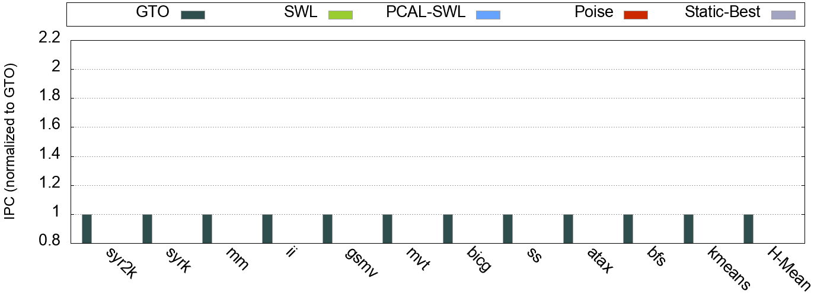
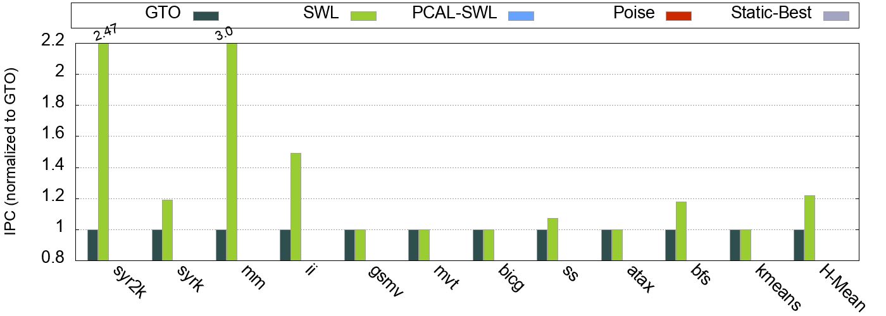
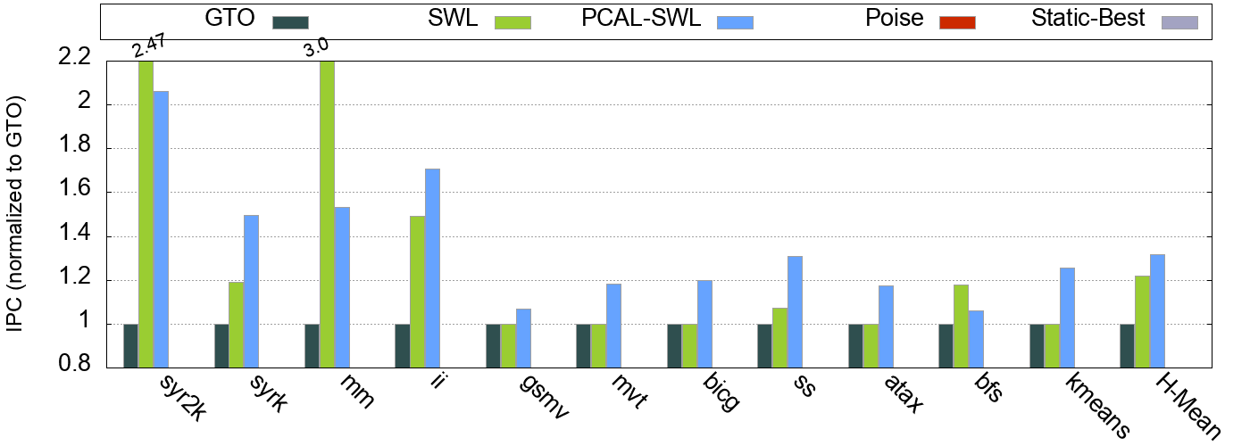
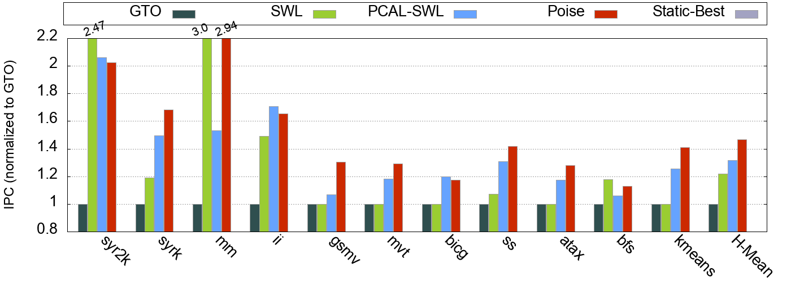
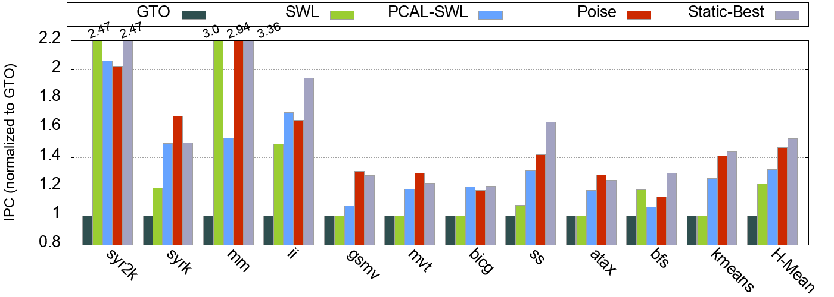
Results
Performance
31.5%
46.6%
52.8%
21.8%
Poise outperforms PCAL-SWL by 15.1% on average
Evaluation
Results
Notes:
Performance gap between Poise and Static-Best can be due to prediction errors or the local search overheads
Poise detects phase changes in monolithic kernels which go undetected in Static profiling

Slide 35
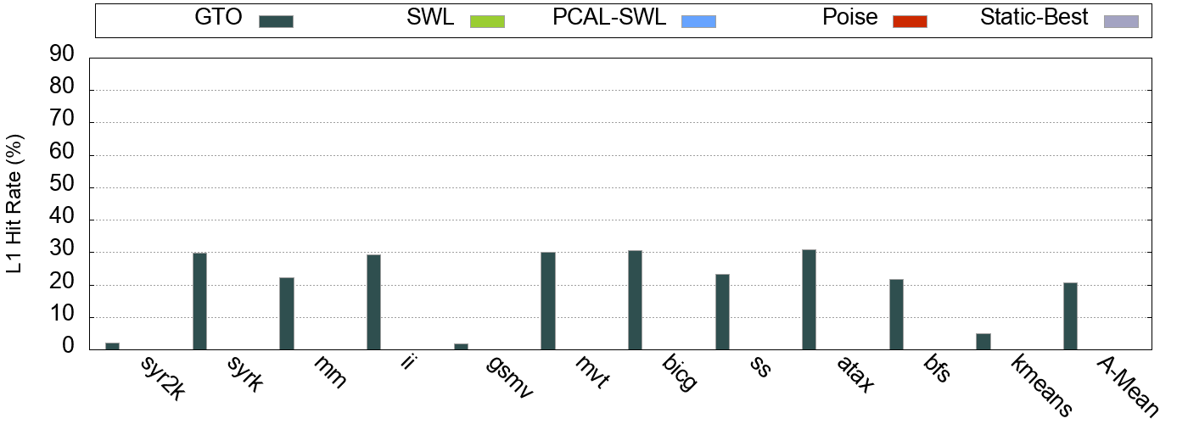
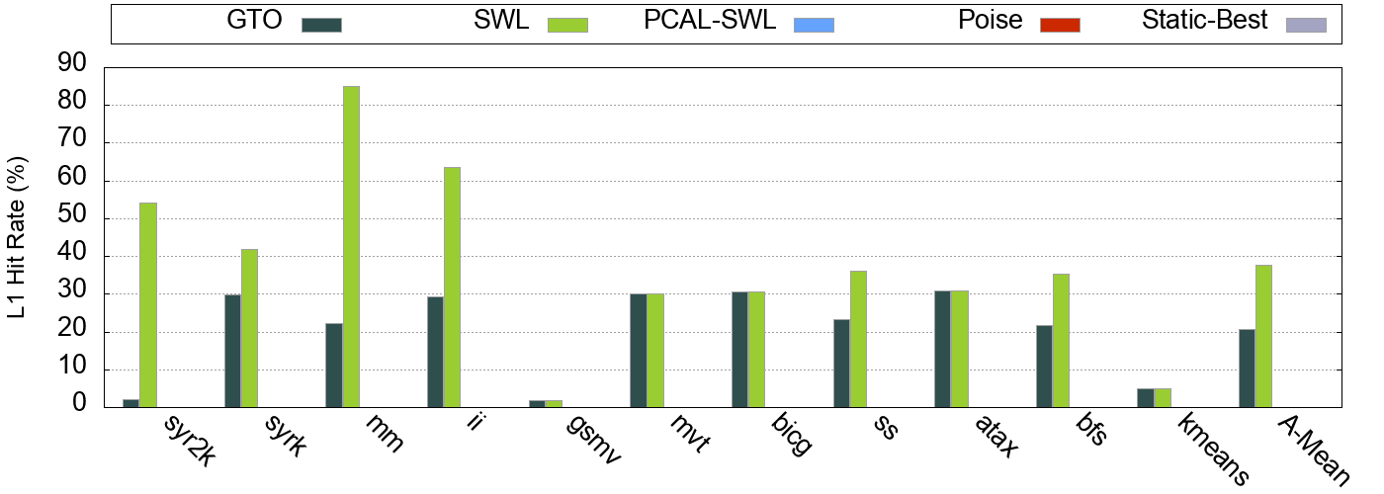
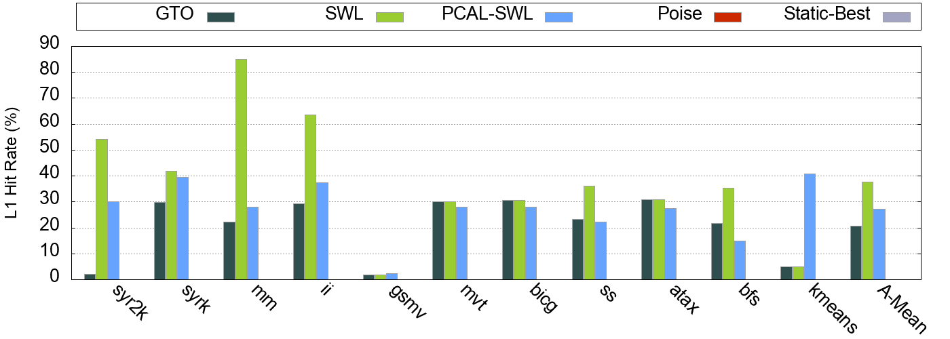
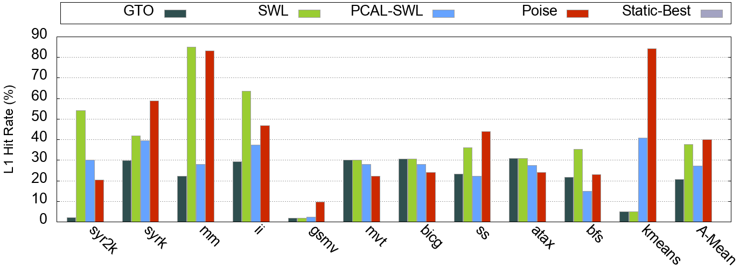
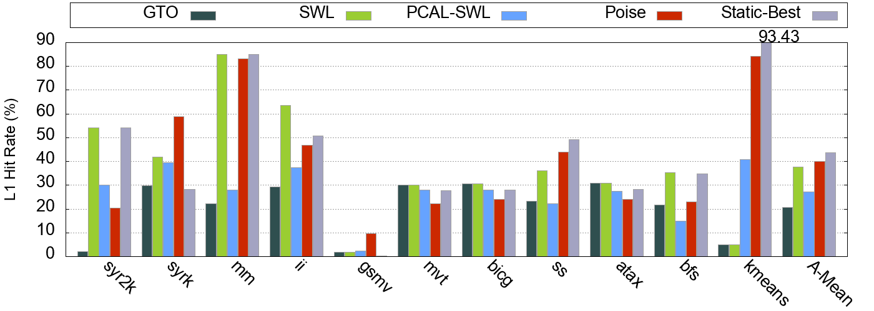
Results
L1 Hit Rate
27.1%
37.7%
40.1%
20.6%
Poise reduces cache thrashing and reduces pressure on memory system
Evaluation
Results

Slide 36
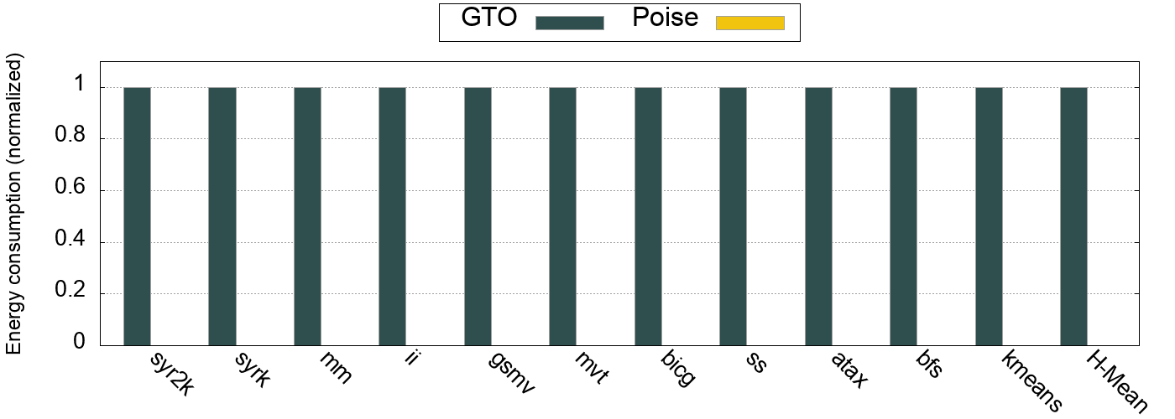
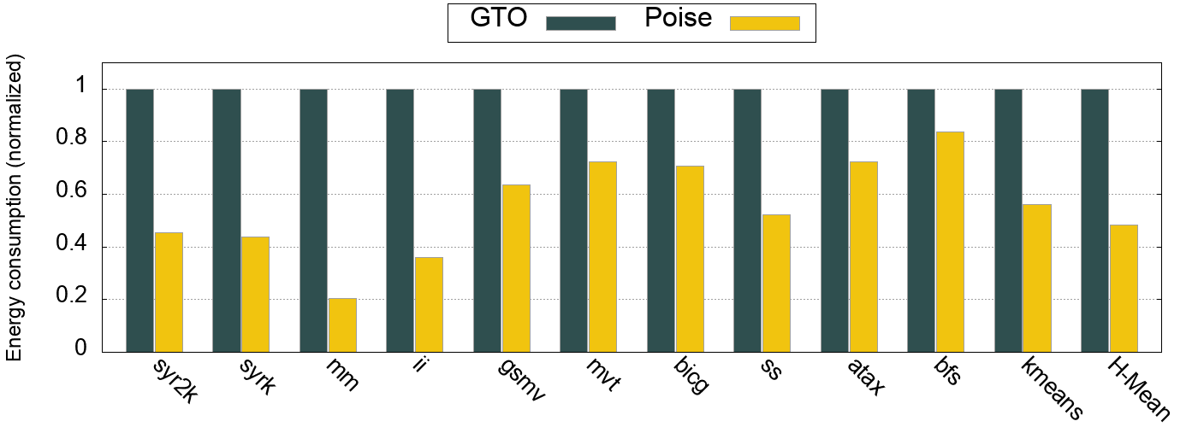
Results
Energy consumption
79%
51.6%
Poise reduces the energy consumption by 51.6% over GTO
Evaluation
Results

Slide 37
Hardware Overhead
Arithmetic Units for link function computation
Enough spare cycles in existing FP units
Time-multiplexing existing FP units on SM
No extra hardware needed
Feature collection
Seven 32-bit hardware performance counters per SM
Finite State Machine
Two 3-bit registers per SM
Modified Warp Scheduler
2-bits per entry in warp scheduler queue
Net storage overhead of 40.75 bytes per SM
Evaluation
Hardware Overhead
Notes:
Required once in several hundreds of thousands of cycles
Link function computation not in critical path

Slide 38
Conclusion
Problem
Investigate conflict between TLP and memory system performance
Traditional techniques to balance are slow and sub-optimal
Goal is to find good warp-tuples expeditiously in hardware
Proposal
Poise – a machine learning based architectural technique
Offline training to learn about good warp scheduling decisions
Use prior knowledge to make good runtime predictions
Results
Harmonic mean speedup of 46.6% over baseline GTO scheduler
Extremely lightweight in terms of hardware overheads
Demonstrate an effective use of ML to solve an architectural problem
Conclusion

Slide 39
Poise: Balancing Thread-Level Parallelism and Memory System Performance in GPUs using Machine Learning
Questions?
Saumay Dublish
saumay.dublish@synopsys.com
http://homepages.inf.ed.ac.uk/s1433370/

Slide 40
Backup Slides

Slide 41
Discussion
Why not larger models such as DNNs?
Bulky nature of complex models
Generate prohibitively large feature weight matrices with high storage needs
High computational demands for training and inference
Black box nature of complex models and feature sets
Lack of mathematical insights prevents reasoning
Discussion
Notes:
Larger models: overfitting; bulky features; black box

Slide 42
Discussion
Poise – a machine learning based architecture technique
Harness domain knowledge to reduce model size and feature vector
Small, yet effective regression model
Inference has low computational and storage needs
Viable architectural mechanism
Demonstrate an effective use of ML to solve an architectural problem
Conclusion
Notes:
Allows future adaptability by allowing changes to feature weights through the compiler interface

Slide 43
The Case of Limited Parallelism
Fewer independent operations per warp
Low instruction concurrency
Compensated by high warp concurrency
Pressure on memory system increases further
Latencies grow even more
May benefit from lower latencies – low TLP
Memory-sensitive applications
Notes:
Load latencies get overlapped due to memory level parallelism, and busy cycles get added.
Instruction concurrency - Independent instructions within a warp
Warp concurrency - Independent instructions interleaved across warps

Slide 44
The Case of Limited Parallelism
Fewer independent operations
LOAD
Independent
Independent
Independent
Independent
Load latency
Instruction concurrency
(Intra-warp concurrency)
Execution
stall
time
DEPENDENCY
LOAD
Higher load latency due to congestion
LOAD
Independent
Independent
Independent
Independent
LOAD
LOAD
LOAD
Independent
Independent
Independent
Independent
LOAD
LOAD
Independent
Independent
Independent
Independent
Independent
Independent
Independent
Independent
LOAD
Independent
Independent
Independent
Independent
Warp concurrency
LOAD
Load latency
Independent
Independent
Independent
Independent
Independent
Independent
Independent
Independent
LOAD
LOAD
LOAD
Independent
Independent
Independent
Independent
Independent
Independent
Independent
Independent
Independent
Independent
Independent
Independent
(Inter-warp concurrency)
LOAD
LOAD
LOAD
Independent
Independent
Independent
Independent
DEPENDENCY
Independent
Independent
Independent
Independent
Execution
time
Independent
Independent
Independent
Independent
Independent
Independent
Independent
Independent
DEPENDENCY
Independent
Independent
Independent
Independent
DEPENDENCY
DEPENDENCY
DEPENDENCY
DEPENDENCY
DEPENDENCY
Improving memory-system performance is more useful
DEPENDENCY
DEPENDENCY
DEPENDENCY
DEPENDENCY
DEPENDENCY
DEPENDENCY
DEPENDENCY
DEPENDENCY
GPU Architecture
The Case of Limited Parallelism

Slide 45
Problem Statement
Balance TLP and memory system performance
Provide enough concurrency via TLP without significantly increasing memory latency

Slide 46
Prior state-of-the-art
Priority-based cache allocation (PCAL)
Alter parallelism independent of memory system performance
☓
Warps
L1 cache
Prior state-of-the-art
PCAL
Notes:
High TLP maybe counter-productive as it increases the latencies which we wanted to hide in the first place
Instruction concurrency - Independent instructions within a warp
Warp concurrency - Independent instructions interleaved across warps

Slide 47
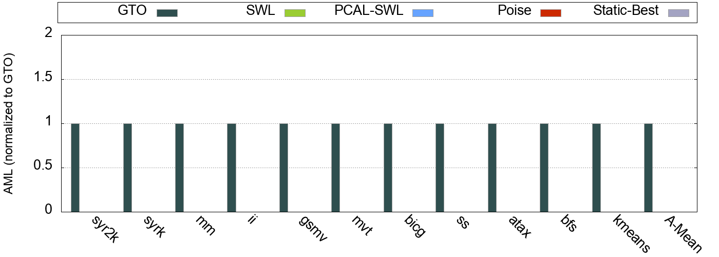
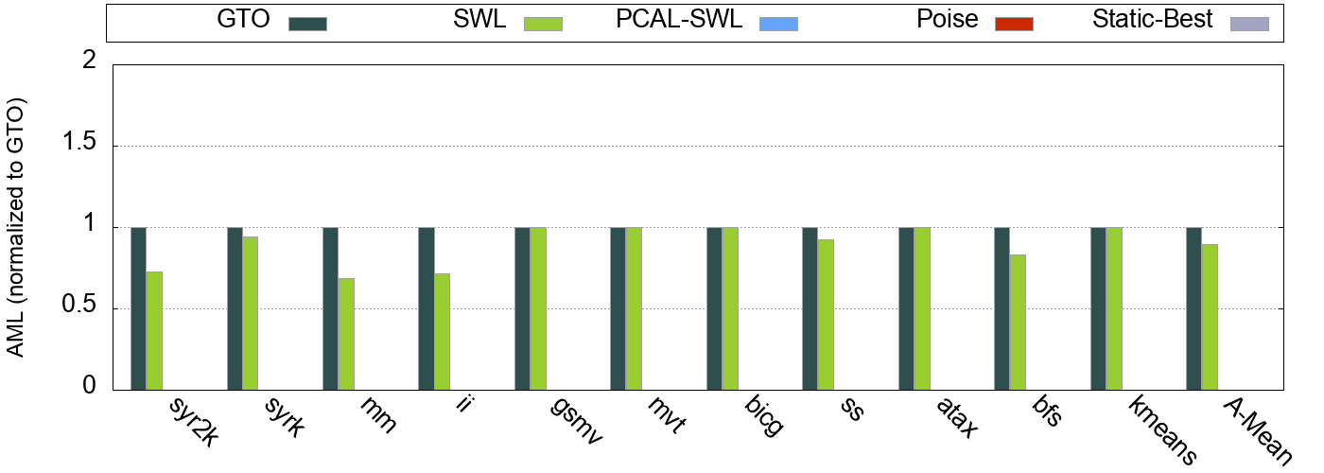
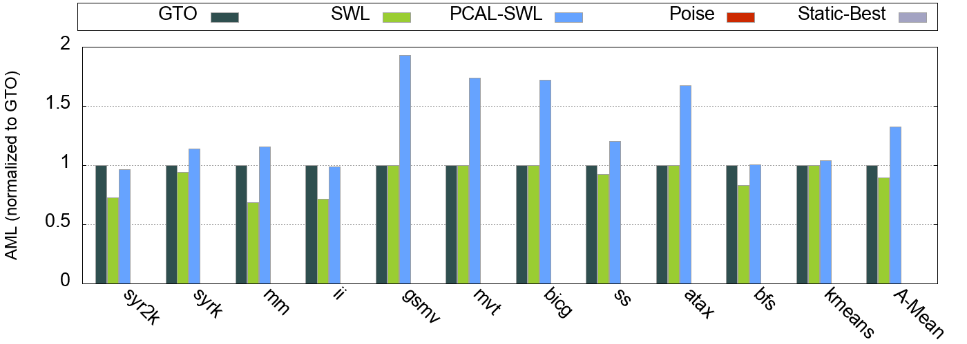
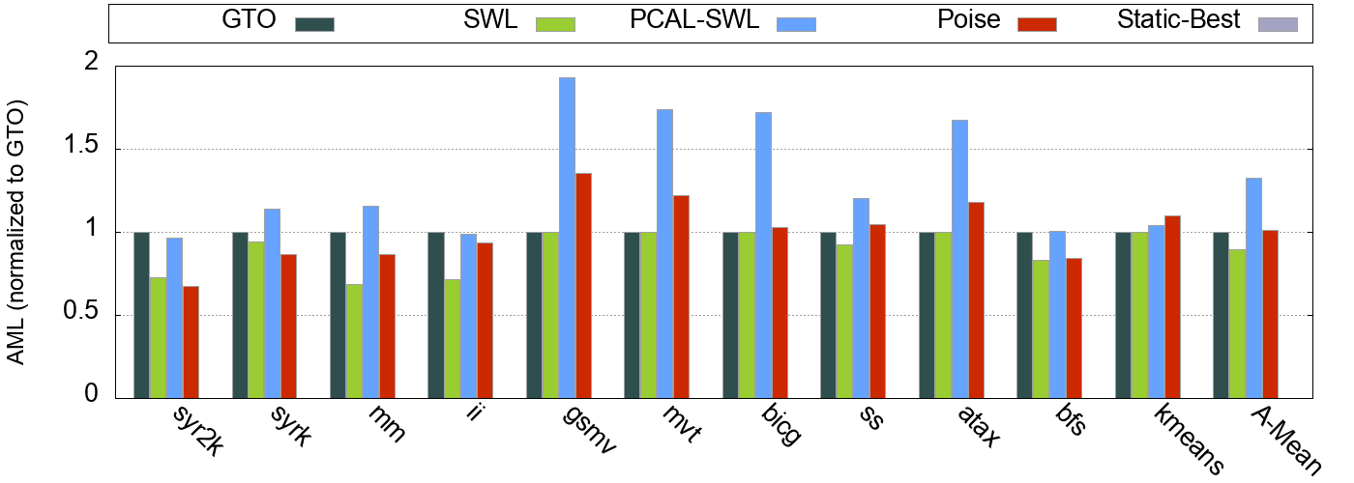
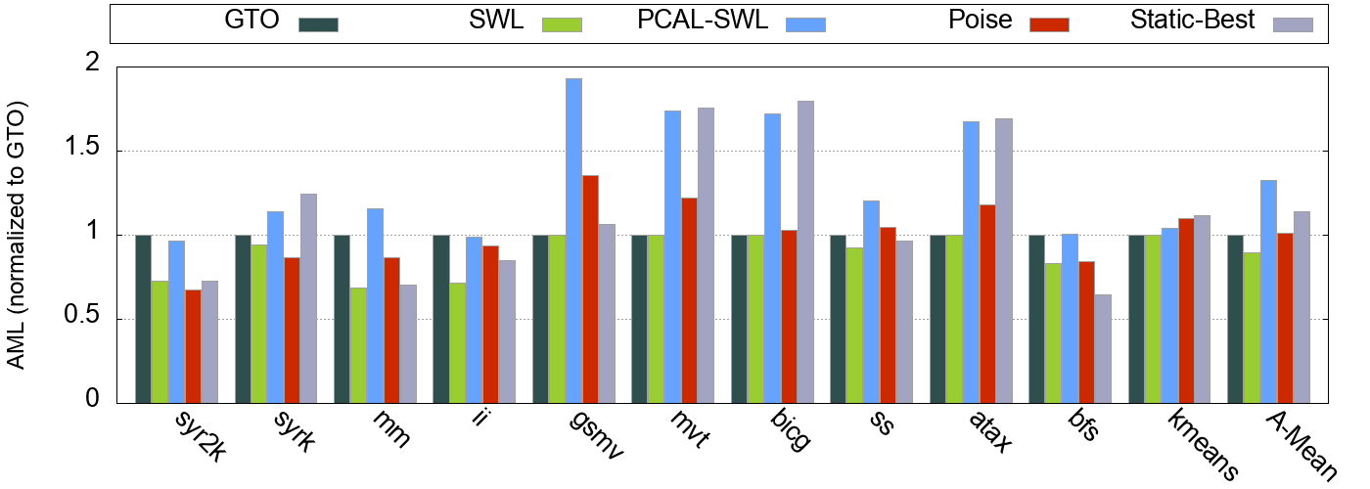
Results
Average Memory Latency
32.4%
1.1%
-10.7%
14.1%
Poise increases the AML by only 1.1% over GTO

Slide 48
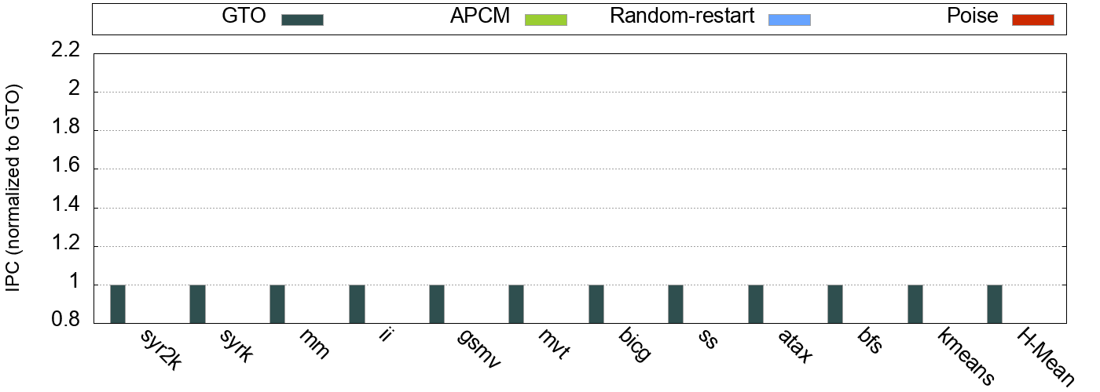
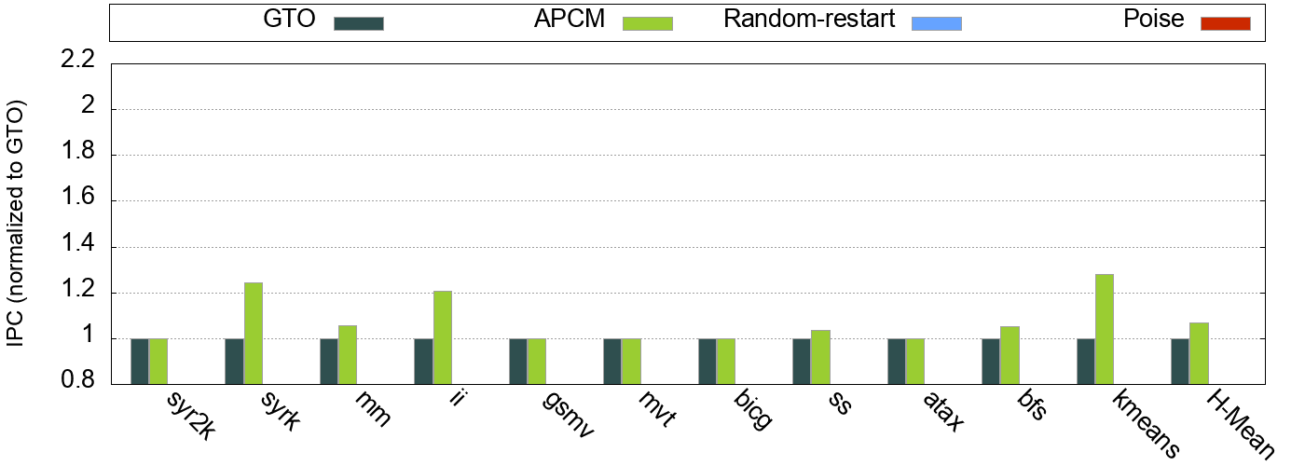
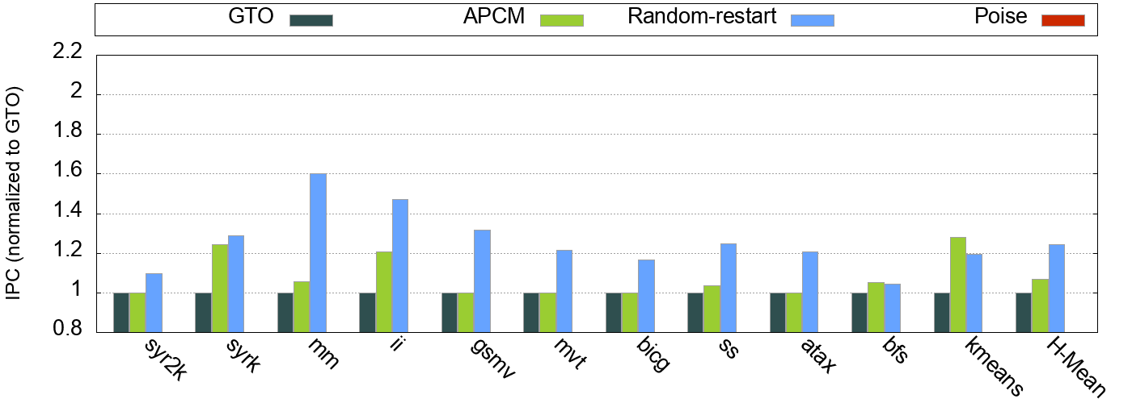
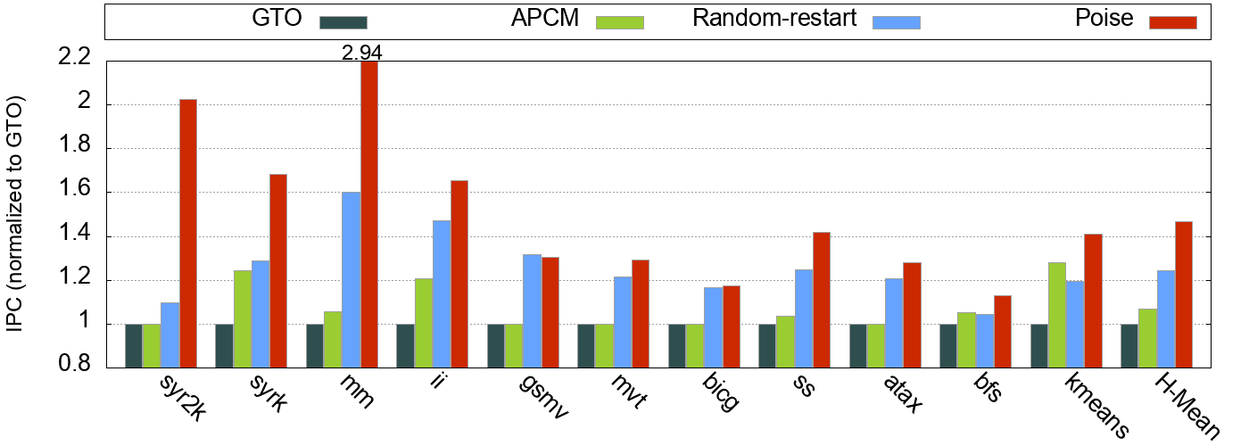
Results
Cache Bypassing & Stochastic Search
24.2%
7.05%
46.6%
Notes:
APCM is a scheme to protect and bypass cache lines on the basis of instruction locality. It bypasses streaming accesses in the cache and protects high locality accesses.
Stochastic search uses a random starting point following by gradient ascent just like Poise.

Slide 49
Machine Learning Framework
Training is done on a set of sample input-output pairs
Regression model learns a mapping from the input to the output
The learned mapping is expressed through feature weights
Feature weights are provided to the GPU via the compiler
Major components of the machine learning framework:
Analytical Model
Regression Model

Slide 50
Working Summary
PCAL
Poise
Feature collection
Iterative hill climbing
Cache-polluting warps
Cache-polluting warps
Local Search
Feature collection
Local optimum
Prediction
Vital warps
Vital warps

Slide 51
Hiding Latencies in GPUs
Harnessing concurrency
LOAD
Independent
Independent
Independent
Independent
Load latency
Instruction concurrency
(Intra-warp concurrency)
Core Busy
time
DEPENDENCY
LOAD
LOAD
Independent
Independent
Independent
Independent
Warp concurrency
LOAD
Independent
Independent
Independent
Independent
LOAD
(Inter-warp concurrency)
Independent
Independent
Independent
Independent
LOAD
Independent
Independent
Independent
Independent
Independent
Independent
Independent
Independent
DEPENDENCY
DEPENDENCY
DEPENDENCY
DEPENDENCY
DEPENDENCY
Notes:
A warp typically hosts a load instruction and an instruction dependent on the load with a bunch of independent operations in between

Slide 52
Hardware Inference Engine
Prediction Stage
Perform periodic predictions at runtime using feature weights and learned mapping
Unseen user application
Analytical feature set
Runtime Input
Sample Input
Profiled Kernels
Regression Model
Feature weights
Predictor
via compiler
Predicted Output
Sample Output
Good warp-tuple
Best warp-tuple
Poise
Hardware Inference Engine
Prediction Stage

Slide 53
Results
Performance
31.5%
46.6%
52.8%
21.8%
Poise outperforms PCAL-SWL by 15.1% on average
Poise even surpasses Static-Best for monolithic kernels
Evaluation
Results
Notes:
Performance gap between Poise and Static-Best can be due to prediction errors or the local search overheads
Poise detects phase changes in monolithic kernels which go undetected in Static profiling

