Slide 1


Evaluating and Mitigating Bandwidth Bottlenecks Across the Memory Hierarchy in GPUs
Saumay Dublish, Vijay Nagarajan, Nigel Topham
The University of Edinburgh
ISPASS 2017
25th April
Santa Rosa, California

Slide 2



Multithreading on GPUs
Kernel
Hardware
Scheduler
Core
Core
Core
Core
Host CPU
to
GPU
Cores hide memory latencies with concurrent execution
DRAM

Slide 3
Multithreading on GPUs
Kernel
Hardware
Scheduler
Core
Core
Core
Core
Memory-intensive
applications
Host CPU
to
GPU
Latencies grow
Appear in critical path
Bandwidth Bottleneck
DRAM

Slide 4
Deeper Memory Hierarchy
Core
Core
Core
Core
Small caches
High multithreading
Bandwidth filtering
L1
L1
L1
L1
High cache miss rates
Bandwidth filtering
L2
Distributed Bandwidth Bottleneck
DRAM

Slide 5
Deeper Memory Hierarchy
L2 roundtrip latency
̴ 300 cycles
(2-3x higher)
Core
Core
Core
Core
Small caches
High multithreading
Bandwidth filtering
L1
L1
L1
L1
High cache miss rates
Bandwidth filtering
L2
Distributed Bandwidth Bottleneck
DRAM

Slide 6
Deeper Memory Hierarchy
L2 roundtrip latency
̴ 300 cycles
(2-3x higher)
Core
Core
Core
Core
̴̴ 200 cycles
Small caches
High multithreading
Bandwidth filtering
L1
L1
L1
L1
High cache miss rates
Identify and mitigate bottlenecks across the memory hierarchy
Bandwidth filtering
L2
Distributed Bandwidth Bottleneck
DRAM

Slide 7
Goals
Characterize : Understand the bandwidth bottlenecks across different levels of the memory hierarchy such as L1, L2 and DRAM
Cause : Investigate the architectural causes for congestion
Effect : Design-space exploration to evaluate the effect of mitigating congestion
Proposal: Use cause and effect analysis to present cost-effective configurations of the memory hierarchy

Slide 8
Experimental Environment
Platform
GPGPU-Sim (v3.2.2)
GPUWattch (McPAT)
Benchmark Suites
Rodinia
Parboil
MapReduce

Slide 9
Baseline Configuration
GTX 480 NVIDIA GPU
15 SMs
Private L1 Data Cache (16 KB; 32 MSHRs)
Shared L2 Cache (768 KB; 32 MSHRs/bank)
L1-L2 Interconnect (Crossbar; 32+32 bytes)
DRAM (384 bits bus width)

Slide 10
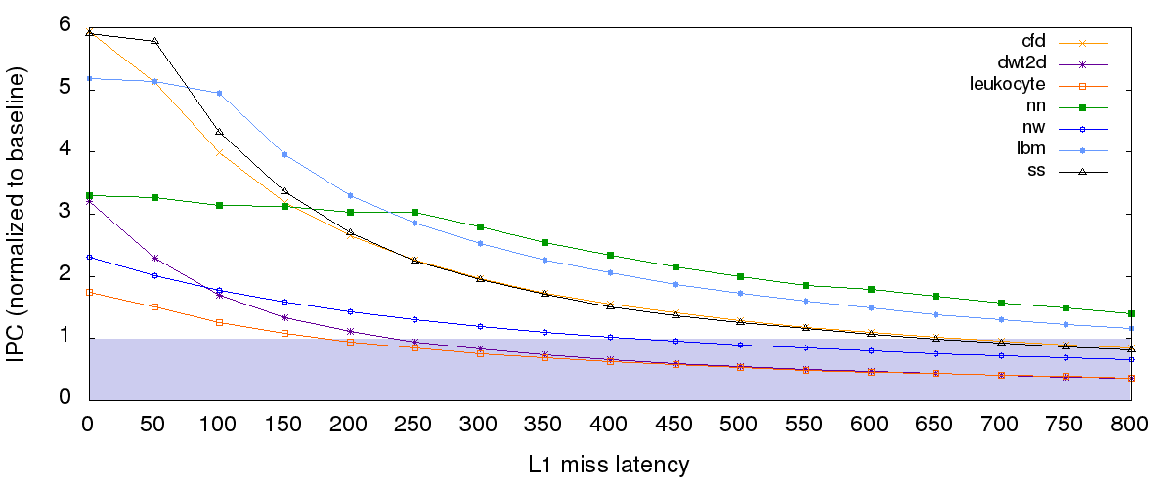
Latency Tolerance
Performance plateau
Latency tolerance
Latency appears in the critical path
Performance versus Latency curve for memory-intensive benchmarks

Slide 11
Latency Tolerance
Performance plateau
[ 120 cycles ,
220 cycles ]
Ideal L2 access latency
Ideal DRAM access latency
Added latencies due to increasing congestion

Slide 12
Latency Tolerance
Performance plateau
Baseline Memory Latencies
1x
[ 120 cycles ,
220 cycles ]
Far from saturation
(theoretically possible)
Practically possible
to improve performance
Ideal L2 access latency
Ideal DRAM access latency
Observations about “baseline memory latencies”
Baseline memory latencies critically higher than performance plateau latencies
Baseline memory latencies critically higher than ideal access latencies to L2/DRAM

Slide 13
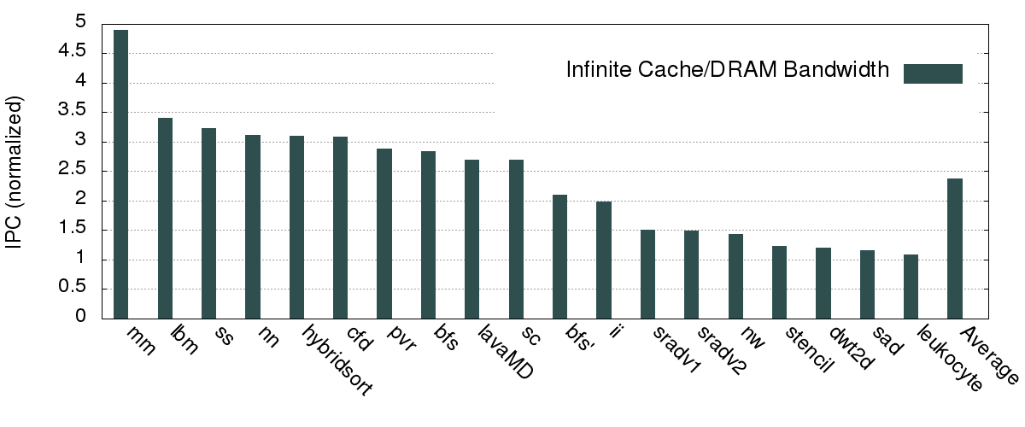
Infinite Bandwidth
2.37x

Slide 14
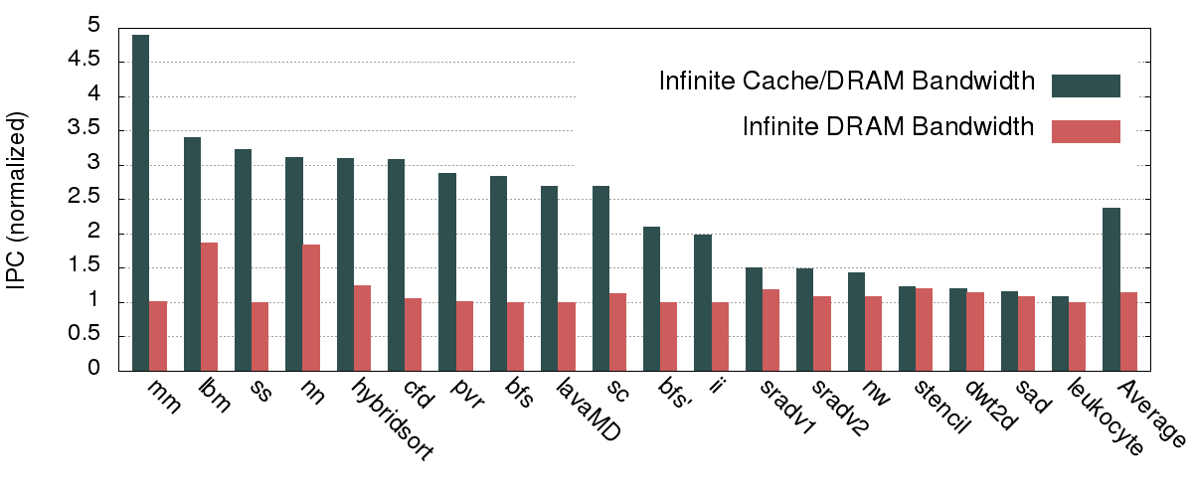
Infinite Bandwidth
2.37x
1.15x
Significant congestion in the cache hierarchy

Slide 15
Understanding Bandwidth Bottleneck
Core
While the bandwidth provided decreases in the lower levels of the memory hierarchy, bandwidth demand does not reduce proportionally.
This leads to a bandwidth skew between adjacent levels.
As a result, requests queue up in the memory hierarchy for long durations, causing congestion.
L2 access queues are full for 46% of its usage lifetime.
DRAM access queue are full for 39% of its usage lifetime
L1 access
queue
L1
L2 access
queue
Decreasing bandwidth
L2
DRAM
access queue
DRAM

Slide 16
Causes of congestion
Structural Hazards
Back Pressure
Core
L1
L1 MSHR
L2
L2 MSHR
DRAM

Slide 17
Causes of congestion
Structural Hazards
Back Pressure
Core
Prolonged contention for cache resources such as MSHRs or replaceable cache lines.
Pending requests must complete and relinquish the resources.
Therefore, new miss requests get serialized, increasing the memory latencies even more.
L1
L1 MSHR
HIT?
L2
FULL
MISS
L2 MSHR
Structural Hazard
High cache hit latencies
DRAM

Slide 18
Causes of congestion
STALL
Structural Hazards
Back Pressure
Core
X
Independent compute?
Cascading effect of structural hazards
Higher level gets throttled
Eventually throttles core performance
L1
X
L1 MSHR
L2
L2 MSHR
Restricted parallelism on cores
DRAM

Slide 19
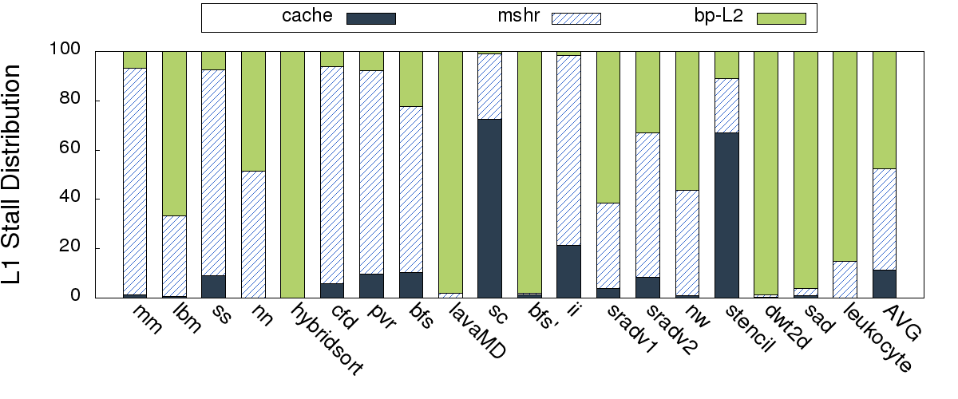
Causes of congestion
Structural Hazards
Back Pressure
Core
L1 cache stalls
L1
L1 MSHR
41%
L2
11%
L2 MSHR
DRAM

Slide 20
Causes of congestion
Structural Hazards
Back Pressure
Core
L1 cache stalls
L1
48%
L1 MSHR
L2
L2 MSHR
DRAM
Major causes of stalls at L1
L1 MSHR : 41% (Structural Hazards)
L2 back pressure : 48% (Back pressure)

Slide 21
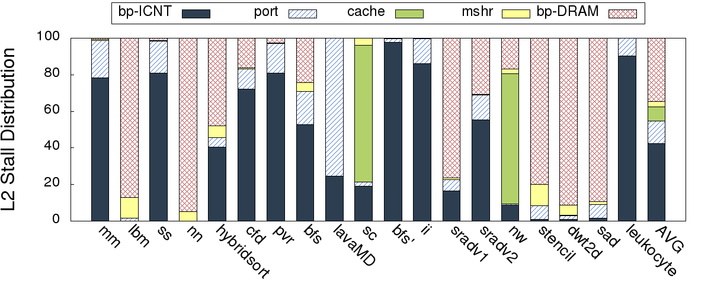
Causes of congestion
Structural Hazards
Back Pressure
Core
L2 cache stalls
L1
35%
L1 MSHR
L2
42%
L2 MSHR
DRAM
Major causes of stalls at L2
Crossbar (response path) : 42% (Back pressure)
DRAM : 35% (Back pressure)

Slide 22
Mitigating congestion
Core
Classifying the Design Space
Category-1: Operate at peak throughput
Minimize stalls by exploiting existing peak throughput
e.g. MSHRs, Access Queue size
Category-2: Increase peak throughput
Minimize stalls by increasing the peak throughput
e.g. Crossbar flit size, DRAM bus width
L1
L1 MSHR
L2
L2 MSHR
DRAM

Slide 23
Identifying the Design Space
L1 parameters
L1 Miss Queue
L1 MSHR
Memory pipeline width
L2 parameters
L2 Miss/Response Queue
L2 MSHR
L2 Data Port Width
L2 Banks
Flit Size (Crossbar)
DRAM parameters
Scheduler Queue
Banks
Bus width
Core
L1
L1 MSHR
L2
L2 MSHR
DRAM

Slide 24
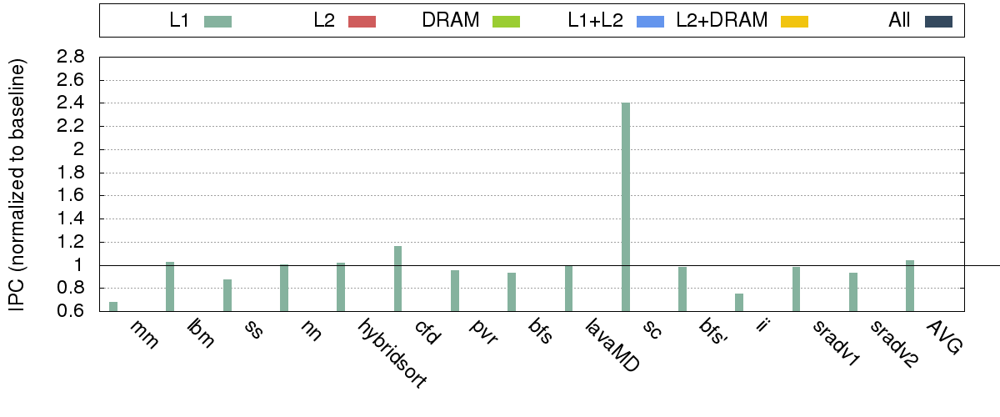
Mitigating congestion
4%
Scaling L1 parameters by 4x

Slide 25
Mitigating congestion
- 33%
- 13%
- 25%
- 7%
4%
Scaling L1 parameters by 4x
Improving bandwidth in isolation can lead to even more congestion at the lower levels

Slide 26
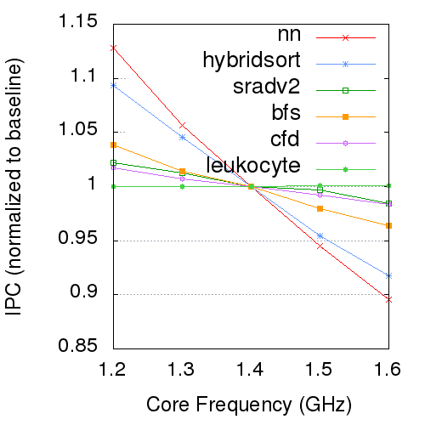
Mitigating congestion
Core frequency scaling on real GTX 480
Up to 23% slowdown
Improving bandwidth in isolation can lead to even more congestion at the lower levels

Slide 27
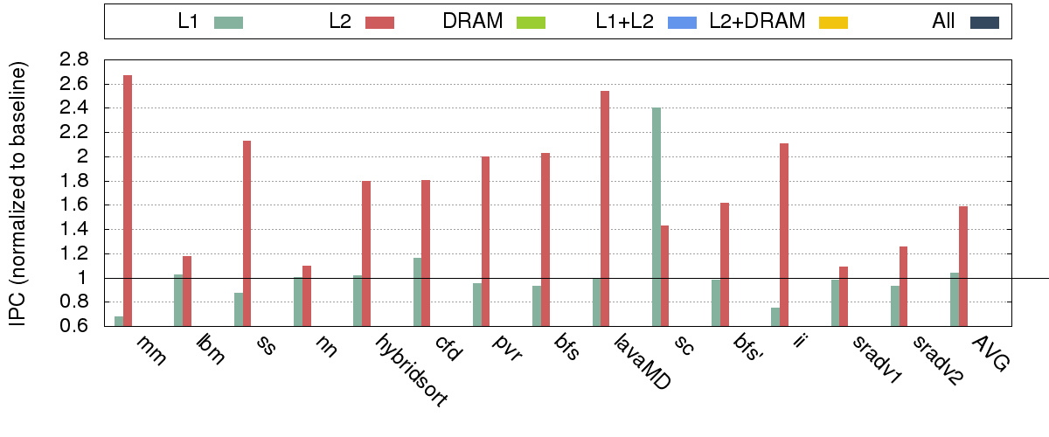
Mitigating congestion
59%
Scaling L2 parameters by 4x
Shows the criticality of the L2 bandwidth

Slide 28
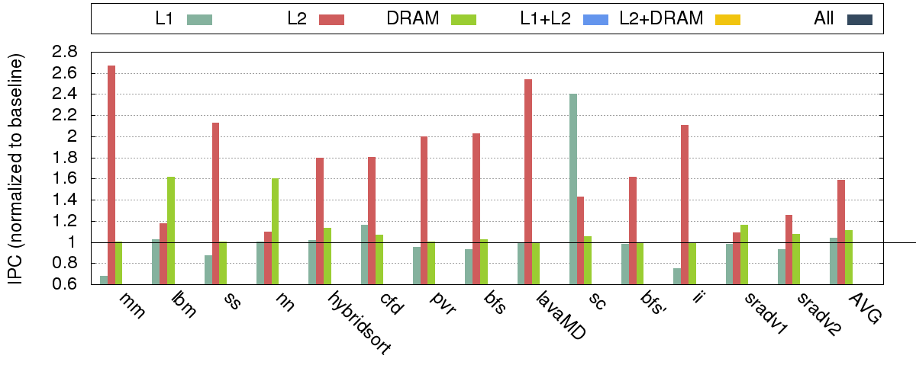
Mitigating congestion
11%
Scaling DRAM parameters by 4x (HBM)

Slide 29
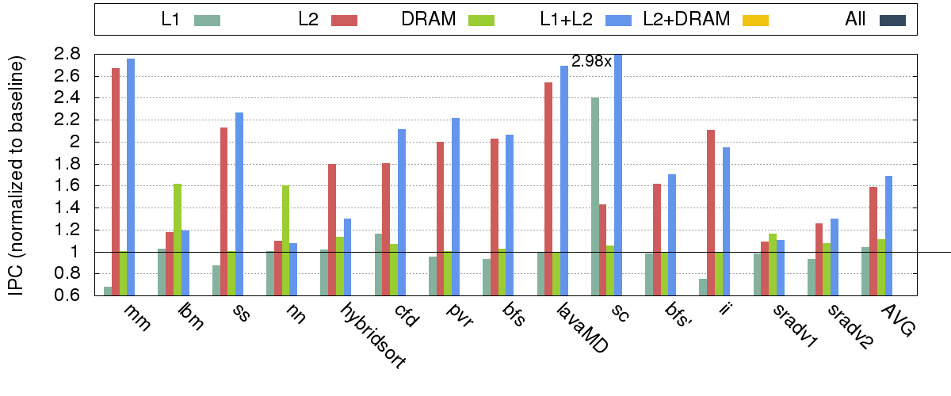
Mitigating congestion
212%
226%
- 13%
59%
69%
4%
Scaling L1 and L2 parameters by 4x
A case for synergistic scaling!

Slide 30
Mitigating congestion
11%
69%
Scaling L1 and L2 parameters by 4x
Higher speedup on mitigating congestion in the cache hierarchy compared to DRAM (as done in HBM)

Slide 31
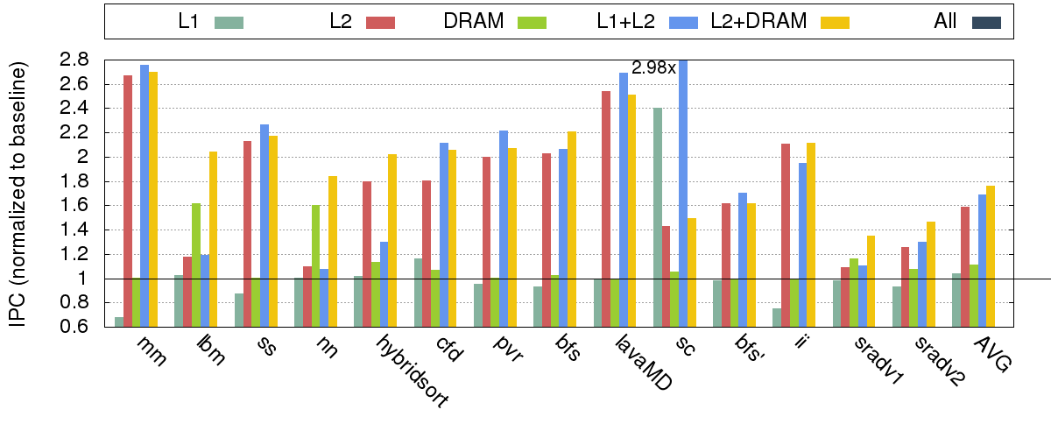
Mitigating congestion
76%
Scaling L2 and DRAM parameters by 4x

Slide 32
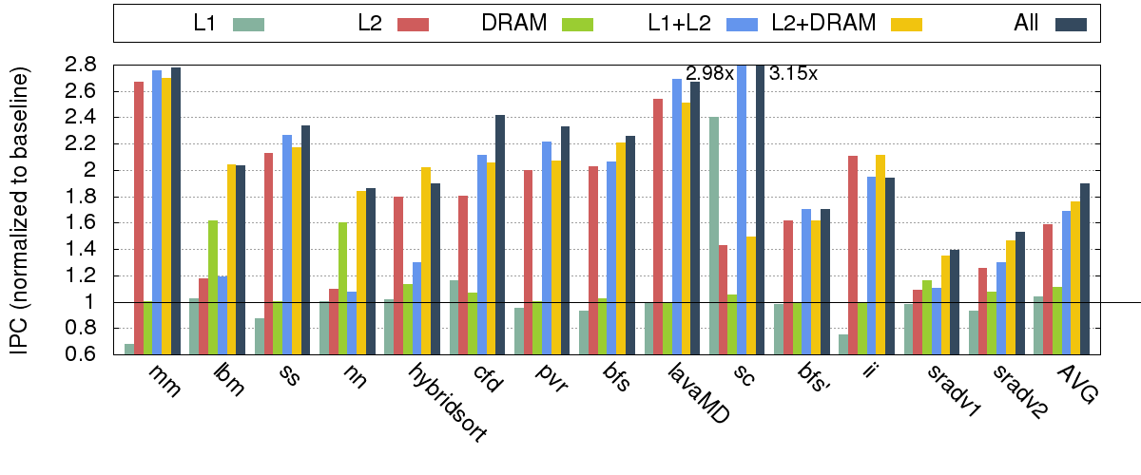
Mitigating congestion
90%
Scaling the entire memory hierarchy by 4x

Slide 33
Pruning the Design Space
Scaling all architectural parameters by 4x impractical
Need to prune the design space
We now know the …
Causes of congestion (at each memory level)
Effects of reducing congestion (at different memory levels)
Cost effective configuration
Mitigate causes where the effect is maximum
Boost bandwidth resources where it hurts most!

Slide 34
Cost-effective Design Space
L1 parameters
L1 Miss Queue
L1 MSHR
Memory pipeline width
L2 parameters
L2 Miss/Response Queue
L2 MSHR
L2 Data Port Width
L2 Banks
Flit Size (Crossbar)
DRAM parameters
Scheduler Queue
Banks
Bus width

Slide 35
Cost-effective Design Space
L1 parameters
L1 Miss Queue
L1 MSHR
Memory pipeline width
L2 parameters
L2 Miss/Response Queue
Flit Size (Crossbar)
Simple Buffers
Minimal cost of scaling
Scale by 4x

Slide 36
Cost-effective design-space
L1 parameters
L1 Miss Queue
L1 MSHR
Memory pipeline width
L2 parameters
L2 Miss/Response Queue
Flit Size (Crossbar)
Fully Associative Array
Moderate cost of scaling
Scale by 1.5x

Slide 37
Cost-effective design-space
L1 parameters
L1 Miss Queue
L1 MSHR
Memory pipeline width
L2 parameters
L2 Miss/Response Queue
Flit Size (Crossbar)
32+32 Baseline Crossbar
Scales quadratically with flit size
“Asymmetric Crossbar”

Slide 38
Asymmetric Crossbar
Core
Symmetric Crossbar
Asymmetric Crossbar
Reads >> Writes
L1-L2 Crossbar
L1
Control
(8 bytes)
L1
Cache line
(128 bytes)
L1
32 bytes
request
32 bytes
response
16 bytes
request
48 bytes
request
L2
L2
L2
No wiring overhead
Point-to-point
Wiring
(bytes)
32+32 = 64
DRAM
16+48 = 64
Wiring overhead of 20 bytes
16+68 / 32+52 = 84

Slide 39
Cost-effective Design Space: Summary
L1 Cache
L1 Miss Queue : 8 entries → 32 entries
Memory pipeline width : 10 wide → 40 wide
L1 MSHR : 32 entries → 48 entries
L2 Cache
L2 Miss/Response Queue : 8 entries → 32 entries
Flit Size (Crossbar) : 32+32 → 16+48 (=64); 16+68/32+52 (=84)
Evaluate 3 cost-effective configurations: 16+48 16+68 32+52

Slide 40
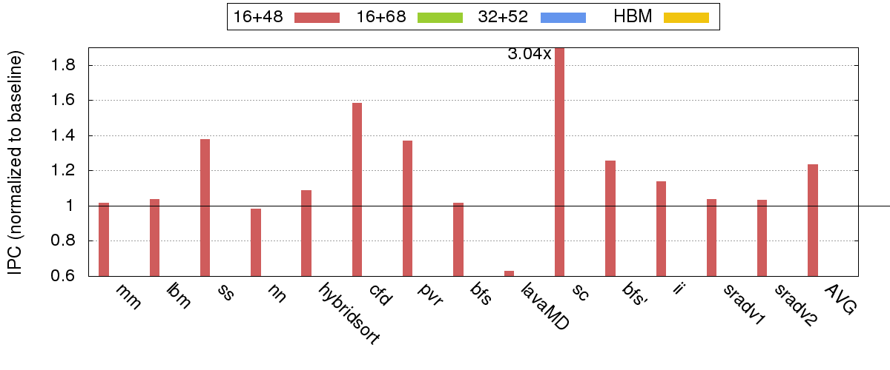
Results
Cost-effective configurations
23%
Area overhead: 1.1%
Point-to-point wires remains same as baseline

Slide 41
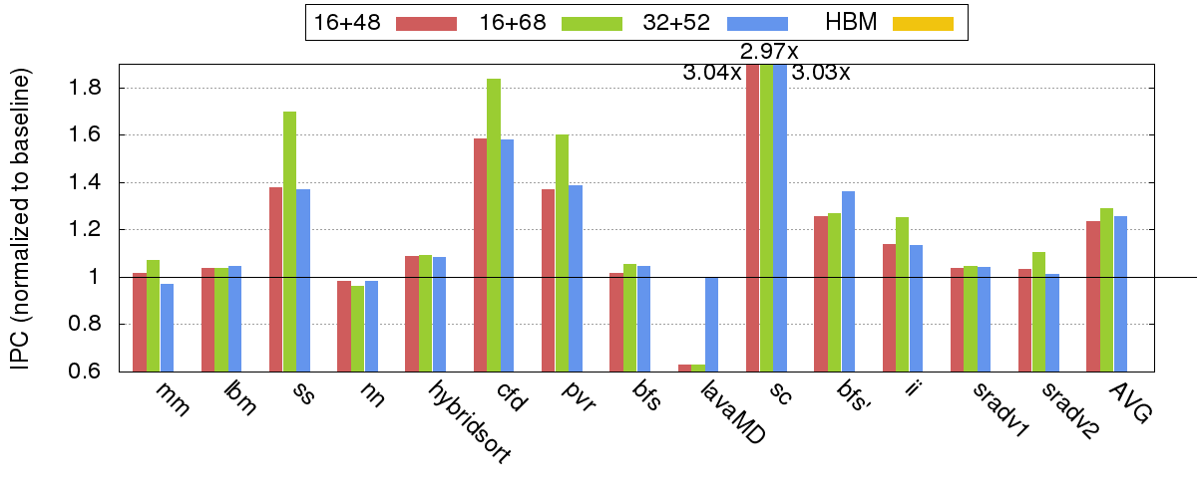
Results
Cost-effective configurations
29%
25%
Area overhead: 1.6%
Investing in the response path gives better returns

Slide 42
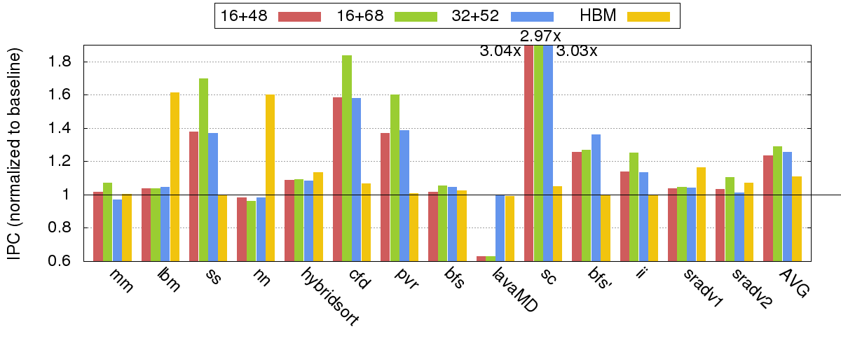
Results
Cost-effective configurations
25%
11%
29%
Higher speedup on resolving bandwidth bottleneck in cache hierarchy
Configuration with synergistic scaling (of L1 and L2) and
asymmetric crossbar with higher response bandwidth (16+68) performs best

Slide 43
Conclusion
Problem
High congestion across the memory hierarchy
Congestion leads to high memory latencies (both to L2 and DRAM)
High latencies appear in the critical path for memory-intensive applications, causing slowdown
Observation
Characterize stalls and develop insights about bandwidth bottleneck
Significant bandwidth bottleneck in the cache hierarchy
Addressing bandwidth problem in isolation can even lead to slowdown
Proposal
Synergistic scaling of bandwidth of L1 and L2 cache
Asymmetric scaling of bandwidth of crossbar
23% speedup with 1.1% area overhead (no additional wires in crossbar)
29% speedup with 1.6% area overhead (additional wiring in crossbar)

Slide 44
Questions?
Saumay Dublish
saumay.dublish@ed.ac.uk
http://homepages.inf.ed.ac.uk/s1433370/

