Slide 1


Cooperative Caching for GPUs
Saumay Dublish, Vijay Nagarajan, Nigel Topham
The University of Edinburgh
at
HiPEAC
Stockholm, Sweden
24th January, 2017

Slide 2



Multithreading on GPUs
Kernel
Hardware
Scheduler
Core
Core
Core
Core
Host CPU
to
GPU
Hide memory latencies with execution
DRAM

Slide 3
Multithreading on GPUs
Kernel
Hardware
Scheduler
Core
Core
Core
Core
Memory-intensive
applications
Host CPU
to
GPU
Latencies grow
Appear in critical path
Bandwidth Bottleneck
DRAM

Slide 4
Deeper Memory Hierarchy
Core
Core
Core
Core
Small L1s
High multithreading
Bandwidth filtering
L1
L1
L1
L1
High L1 miss rates
L2
Bandwidth Bottleneck
Bandwidth filtering
DRAM

Slide 5
Deeper Memory Hierarchy
L2 roundtrip latency
̴ 300 cycles
(2-3x higher)
Core
Core
Core
Core
Small L1s
High multithreading
Bandwidth filtering
L1
L1
L1
L1
High L1 miss rates
L2
Bandwidth Bottleneck
Bandwidth filtering
DRAM

Slide 6
Deeper Memory Hierarchy
L2 roundtrip latency
̴ 300 cycles
(2-3x higher)
Core
Core
Core
Core
̴̴ 200 cycles
Small L1s
High multithreading
Bandwidth filtering
L1
L1
L1
L1
High L1 miss rates
Bandwidth Bottleneck
L2
Reduce congestion
Bandwidth filtering
DRAM

Slide 7
Outline
Observations : Inter-core reuse
Proposed Architecture : Cooperative Caching Network
Results : Reduced L2 Congestion, Lower Latencies, Speedup
Comparative study : Increasing L2 banks, Clustered sharing
Conclusion

Slide 8
Observations
Graphics applications
Kernels work on independent data
Thread-blocks execute in considerable isolation
General-purpose applications
Thread-blocks tend to share data
Thread-blocks scheduled on different cores lead to inter-core reuse

Slide 9
Inter-core Reuse
Benchmark: Coulombic Potential (cutcp)
Compute electrostatic potential from neighbours

Slide 10
Inter-core Reuse
Benchmark: Coulombic Potential (cutcp)
Intra Thread Block Reuse
Inter Thread Block Reuse
Thread Block-1
Thread Block-2
Thread Block-3
Thread Block-4
Compute electrostatic potential from neighbours

Slide 11
Inter-core Reuse
Benchmark: Coulombic Potential (cutcp)
Core
Core
Core
Core
L1
L1
L1
L1
Thread Block-1
Thread Block-2
L2
Thread Block-3
Results in Inter-Core Reuse
Thread Block-4
Duplicate Requests to L2
DRAM
Compute electrostatic potential from neighbours

Slide 12
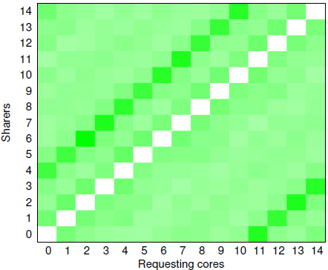
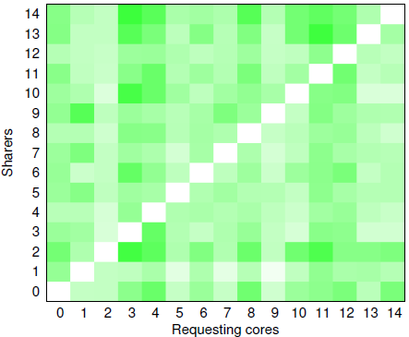
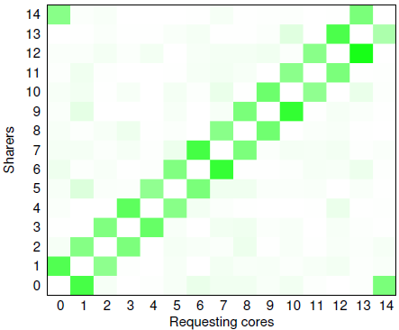
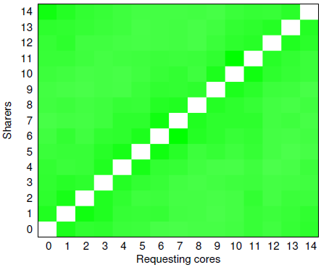
Reuse patterns
cutcp
tpacf
Strong sharing at core distance of 4
Random sharing
Remote sharers for L1 miss
Core where the L1 miss occurs
dwt2D
Reuse Score
pvr
Strong sharing with immediate neighbour
Sharing with all cores

Slide 13
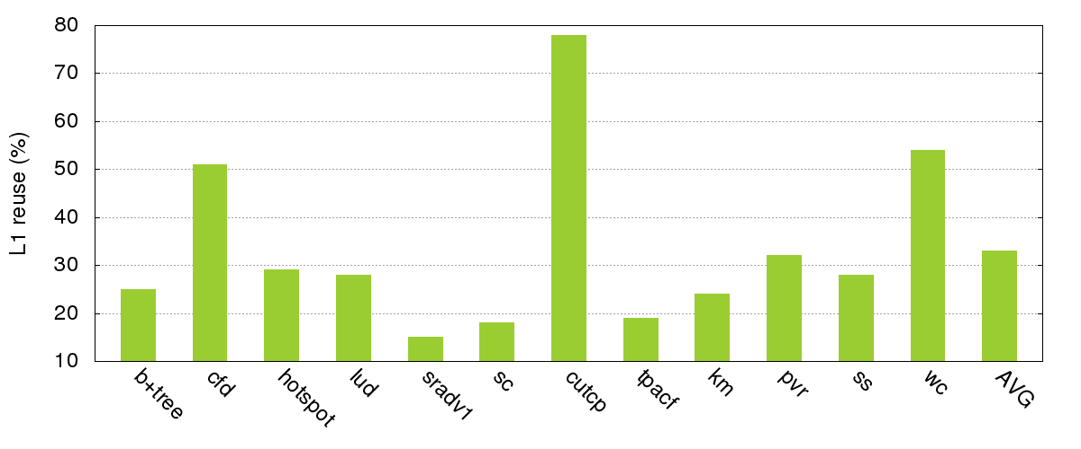
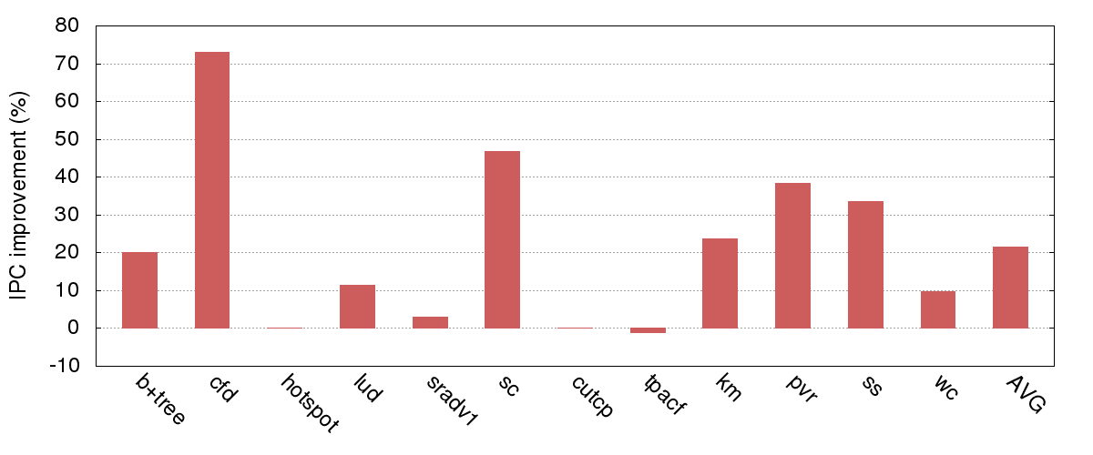
Efficacy of Reuse
78%
18%
33%
L1 misses cached in remote L1s
46%
22%
0.19%
Speedup with no reuse overhead

Slide 14
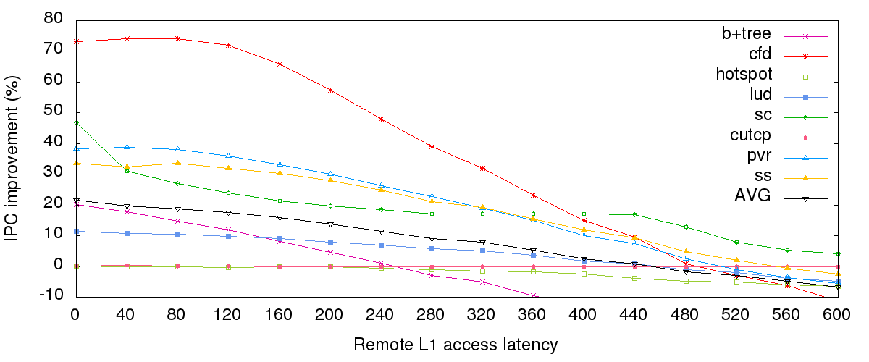
Sensitivity to Reuse Overhead
(Performance as a function of remote L1 access latencies)

Slide 15
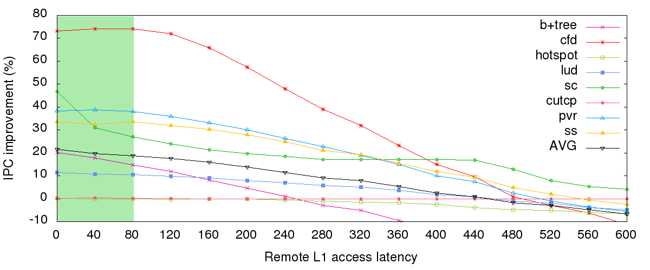
Sensitivity to Reuse Overhead
(Performance as a function of remote L1 access latencies)
Stable reuse latency range
Mean
Speedup
22%
20%
Permissible range for each remote L1 access: 0-80 cycles

Slide 16
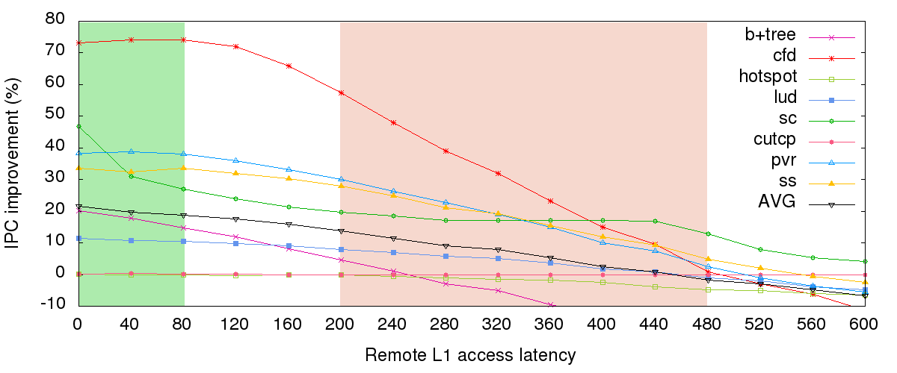
Sensitivity to Reuse Overhead
(Performance as a function of remote L1 access latencies)
Stable reuse latency range
L2 access latency range
Mean
Speedup
22%
20%
13%
2%
Permissible range for each remote L1 access: 0-80 cycles

Slide 17
Proposal
Cooperative Caching Network
Lightweight ring-based network for inter-core communication
All core-to-core connections are near-neighbour
Fewest number of inter-core connections compared to other topologies
Routers are simple multiplexers
Leverages latency tolerance of up to 80 cycles
Key design point
Trade-off higher latencies for simplicity and short wires

Slide 18
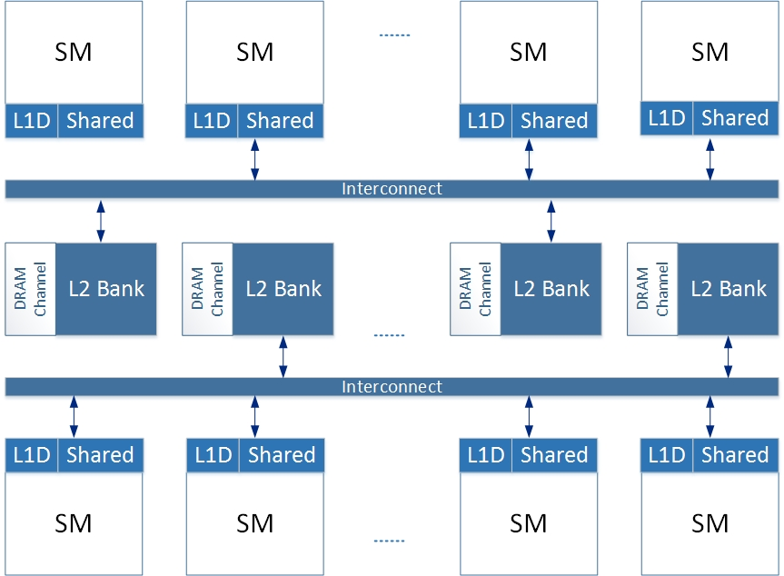
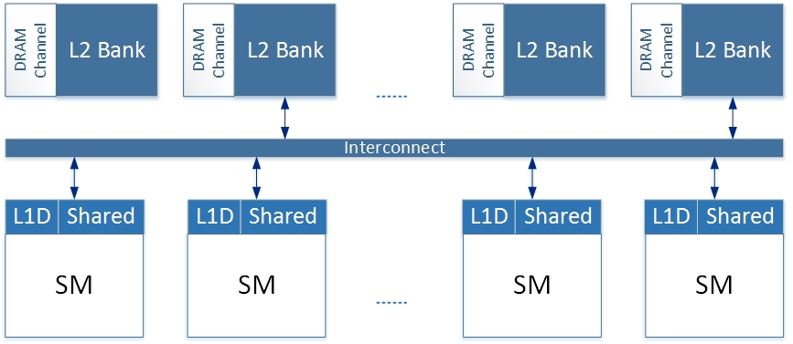
Baseline GPU
Representation of GTX480 die shot

Slide 19
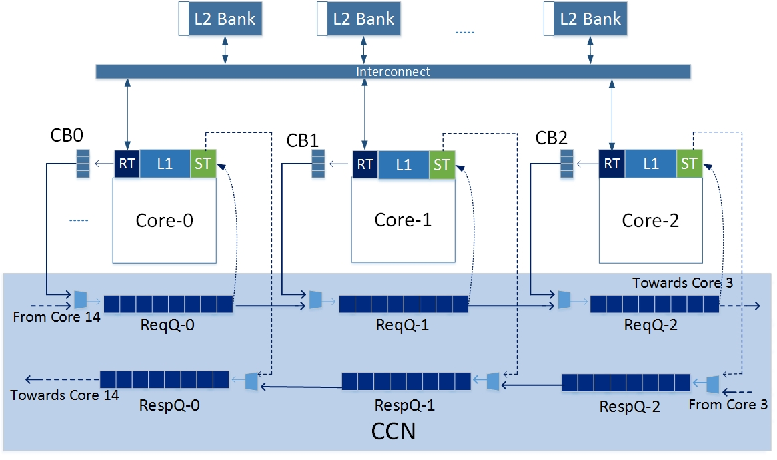
Cooperative Caching Network (CCN)
Representation of GTX480 die shot

Slide 20
Cooperative Caching Network (CCN)
Request Ring
(8-byte channel)
Two unidirectional rings : Request and Response
Shadow Tags at each L1 cache
Response Ring
(32-byte channel)

Slide 21
Cooperative Caching Network (CCN)
MISS

Slide 22
Cooperative Caching Network (CCN)
MISS
Remote
Miss

Slide 23
Cooperative Caching Network (CCN)
MISS
Remote
Miss
Remote
Hit
Notes:
Motivation
Latencies lie in the critical path
Presence of inter-core reuse

Slide 24
Cooperative Caching Network (CCN)
MISS
Remote
Miss
Remote
Hit

Slide 25
Cooperative Caching Network (CCN)
MISS
Remote
Miss
Remote
Hit

Slide 26
Source of Speedup?
Reduced latency due to less congestion in L2 cache outstrips the overhead of traversing the ring
Average memory latencies, therefore, are lower with CCN
Detailed analytical model in the paper

Slide 27
In the paper …
Request Throttling (CCN-RT)
Record statistics about the presence of inter-core reuse
When no reuse is detected, throttles requests directly to L2
Maintains low congestion in the ring and minimizes ring overhead
Memory Consistency
GPUs employ weak memory consistency model
CCN does not further weaken the existing memory model

Slide 28
Evaluation
Platform
GPGPU-Sim (v3.2.2)
GPUWattch (McPAT)
Benchmarks
Rodinia
Parboil
MapReduce

Slide 29
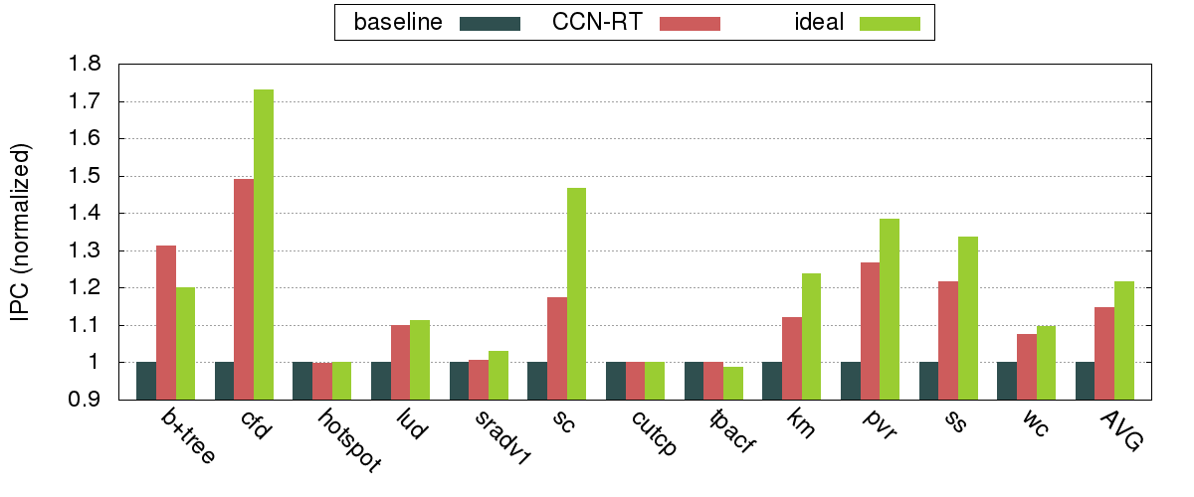
Results
Speedup
Memory-intensive
Non-memory-intensive
14.7%

Slide 30
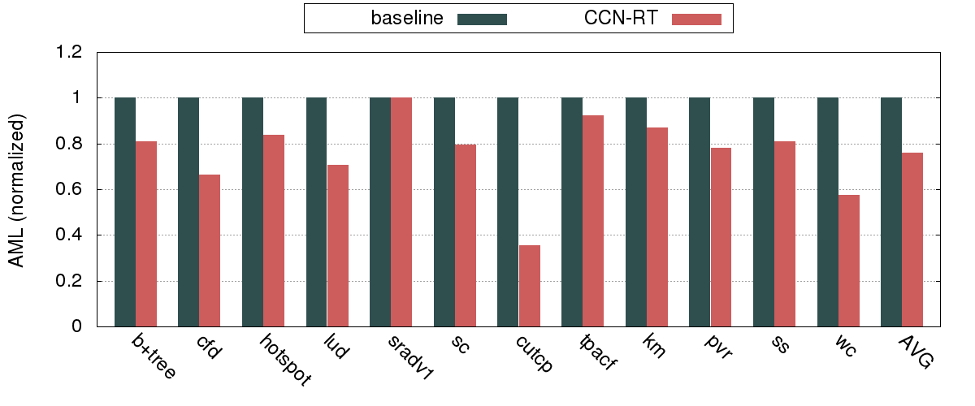
Results
Average Memory Latency
- 24%
Overheads
Area: 1.3%
Energy: 2.5%

Slide 31
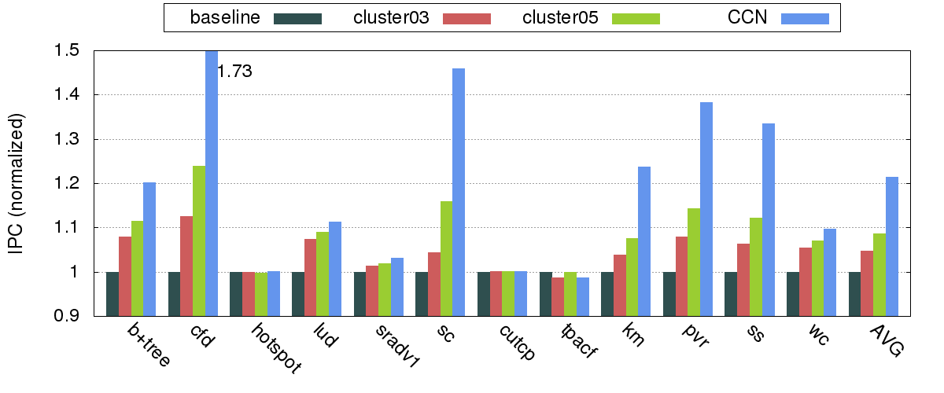
Comparative Study
Clustering*
22%
8.6%
*Keshtegar et. al. Cluster-based approach for improving graphics processing unit performance by inter streaming multiprocessors locality, IET-CDT 2015

Slide 32
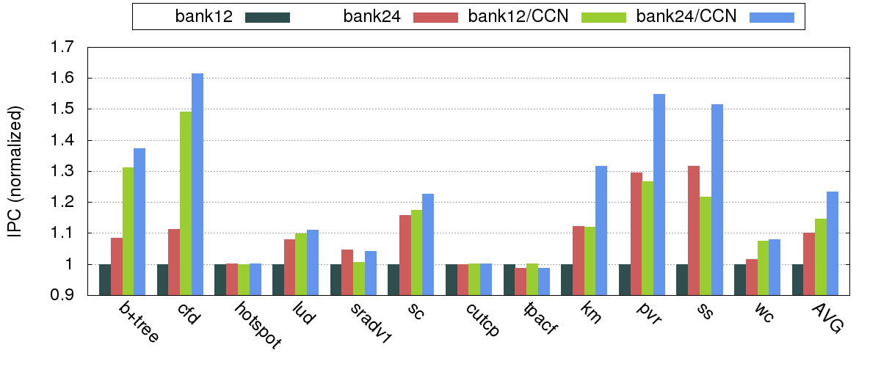
Comparative Study
2x L2 Bandwidth
14.7%
10%
24%

Slide 33
Conclusion
Problem :
High congestion between L1 and L2
Congestion leads to high memory latencies
High latencies appear in the critical path for memory-intensive applications
Observation :
Considerable inter-core reuse in GPGPU applications
GPUs can tolerate reuse latencies gracefully up to 80 cycles
An aggressive policy/network to fetch sharers is an overkill
Proposal :
Propose a ring-based Cooperative Caching Network
Trades-off higher latencies for simplicity and cost
Reduces congestion in the L1-L2 access path
Lower average memory latencies

Slide 34
Questions?
Saumay Dublish
saumay.dublish@ed.ac.uk
http://homepages.inf.ed.ac.uk/s1433370/

