Slide 1

Group Number 1
Mentor
Rahul Vikash

Slide 2
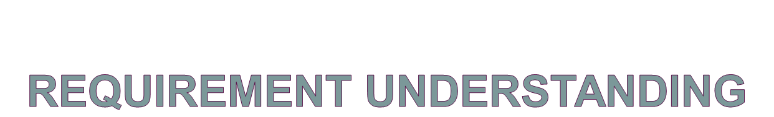
The users are classified into three types:
  Admin-can add/update/cancel a flight.
  Executive-can view flight occupancy.
  User-can register/view flights/book/cancel flight ticket.

Slide 3
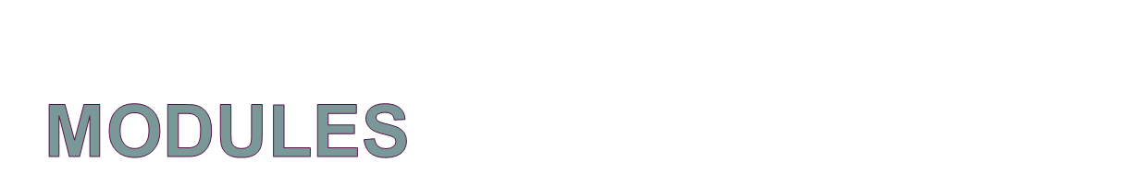
Login
Registration
Display Flights
Book Ticket
Cancel Ticket
Search Flight
Add Flights
Update Flights
Delete Flight

Slide 4
Login Module:
Login module is common for all the users of the system i.e. Admin, User and Executive
Basic functionality of module are as follows:
  Taking login credentials from the user.
  If given credentials are wrong show appropriate
  message.
  If login succeeds, user will be navigated to their
  respective homepage as per the role.

Slide 5
Registration Module:
If a user wants to register to the system then
he/she will be directed to the registration page.
User will be asked to enter the following details:
    First Name
    Last Name
    User Name
    Password
    Mobile No

Slide 6
  Display Flights Module:
  Available Flights can be viewed by a registered user.
  For a user (who is not logged in) first has to login with correct credentials to view the flights.
  After successfully logging in all the available flights for booking tickets are displayed to the user.
  User can book a ticket for the flight he wants.

Slide 7
Book Ticket Module:
The user is shown the flight details with the book ticket option.
When user clicks on book ticket he is redirected to fill the booking form having following fields.
  Flight Number
  Source
  Destination
  Email
  Number Of Passenger
  Class type
  Credit-card Number
After user fills valid details his/her ticket is booked for that flight and he can view his booking details.

Slide 8
Cancel Ticket Module:
  User can cancel a flight that he has booked.
  When a user cancels a ticket, seats cancelled again gets available for booking for that flight.

Slide 9
Search Flight Module:
This module usage rights are given to the executive and admin.
Executive and Admin can search for flights to check the occupancy details. Search can be done by following two ways:
  Search Flights By Source and Destination
  Search Flights By Date
Admin can search the passenger list for a particular flight using flight number.

Slide 10
Add Flights Module:
Admin will add a new flight.
Admin will be asked to enter the following details for adding a new flight:
  Flight Number
  Airline Name
  Source
  Destination
  Departure Date
  Arrival Date
  Departure Time
  Arrival Time
  First Class Seats
  First Class Seats Fare
  Business Class Seats
  Business Class Seats Fare

Slide 11
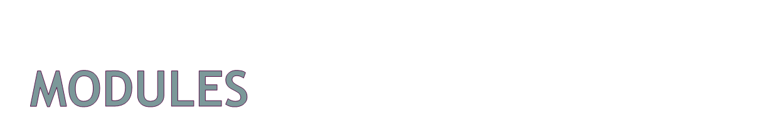
Update Flights Module:
Admin will update an existing flight.
Admin can update all the details mentioned in the add flight module except flight number and airline name.

Slide 12
Delete Flight Module:
Admin can delete an existing flight.
After admin deletes a flight it will no longer be available for the user to book it’s tickets.

Slide 13
