Slide 1


Simulated clinical trials and endpoints
Saumil Shah Postdoc Simulation CDS (10499)

Slide 2
Contents
Aim
Background
Simulation study
Possible extensions

Slide 3
Aim
Replicate, in-silico, primary endpoint from a clinical trial
Estimate the sample size for the in-silico clinical trial
Test two different survival models

Slide 4
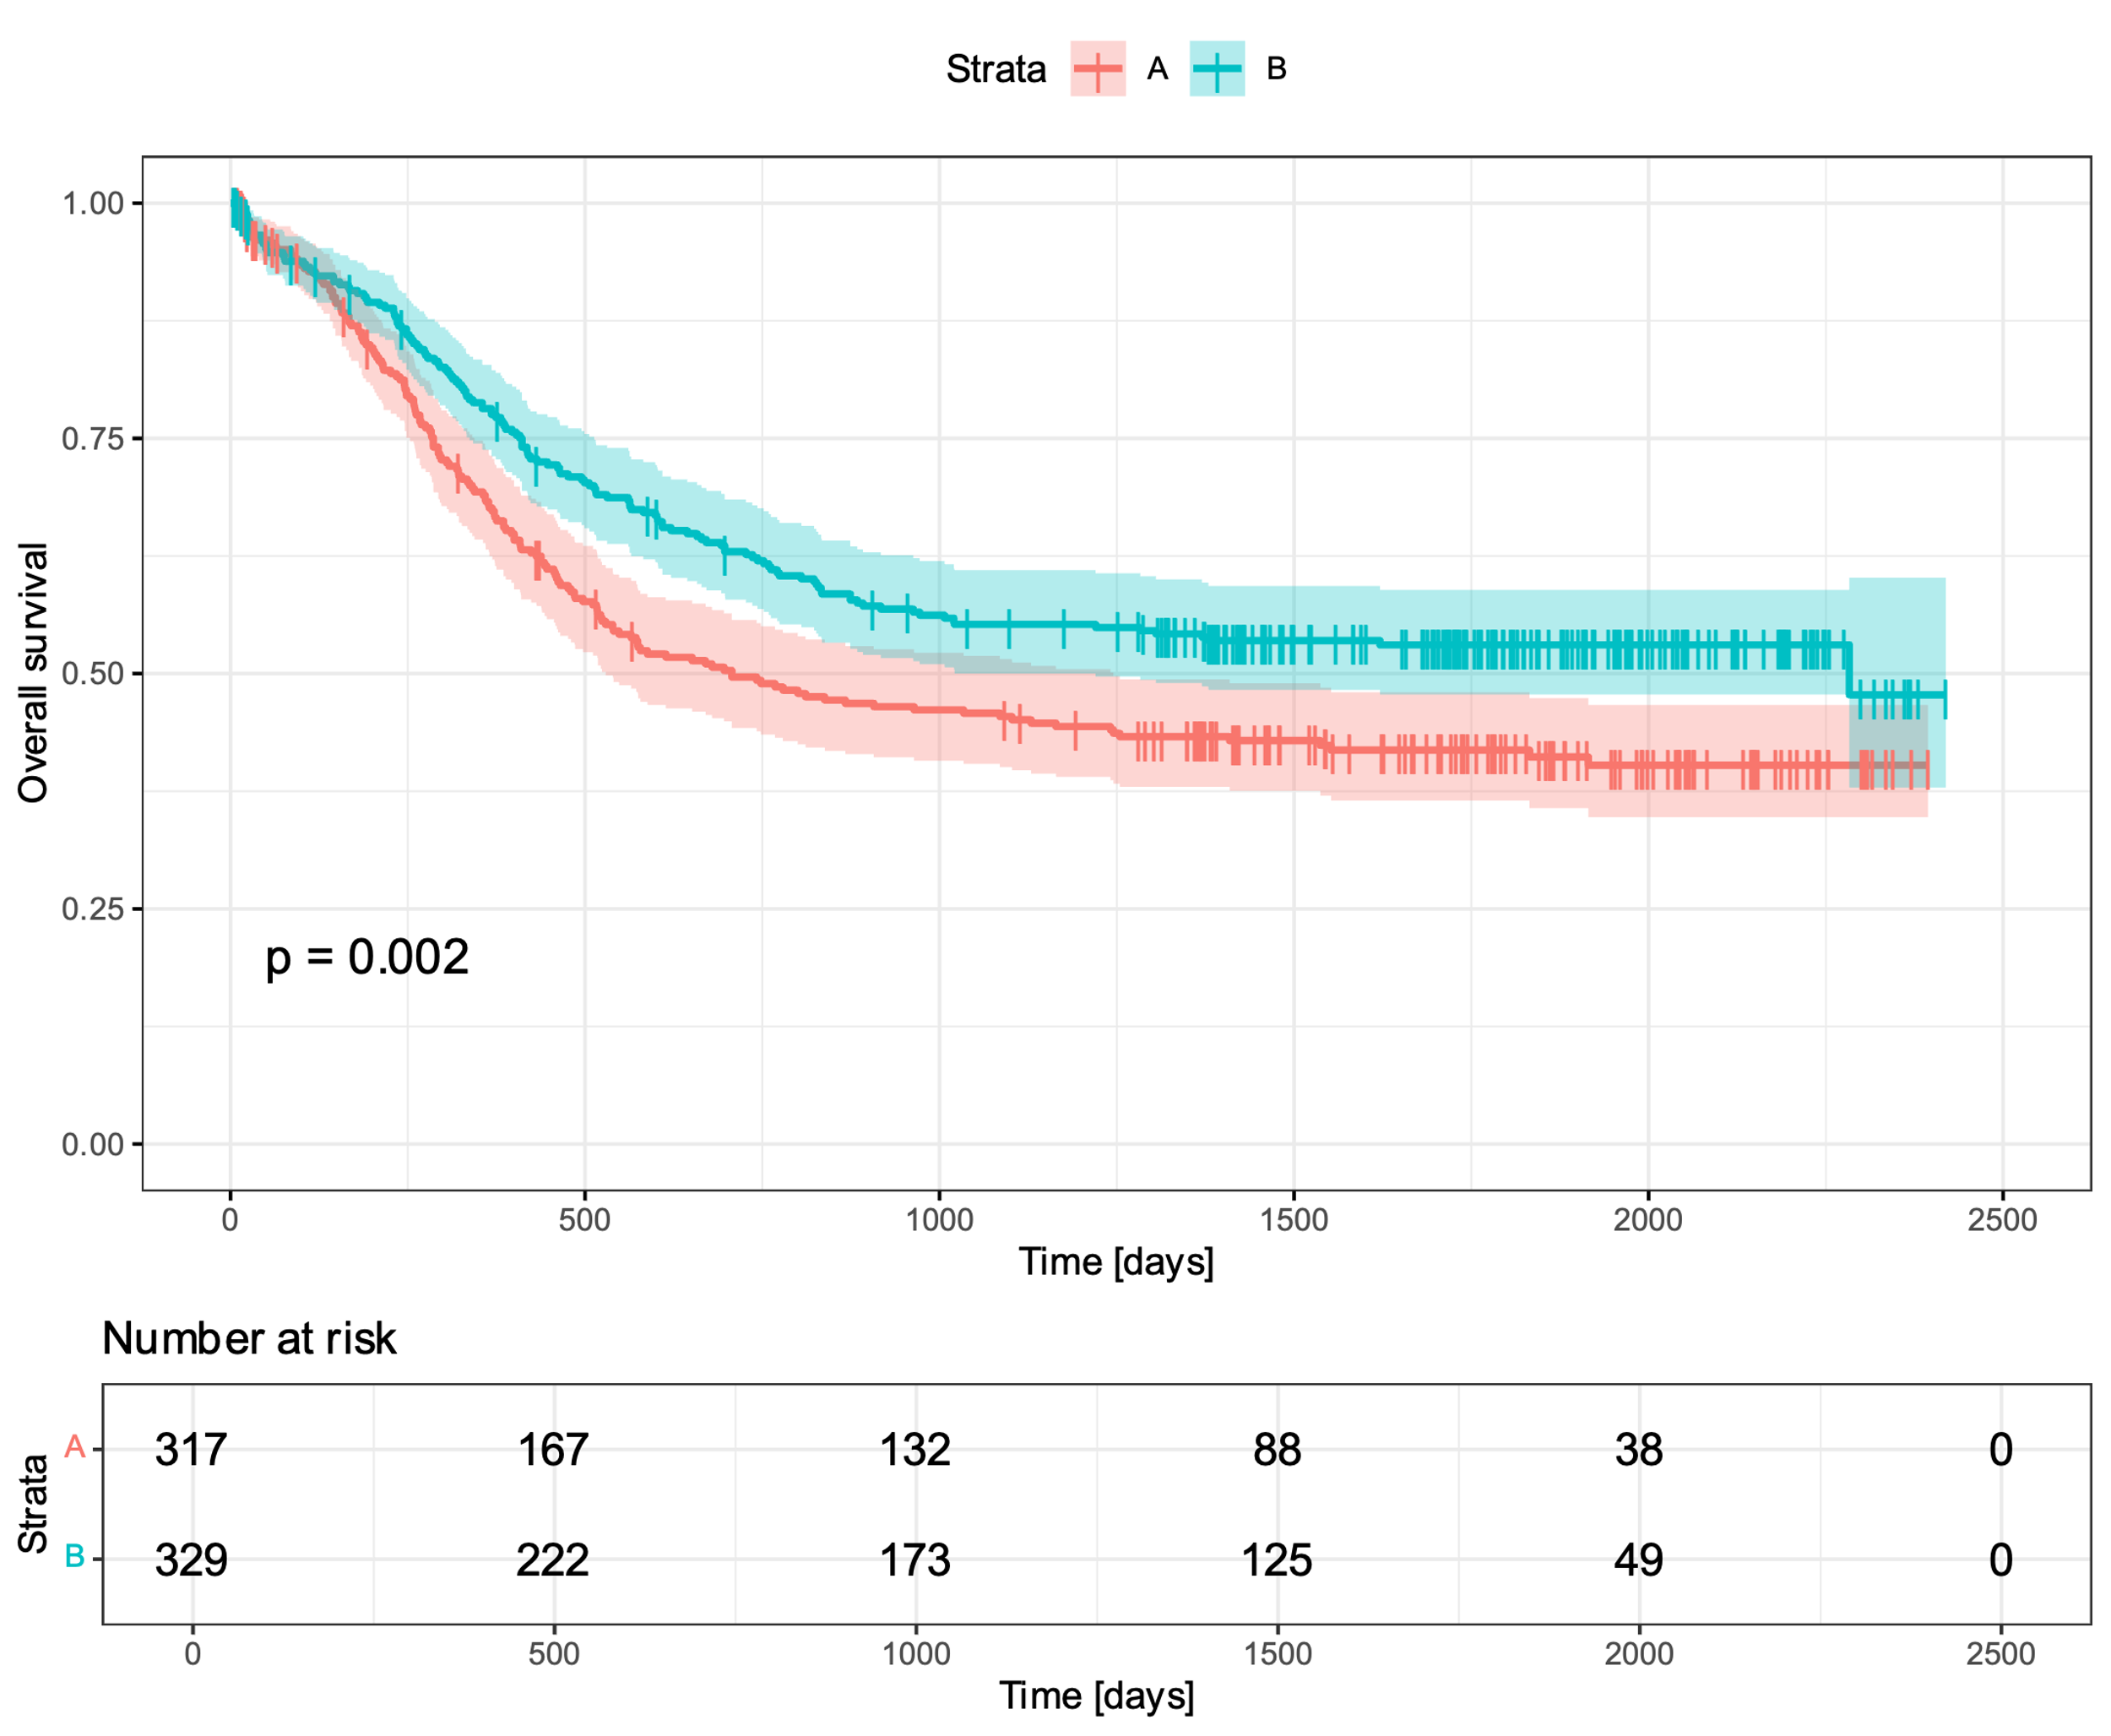
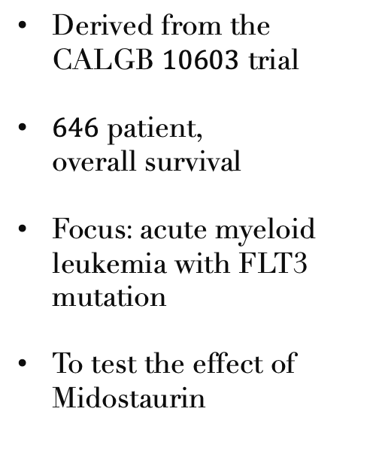
Background
Derived from the CALGB $10603$ trial
$646$ patient, overall survival
Focus: acute myeloid leukemia with FLT3 mutation
To test the effect of Midostaurin

Slide 5
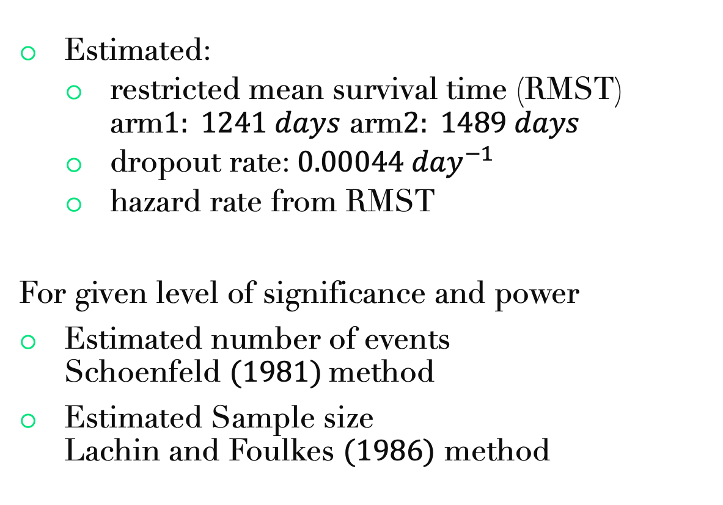
Sample size estimation
Estimated:
restricted mean survival time (RMST) arm$1: 1241 days$ arm$2: 1489 days$
dropout rate: $0.00044 {day}^{−1}$
hazard rate from RMST
For given level of significance and power
Estimated number of events Schoenfeld $(1981)$method
Estimated Sample size Lachin and Foulkes $(1986)$ method

Slide 6
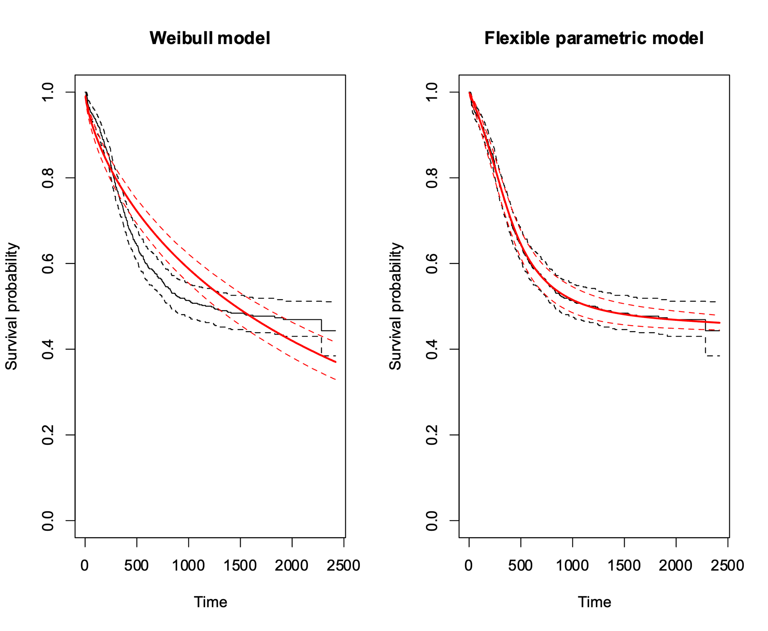
Two hazard models
Weibull distribution vs Flexible model

Slide 7
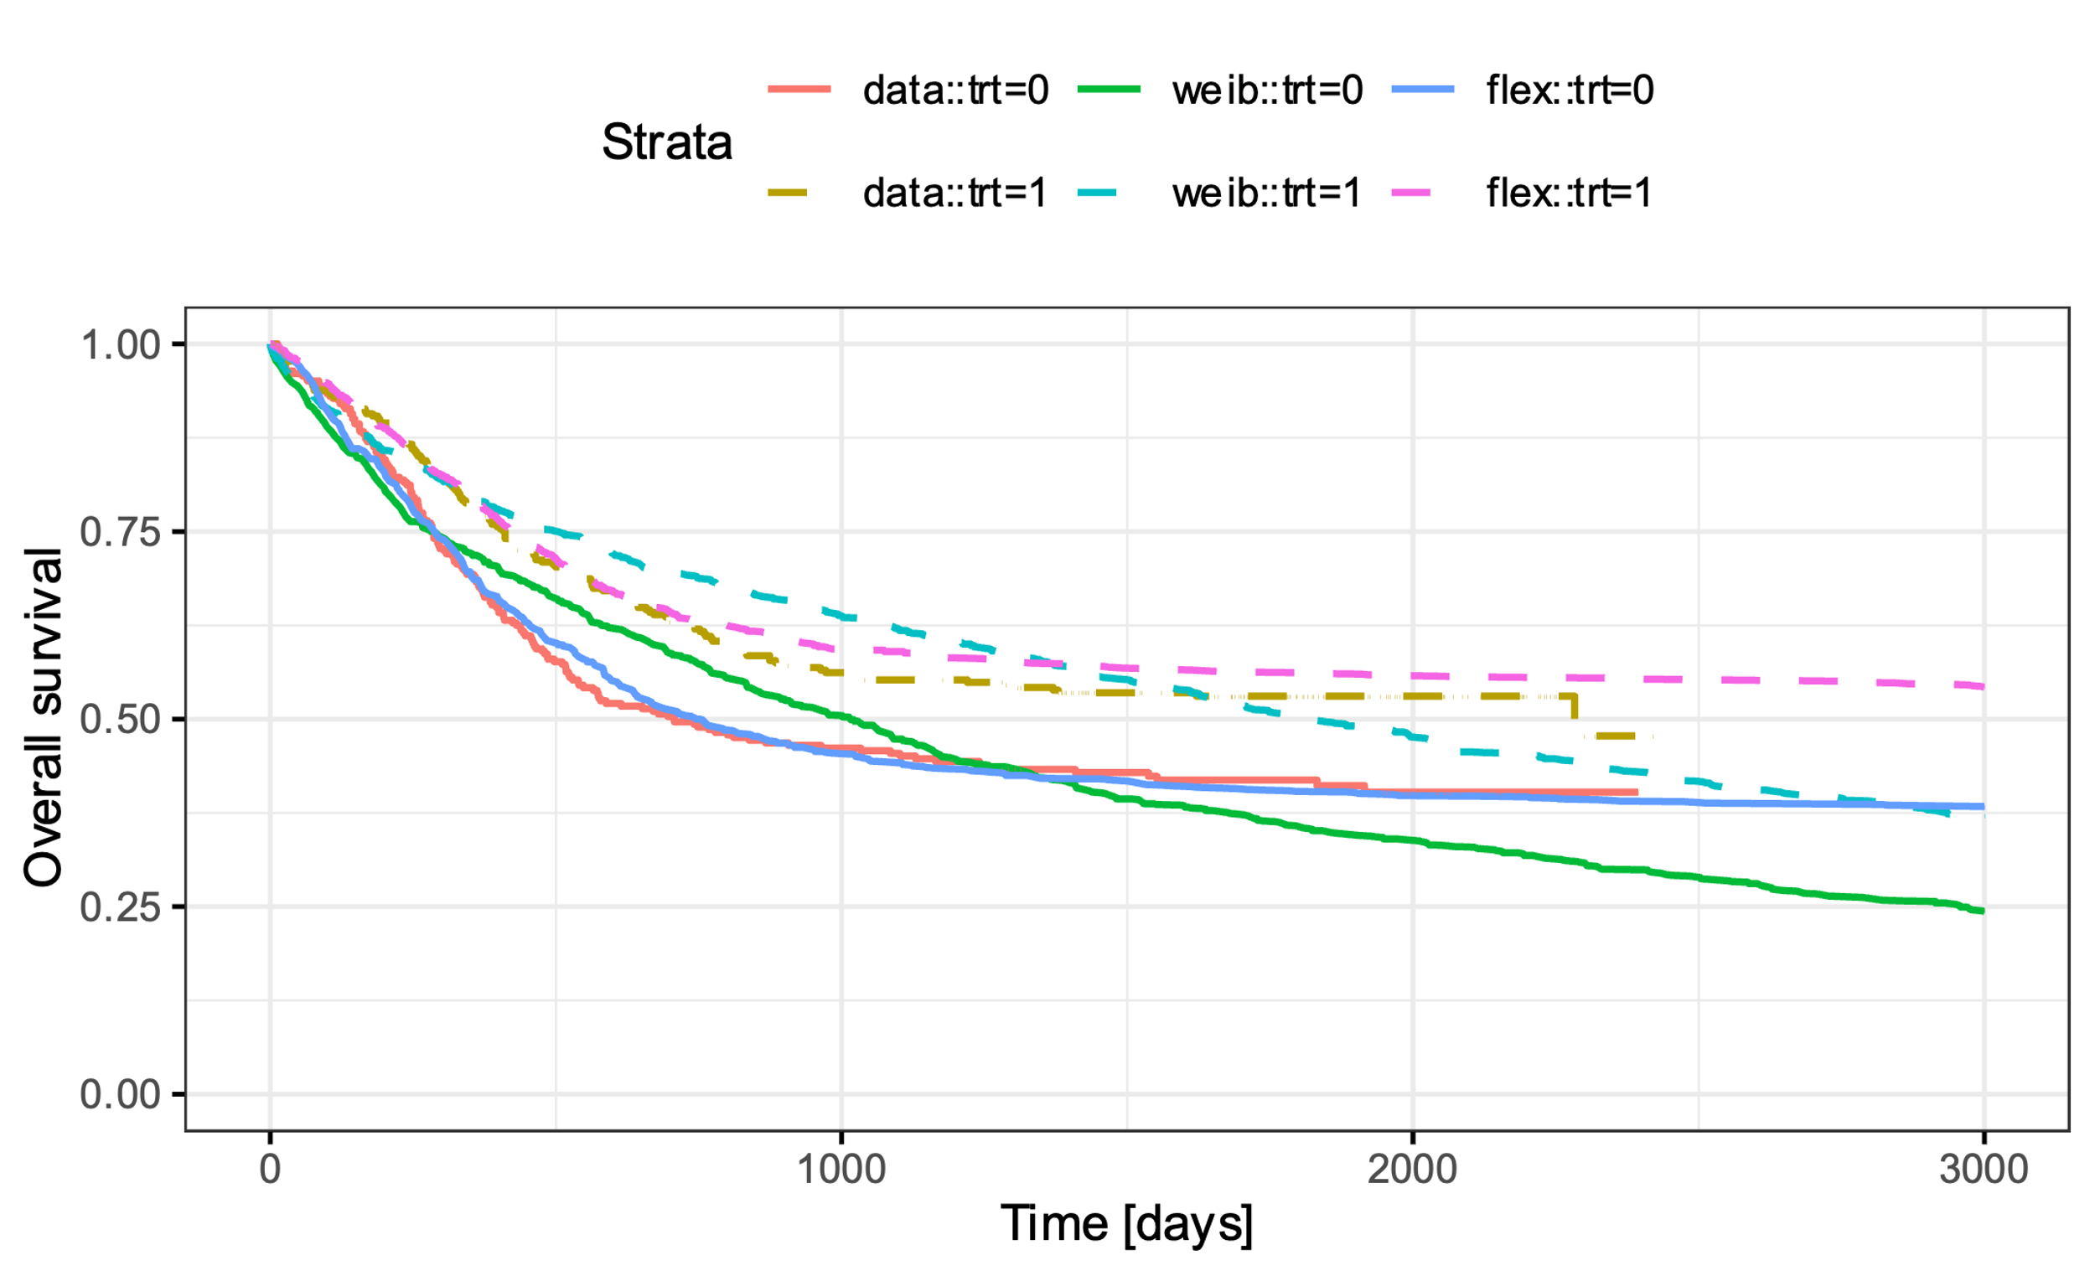
Simulated overall survival

Slide 8
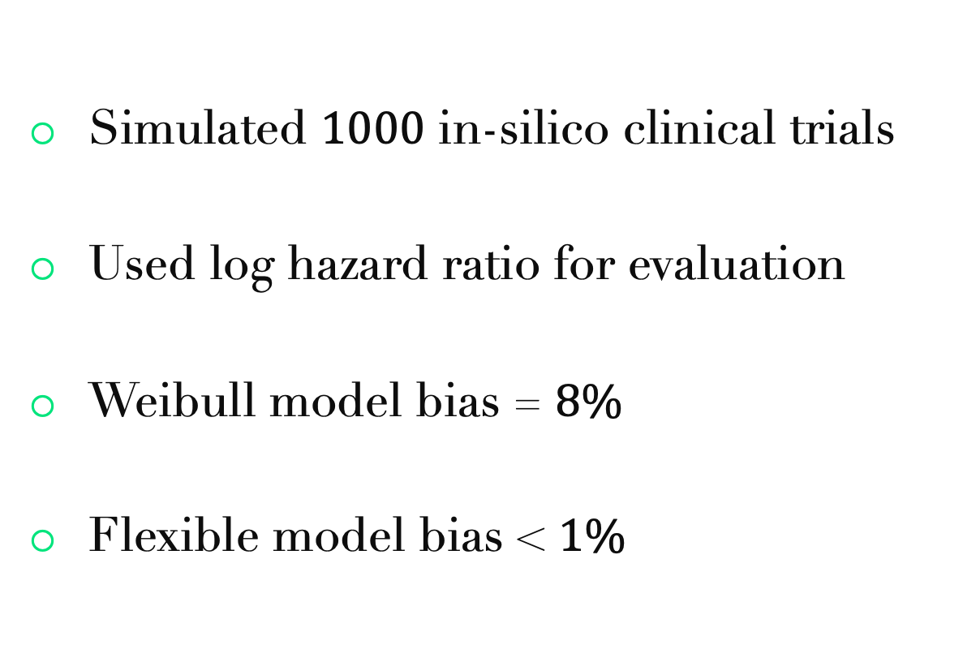
Comparison
Simulated $1000$ in-silico clinical trials
Used log hazard ratio for evaluation
Weibull model bias = $8\%$
Flexible model bias < $1\%$

Slide 9

Possible extensions
Interim sample size re-estimation
Multi-state models for joint models of $>1$ endpoints
progression
progression-free
death

Slide 10
Take away
Based on real-world leukemia dataset
Estimated sample size for clinical trials given level of significance and power

Slide 11
Implementation
R programming language
survival package ecosystem
code is available on github

Slide 12
Thank you!
Postdoc Simulation CDS (10499)

Slide 13
References
Le-Rademacher JG, Peterson RA, Therneau TM, Sanford BL, Stone RM, Mandrekar SJ. Application of multi-state models in cancer clinical trials. Clin Trials. 2018 Oct; 15 (5):489-498.
Schoenfeld D (1981), The Asymptotic Properties of Nonparametric Tests for Comparing Survival Distributions. Biometrika, 68, 316-319.
Lachin JM and Foulkes MA (1986), Evaluation of Sample Size and Power for Analyses of Survival with Allowance for Nonuniform Patient Entry, Losses to Follow-Up, Noncompliance, and Stratification. Biometrics, 42, 507-519.

