Slide 1


Simulated clinical trials and endpoints
Saumil Shah Postdoc Simulation CDS (10499)

Slide 2
Contents
Premise
Hazard models
Simulations
Comparison

Slide 3
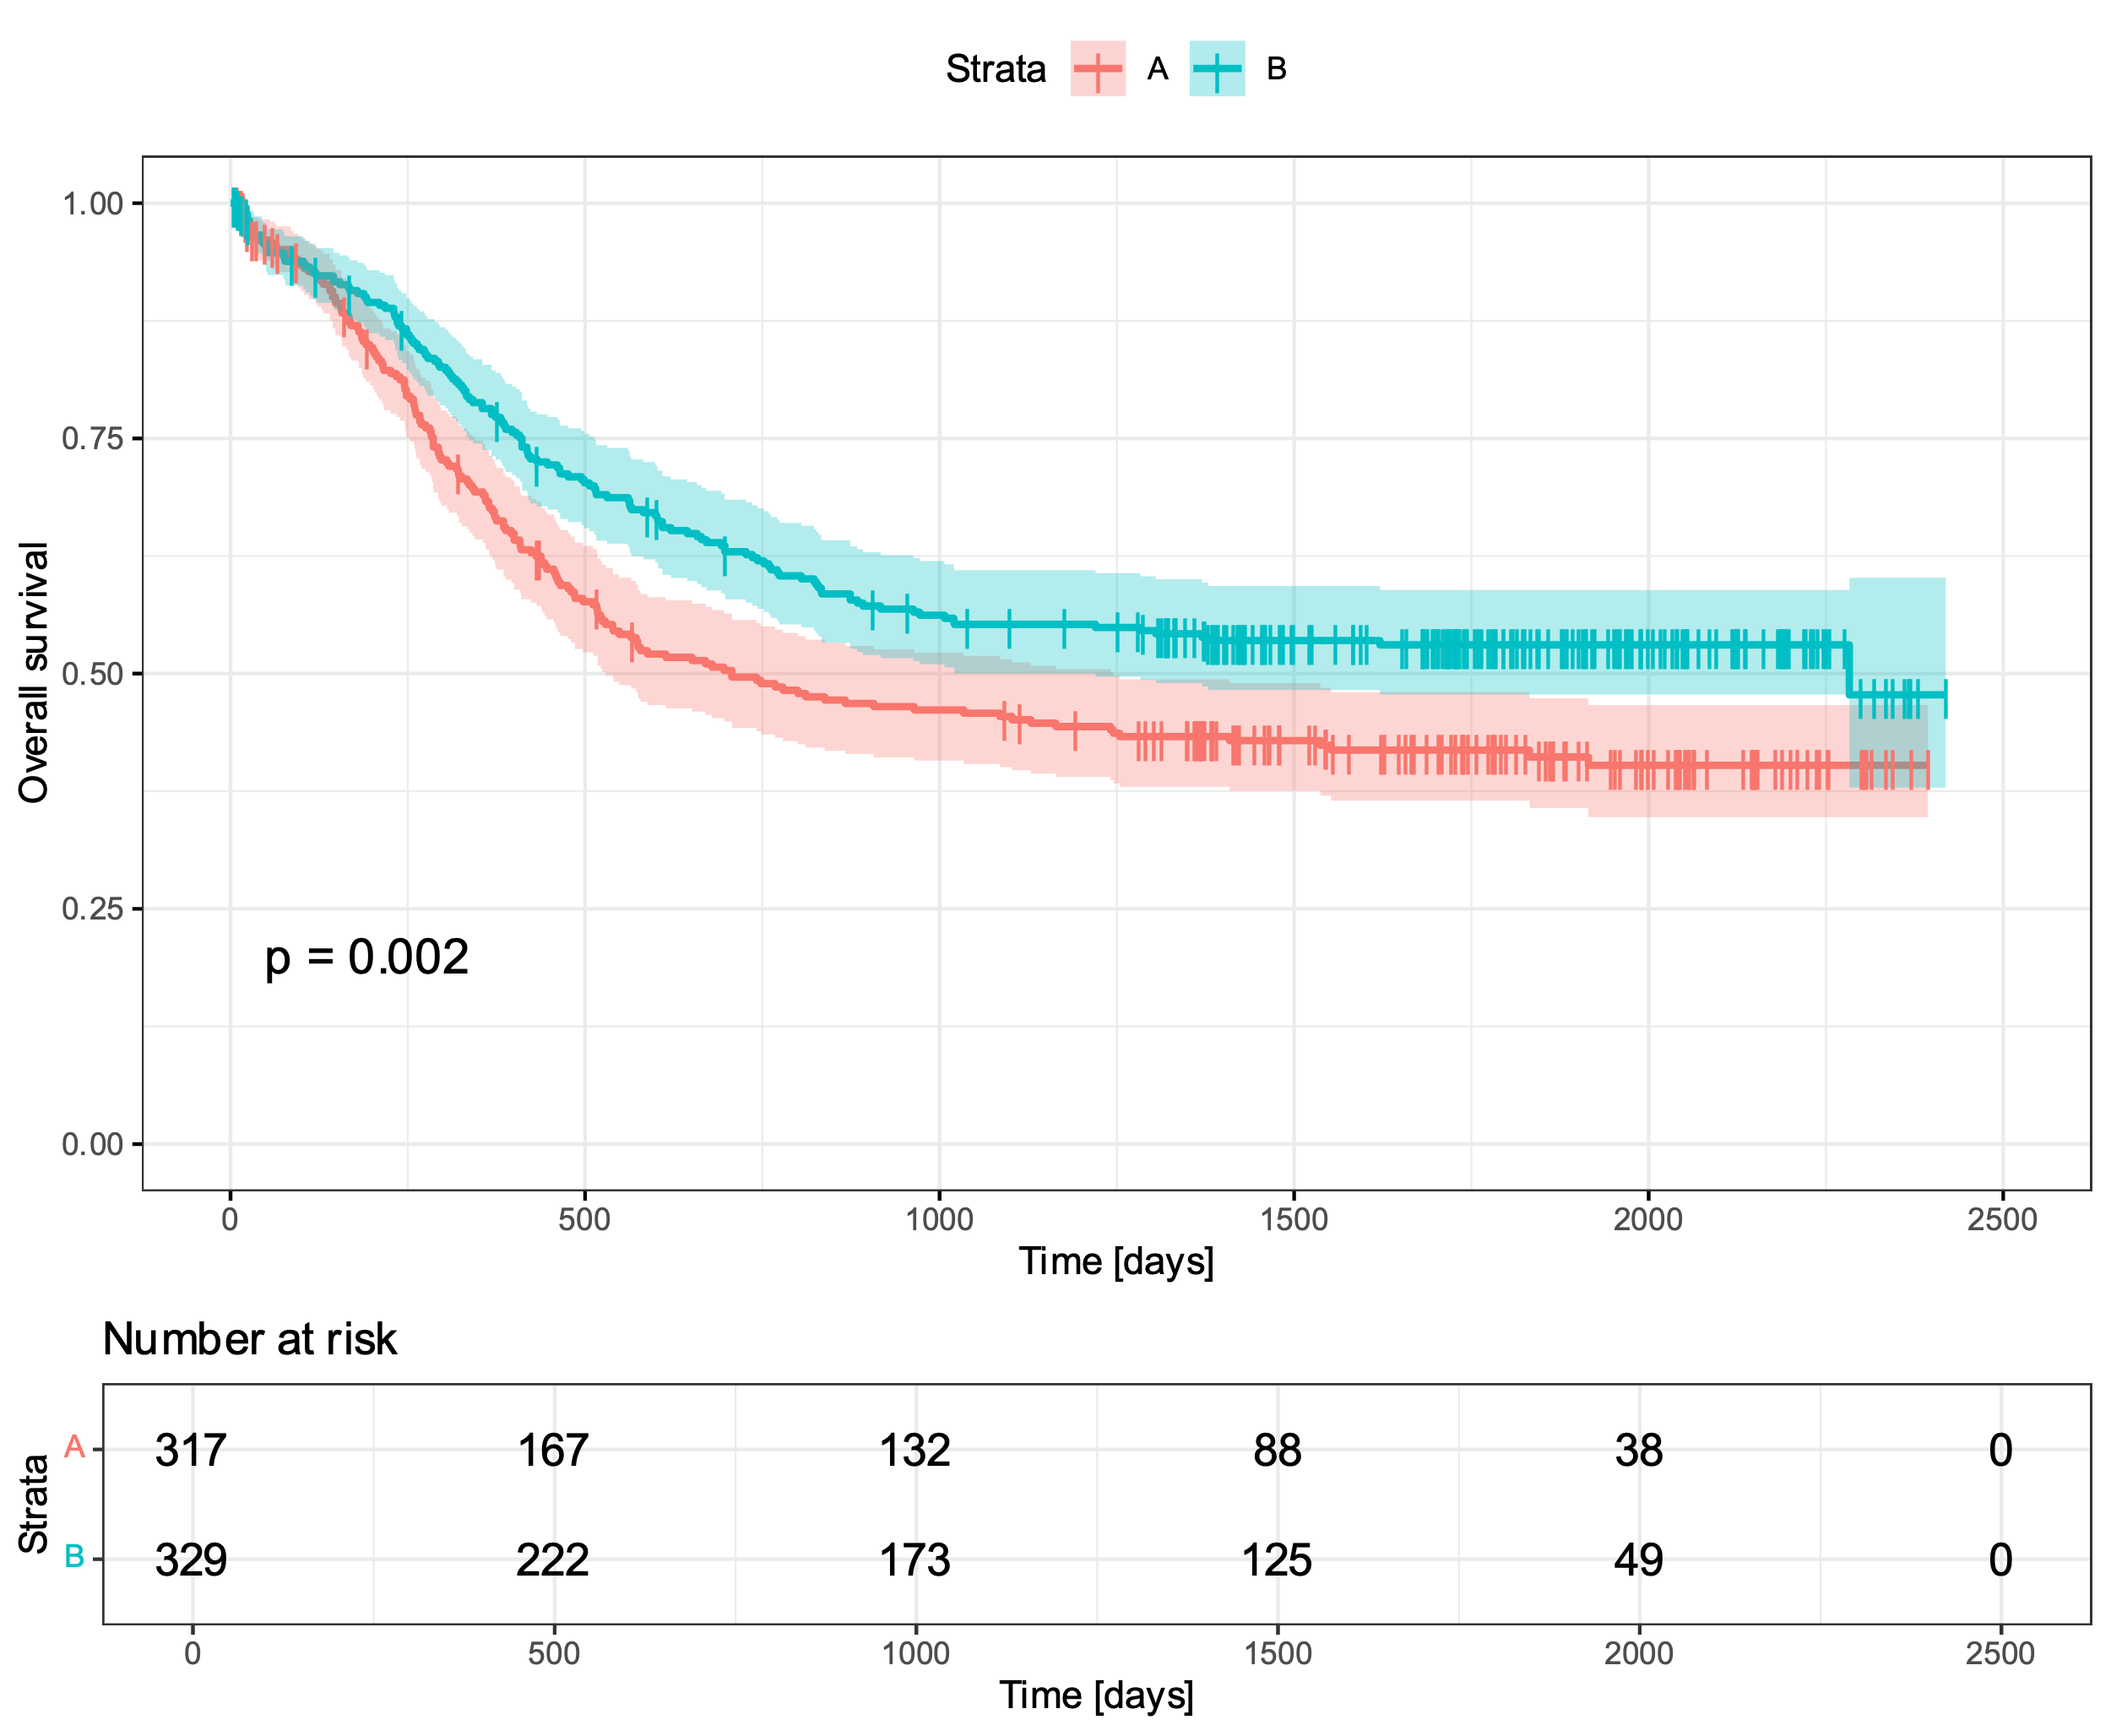
Premise

Slide 4
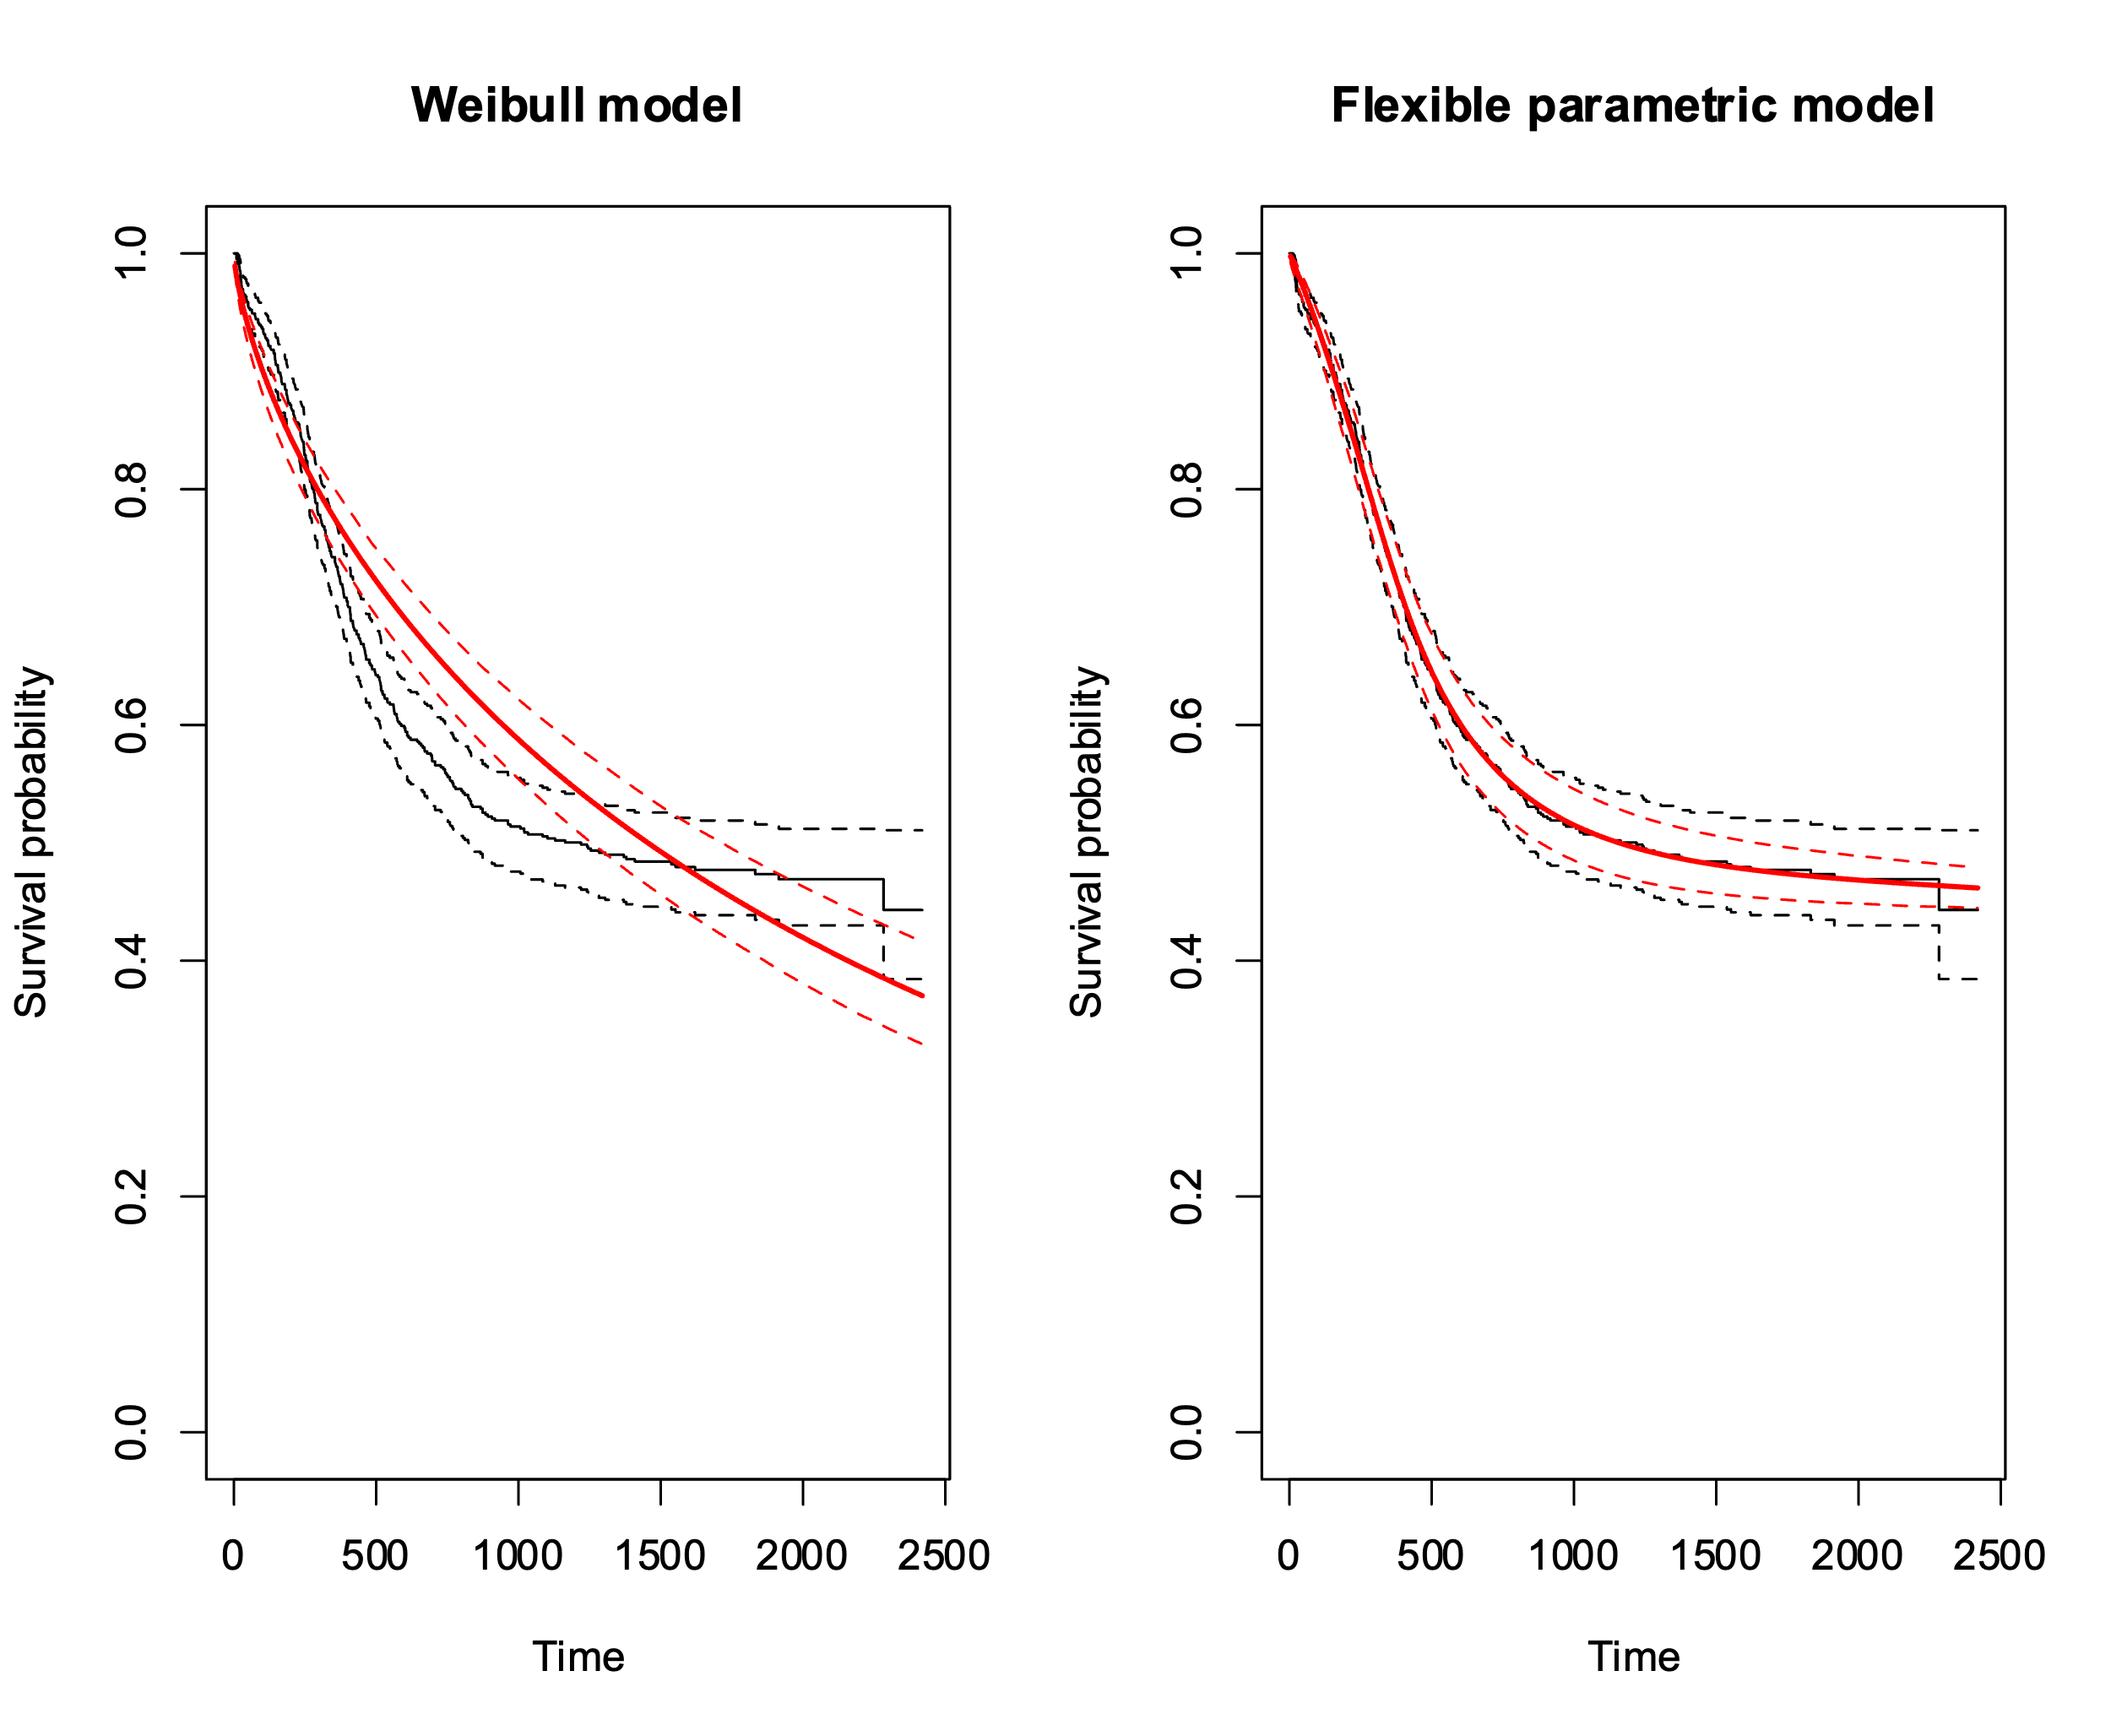
Hazard models
Weibull vs Royston-Parmar spline

Slide 5
Implementation
Used R
Estimated hazard from the data
Used two different models
Code available on github

Slide 6
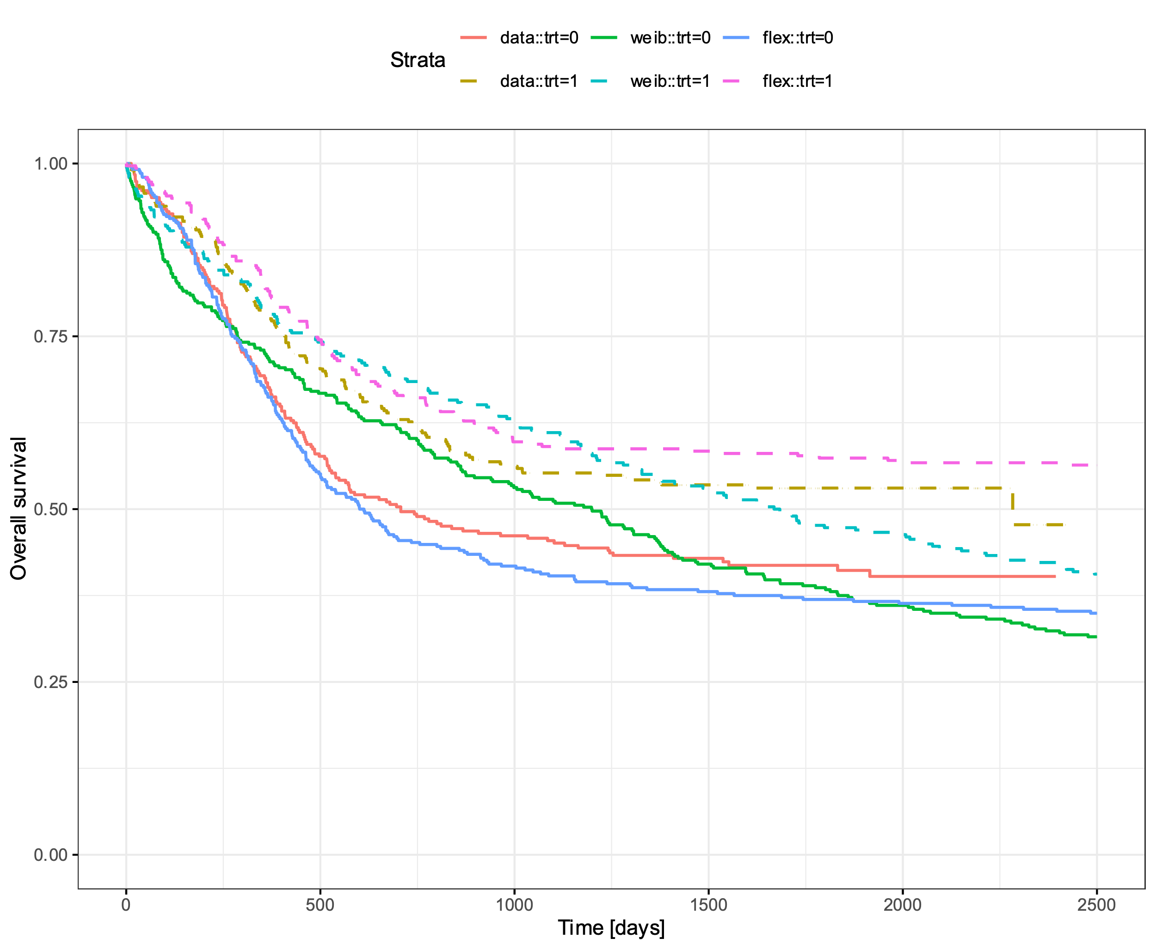
Simulations

Slide 7

Comparison
$11\%$vs $5\%$bias

Slide 8
Take away
Premise
Hazard models
Simulations
Comparison

