Slide 1


Simulated clinical trials and endpoints
Saumil Shah Postdoc Simulation CDS (10499)

Slide 2
Contents
Premise
Hazard models
Simulations
Comparison

Slide 3
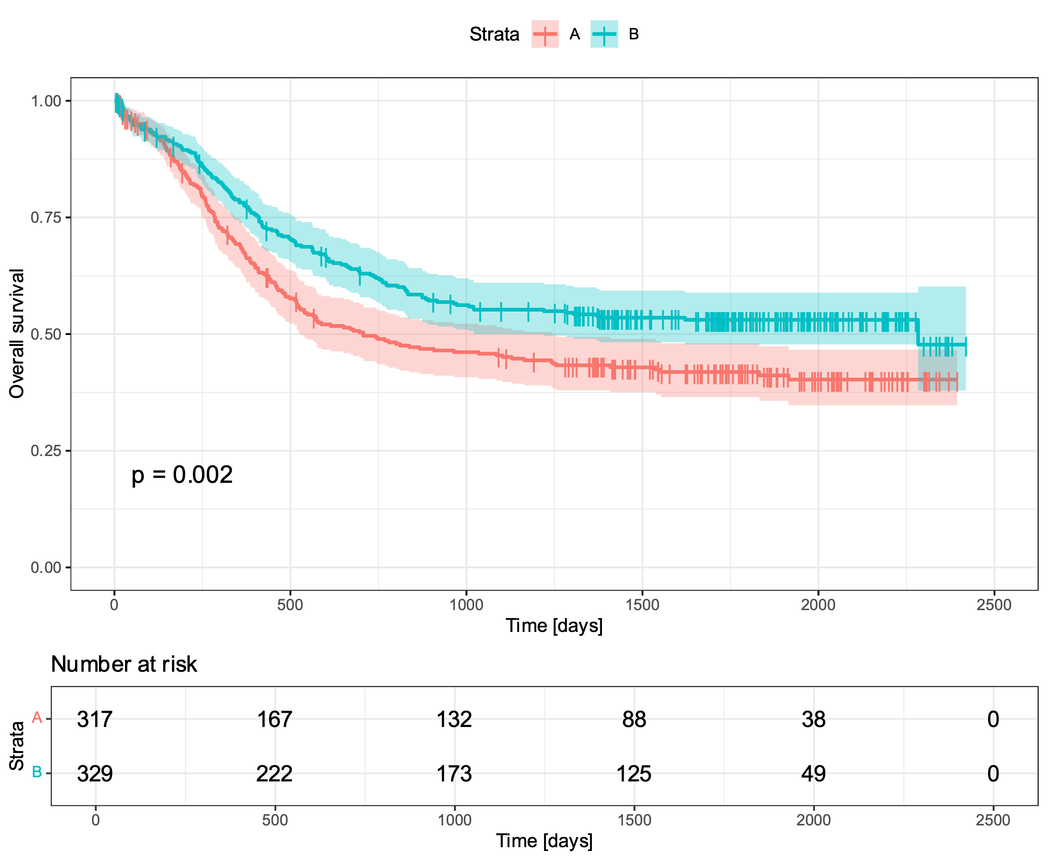
Premise

Slide 4
Hazard models
Premise
Hazard models
Simulations
Comparison

Slide 5
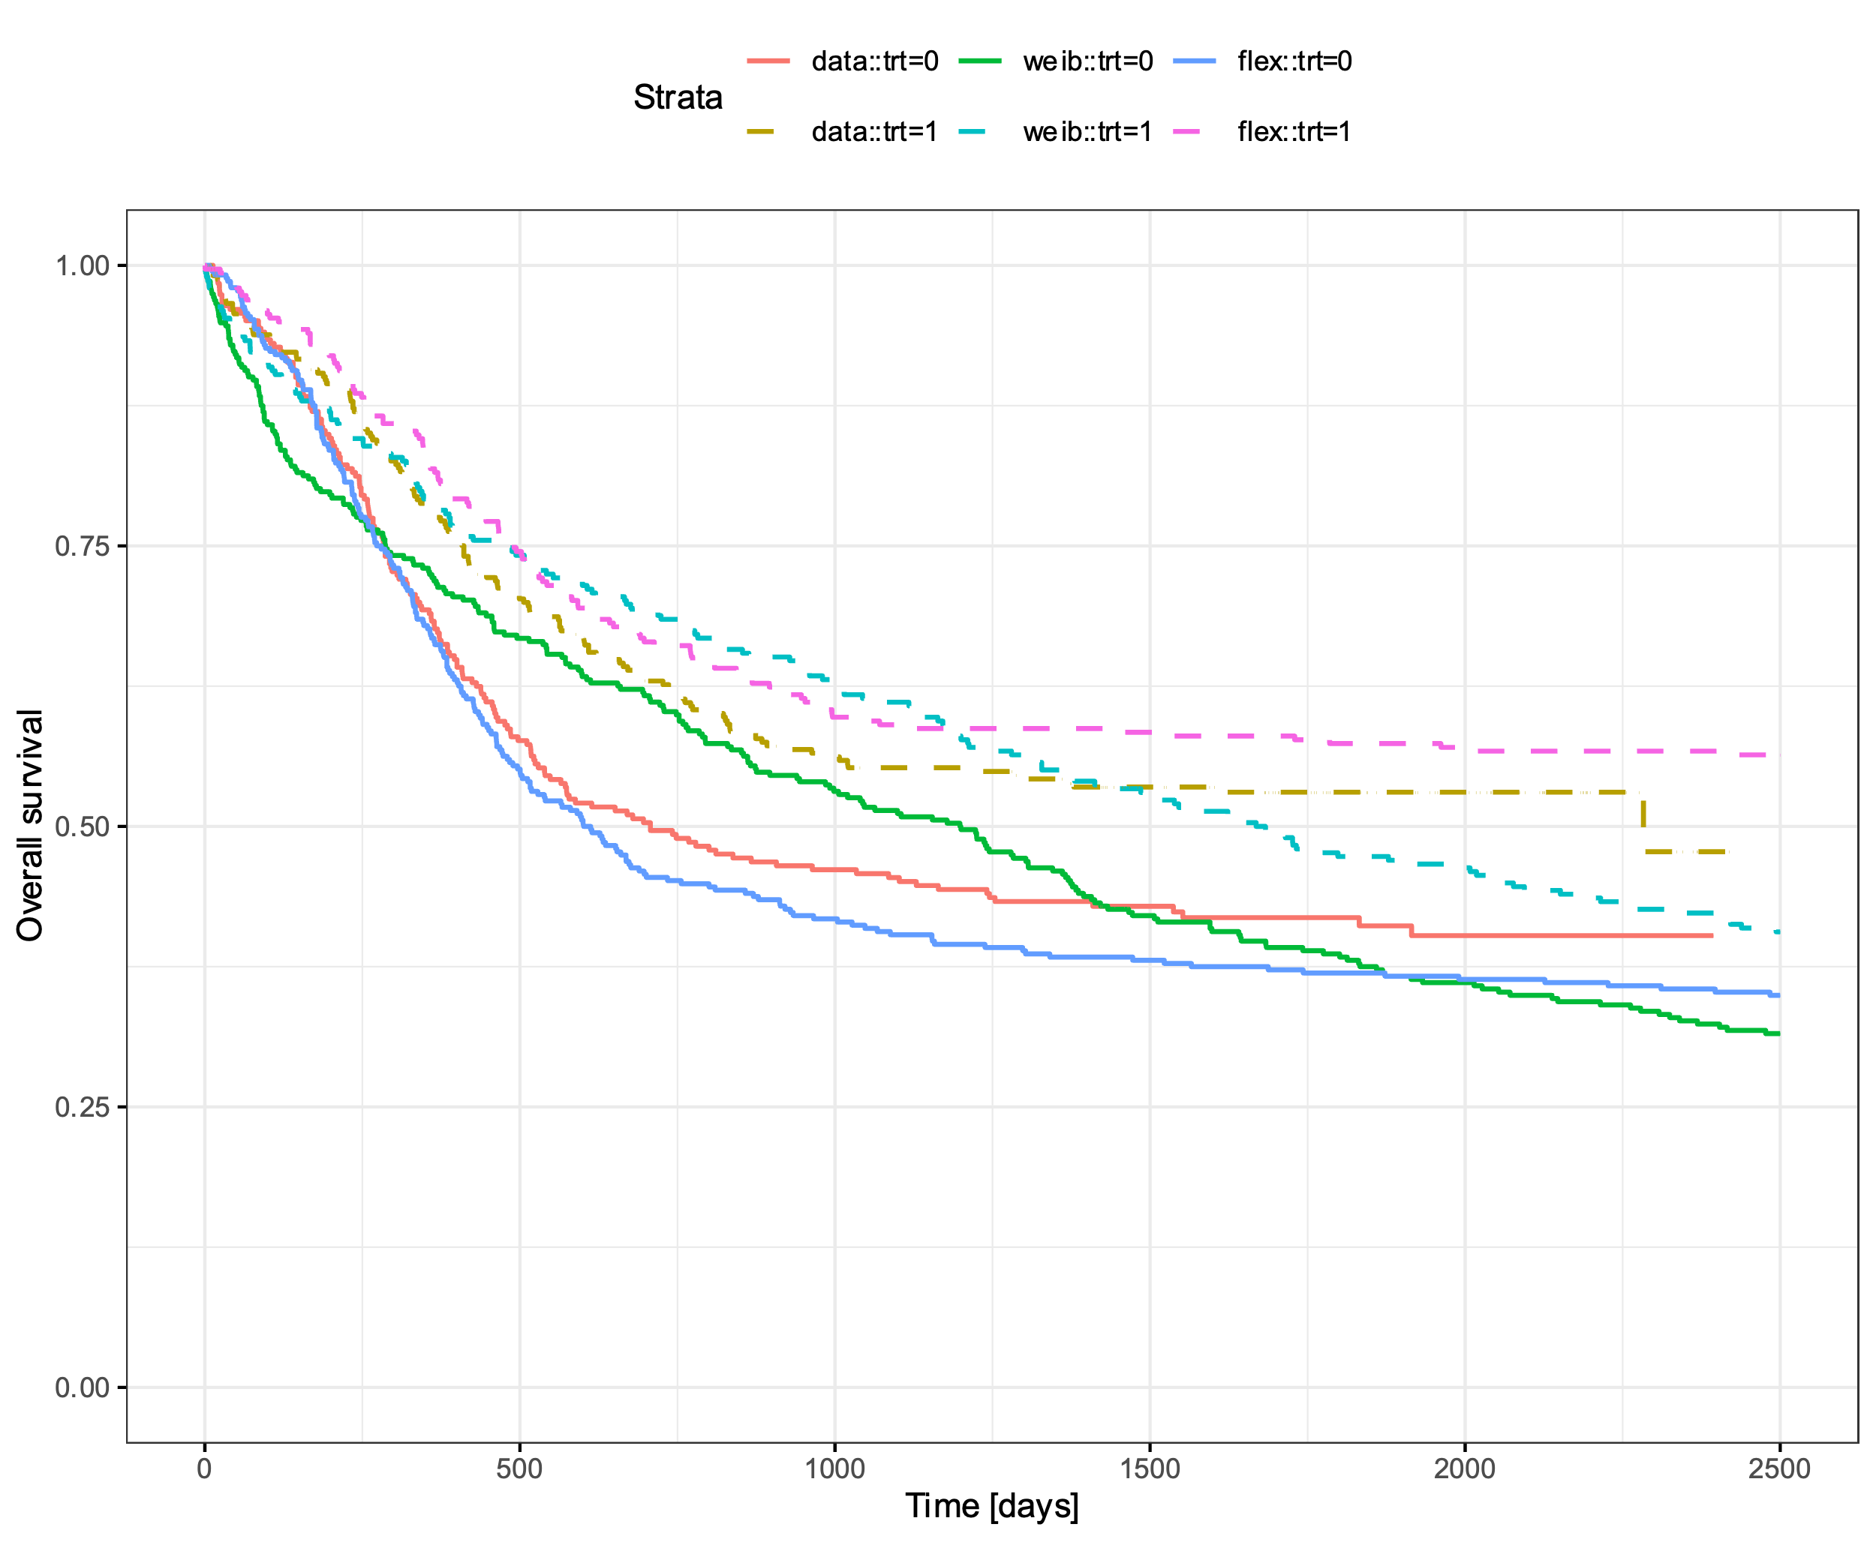
Simulations

Slide 6
Comparison
Premise
Hazard models
Simulations
Comparison

Slide 7
Take away
Premise
Hazard models
Simulations
Comparison

