Slide 1
Quora

Slide 2
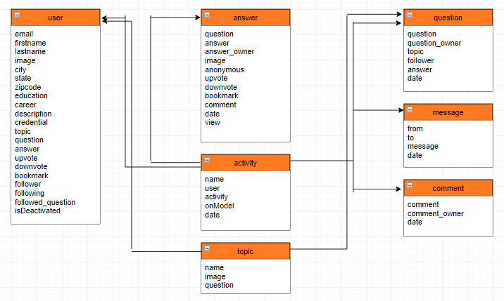
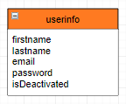
Database Schemas
MySQL
MongoDB

Slide 3
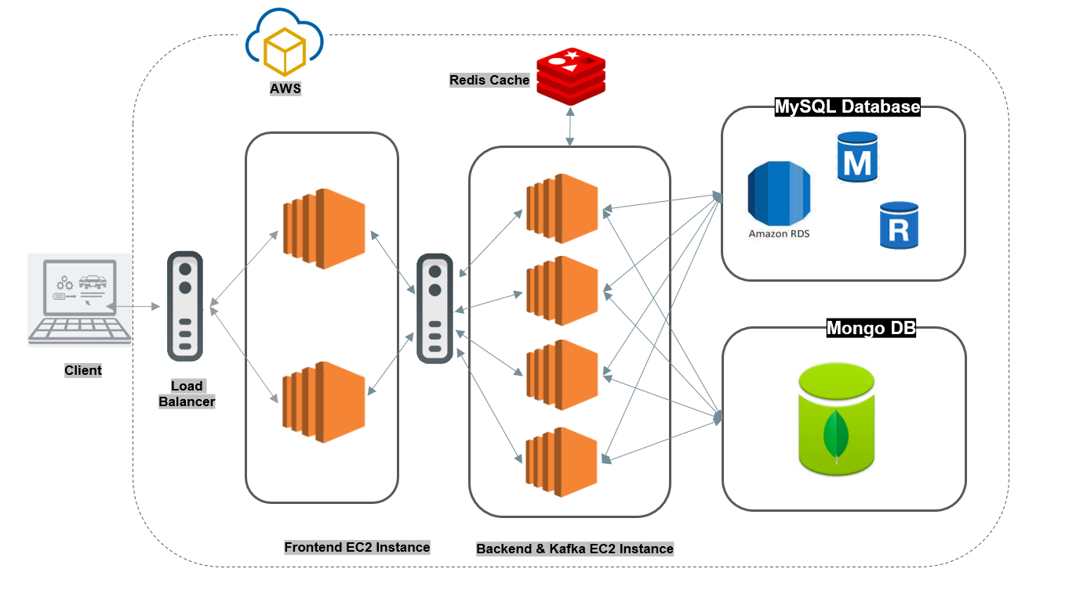
System Architecture

Slide 4
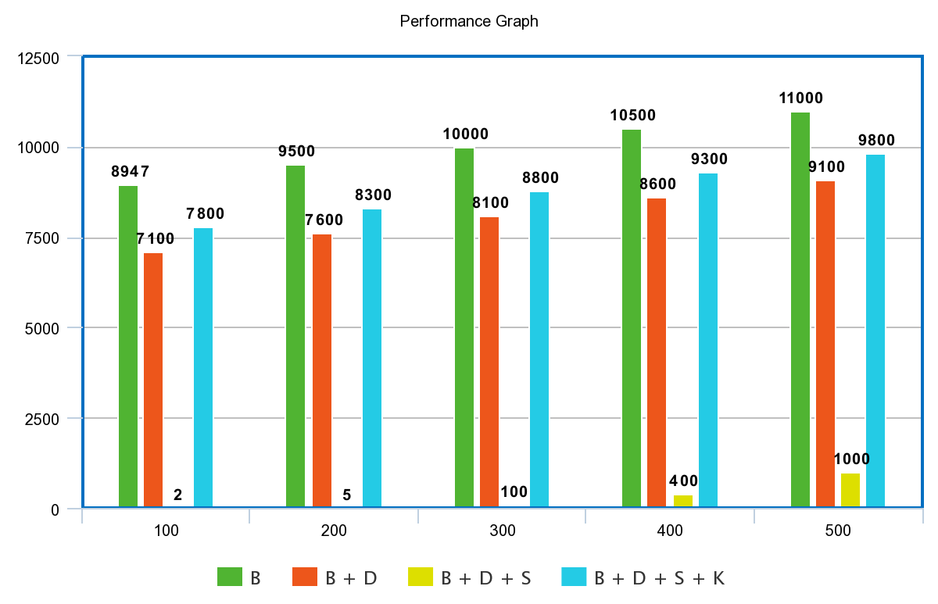
Performance Graph: Part 1

Slide 5
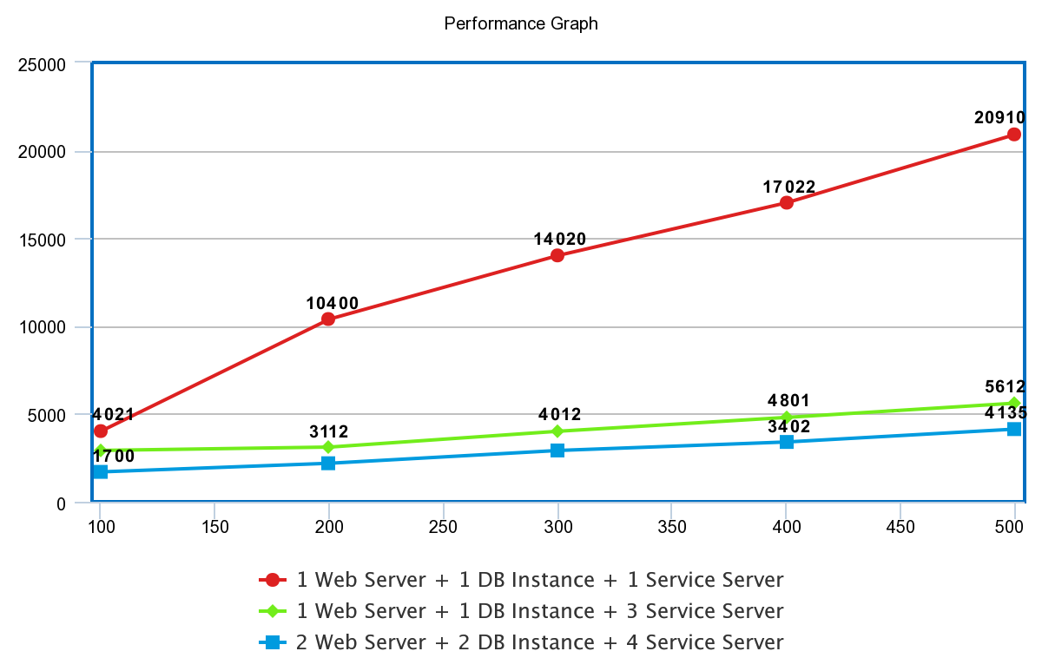
Performance Graph: Part 2
￼

