Slide 1
Predicting Likelihood of Loan Default
Saumit Bhave

Slide 2
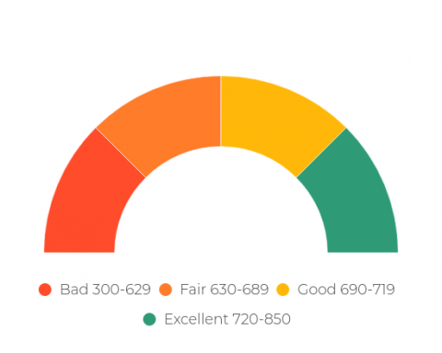
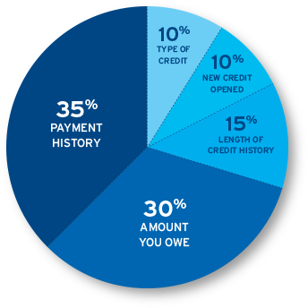
Introduction
FDIC Survey:
  6.5% (8.4 million) households in US were unbanked in 2017
  Additional 18.7% (24.2 million) households were underbanked
Traditional financial institutions rely on credit score to assess risk

Slide 3

Problem
Applicants with poor credit fall victim to predatory lenders
How to assess and minimize risk using a holistic approach?
  Important to look beyond credit score

Slide 4
Project Motivation
Is there a way to predict likelihood of loan default using alternative metrics and machine learning models?

Slide 5

Data Acquisition/Wrangling
Raw CSV
300K+ records
Data Cleaning
Dropping null/invalid values
Missing Value Imputation
Cleaned Dataset
80K+ records
122 fields
Outlier Treatment
Acquired from Home Credit, a company that “focuses on responsible lending primarily to people with little or no credit history”

Slide 6
Feature Selection
Correlation
Correlation with target variable
Evaluate top 20 positive and negative features
Weight of Evidence and Information Value
Used for variable selection in credit modeling
Retain features with 0.1 < IV < 0.7
Multicollinearity Analysis
Use metric Variance Inflation Factor
Retain features with VIF < 5
Final Dataset for Modeling: 80,603 records, 23 features

Slide 7
Modeling Approach
Supervised Binary Classification Problem
  0 if applicant repaid loan, 1 if applicant defaulted on loan
  Imbalanced Dataset – evaluate ROC AUC as well as Precision Recall Curve
Apply Logistic Regression, Random Forest, XGBoost models
  Evaluate baseline performance and then use hyperparameter tuning to find best parameters

Slide 8
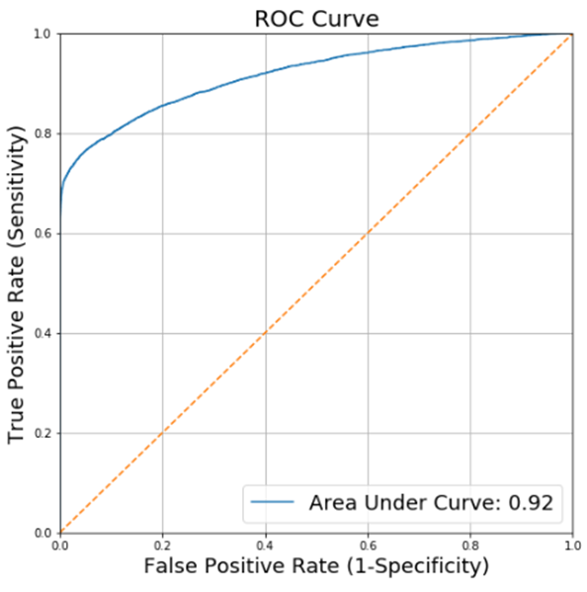
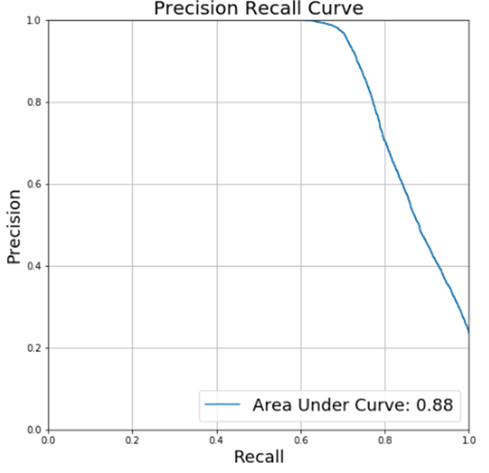
Results
Tree based models had best performance
Extreme Gradient Boosting (XGBoost) had best overall performance, with highest ROC AUC and Precision Recall Curve AUC

Slide 9
Client Recommendations
Apply Random Forest and XGBoost models to each new applicant
Use model results as supplement to human review
  Use predicted probability outputs to signal different levels of review
Applicants deemed low risk (model predicts low probability of default) can be automatically approved for a consumer loan
  Save immense manpower and manual review
  Risk threshold can be set and modified as necessary

Slide 10
Future Work
Apply other machine learning techniques/models
Incorporate more data from HomeCredit or external agencies to build a more robust model

Slide 11
Thank You!

