Slide 1
Segmentation of Search Engine Results for Effective Data-Fusion
Saumitra Jain
Akhilesh Desu

Slide 2
Abstract
Metasearch and data-fusion techniques combine the rank lists of multiple document
We propose a new fusion method that partitions the rank lists of document retrieval systems into chunks
Using a small number of training queries, the probabilities of relevance of documents in different chunks are approximated for each search system.
We tried to show that our proposed method produces higher average precision values than previous systems.

Slide 3
Modules
ProbFuse
Segfuse
Experimental Results

Slide 4
ProbFuse
It ignores the rank provided by the system and builds its own rank based on the frequency of the words
ProbFuse divides the probability of relevance of a document by its segment number (k). This strategy advantages the documents that appear on the top ranks of each result set (the skimming effect)
So we use it as one of our baseline of our experiment

Slide 5
SEGFUSE
SegFuse is a probabilistic data-fusion method that estimates the probabilities of relevance of documents using a small number of training queries
SegFuse can be summarized in three steps

Slide 6
For each search system, the returned rank list is partitioned into chunks. The size of chunks increases exponentially in the rank lists
For each search system, the probability of relevance for documents in each chunk is estimated using a few training queries.
The final score of a document is computed according to its probabilities of relevance in the rank lists. SegFuse merges the results and ranks the documents according to their final scores

Slide 7
Results

Slide 8
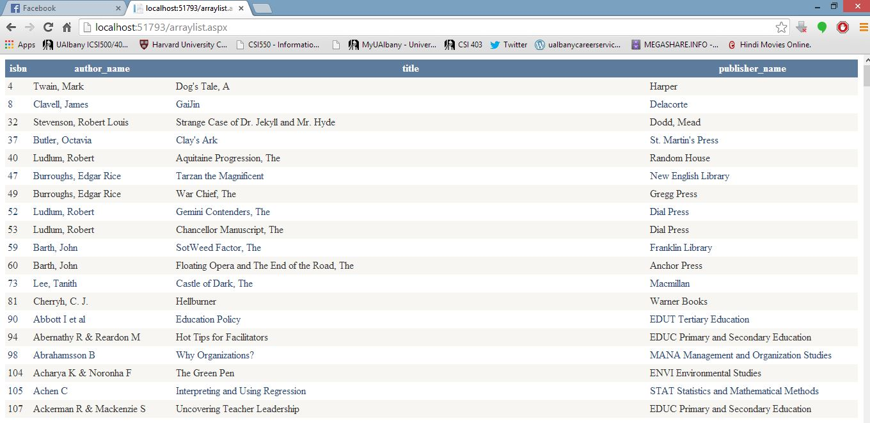
Retrieved Results from Database 1

Slide 9
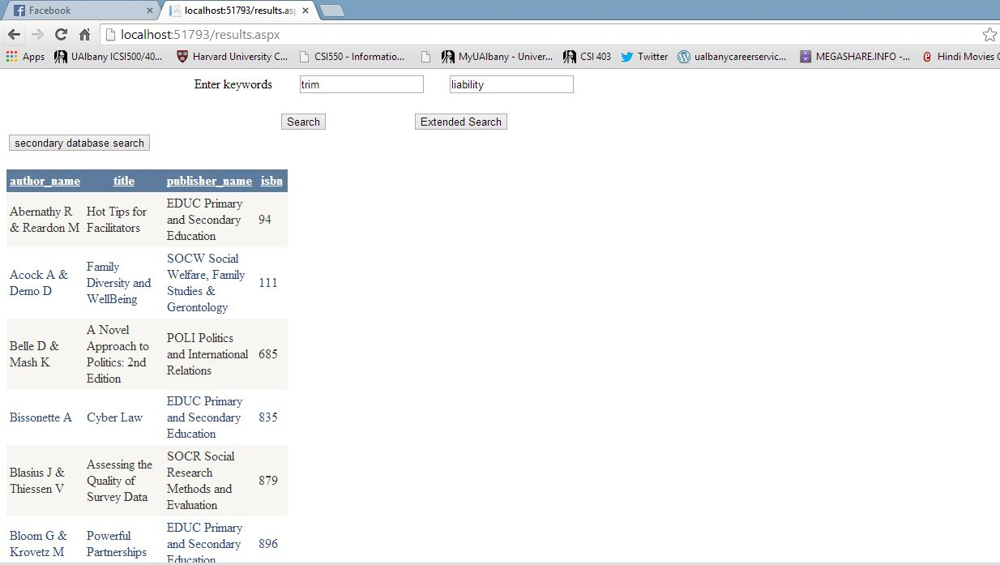
Final Relevant Results

Slide 10
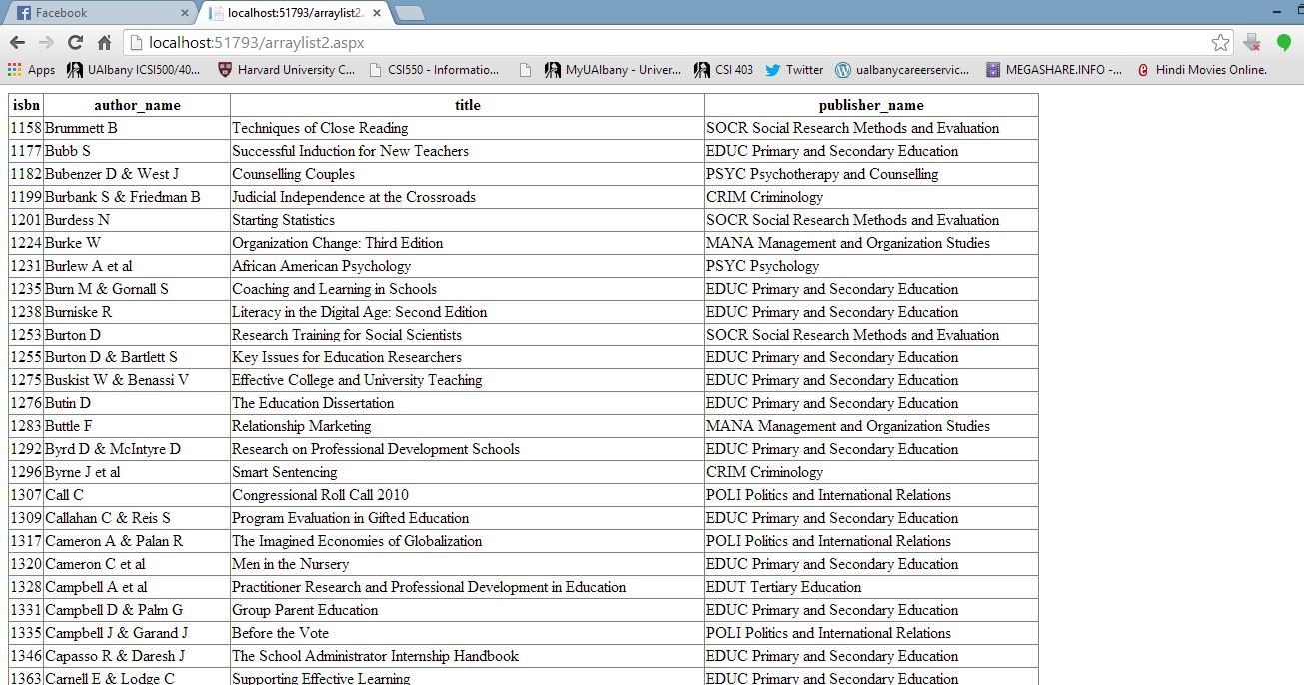
Retrieved results from Database 2

Slide 11
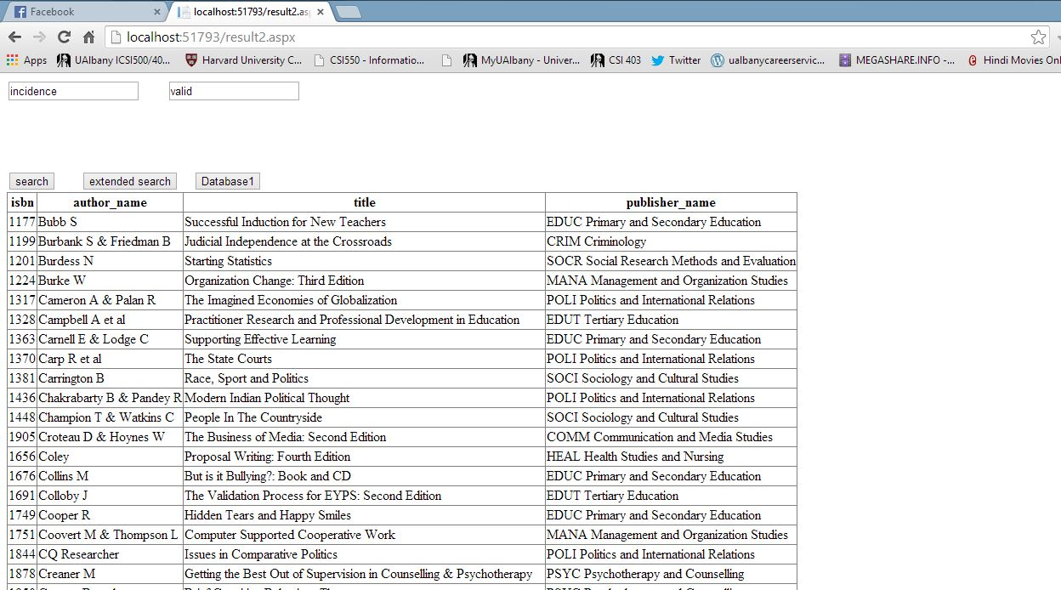
Final relevant results of Database 2

Slide 12
R-P Curve for Database 1
Retrieved | Relevant | Required document | Precision | Recall
26 | 4 | 2 | 0.15 | 0.50
35 | 5 | 1 | 0.14 | 0.20
24 | 6 | 4 | 0.25 | 0.67
32 | 7 | 6 | 0.22 | 0.86
56 | 5 | 1 | 0.09 | 0.20
71 | 9 | 1 | 0.13 | 0.11
14 | 1 | 1 | 0.07 | 1.00
36 | 8 | 3 | 0.22 | 0.38
42 | 12 | 5 | 0.29 | 0.42
40 | 10 | 2 | 0.25 | 0.20
34 | 12 | 3 | 0.35 | 0.25
30 | 15 | 7 | 0.50 | 0.47
40 | 9 | 4 | 0.23 | 0.44
37 | 25 | 9 | 0.68 | 0.36

Slide 13
R-P Curve for Database 2
Retrieve | Relevant | Required Document | Precision | Recall
16 | 2 | 1 | 0.13 | 0.50
36 | 9 | 3 | 0.25 | 0.33
52 | 8 | 4 | 0.15 | 0.50
33 | 7 | 2 | 0.21 | 0.29
67 | 12 | 7 | 0.18 | 0.58
33 | 4 | 4 | 0.12 | 1.00
17 | 4 | 2 | 0.24 | 0.50
31 | 9 | 5 | 0.29 | 0.56
12 | 2 | 1 | 0.17 | 0.50
13 | 3 | 2 | 0.23 | 0.67
21 | 6 | 3 | 0.29 | 0.50
13 | 7 | 1 | 0.54 | 0.14
17 | 3 | 2 | 0.18 | 0.67
57 | 28 | 5 | 0.49 | 0.18

Slide 14
Comparison with other techniques
 | Alta Vista | Google | Hotbot | Scirus | Bioweb | Our Method
Precision | 0.27 | 0.28 | 0.29 | 0.57 | 0.14 | 0.25
Recall | 0.18 | 0.2 | 0.29 | 0.32 | 0.05 | 0.46

Slide 15
Thank You

