Slide 1
ERM / GRC PLATFORM · DEMONSTRATION DECK 01
Risk Assessment Approval
Workflow L1-01 — the canonical maker-checker pattern
Meridian Asset Management Ltd. · Enterprise Risk Management module
Personas: Arjun Mehta (Risk Manager, maker) → Priya Raghunathan (Chief Risk Officer, checker)
Executed live against the UX Reference Prototype, 2026-07-25
Source: docs/19-roadmap/01-demonstration-workflow-catalogue.md §§4, §10 (Recommended Day-1 deck)
Meridian Asset Management Ltd. — ERM/GRC Platform UX Reference Prototype — Deck 01: Risk Assessment Approval (L1-01)
1

Slide 2
SECTION 1 OF 8
Executive Summary
• This deck is the catalogue's recommended “Day 1” demonstration (§10): the smallest, safest, most rehearsable package that proves the platform's single most differentiating mechanic — governed maker-checker approval — in 8 screens and roughly 8 minutes.
• Executed live, end to end, against the running UX Reference Prototype: Risk Manager Arjun Mehta submits a periodic re-assessment on an ACTIVE risk; Chief Risk Officer Priya Raghunathan, a separate checker persona, reviews and approves it.
• Every screenshot in this deck was captured immediately after a real business-state transition in the running application — no mockups, no staged data beyond the prototype's own seed dataset.
• The workflow ran cleanly on first execution: no prototype defects, workarounds, or manual data changes were required (see the accompanying defects-and-gaps-observed.md).
• This deck establishes the maker-checker vocabulary every other Level 1–Level 4 workflow in the catalogue assumes the audience already understands (catalogue §5).
Meridian Asset Management Ltd. — ERM/GRC Platform UX Reference Prototype — Deck 01: Risk Assessment Approval (L1-01)
2

Slide 3
SECTION 2 OF 8
Business Objective
Why periodic risk re-assessment matters for a SEBI-regulated AMC
• SEBI's Risk Management System framework for Mutual Funds expects an AMC to keep its risk register current — risks are not identified once and forgotten; they are periodically re-scored against evolving conditions.
• A re-assessment that changes an enterprise risk's standing must be independently reviewed, not self-certified by the person proposing it — separation of duties between the risk owner (maker) and the independent risk function (checker).
• The platform's job is to make that discipline structural rather than procedural: a re-assessment cannot silently take effect, cannot be decided by its own author, and leaves an immutable record of who proposed it, who decided it, and why.
• This workflow demonstrates that discipline on RSK-2026-0004 (“Credit default of a portfolio issuer below investment grade”) — a live, representative fund-management risk in the prototype's seed dataset.
Meridian Asset Management Ltd. — ERM/GRC Platform UX Reference Prototype — Deck 01: Risk Assessment Approval (L1-01)
3

Slide 4
SECTION 3 OF 8
Personas
MAKER
CHECKER
Arjun Mehta
Priya Raghunathan
Risk Manager
Chief Risk Officer
Risk Management department · reports into Priya Raghunathan
Risk Management department · head of department
Maintains the risk register, assessments, treatment plans and KRIs. Submits the governed re-assessment in this workflow.
Risk checker with oversight of all modules; decides the re-assessment independently of Arjun — separation of duties enforced by the platform.
Prototype role grants:
Prototype role grants:
RISK_MAKER · CONTROLS_VIEWER · COMPLIANCE_VIEWER
INCIDENT_VIEWER · TPR_VIEWER · BCP_VIEWER · ANALYTICS_VIEWER · REPORTING_VIEWER
RISK_CHECKER · INCIDENT_CHECKER · ANALYTICS_CHECKER
CONTROLS_VIEWER · COMPLIANCE_VIEWER · AUDIT_VIEWER · SECURITY_VIEWER
POLICY_VIEWER · TPR_VIEWER · BCP_VIEWER · REPORTING_VIEWER
Source: prototype/src/data/org.json (personas[] / users[])
Meridian Asset Management Ltd. — ERM/GRC Platform UX Reference Prototype — Deck 01: Risk Assessment Approval (L1-01)
4

Slide 5
SECTION 4 OF 8
Workflow Overview
Workflow ID
L1-01 · Level 1 — Quick Demonstration
Module
RISK (Enterprise Risk Management)
Trigger
Maker submits a re-assessment on an ACTIVE risk
Start → End screen
Risk Register list → Risk Detail (Approvals / Decision History)
Governance flags (MC·Ex·Rp·An)
Y · N · N · N — maker-checker only, no exec/reporting/analytics surface
Complexity · Priority
Simple · Critical (Business/Operations)
Screens captured
8 (7 cataloged workflow screens + 1 supplementary login screen)
ACTIVE
→ Submit
Re-assessment
UNDER_REVIEW
→ Checker
approves
ACTIVE
Meridian Asset Management Ltd. — ERM/GRC Platform UX Reference Prototype — Deck 01: Risk Assessment Approval (L1-01)
5

Slide 6
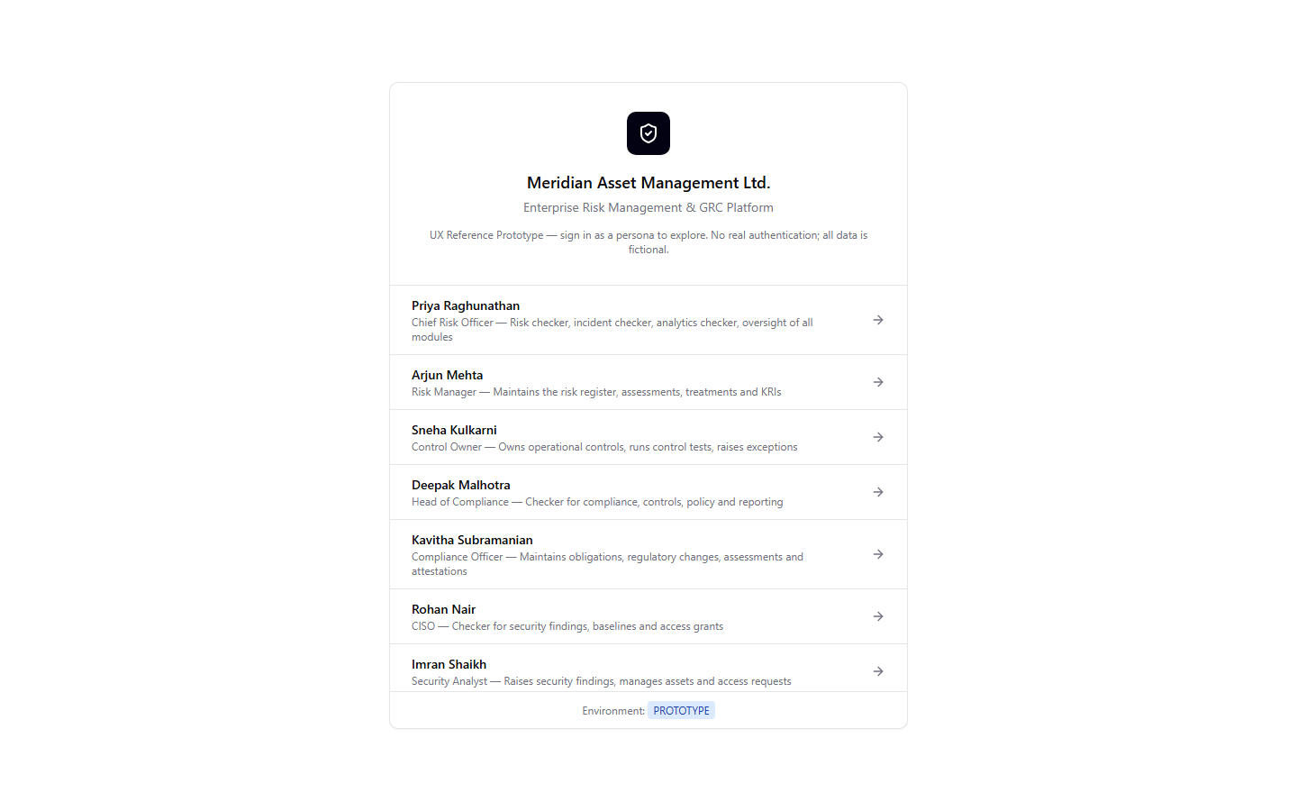
STEP 1 OF 8 · Sign-In
Sign In as Risk Manager
ACTOR: Arjun Mehta (Risk Manager)
USER ACTION
Arjun opens the prototype and selects his persona, “Arjun Mehta — Risk Manager,” from the sign-in screen. The prototype substitutes persona selection for real authentication.
EXPECTED SYSTEM RESPONSE
The session resolves Arjun's RISK_MAKER permission set and routes to the enterprise Home dashboard as him.
GOVERNANCE / MAKER-CHECKER EVENT
None at this step.
00-login-persona-picker.png
Meridian Asset Management Ltd. — ERM/GRC Platform UX Reference Prototype — Deck 01: Risk Assessment Approval (L1-01)
6

Slide 7
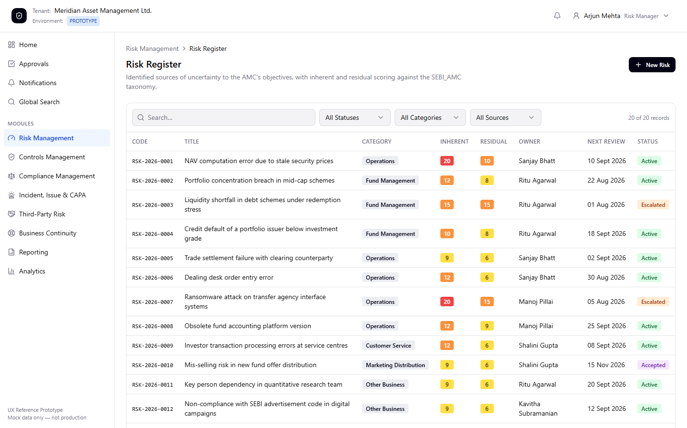
STEP 2 OF 8 · Navigate
Open the Risk Register
ACTOR: Arjun Mehta (Risk Manager)
USER ACTION
Arjun navigates to Risk Management → Risk Register.
EXPECTED SYSTEM RESPONSE
All 20 seeded enterprise risks render with code, category, inherent/residual scores, owner and status. RSK-2026-0004 (“Credit default of a portfolio issuer below investment grade”) is visible with status ACTIVE.
GOVERNANCE / MAKER-CHECKER EVENT
None at this step.
01-risk-register-list.png
Meridian Asset Management Ltd. — ERM/GRC Platform UX Reference Prototype — Deck 01: Risk Assessment Approval (L1-01)
7

Slide 8
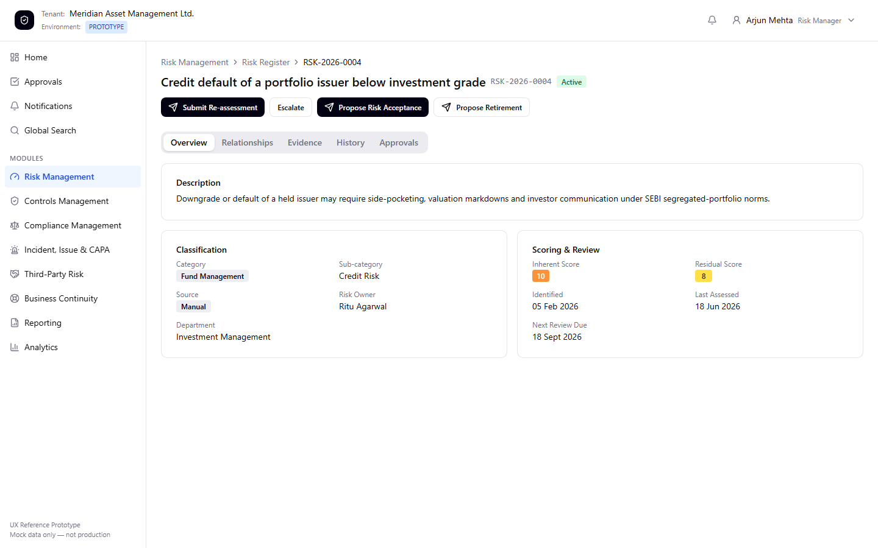
STEP 3 OF 8 · Review
Open the Risk Record
ACTOR: Arjun Mehta (Risk Manager)
USER ACTION
Arjun opens RSK-2026-0004 from the register.
EXPECTED SYSTEM RESPONSE
The detail page renders classification, inherent/residual scoring (10/8) and review dates. Because no pending action exists on this record, all four workflow actions the risk owner may take from ACTIVE are enabled, including “Submit Re-assessment.”
GOVERNANCE / MAKER-CHECKER EVENT
GOV-07 precondition satisfied: an action button is only offered when no pending action already exists for this record.
02-risk-detail-active.png
Meridian Asset Management Ltd. — ERM/GRC Platform UX Reference Prototype — Deck 01: Risk Assessment Approval (L1-01)
8

Slide 9
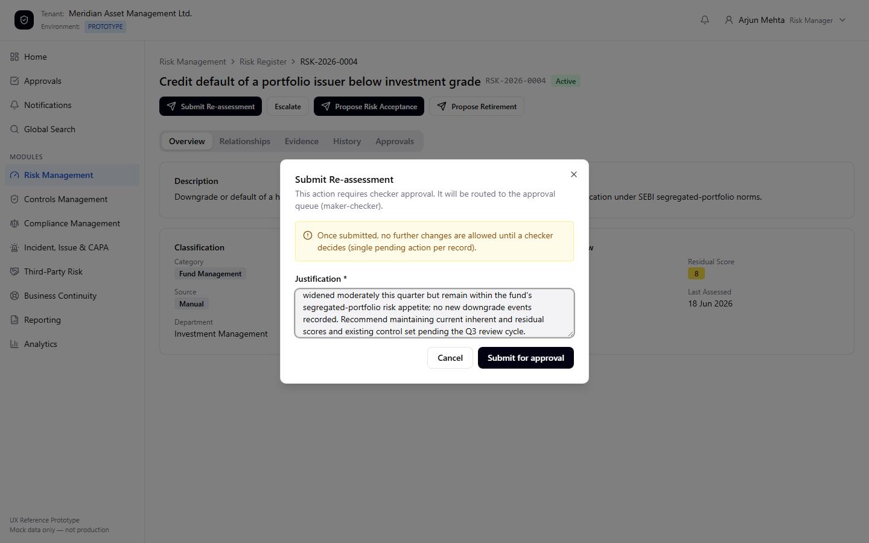
STEP 4 OF 8 · Maker Action
Submit the Re-assessment Justification
ACTOR: Arjun Mehta (Risk Manager)
USER ACTION
Arjun clicks “Submit Re-assessment” and enters a mandatory justification: issuer spreads have widened but remain within appetite; recommends holding current scores pending Q3 review.
EXPECTED SYSTEM RESPONSE
The governed-action dialog explains that this action requires checker approval and will be routed to the approval queue. “Submit for approval” stays disabled until the justification field is non-empty.
GOVERNANCE / MAKER-CHECKER EVENT
Maker justification is a mandatory, structurally-enforced field for every governed action — not a convention the maker can skip.
03-reassessment-justification-dialog.png
Meridian Asset Management Ltd. — ERM/GRC Platform UX Reference Prototype — Deck 01: Risk Assessment Approval (L1-01)
9

Slide 10
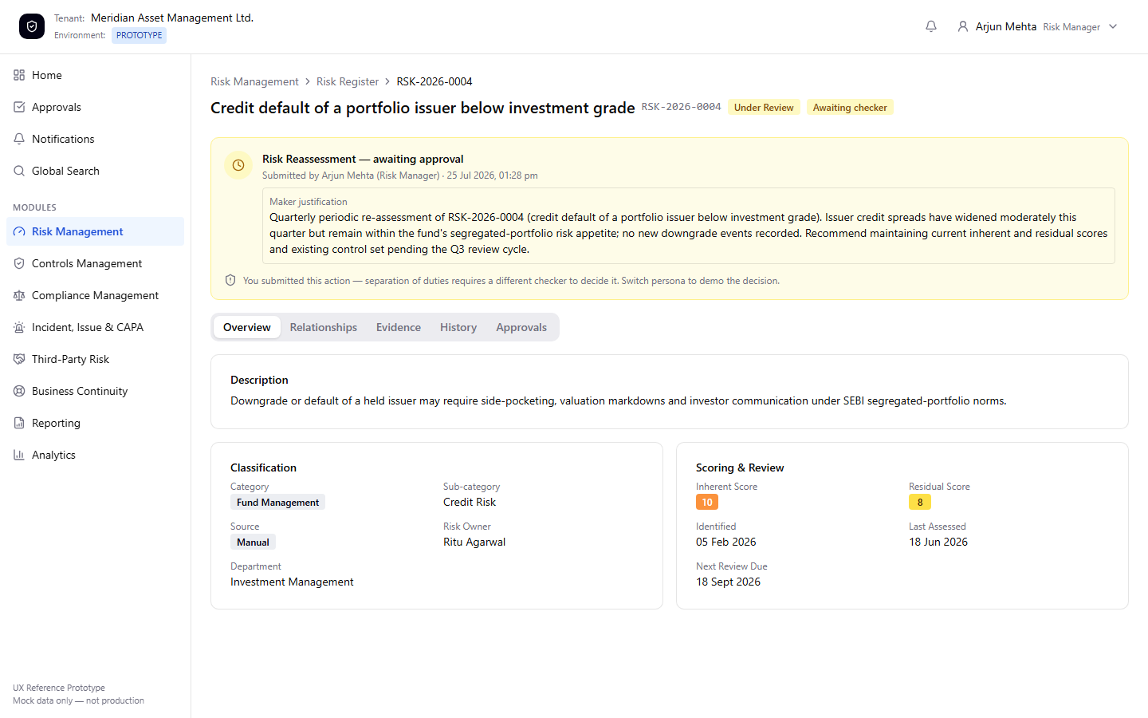
STEP 5 OF 8 · Governed Transition
Risk Enters UNDER_REVIEW
ACTOR: Arjun Mehta (Risk Manager)
USER ACTION
Arjun confirms the submission.
EXPECTED SYSTEM RESPONSE
The status badge changes from Active to Under Review with an “Awaiting checker” badge. All workflow-action buttons disappear — Arjun (or anyone else) cannot submit a second action on this record while one is pending.
GOVERNANCE / MAKER-CHECKER EVENT
A PendingAction record and a history event (ACTION_CREATED) are written; a notification is routed to every persona holding RISK_CHECKER. GOV-07 (single pending action per target) is now structurally enforced.
04-risk-under-review-pending.png
Meridian Asset Management Ltd. — ERM/GRC Platform UX Reference Prototype — Deck 01: Risk Assessment Approval (L1-01)
10

Slide 11
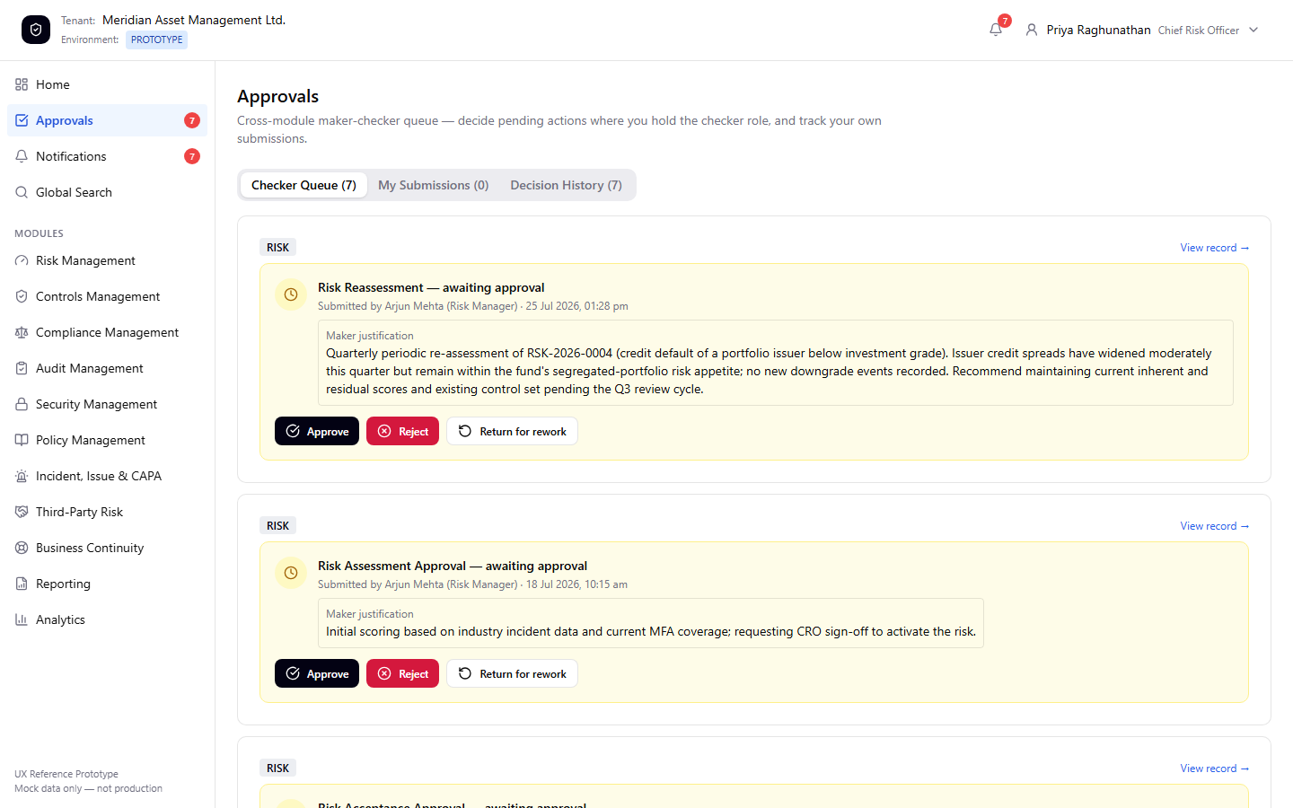
STEP 6 OF 8 · Checker Review
Checker Opens the Approval Queue
ACTOR: Priya Raghunathan (Chief Risk Officer)
USER ACTION
The persona switches to Priya Raghunathan. Priya opens Approvals → Checker Queue.
EXPECTED SYSTEM RESPONSE
Priya's cross-module checker queue lists every pending action she may decide. Arjun's Risk Reassessment request appears at the top, with his full justification quoted inline.
GOVERNANCE / MAKER-CHECKER EVENT
Separation of duties is structural, not procedural: Arjun's own submission can only ever appear in a different persona's checker queue, never his own.
05-checker-queue-pending-item.png
Meridian Asset Management Ltd. — ERM/GRC Platform UX Reference Prototype — Deck 01: Risk Assessment Approval (L1-01)
11

Slide 12
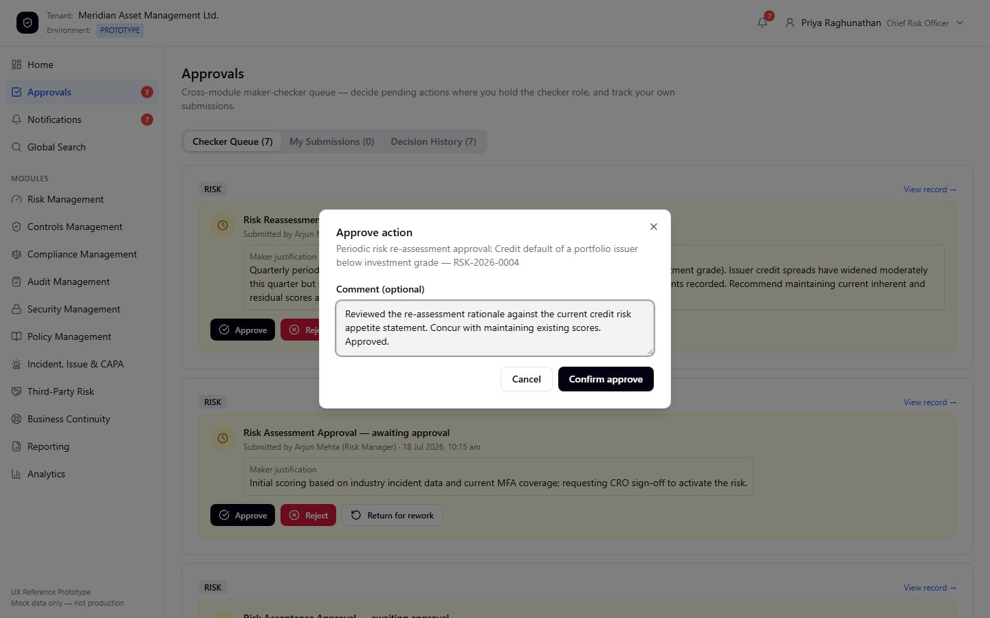
STEP 7 OF 8 · Checker Decision
Checker Records the Decision
ACTOR: Priya Raghunathan (Chief Risk Officer)
USER ACTION
Priya clicks Approve, adds an optional decision comment concurring with the maker's rationale, and confirms.
EXPECTED SYSTEM RESPONSE
The Approve dialog restates the action's description and the entity code (RSK-2026-0004) so the checker's decision is unambiguous. A comment is optional on approval, mandatory on reject/return.
GOVERNANCE / MAKER-CHECKER EVENT
decidePendingAction() refuses the decision outright if the checker is the same persona as the maker — separation of duties is enforced in code, not just in the UI.
06-approve-decision-dialog.png
Meridian Asset Management Ltd. — ERM/GRC Platform UX Reference Prototype — Deck 01: Risk Assessment Approval (L1-01)
12

Slide 13
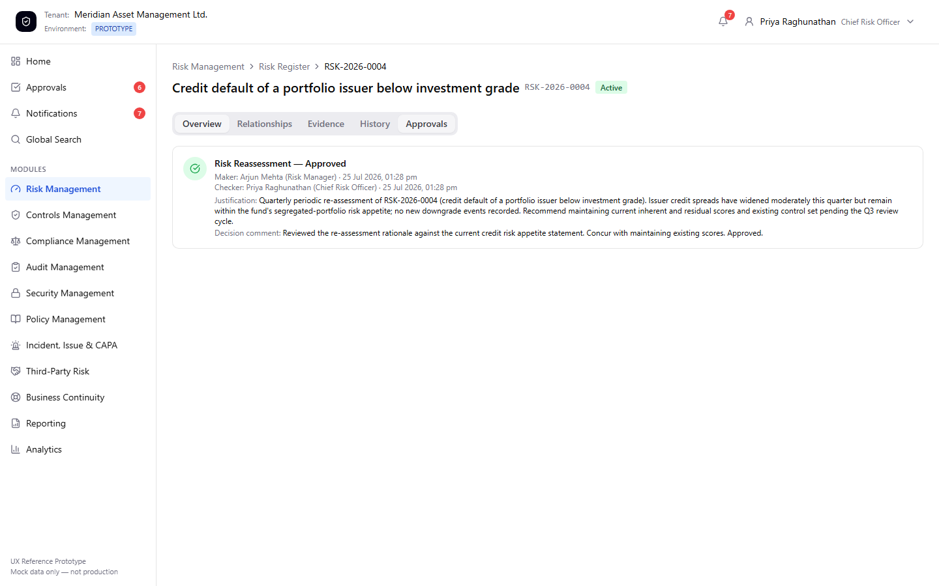
STEP 8 OF 8 · Final Outcome
Final Governed Outcome
ACTOR: Priya Raghunathan (Chief Risk Officer)
USER ACTION
Priya returns to RSK-2026-0004 and opens its Approvals tab.
EXPECTED SYSTEM RESPONSE
The risk is back to ACTIVE. The Approvals tab shows the complete, immutable maker-checker record: maker, checker, both timestamps, the original justification and the decision comment, side by side.
GOVERNANCE / MAKER-CHECKER EVENT
A notification is routed back to Arjun confirming the outcome. The decision record is permanent — the same audit trail an examiner or the Board would review.
07-risk-detail-approved-decision-history.png
Meridian Asset Management Ltd. — ERM/GRC Platform UX Reference Prototype — Deck 01: Risk Assessment Approval (L1-01)
13

Slide 14
SECTION 6 OF 8
Governance / Maker-Checker Events
Event
Actor
Record change
Artifact created
ACTION_CREATED
Arjun Mehta (maker)
RSK-2026-0004: ACTIVE → UNDER_REVIEW
PendingAction (RISK_REASSESSMENT) · history event · notification to RISK_CHECKER personas
Checker queue exposure
Priya Raghunathan (checker)
No entity change — read only
Pending action visible only to a different persona holding RISK_CHECKER (separation of duties)
ACTION_APPROVED
Priya Raghunathan (checker)
RSK-2026-0004: UNDER_REVIEW → ACTIVE
PendingAction closed (approved) · history event · notification back to Arjun
This mock ledger mirrors PRSMTD's real pending_action governance mechanism (append-only ledger, GOV-07 single-pending-action dedup, projection to entity status) — the platform capability this workflow's governed actions are designed to run on when implemented (CLAUDE.md PRSMTD capability inventory: Maker-checker governance).
Meridian Asset Management Ltd. — ERM/GRC Platform UX Reference Prototype — Deck 01: Risk Assessment Approval (L1-01)
14

Slide 15
SECTION 7 OF 8
Final Business Outcome
RSK-2026-0004 — Credit default of a portfolio issuer below investment grade
Status: ACTIVE (unchanged) · Inherent score: 10 · Residual score: 8 · Next review due: 18 Sept 2026
• The risk's periodic re-assessment is complete and independently confirmed: current scoring and control posture remain appropriate for another review cycle.
• A permanent, queryable record now exists showing who proposed the re-assessment, who decided it, when each step happened, and the reasoning behind both.
• Arjun receives a notification confirming Priya's decision — the loop back to the maker closes the workflow, matching the journey documented in prototype/docs/user-journeys.md §1.
• No manual data correction, workaround, or unsupported assumption was required to reach this outcome — the workflow behaved exactly as the RISK module specification (docs/10-risk/01-enterprise-risk-management.md) defines it.
Meridian Asset Management Ltd. — ERM/GRC Platform UX Reference Prototype — Deck 01: Risk Assessment Approval (L1-01)
15

Slide 16
SECTION 8 OF 8
Key Takeaways
• Maker-checker governance is real and structural in the running prototype — not a UI convention. GOV-07 (single pending action) and separation of duties are both enforced in the underlying logic, not just hidden by disabled buttons.
• This is the smallest, safest package that proves that mechanic: 8 screens, 2 personas, one module, one governed transition — by design, the catalogue's recommended Day-1 opener (docs/19-roadmap/01-*.md §10).
• Every other cataloged workflow (L1-02 through L4-01) assumes an audience that has already seen this pattern once — this deck establishes that shared vocabulary.
• The workflow executed cleanly against the prototype's own seed data with zero defects, workarounds, or unsupported assumptions (see defects-and-gaps-observed.md).
• Next recommended step per the catalogue's deck order (§7): the RISK Foundations deck bundling L1-02/03/04 — not started as part of this deliverable, per explicit scope.
Meridian Asset Management Ltd. — ERM/GRC Platform UX Reference Prototype — Deck 01: Risk Assessment Approval (L1-01)
16

