Slide 1
Post Assignment Presentation
Name- Saumitra Sapre
Mentor- Hansraj Mete

Slide 2

Protocol Buffers
Protocol buffers are Google's language-neutral, platform-neutral, extensible mechanism for serializing structured data.
We define how we want our data to be structured once.
Then we use special generated source code to easily write and read that structured data to and from a variety of data streams and using a variety of languages.
Protobuf results in smaller file sizes and faster operation.

Slide 3
Why protobuf though?
Sending binary data works, but it is fragile in the long run.
Here, the receiving code must be compiled with the same memory layout, endianness, etc.
Another approach is to serialize to XML.
But it is space intensive, and encoding/decoding it imposes a huge performance penalty on applications.
Protobuf is smaller, faster and simpler.

Slide 4
Linux LVM
Stands for - Logical volume manager.
It introduces an extra layer between the physical disks and the file system.
Using LVM, filesystems can-
be resized and moved easily and online without requiring a system-wide outage.
Use discontinuous space on disk
have meaningful names to volumes, rather than the usual cryptic device names.
span multiple physical disks

Slide 5
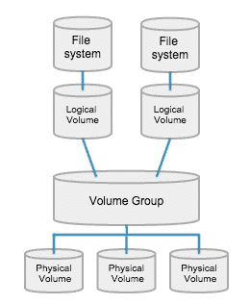
LVM Essentials-
Physical Volumes (PV)-
They can be a disk partition, the whole disk, a meta-device, or a loopback file.
E.g. /dev/sda, /dev/sdb
Volume Group (VG) –
It is an arbitrary container for PVs and LVs. It sits on top of PVs.
Logical Volumes (LV)-
A Logical Volume is the conceptual equivalent of a disk partition in a non-LVM system.
An LV can be grown or shrunken as per our convenience. (assuming there is unclaimed space present in the VG).
E.g., `/`, `/var`, `/home`
File Systems-
Every time we create an LV, we need to format it with a file system.\
E.g., Ext4, XFS.

Slide 6
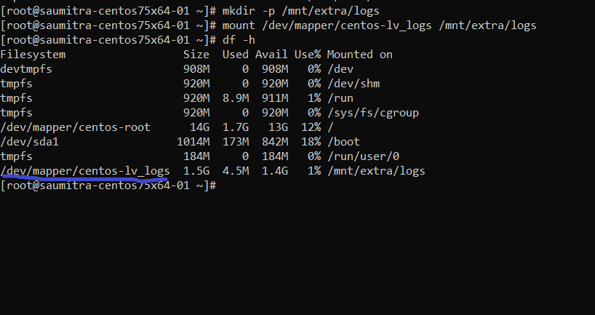
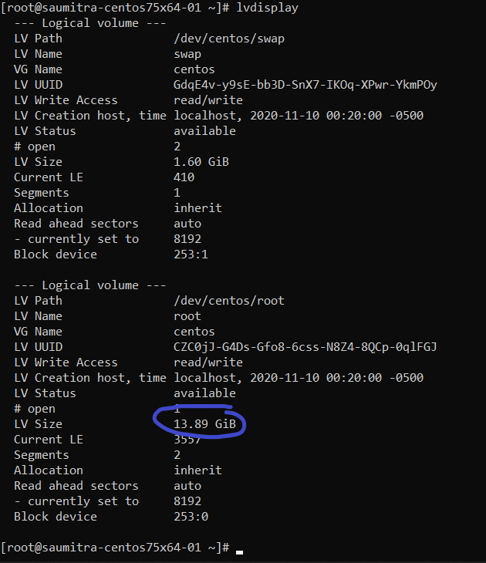
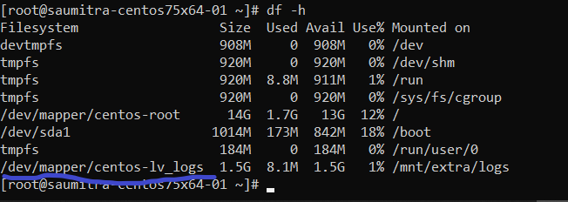
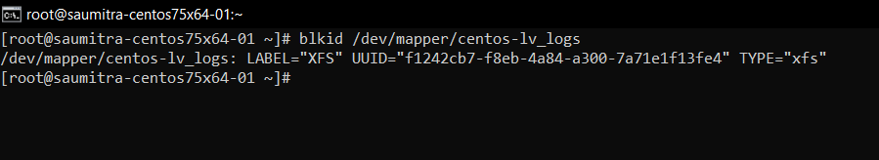

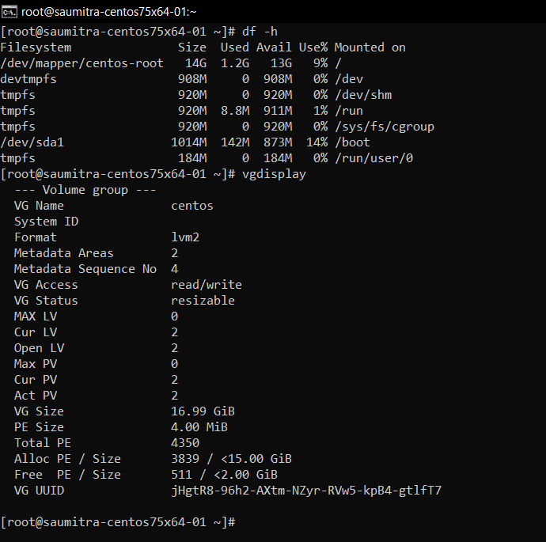
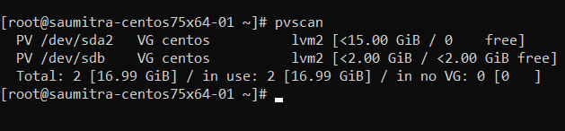
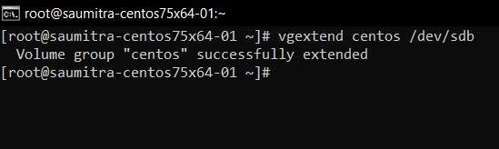
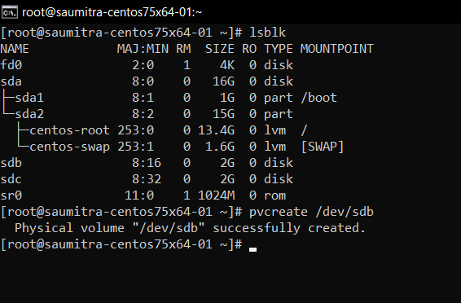
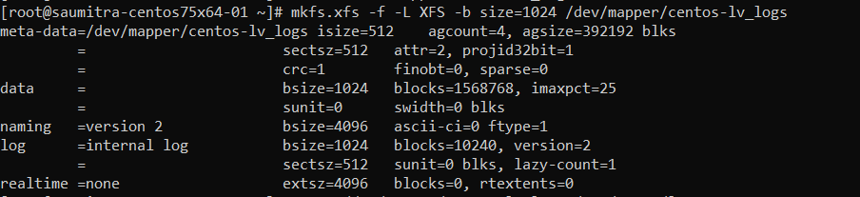
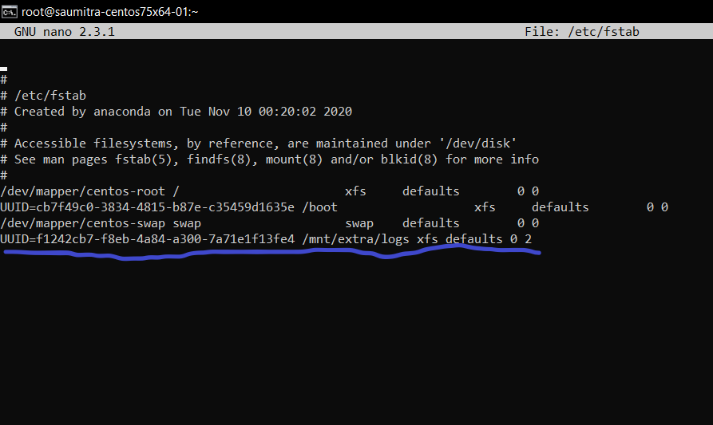
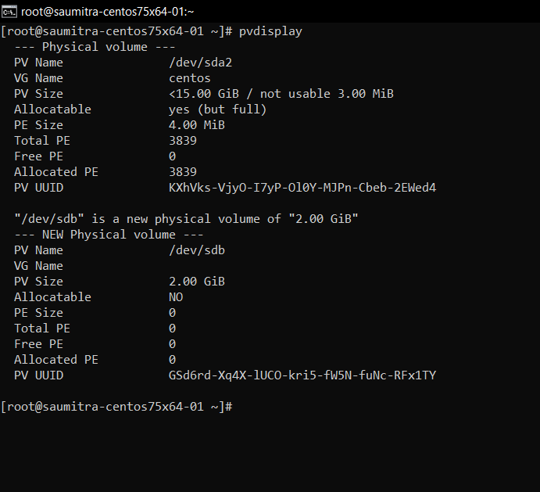
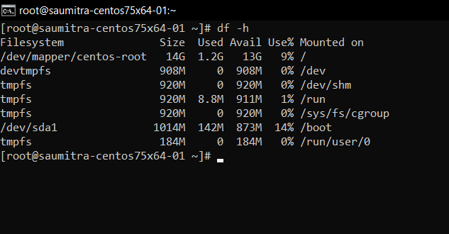
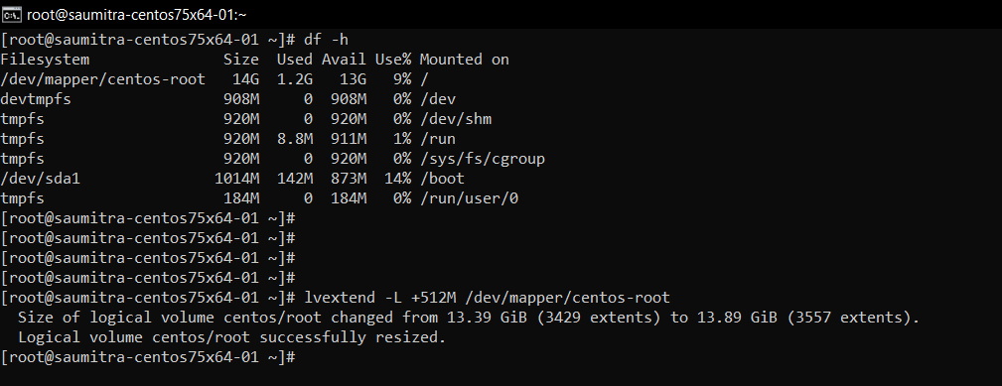
The assignment
Creating PVs –
Extending VGs -
Logical Volumes-
Extending Existing LVs
`xfs_growfs /dev/centos/root`
Creating New LVs
Creating the file system
Editing fstab

Slide 7
Windows VSS
Stands for Volume Shadow Copy Service.
The VSS service in Windows enables users to have a backup (shadow) volume of a particular drive.
This enables users to roll back to a previous state on the drive if a need arises to do so.
As users overwrite data blocks in a drive, the previous data blocks are stored in the Shadow Storage.
Thus, the old data which we replace, is technically not "replaced". It is copied into the Shadow Storage.
As a result, the Shadow Storage continues to grow as we keep making changes to a drive.

Slide 8
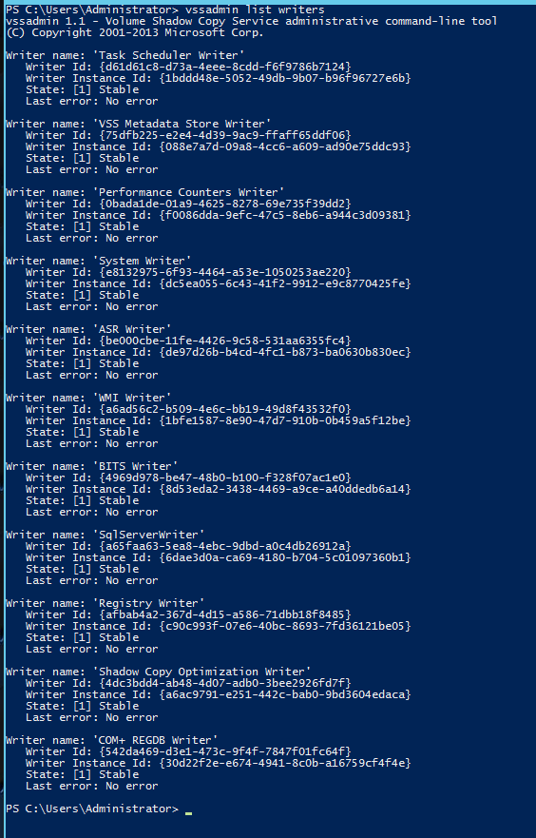
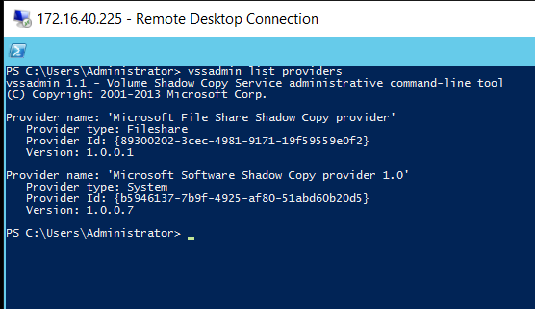
VSS Essentials-
VSS Writers-
They tell Shadow Copy when it can start backup.
They are application specific (e.g., SQL Writer, Exchange Writer).
They are provided by the of the vendor application.
If an application does not have its own VSS Writer, there is a chance that the backed-up file might end up corrupted.
They trigger the backup process.
VSS Requesters–
They initiate the request for VSS.
It could be a click in the UI, a backup app which starts the request, or even a system activity.
VSS Providers-
Triggered by the vss requester.
They tell Windows where to go and start a backup.
Can be hardware or software

Slide 9
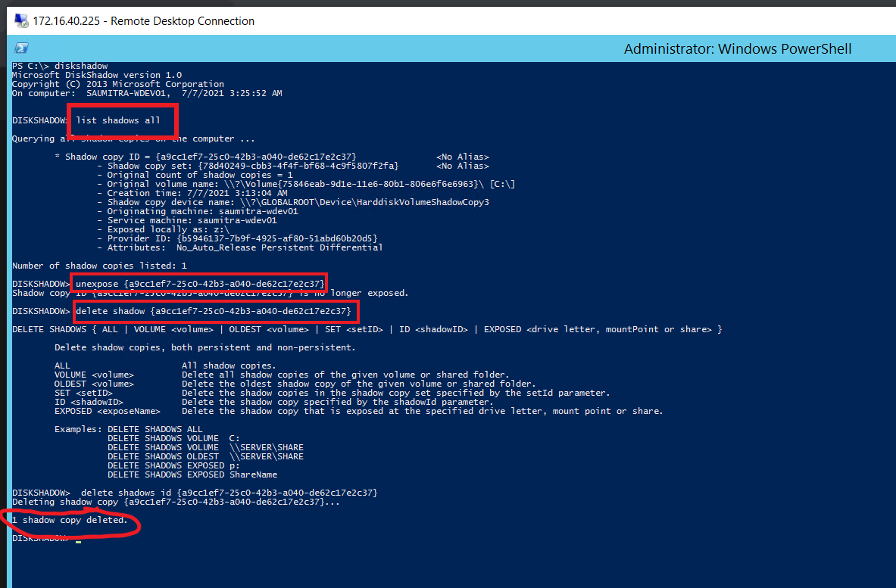
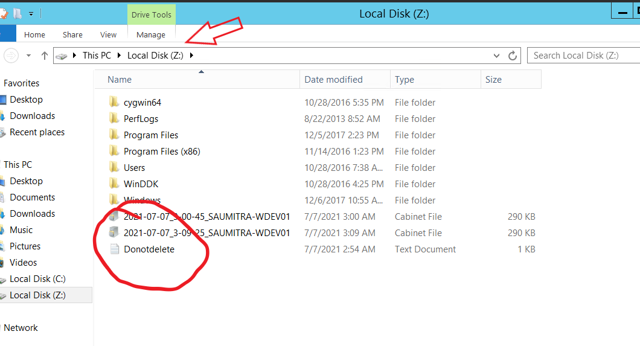
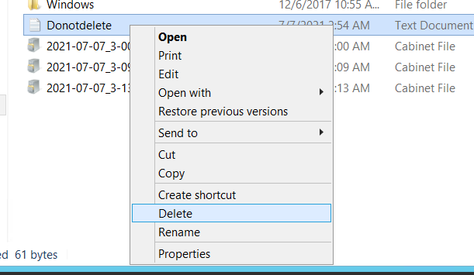
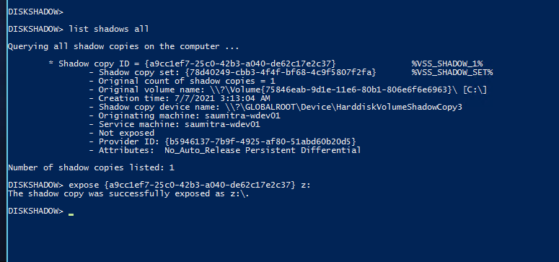
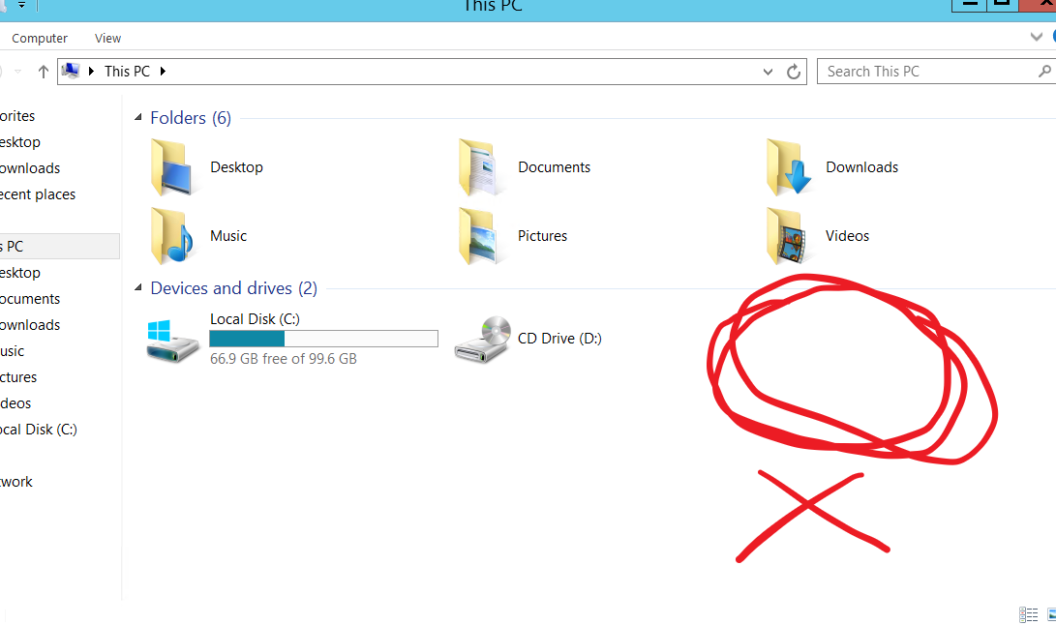
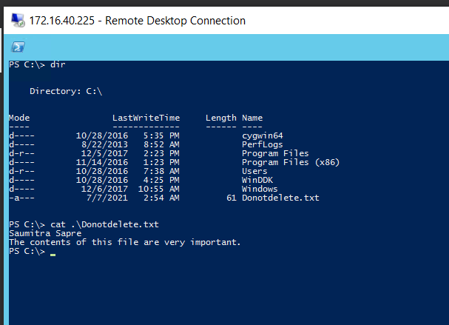
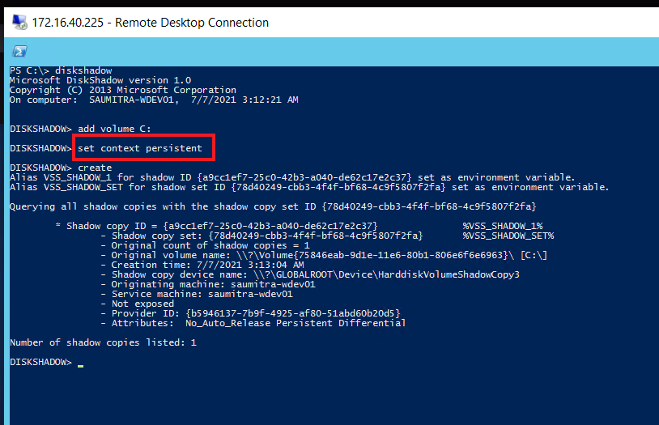
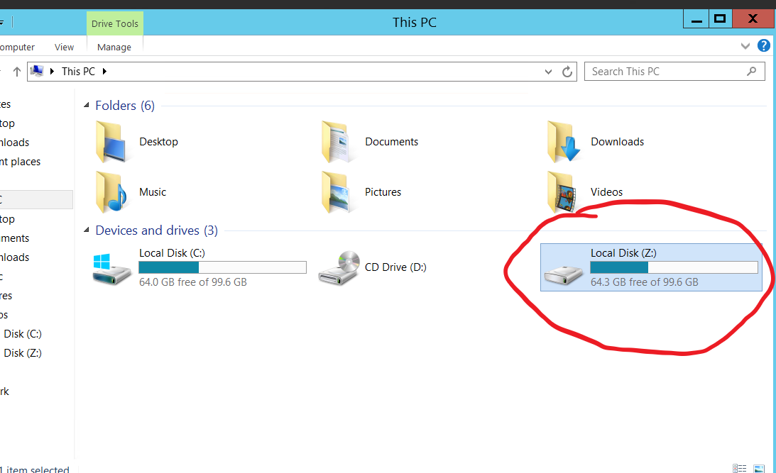
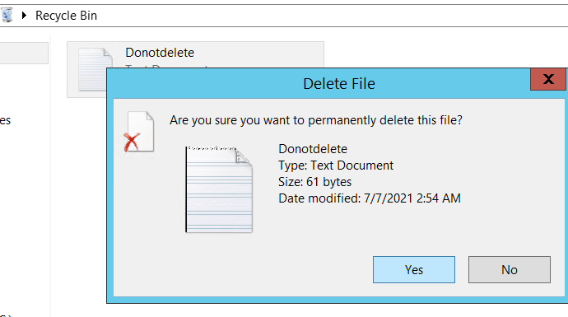
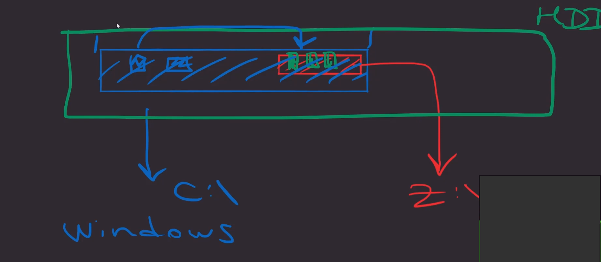
The assignment
Creating sample file
Creating persistent shadow copy
diskshadow
add volume volume_path
set context persistent
Making changes
Exposing the shadow copy to the filesystem
expose shadow_copy_id new_drive_letter
Recover file
Cleaning Up
unexpose shadow_copy_id
delete shadows id shadow_copy_id

Slide 10
Microsoft WMI
Stands for Windows Management Instrumentation
It is a subsystem of Windows Powershell that gives administrators access to powerful system monitoring tools.
It is basically a management interface that can access data in great detail about a computer.
Built upon the Common Information Model (CIM) - an open-source standard for displaying information about a computer.
WMI is Microsoft’s version of CIM.

Slide 11
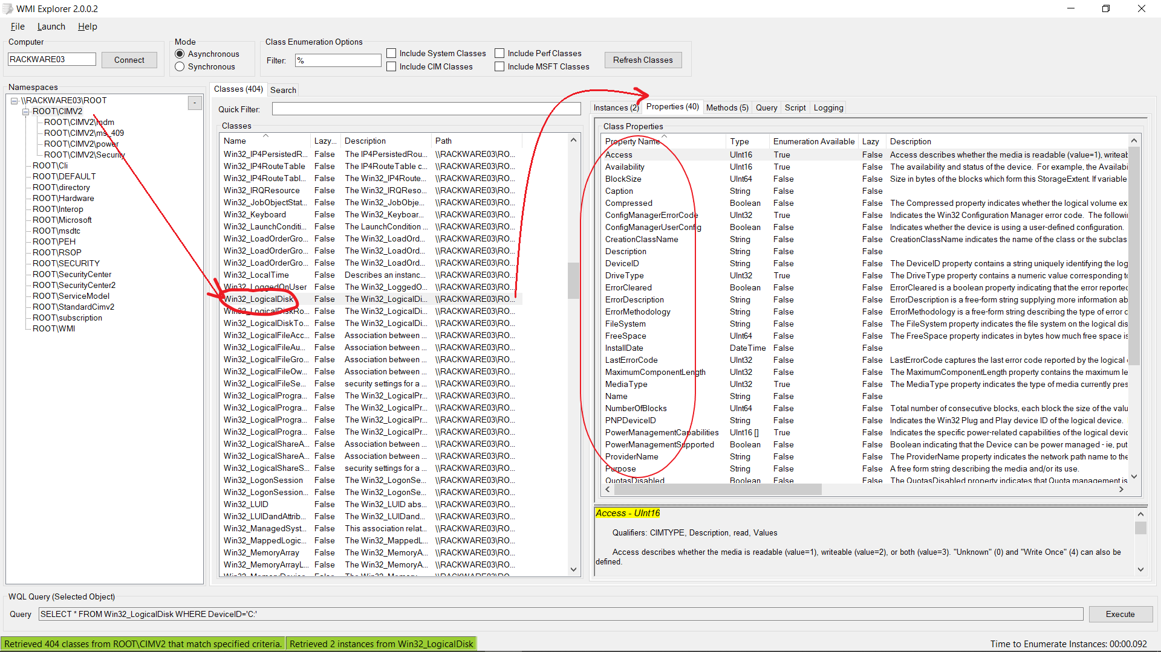
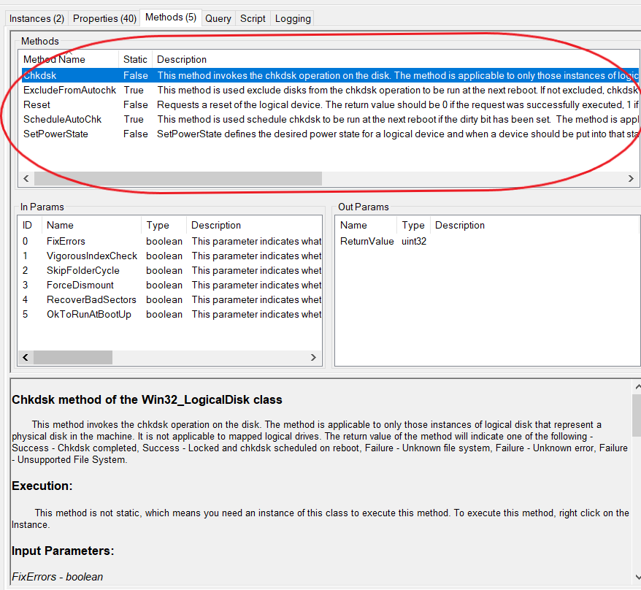
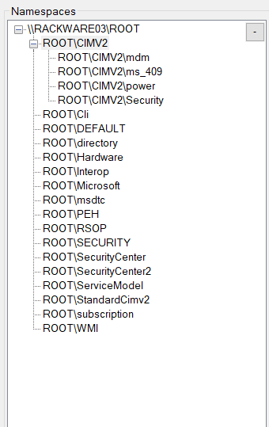
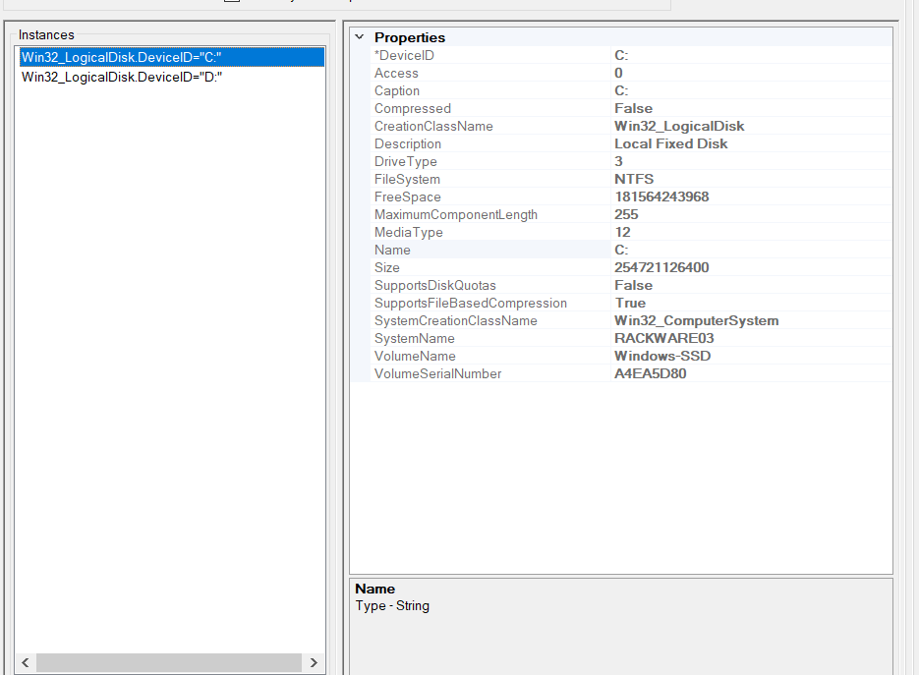
WMI Structure-
Namespaces-
Logical grouping of classes belonging to the same environment.
Organizes information like folders in a filesystem.
The top “folder” of the WMI namespace is always called root.
The default namespace is root/cimv2.
Classes-
Used as the recipe to create an instance of a WMI object.
Like an OOP class, the WMI class also defines properties and methods.
Instances-
Implementation of a WMI class.
It is not necessary that every WMI class should have an instance in the system.
E.g., The class Win32_Battery class will not have an instance in a desktop.

Slide 12
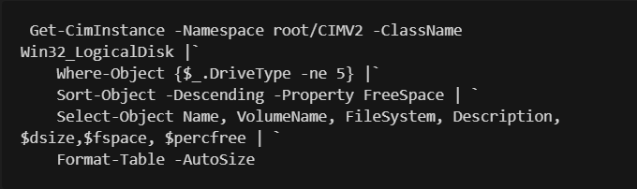
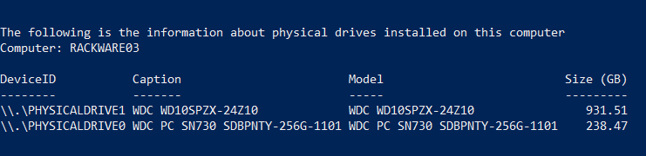
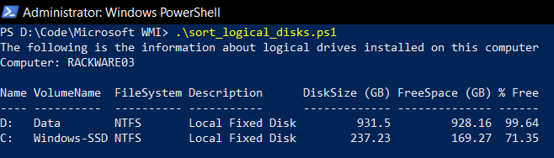
The assignment
The base command –
Get-CimInstance -Namespace root/CIMV2 -ClassName Win32_LogicalDisk
Filters –
Where-Object - select only those instances which satisfy a certain condition
Where-Object {$_.DriveType -ne 5}
Sort-Object - sort our disks in descending order of free space.
Sort-Object -Descending -Property FreeSpace
Select-Object - we specify only those properties that we need (Name, VolumeName, FileSystem, Description, Size,FreeSpace, PercentageFree).
$dsize = @{label = "DiskSize (GB)"; expression = {"{0:N}" -f ($_.Size/1GB) -as [float]}}
$fspace = @{label = "FreeSpace (GB)"; expression = {"{0:N}" -f ($_.FreeSpace/1GB) -as [float]}}
$percfree = @{label = "% Free"; expression = {"{0:N}" -f ($_.FreeSpace/$_.Size * 100) -as [float]}}
Select-Object Name, VolumeName, FileSystem, Description, $dsize,$fspace, $percfree
Format-Table - specify that we want to view the output in a table
Format-Table -AutoSize
Final Command

Slide 13
SSH, Winexe & Rsync
SSH
Stands for ‘Secure Shell’.
Provides a secure way to access a computer over an unsecured network.
Widely used for managing systems remotely.
Enables users to log in to another computer over a network, execute commands and move files from one computer to another.
Winexe
A Linux-based application that allows users to execute commands remotely on Windows systems.
It installs a service on the remote system, executes the command, and uninstalls the service.
Allows execution of most of the windows shell commands.
Rsync
A utility for efficiently transferring and synchronizing files between a computer and an external hard drive and across networked computers
Found in Unix-like OS.

Slide 14
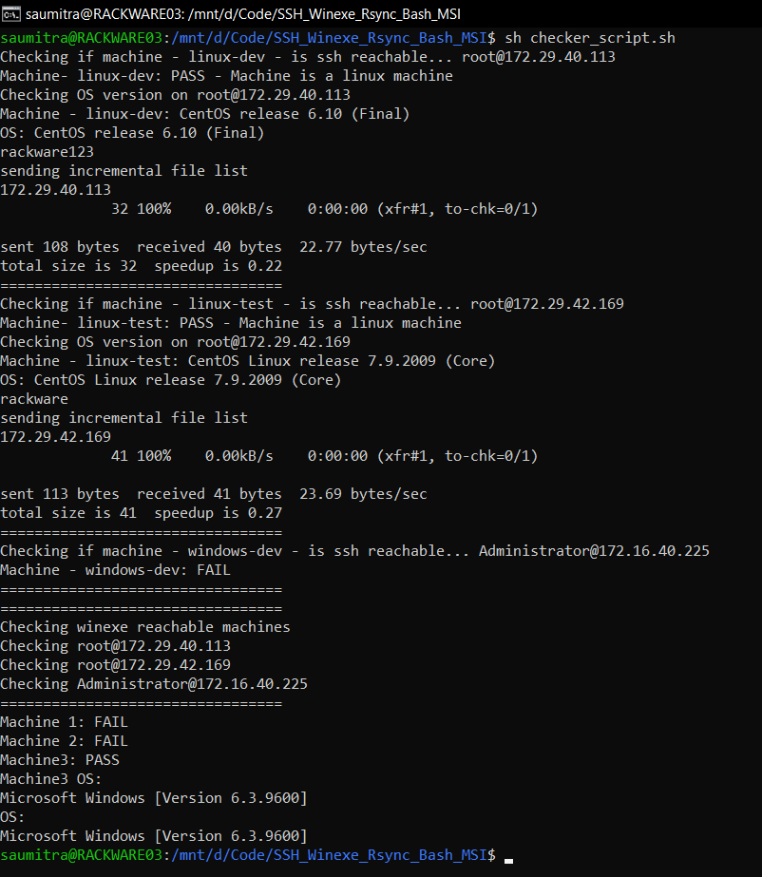

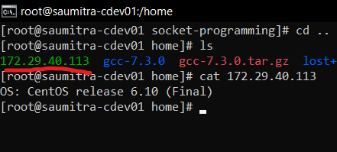

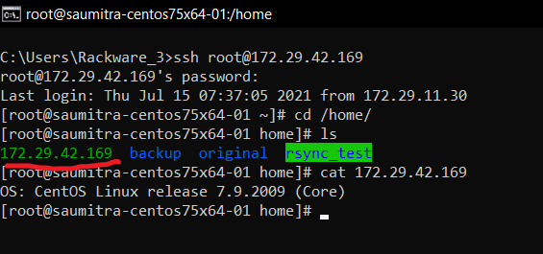
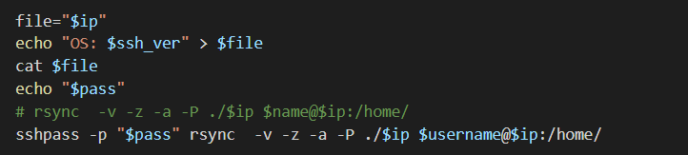
The Assignment
Creating the text file
Reading the file inside the shell script
SSH Commands
sshpass –p pass_word
ssh –n (prevents ssh from reading from standard input)
StrictHostKeyChecking (When enabled,ssh connects only to known hosts with keys that are stored in the known hosts list.
BatchMode (connection fails immediately if the key is rejected, instead of failing back to a password prompt)
ConnectTimeout (Timeout for waiting)
RemoteCommand
Winexe Commands
winexe -U [Domain/]User%Password //host command
Rsync Commands
Output

Slide 15
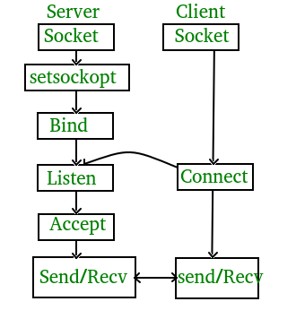
Socket Programming
Sockets allow communication between two different processes on the same or different machines.
In simpler words, sockets are simply a mechanism using which two computers can easily talk to each other.
At the programming level, a socket looks like a file descriptor, and we can perform read and write operations over it.
2 Types of Sockets-
Stream Socket (TCP)
Datagram Socket (UDP)

Slide 16

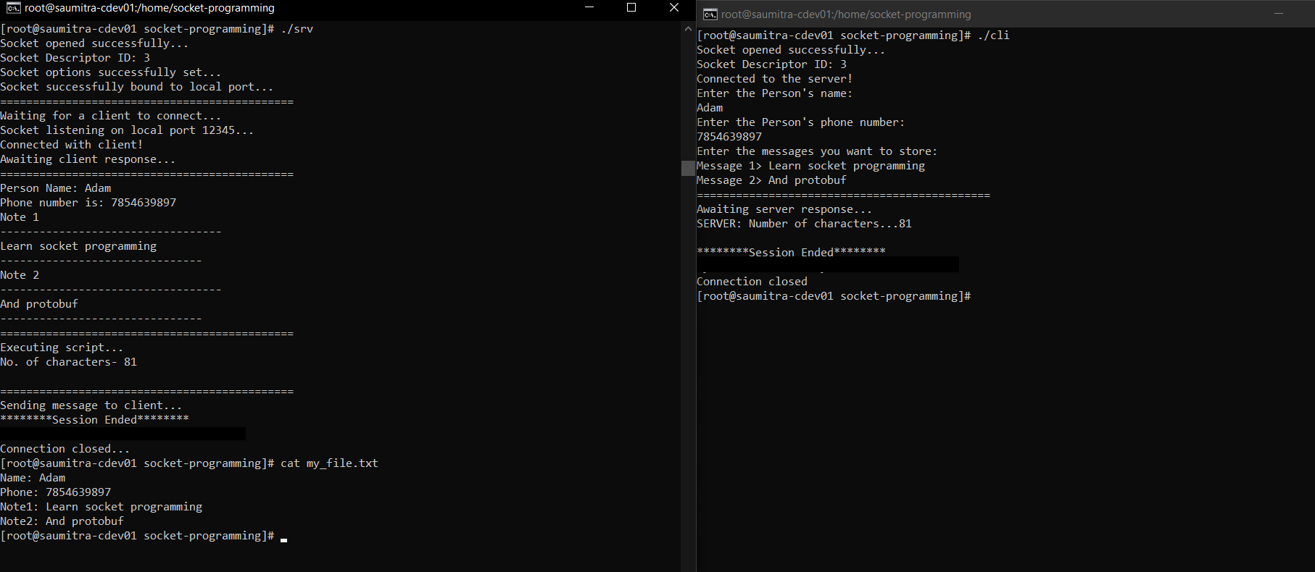
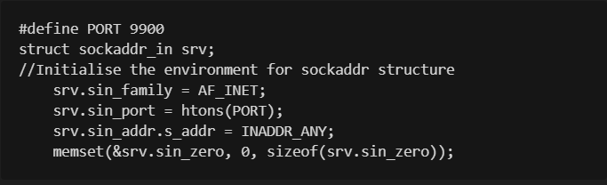
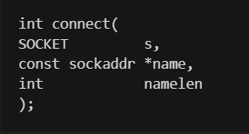
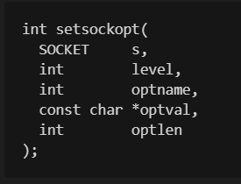
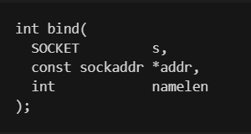
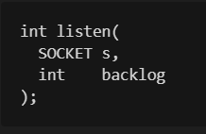
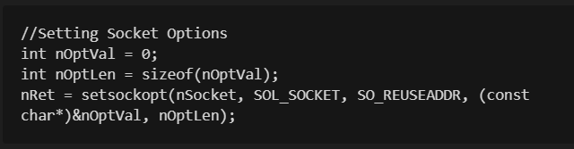


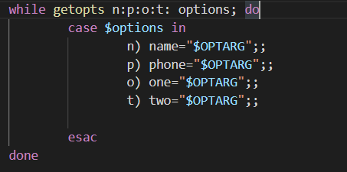

The Assignment
Server-
Creating a socket
Initialising the sockaddr structure
Selecting socket options
Binding the socket to the port
Listen to client requests
Client-
Same till server step 2.
Connecting to server
Script
Get options
Write to file
Count characters
Send to client
Output

Slide 17
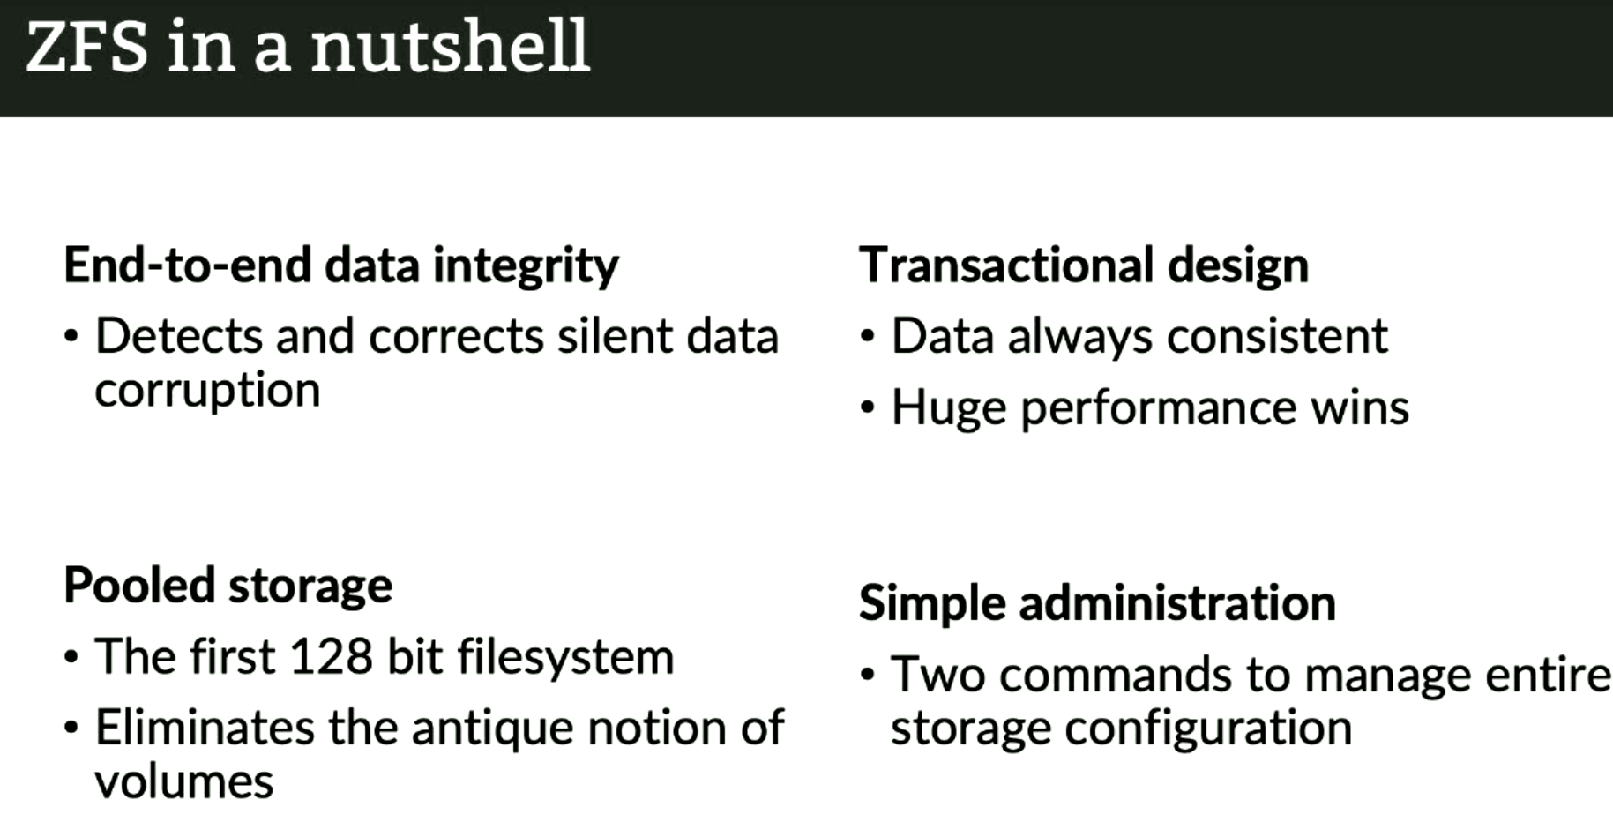
ZFS
Stands for the "Z" File System.
Developed by Sun Microsystems, and eventually made open-source.
Designed to have impeccable file integrity and it can achieve it using commodity hardware.
Created with the assumption that "mechanical hard drives are unreliable and are eventually going to fail".
It is a filesystem, a volume manager and device manager, all rolled into one.

Slide 18
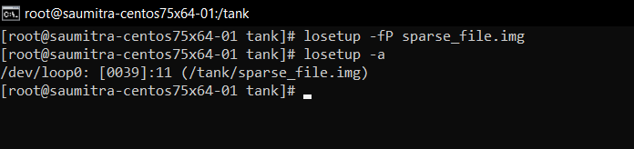
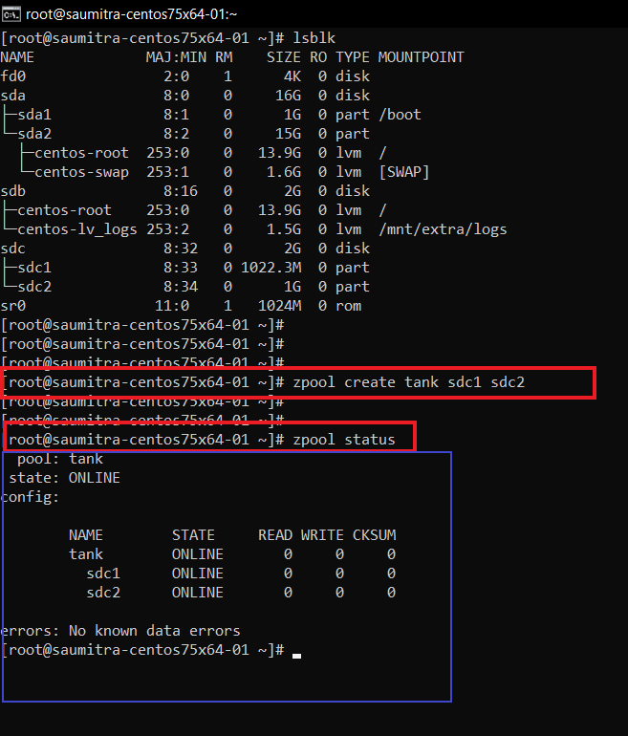
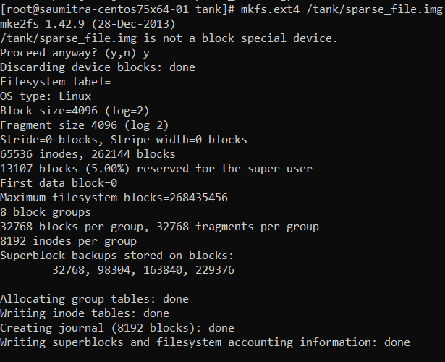








The assignment
Before we start, create partitions
Creating a storage pool
ZFS will automatically:
Create a filesystem with the same name (i.e. tank)
Mount the filesystem under that name (e.g. /tank)
Creating a sparse file
It is a file that has large amounts of space pre-allocated to it, without occupying that entire space from the filesystem.
To create a sparse file, use the dd command
Creating a loop device
losetup –fP sparse_file.img
-f implies that Linux finds the first unused loop device. If a file argument is present, use this device. Otherwise, print its name.
-P – force kernel to scan partition table on newly created loop device.
Create filesystem and mount
Partitioning the mount

Slide 19
Thank You!
Detailed notes, and codes available at: https://github.com/saumitrasapre/training-codes

