Slide 1

Stock Exchange Prediction
IBM Data Science Summer Training Project

Slide 2
Agenda
Introduction
Workflow
Code Snippets
Tools Used
Conclusion
Presentation Title

Slide 3

Introduction
Predicting stock prices is a difficult but fascinating task that fascinates scholars, financial experts, and data scientists alike. In this project, we use machine learning approaches to predict future stock prices using previous data. The goal of this project is to create a predictive model using linear regression that can analyse previous stock prices and forecast future prices.By analysing the underlying trends and patterns in stock market data, we hope to create informed predictions that will be useful to investors and analysts.
This Photo by Unknown Author is licensed under CC BY-ND

Slide 4



Tools Used
Python
Python is a versatile and powerful programming language that has become the de facto standard for machine learning and data analysis.
Its popularity in the data science community can be attributed to several key features
Python Libraries
In this project, we utilized Python's powerful libraries such as pandas for data manipulation, scikit-learn for implementing machine learning algorithms, and matplotlib for data visualization
It showcases Python's ability to handle end-to-end data science workflows efficiently.
Machine Learning
In this project, we employed Supervised Learning to predict the stock prices of Britannia Industries Ltd.
We used a Random Forest Regression model, a popular supervised learning algorithm that assumes a linear relationship between the input feature (date) and the output label (closing price).

Slide 5





Workflow of the Project
Data Collection
Data Preparation
Model Training
Prediction and Evaluation
Visualization
The first step in any machine learning project is gathering the data. In this project, we use historical stock prices of Britannia Industries Ltd.
Convert date information to a numerical format suitable for machine learning algorithms and split the data into training and testing sets.
Train a random forest regression model using the training dataset to understand the relationship between the date and the stock closing price.
Use the trained model to predict stock prices on the test dataset and evaluate the model’s performance using mean squared error (MSE).
Plot the actual and predicted stock prices to visually assess the model's accuracy and predictive capabilities.

Slide 6
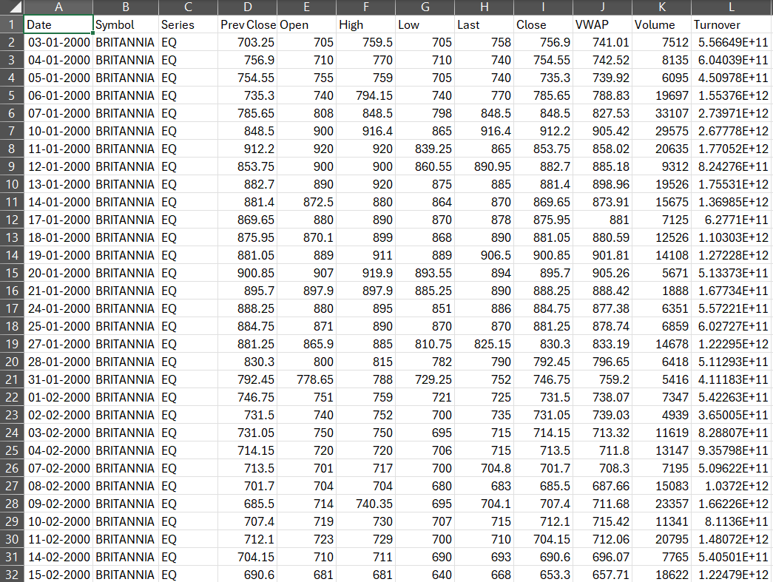
Data Collection
For this project, we used historical stock price data for Britannia Industries Ltd., spanning from March 2000 to April 2021. The dataset includes the following columns:
Date: The date of each trading day.
Close: The closing price of the stock on each trading day.

Slide 7
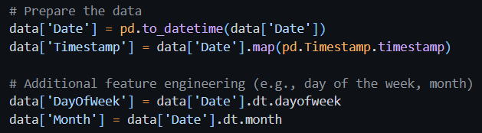
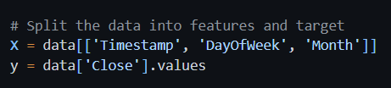
Data Preparation
Date Conversion: Dates are converted from string format to datetime objects.
Numerical Mapping: Dates are mapped to numerical timestamps to be used as features.
Feature and Target Split: The dataset is split into features (Date) and target (Close price).

Slide 8
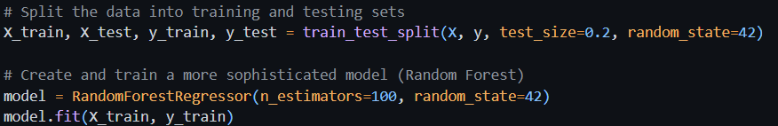
Model Training
Random Forest Regressor : This is a regressor from the ensemble family in the scikit-learn library. It fits a number of decision tree regressors on various sub-samples of the dataset and uses averaging to improve the predictive accuracy and control over-fitting.
n_estimators=100: This parameter specifies the number of trees in the forest.
random_state=42: This parameter ensures reproducibility of the results.

Slide 9

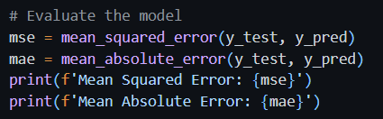
Prediction and Evaluation
The trained Random Forest Regression model was used to make predictions on the test set. We then compared the predicted prices with the actual prices to evaluate the model's performance.
Blue Points: Actual closing prices.
Red Line: Predicted closing prices.
We used Mean Squared Error (MSE) to evaluate the model's performance. MSE measures the average squared difference between the actual and predicted prices.

Slide 10
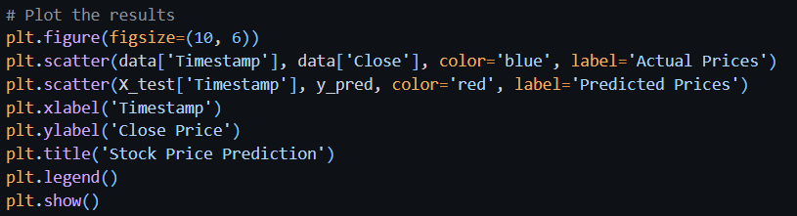
Visualization
The plot below shows the actual vs. predicted stock prices for the test period. The blue points represent the actual prices, while the red points represents the predicted prices. This visualization helps us assess the accuracy and effectiveness of the model.

Slide 11
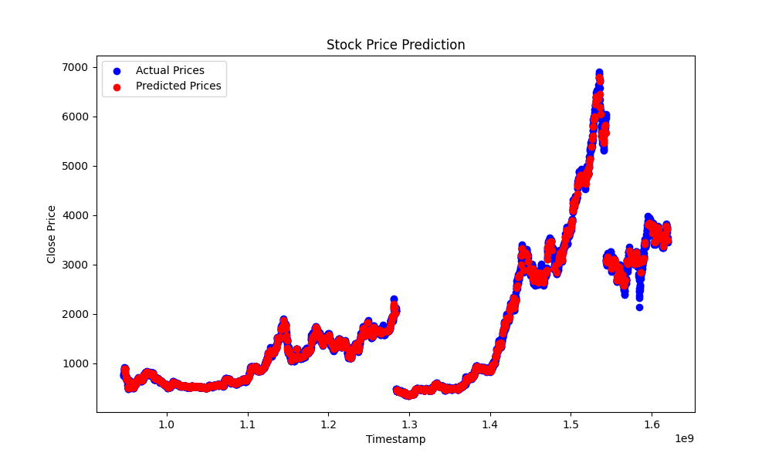
Output

Slide 12




Libraries Used
Pandas
ScikitLearn
Data Cleaning
Machine Learning Algorithms
NumPy
Matplotlib
Numerical Operations
Data Visualization

Slide 13


Summary
We successfully developed a Random Forest Regression model to predict the stock prices of Britannia Industries Ltd. based on historical data. The model demonstrated reasonable accuracy, as evidenced by the Mean Squared Error metric and Mean Absolute Error metric. This project highlights the potential of machine learning in financial analysis and stock market prediction.

