Slide 1
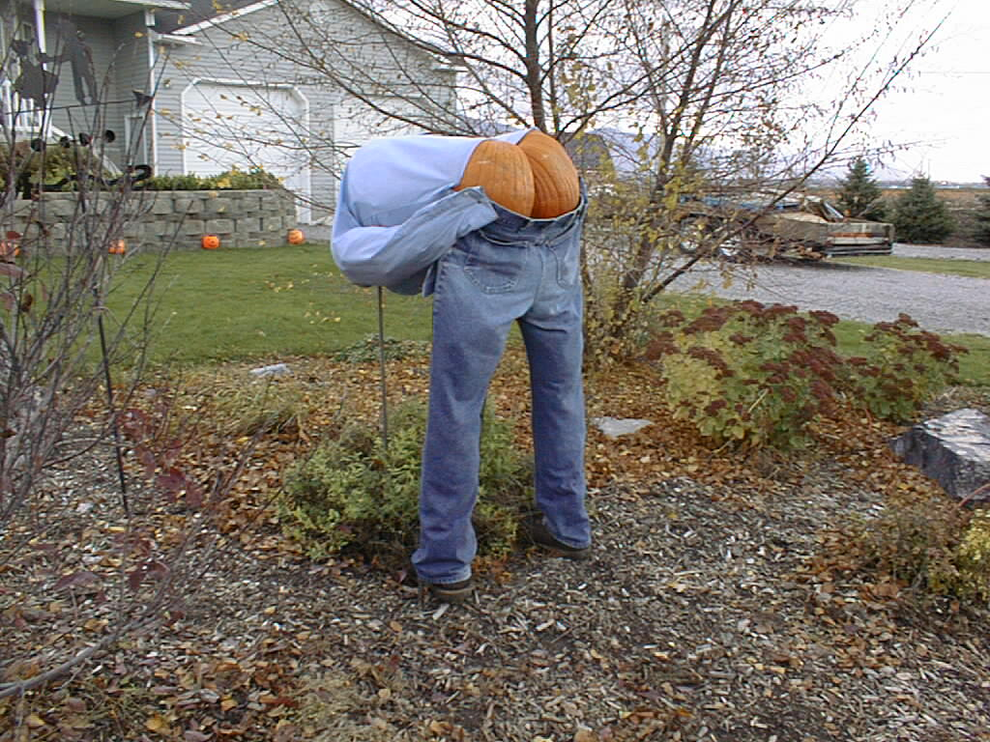
Presentation Suggestions
Dr. Burnett and Dr. Singiser
BIOL/CHEM 4900
Photo courtesy of Dr. Nickie Cauthen

Slide 2
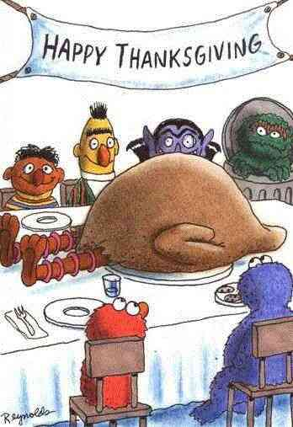
A Sad Day on Sesame Street
Citing your images
Use small print
http://www.bilibala.com/veryveryfunny/html/jokedata/sadday.html

Slide 3
Example of a Bad Color Scheme
Fonts in the same color family as the background do not show up well.
Here are some tips for good color combinations
  Use the Design Templates
    Go under the format menu and select Slide Design
  Use the Standard Color schemes
    You can’t go wrong with the dark blue background and yellow or white text

Slide 4
Another Bad Color Scheme
Dark text on dark background
Beware of shaded backgrounds
The dark text is harder to read down here

Slide 5
Distracting Backgrounds
Color
  Too bright
  Not enough contrast
  Some colors will look different when projected
Distracting designs

Slide 6
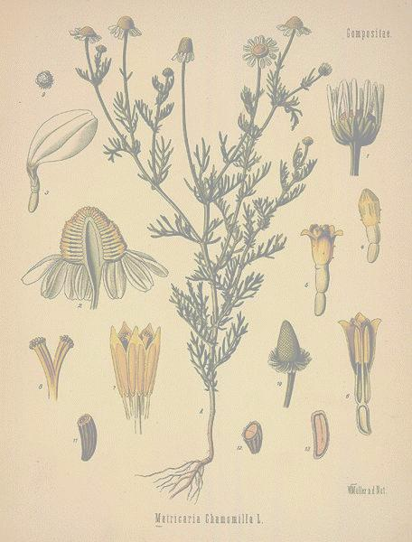
Regulation of Herbs and Drugs
Regulation varies from country to country
Herbs are classified as dietary supplements in United States
  Manufacturers are limited in claims they can make
US Regulating Agencies
  American Herbal Products Association
  Natural Nutritional Foods Association
Safety with herbs
  Be informed
  Dosage
  Side effects

Slide 7
Text on Slides
How much text should be on a slide?
Presentation vs. lecture
Bullet points

Slide 8
Decorating Your House for Halloween
It is important to decorate your house for Halloween so that children can find who is giving out candy. If your house isn’t decorated then kids won’t come to your house.
Spooky decorations are fun, but they may scare the smaller kids away.
Cheesy decorations can be found EVERYWHERE and most people love them.
Funny decorations can be offensive to some so be careful. Make sure they are politically correct and clean.
Homemade decorations are the cheapest and they are fun to make. You can make spooky, cheesy and funny decorations for ½ the cost of buying them.

Slide 9
Halloween Decorations
Importance
  Spirit
  Marking your house
Types of Decorations
  Spooky
    Frightening
    Hard to find
  Cheesy
    Cheap
    Easy to find
    Loved by all
  Funny
    Can be offensive
  Homemade
    Cheap
    Fun to make
    Variety
Photo courtesy of Dr. Nickie Cauthen

Slide 10
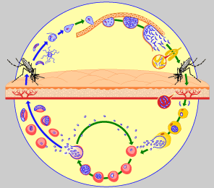
Plasmodium Life Cycle
http://www.who.int/tdr/diseases/malaria/lifecycle.htm

Slide 11
Plasmodium Life Cycle
Mosquito bite
Sporozoites enter blood
Travel to liver
  Hepatocytes
  Asexual growth
    Schizonts  merozoites
  Merozoites to blood
Merozoa to blood
  Infect RBC
    Release trophozoites, merozoites, schizonts
  Merozoite transformation
    Gametocytes
Passed to new mosquito
  Sexual cycle
http://www.who.int/tdr/diseases/malaria/lifecycle.htm

Slide 12
Summary of Helpful Points
Digital Root
Python Assignmentcture says a thousand words
Don’t read the slides
Use correct grammar and spelling
Animation
  Often helpful, but not always necessary
Explain your graphics
Keep slides in order; don’t flip back and forth
  Repeat slides if necessary
Point things out using laser pointer, stick, whatever
Make eye contact (with everyone)
Don’t turn your back on the audience
Avoid hugging the podium

Slide 13
Summary of Helpful Points
Speak in a clear, loud voice
  Don’t trail off
Slow down and think about what you are saying
Practice your presentation
  Helps to avoid “um”, “okay”, etc.
  Helps pacing for time allotted
  Helps with pronunciation
  Don’t memorize (sounds scripted)
Engage your audience
When asking a question, if asked repeat it IN A DIFFERENT WAY (they obviously didn’t get it the first time)
Answer any questions and if you don’t know, you don’t know!!!
If you don’t understand a question ask for a repeat

Slide 14
What is wrong with the following slides?

Slide 15
THE CENTRAL DOGMA OF MOLECULAR BIOLOGY
Transcription of DNA to RNA to protein:
1.The DNA replicates its information in a process
that involves many enzymes: replication.
2. The DNA codes for the production of messenger RNA (mRNA) during transcription.
3. In eucaryotic cells, the mRNA is processed and migrates from the nucleus to the cytoplasm.
4. Messenger RNA carries coded information to ribosomes. The ribosomes "read" this information and use it for protein synthesis. This process is called translation.

Slide 16
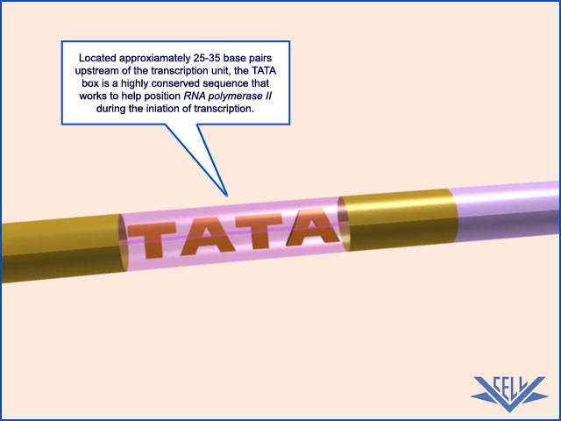
Located approximately 25-30 bases pairs upstream of the transcriptional unti the TATA box is highly conserved sequence that works to help position RNA plms during initiation of transcription.

Slide 17
More Practice
What is the enthalpy change during the process in which 100.0 g of water at 50.0 °C is cooled to ice at –30.0 °C under a constant pressure of 1 atm? The specific heats of ice, water, and steam are 2.03 J/g-K, 4.18 J/g-K, and 1.84 J/g-K, respectively. For H₂O, ΔH_{fus} = 6.01 kJ/mol and ΔH_{vap} = 40.67 kJ/mol.?
© 2009, Prentice-Hall, Inc.

Slide 18
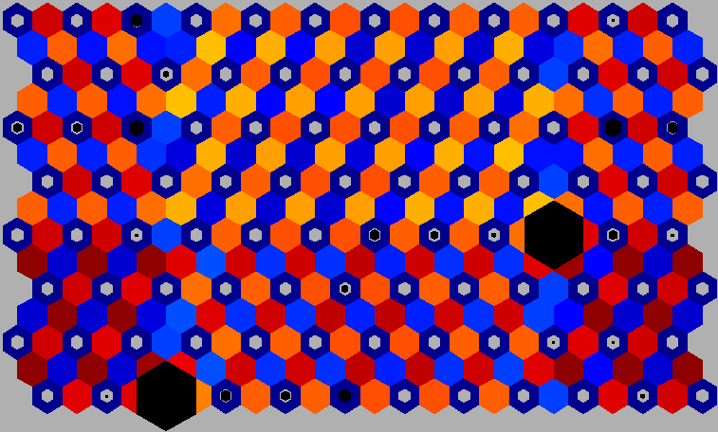
SOM Output

Slide 19
RNA information (in the form of
nucleotide sequences) is then
TRANSLATED into proteins
(long polypeptide chains) by
complex units called ribosomes.
Proteins are the work horses of
biological systems, i.e. enzymes,
messengers, and building blocks.

Slide 20


URSIDAE (Bears)
Large Size: Bears are large-bodied compared to many other carnivores. Most of their diet consists of vegetable matter. Meat is digested quickly but vegetable matter takes much longer. Larger body size brings a decrease in metabolic rate, so large body animals can survive on the small energy from vegetable matter, even though they have to eat a vast amount of food to satisfy their total energy needs.
Powerful limbs and strong claws: Bears have long, powerful limbs with strong claws used in climbing trees, digging and grubbing. The scapula has a post-scapular fossa for the attachment of the subscapularis minor muscle which prevents the humeri popping out of their joints as a bear hauls its large body weight up trees.
Grinding Molars: The premolars of bears are much smaller than other carnivores and often lost at old age. The molars are broadened and flattened for crushing and grinding up tough vegetable matter.
Long Muzzle: The long, powerful muzzle with its mobile snout and protruding lips are important for digging and grubbing. The long muzzle is also a place for olfactory epithelium which accounts for the excellent sense of smell.
Vestigial Tail: Unlike many other carnivores bears have a tail with no specialized function.

Slide 21
Example of bad animations
Example of bad animations
Example of bad animations
Example of bad animations
Example of bad animations
Example of bad animations
Example of bad animations
Example of bad animations
Example of bad animations
Example of bad animations
Example of bad animations
Example of bad animations

Slide 22
BLUNT END VS. STICKY END
HaeIII and AluI cut straight across the double helix producing "blunt" ends. However, many restriction enzymes cut in an offset fashion.
The ends of the cut have an overhanging piece of single-stranded DNA. These are called "sticky ends" because they are able to form with any base pair DNA molecule that contains the complementary sticky end. Any other source of DNA treated with the same enzyme will produce such molecules.

Slide 23
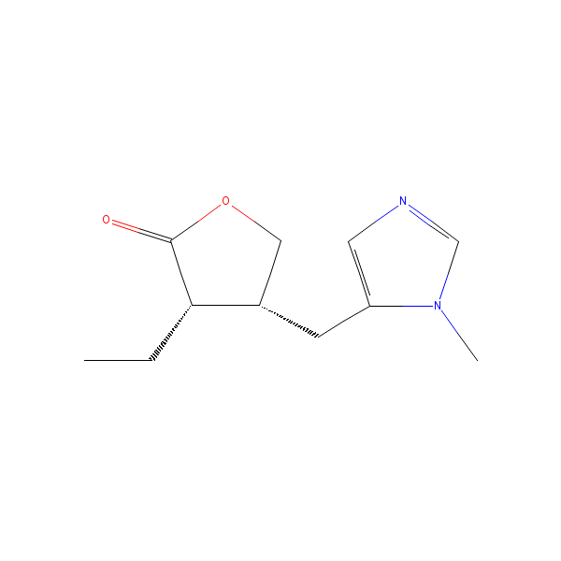
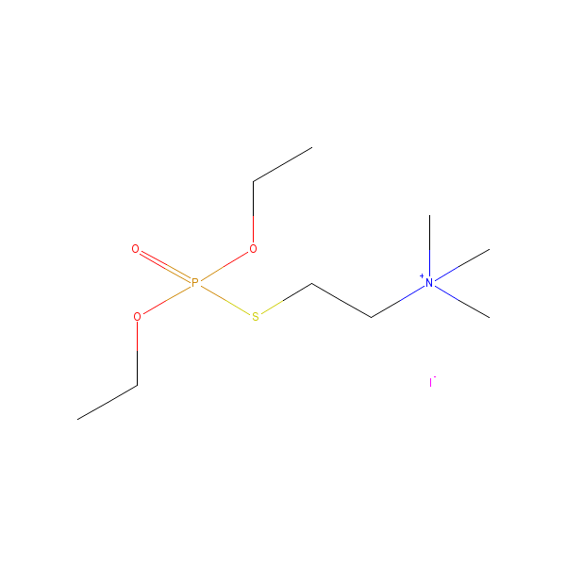
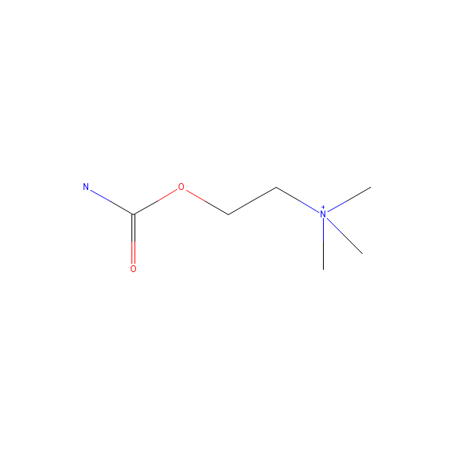
Miotics
-Pilocarpine
a choline ester miotic and a positively charged quaternary ammonium compound.Increase secretion by the exocrine glands. increase secretion by the exocrine glands, and produces contraction of the iris sphincter muscle and ciliary muscle by mainly stimulating muscarinic receptors.
3times a day
-Carbachol
-produces constriction of the iris and ciliary body resulting in reduction in intraocular pressure
-Echothiophate
long-acting cholinesterase inhibitor which enhances the effect acetylcholine in iris, ciliary muscle.It causes miosis, increase in facility of outflow of aqueous humor, and fall in intraocular pressure
Side effects:
pain inside the eye first few days
Blurred vision
extreme nearsightedness (younger age)
reduce pupil size and prevent normal dilation, dim vision, especially at night or in dark rooms
Stuffy nose, sweating, increased salivation
occasional gastrointestinal (stronger miotics)

Slide 24
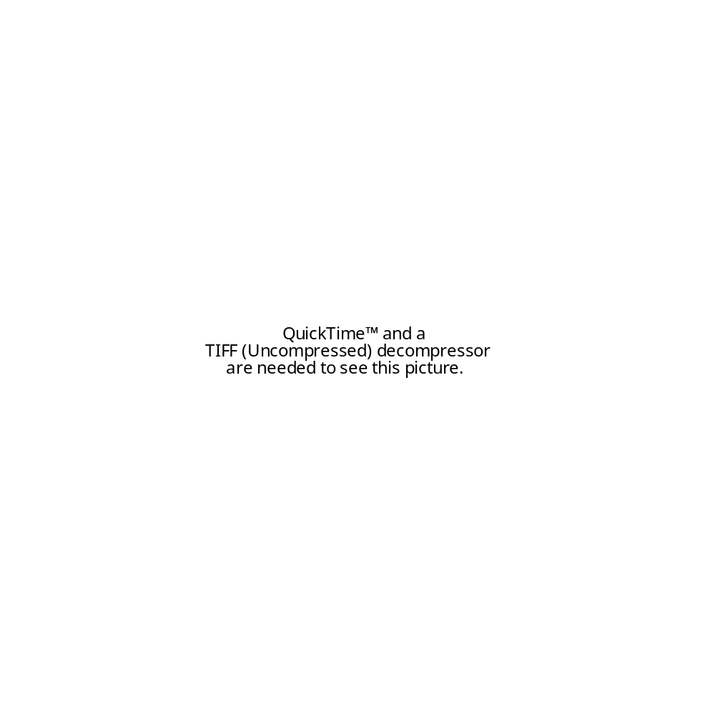

Slide 25

Energy Changes Associated with Changes of State
The heat added to the system at the melting and boiling points goes into pulling the molecules farther apart from each other.
The temperature of the substance does not rise during a phase change.
© 2009, Prentice-Hall, Inc.

Slide 26
Outgroup Monotremata
Didelphimorphia
Paucituberculata
Microbiotheria
Dasyuromorphia
Peramelemorphia
Notorcytemorphia
Diprotodontia

Slide 27
The strands are held in position, binding easily to DNA polymerase, which catalyzes the elongation of the leading and lagging strands.
While the DNA polymerase on the leading strand can operate in a continuous fashion, RNA primer is needed repeatedly on the lagging strand to facilitate synthesis of Okazaki fragments.

Slide 28
Hydrophobic and Hydrophilic
Hydrophilic-- water loving or a molecule that is capable of forming a hydrogen bond with water.
Hydrophobic-- water hating or a molecule that repels water.
Important function in cell’s membrane structure.

Slide 29
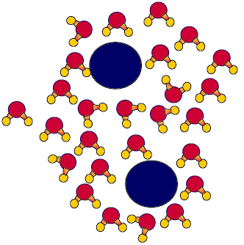
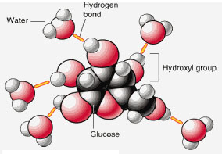
Hydrophobic versus Hydrophilic
http://www.uic.edu/classes/bios/bios100/lecturesf04am/lect02.htm
http://academic.brooklyn.cuny.edu/biology/bio4fv/page/hydro.gif

Slide 30
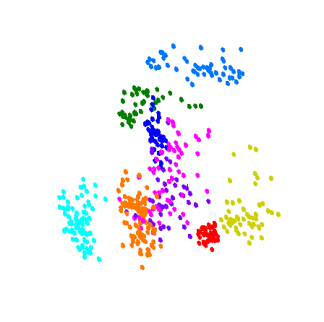
DFA – Results

Slide 31

How Do Neural Networks Compute?
Activation = the final value of a particular unit.
Calculated by adding inputs and bias
Activation function
W1
Bias
W2
Σ
Final Activation
W3
Net Input
Activation Function

