Slide 1
Mini Project
Botnet Attacks Detection in IoT
Devices Using Autoencoders
Presented by:
Saumya Jain IEC2020088
Madhav Badewad IEC2020030
Supervised By :
Prof. Neetesh Purohit

Slide 2
Content
INTRODUCTION
LITERATURE REVIEW : BASE PAPER
PROBLEM STATEMENT
APPROACH
DATASET
PERFORMANCE ANALYSIS
RESULTS
CONCLUSION
REFERENCES

Slide 3
Introduction
Increasing demand and growth in IoT has led to more complex IoT models.
IoT devices use a wireless medium to transmit data, making them vulnerable to attacks.
Vulnerabilities in IoT nodes can provide backdoors for attackers to gather confidential data.
Secured IoT infrastructure is essential for protecting organizations from cybercrimes.

Slide 4
Botnet
N-BaIoT
Botnets are infected computer networks used for malicious activities.
They can perform denial-of-service attacks, spamming, and data theft.
Botnets are a major threat to online security.
Anti-virus software and network security protocols are effective countermeasures against botnet attacks.
N-BaIoT uses deep learning to detect IoT bot attacks.
It trains a deep autoencoder to learn normal device behaviors.
Anomalies in behavior are detected when the autoencoder fails to reconstruct a snapshot.

Slide 5
Literature Survey
Title : N-BaIoT—Network-Based Detection of IoT Botnet Attacks Using Deep Autoencoders
Methods Used : Autoencoders
Dataset Used : N-BaIoT Dataset to Detect IoT Botnet Attacks
Advantages :
Deep autoencoders has ability to learn complex patterns—for example, of various device functionalities.
Hardly any false alarms.
Future Work :
Different autoencoders can be used.
Evaluate transfer learning techniques by assessing the accuracy of models trained on specific devices when they are applied to identical devices.

Slide 6
Problem Statement
To detect botnet attacks in IOT devices using autoencoders.
For detecting attacks launched from IoT bots we have used N-BaIoT, a network-based approach for the IoT that uses deep learning techniques to perform anomaly detection.
We have also used transfer learning technique to detect botnet attack.

Slide 7
Approach
Our method for detecting IoT botnet attacks relies on autoencoders for each device.
In this project we have worked on total 2 datasets, 2 different autoencoders models.
We trained our model on statistical features extracted from benign traffic data.
This method consists of three main stages: data collection, training an anomaly detector, and testing the model.
We have also used Transfer Learning technique to get more accurate results.

Slide 8
Dataset - I
N-BaIoT Dataset to Detect IoT Botnet Attacks
This dataset contains real traffic data of 9 commercial IOT devices which were infected by Mirai and BASHLITE botnet attacks. It contains a total of 7062606 samples and 115 features.
There are 11 instances of data collected for each device, 10 of which are data collected when the device is infected by 10 types of attacks carried out by 2 botnets, plus one instance of uninfected data.
The data is collected by analyzing data packets. A set of 23 features are extracted from analyzing the packet at 5 different time intervals: 100ms, 500ms, 1.5sec, 10 sec and 1 min totalling to 115 features.

Slide 9
Dataset - II
IOT device identification
This dataset was taken from chapter 5 of Machine learning cookbook for cyber security.
This dataset contains traffic data of about 10 devices: Baby monitor, lights, monitor sensor, security camera, smoke detector, socket, thermostat, TV, watch and water sensor.
The data set contains 296 traffic attributes: ip port, packets, ack, bytes, reset, daytime and more.
Each device has about 200 samples.

Slide 10
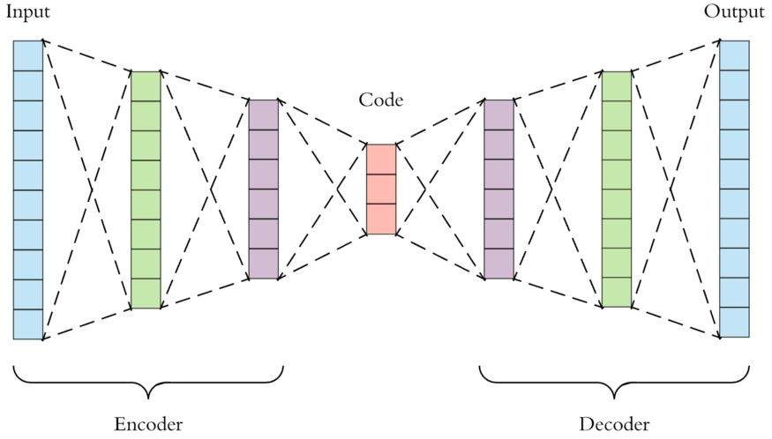
Deep Autoencoder
A deep autoencoder is a type of neural network architecture that consists of multiple hidden layers.
It learns to encode and decode input data in a hierarchical manner, capturing increasingly abstract representations.
The encoder compresses the input data into a lower-dimensional representation, while the decoder reconstructs the original input from the compressed representation.
Deep autoencoders are effective in learning complex data representations and can be used for tasks such as anomaly detection.

Slide 11
Transfer Learning
Conventional machine learning and deep learning algorithms, so far, have been traditionally designed to work in isolation.
These algorithms are trained to solve speciﬁc tasks.
The models have to be rebuilt from scratch once the feature-space distribution changes.
Transfer learning is the idea of overcoming the isolated learning paradigm and utilizing knowledge acquired for one task to solve related ones.

Slide 12
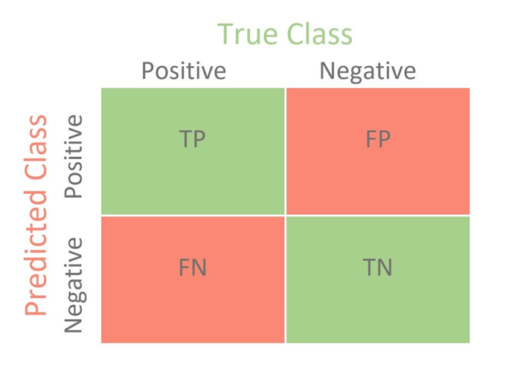
Performance Analysis : Confusion Matrix
True Positive (TP) : Model predicted as abnormal and it’s true.
False Positive (FP) : Model predicted as abnormal and it’s false.
True Negative (TN) : Model predicted as normal and it’s true.
False Negative (FN) : Model predicted as normal and its false.

Slide 13
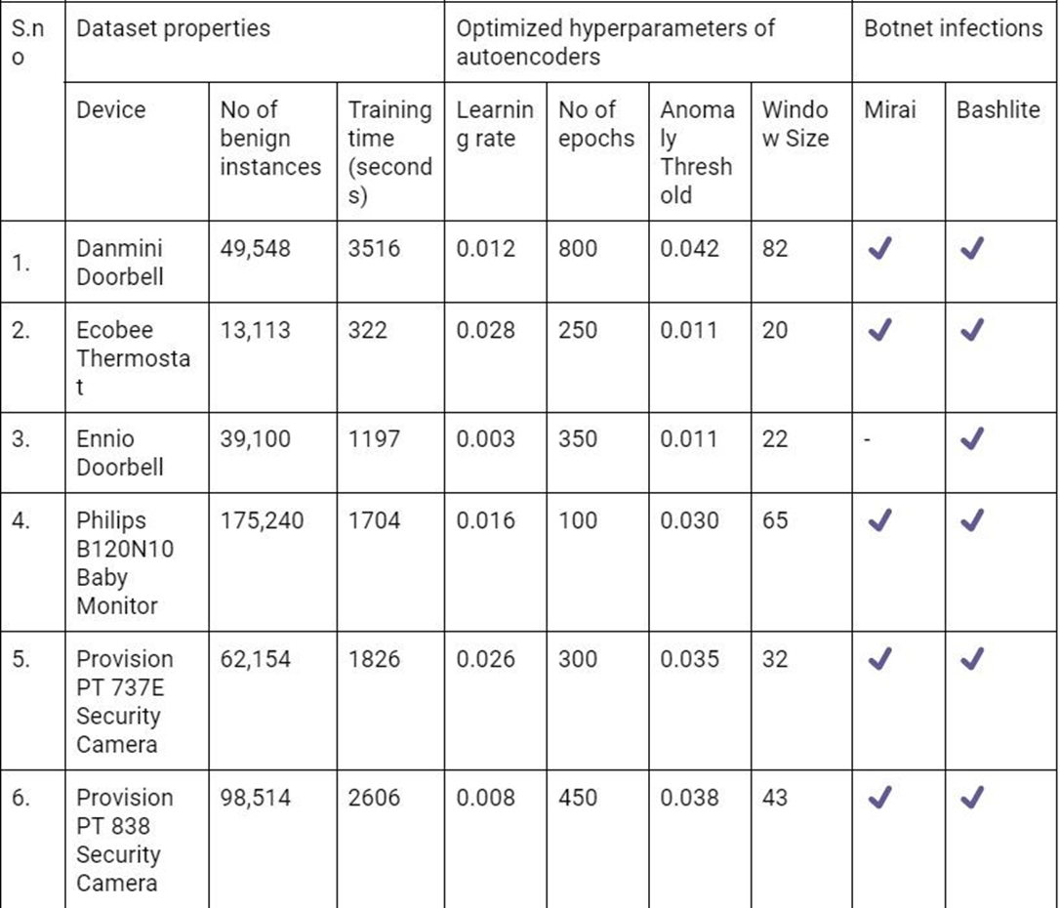
Training Stage of Base Paper Model

Slide 14
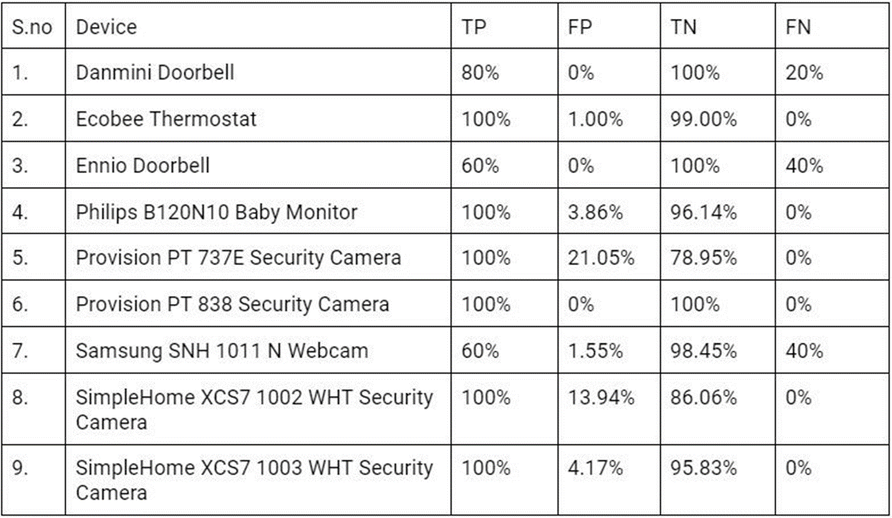
Base Paper Model
Reconstruction

Slide 15
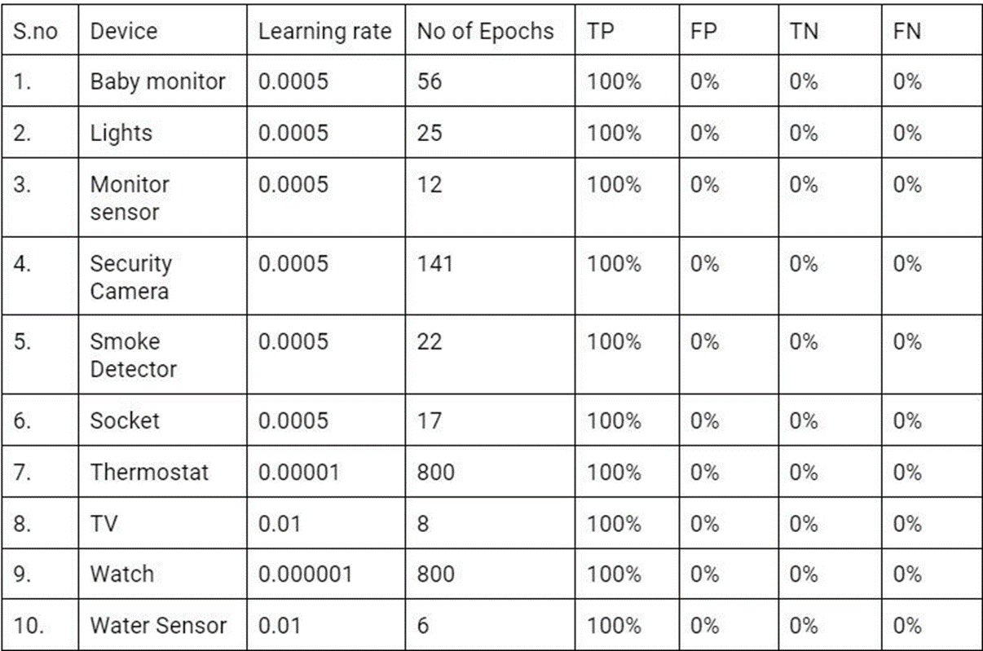
Deep Autoencoders on IOT Device Identiﬁcation Dataset

Slide 16
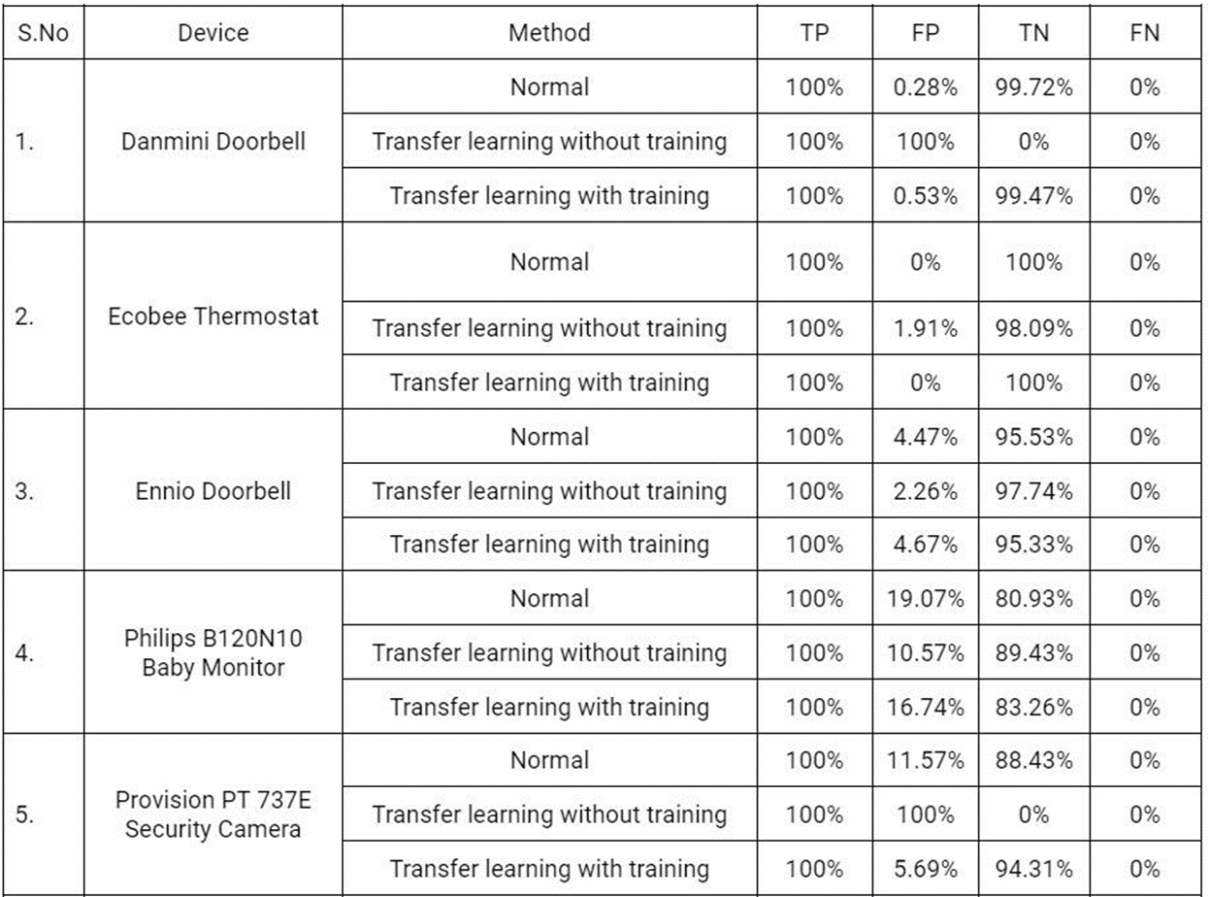
Transfer Learning on Same Device

Slide 17
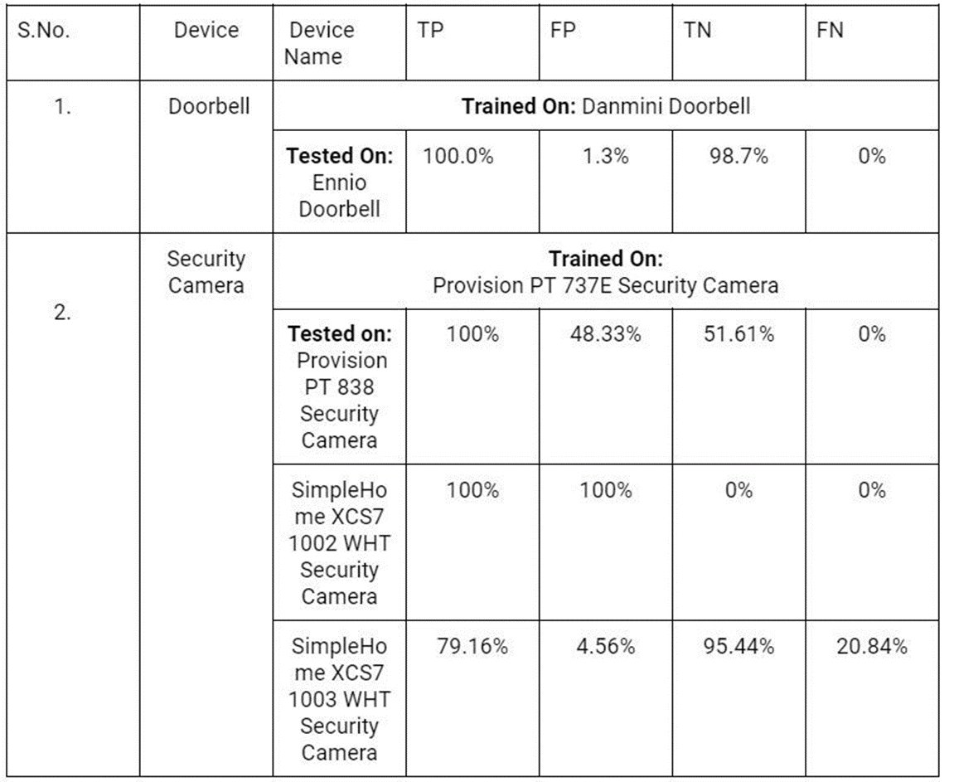
Transfer Learning on Different Device

Slide 18
Conclusion
Meidan and other [1] presented use of autoencoders as an effective means for detecting DDoS traﬃc generation from Bashlite and Mirai infected devices.
We were able to replicate their results and advanced it by evaluating performance of the trained models across different devices.
We further implemented transfer learning by saving the autoencoder trained on one device and using it to predict for other similar devices.

Slide 19
References
Y. Meidan et al., "N-BaIoT—Network-Based Detection of IoT Botnet Attacks Using Deep Autoencoders," in IEEE Pervasive Computing, vol. 17, no. 3, pp. 12-22, Jul.-Sep. 2018, doi: 10.1109/MPRV.2018.03367731.
X. Yang, Z. Guo and Z. Mai, "Botnet Detection Based on Machine Learning," 2022 International Conference on Blockchain Technology and Information Security (ICBCTIS), 2022, pp. 213-217, doi: 10.1109/ICBCTIS55569.2022.00056.
O. Kompougias et al., "IoT Botnet Detection on Flow Data using Autoencoders," 2021 IEEE International Mediterranean Conference on Communications and Networking (MeditCom), 2021, pp. 506-511, doi: 10.1109/MeditCom49071.2021.9647639.
M. Munir, M. A. Chattha, A. Dengel and S. Ahmed, "A Comparative Analysis of Traditional and Deep Learning-Based Anomaly Detection Methods for Streaming Data," 2019 18th IEEE International Conference On Machine Learning And Applications (ICMLA), 2019, pp. 561-566, doi: 10.1109/ICMLA.2019.00105.
H. Sedjelmaci, S. M. Senouci and M. Al-Bahri, "A lightweight anomaly detection technique for low-resource IoT devices: A game-theoretic methodology," 2016 IEEE International Conference on Communications (ICC), 2016, pp. 1-6, doi: 10.1109/ICC.2016.7510811.

Slide 20
Collecting dataset and implementing it on autoencoder
Literature survey
Submission
Jan 2023
Feb 2023
Mar 2023
Apr 2023
May 2023
Implementation of base paper
Transfer learning on all datasets

Slide 21
Thank You

