Slide 1
Sales & Profit Dashboard
Saumya Singh

Slide 2
Objective
• Track total sales, profit, and order volume
• Visualize trends over time and across customer segments
• Compare performance by product category and region
• Distinguish between B2B and B2C sales
• Deliver actionable business insights for strategic planning

Slide 3
Dataset Overview
471 completed orders
Fields: Date, Category, Region, Customer Segment, Qty, Amount, Profit
Calculated fields: Profit, Profit Margin %, Total Sales
Covers the last 12 months
Cleaned in excel and prepared in Power BI
Currency: USD

Slide 4
Key KPIs
• Total Sales: $557.21K
• Total Profit: $167.16K
• Total Quantity Sold: 4K
• Total Orders: 471
• Average Profit Margin: 30%

Slide 5
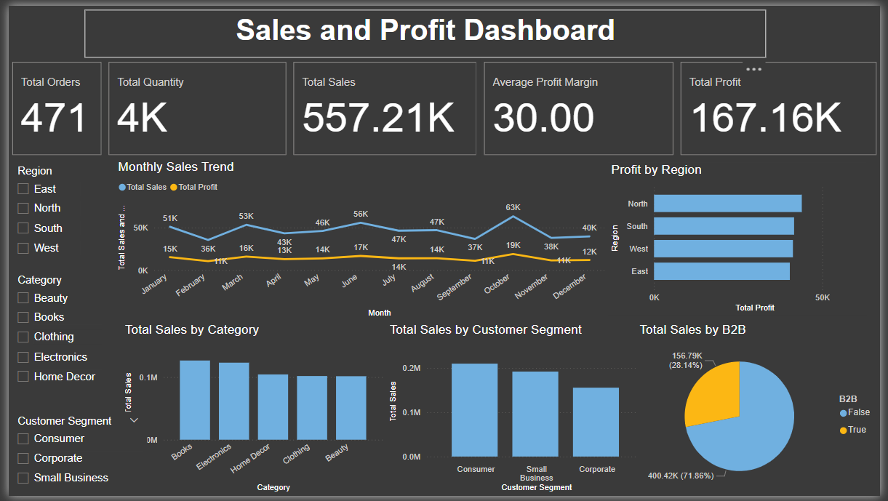
Dashboard Screenshot (created on Power BI)

Slide 6
Sales Trends & Insights
• Sales peaked in October ($63K)
• Steady growth observed mid-year
• Profit line follows a stable trajectory with small dips
• Seasonal variations evident in sales volume

Slide 7
Segment & Category Performance
• Consumer and Small Business segments lead in sales
• Books and Electronics are top-performing categories
• North and South regions generate the highest profits
• B2C accounts for ~72% of total revenue

Slide 8
Conclusions & Recommendations
• Increase focus on high-performing product categories
• Invest more in Consumer and Small Business outreach
• Target growth in profitable regions (North, South)
• Explore marketing to boost Corporate sales segment
• Maintain strong margin strategy in B2B

