Slide 1
The Importance of Parents Being Involved in Their Children's Lives
DATA230 : Group - 4
Edward Montoya
Saumya Sinha
Maharsh Soni
Aayush Srivastava
Rashmi Shree Veeraiah

Slide 2
Motivation
Parents play a crucial role for development of their children, and a stable relationship between parent and child is vital.
The lack of proper guidance and involvement from the parents can have serious negative effects on a child's life and can lead to delinquent behavior.
Notes:
Motivation behind the title is:
Parents play an important role for development of their children, and a stable relationship between parents and child is vital.
The quality of the parent-child relationship is consistently associated with childhood delinquency.
Having two parents are better in all ways, they can monitor and supervise well, and respond well to the behaviors of their children than single parents.
The quality of the parent-child relationship is consistently associated with adolescent delinquency.
The lack of proper guidance and involvement from the parents can have serious negative effects on a child's life and can lead to delinquent behavior.
And High levels of parental support are associated with lower rates of delinquency.
“The Importance of Parents Being Involved in Their Children's Lives”
Why do you choose this title from the data? (motivation)
Explain
We are not domain experts on this dataset
We could have done a bottom-up approach (this would require a lot of time and research)
Instead of trying to become domain experts we decided to do a top down approach to this project
We looked at various literature reviews to gain inspiration for how to formulate a motivation
Based on the literature reviews we decided to focus our motivation onto the importance of parents …. (motivation here)
“Rashmi & Aayush will now discuss the literature reviews that inspired our motivation…”

Slide 3
Literature Review
THE RELATIONSHIP BETWEEN JUVENILE DELINQUENCY AND FAMILY
This study examined whether a child living in a non-intact household is more susceptible to becoming a delinquent youth.
Research had found that parental absence has been linked to a child’s susceptibility toward juvenile delinquency for years.
THE DIFFERENTIAL INFLUENCE OF ABSENT AND HARSH FATHERS ON JUVENILE DELINQUENCY
The paper investigates the role of fathers in fostering their children's delinquent behaviors, focusing on two issues: the quality of the father-child relationship and father absence.
The results show that children with harsh fathers were more likely to commit crimes and use a wide array of substances than children with absent fathers.
The difference between children with absent or harsh father persisted with the mother-child relationship taken into account, which is in line with studies that found the father-child relationship to be a reliable predictor of delinquency when maternal behavior was accounted for.

Slide 4
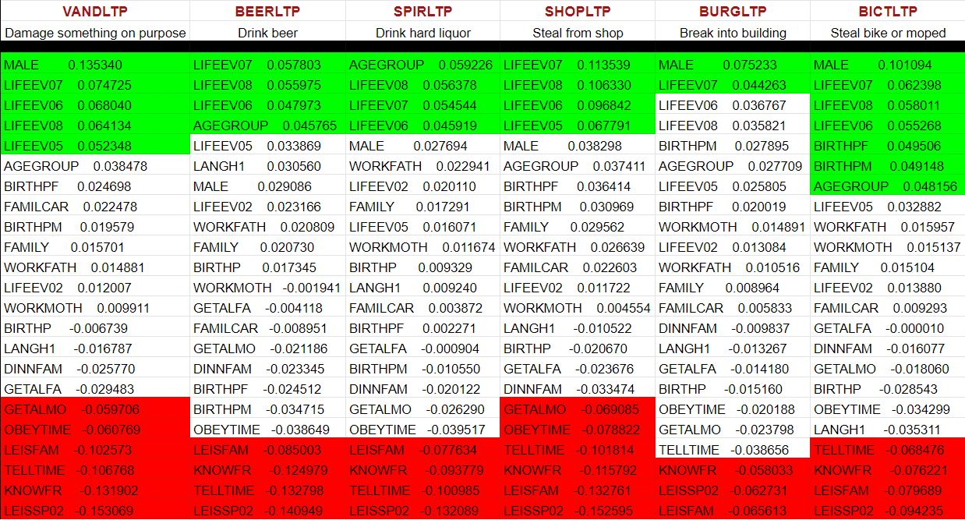
Notes:
We have our motivation (The Importance of Parents Being Involved in Their Children's Lives), but how do we go about visualizing?
Our focus is on family/parents related features
We grouped together 23 features from the codebook that we deemed as being associated with family
And some basic identifying features like gender, and age
This snapshot shows the 23 features and their correlation to each delinquent feature
Explain Vandalism
Explain green (threshold > 0.04) Positive correlation
Explain red (threshold < -0.04) Negative correlation
“Rashmi will now show our first visualization…”

Slide 5
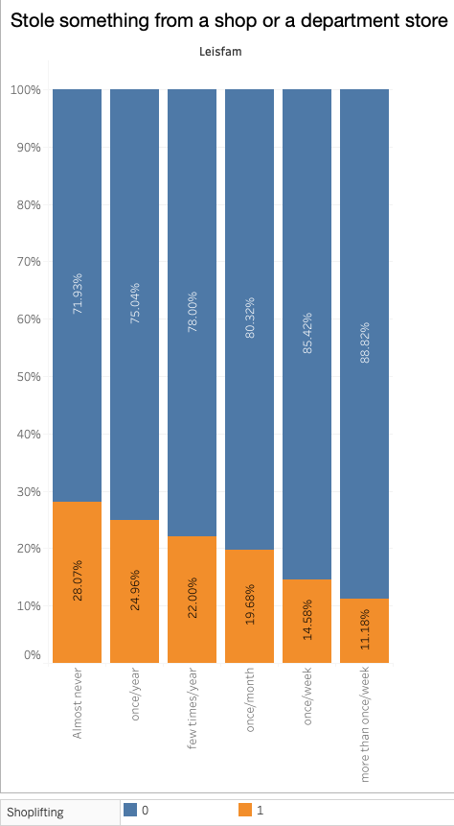
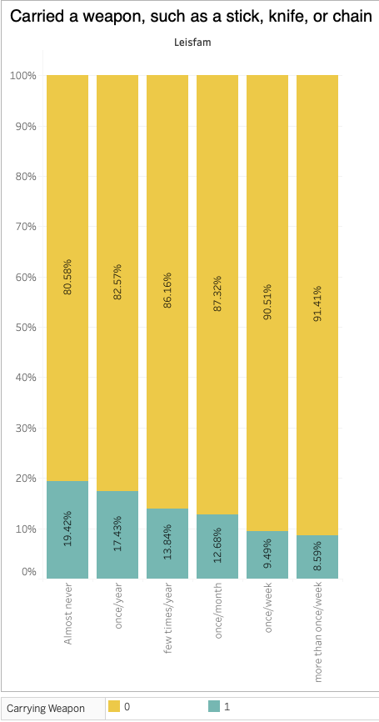
How often do you and your parents (or the adults you live with) do something together, such as going to the movies, going for a walk or hike, visiting relatives, attending a sporting event, and things like that?
Notes:
LEISFAM has high negative correlation with
Shoplifting - LEISFAM -0.132761
Weapon - LEISFAM -0.091924
100% Normalized
They plot the relative contribution of each data series to the total as a percentage.
Stacked column chart that plots the frequency (1-6) of time spent with family shoplifting and possession of a weapon emphasizes the percentage of individuals involved or not involved in shoplifting and possession of weapon
Can distinguish each data series by the color of its section in the stack showing whether they answered yes or no to shoplifting and possessing a weapon.
Result
Spending time with family -> less likely to be involved in delinquent behavior

Slide 6
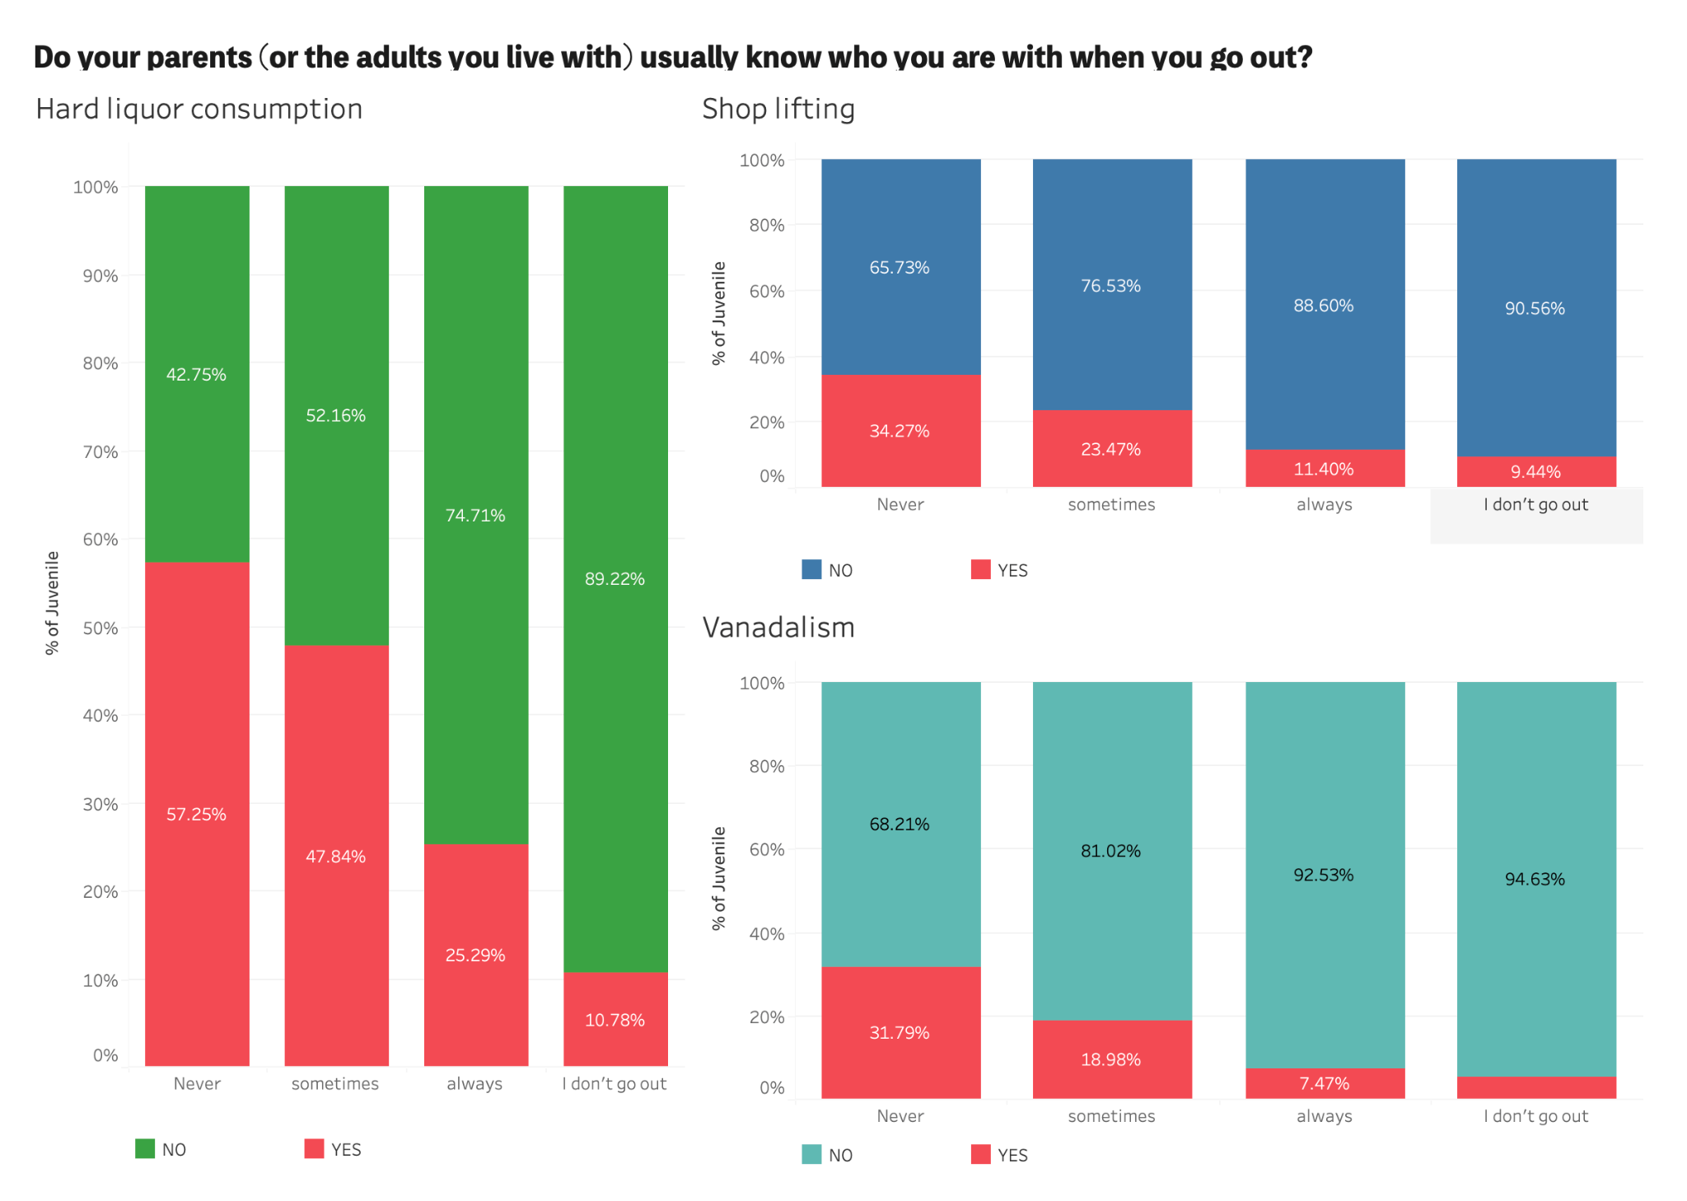

Slide 7
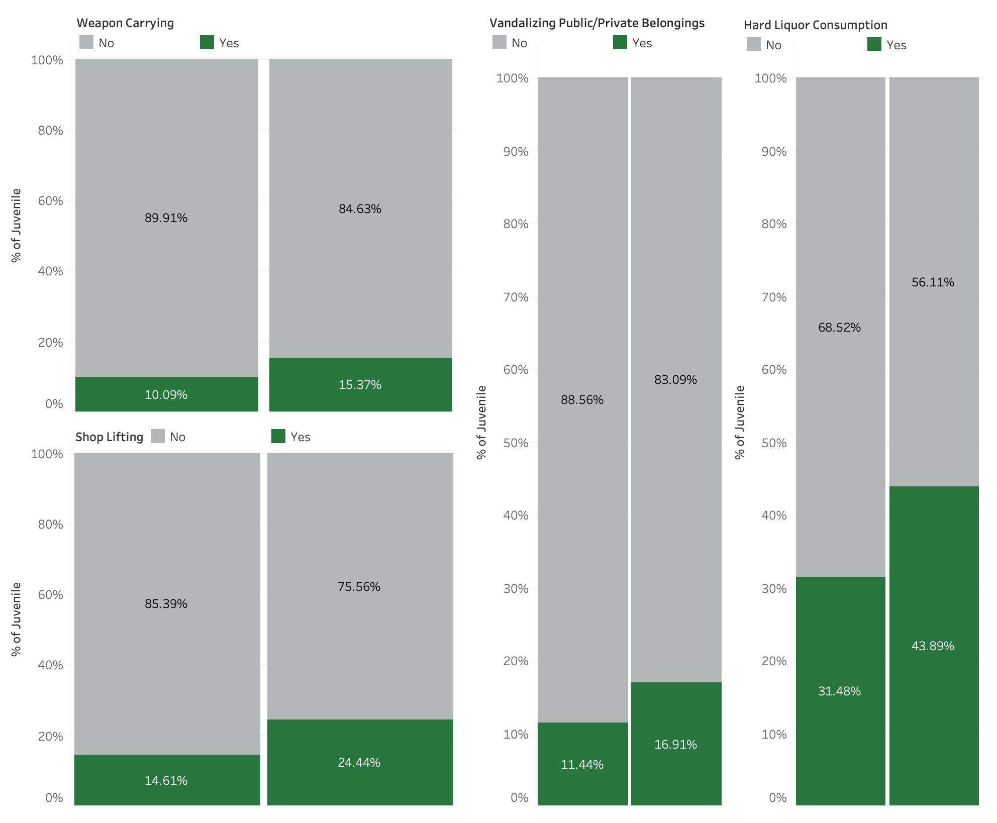
Parents separation on Juveniles can leads to Delinquent Act
Notes:
LIFEEV08 feature shows - Parents separated or (divorced)
The main cause of the increase in the number of Juvenile delinquencies can be attributed to the increase in the number of divorces being witnessed in the whole world. For a child to grow up with upright morals he has to be fully guarded by both of his parents. Both the Mother and Father have particular roles that they have to play to ensure that they bring up morally upright kids.
This feature has strong positive correlation with vandltp, Weapltp, shopltp, Spirltp (vandalization, weapon carrying, shop-lifting and hard liquor consumption)
If parents get divorced then there is high chance of their children getting involved into violence, stealing and do substance.
Violence - (i) Weapltp (carry weapons) || LIFEEV08 = 0.066217
(iii) vandltp (destroy things) || LIFEEV08 = 0.064134
Stealing - (ii) shopltp (stealing from shops) || LIFEEV08 = 0.106330
Substance - (iv) Spirltp (drink hard liquor) || LIFEEV08 = 0.056378
Normalization was needed because the distribution was distorted and plots were not getting depicted properly that’s why I used normalized stacked bar chart.
Results:
52% increase in weapon-carrying by Juveniles after parental separation
67% increase in crimes related to Shoplifting by Juveniles after parental separation
48% increase in Vandalism (deliberate damage to public/private property) by Juveniles after parental separation
39% increase in Hard Liquor consumption by Juveniles after parental separation
(wanted to keep the ppt neat, that’s why did not put so many information on the plot)

Slide 8
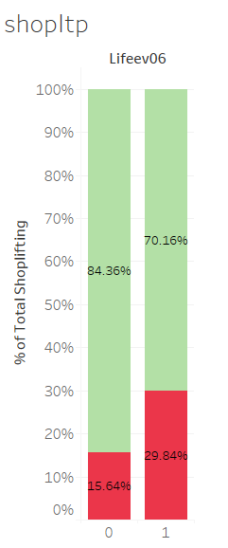
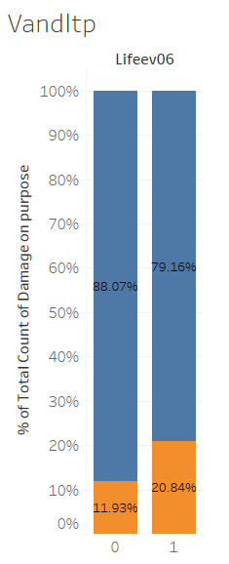
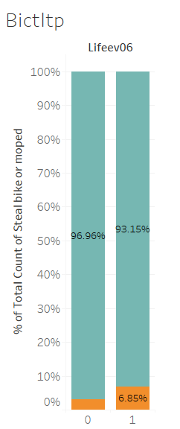



Have you ever experienced problems of one of your parents with alcohol or drugs?
Notes:
This visual is depicting parents with possible substance abuse issues
This visually depicts positive correlation
If parent substance abuse, then higher potential to commit shoplifting
If parent substance abuse, then higher potential to commit vandalism
If parent substance abuse, then higher potential to steal things like bicycles and mopeds (oddly specific lol)
This positive correlation makes sense and is intuitive
If the parent is drunk, or high, then it’s implicit that they’re not fully coherent to parent
If the parent is not coherent, then perhaps the child can do things as they please w/out parental oversight
Perhaps,

Slide 9
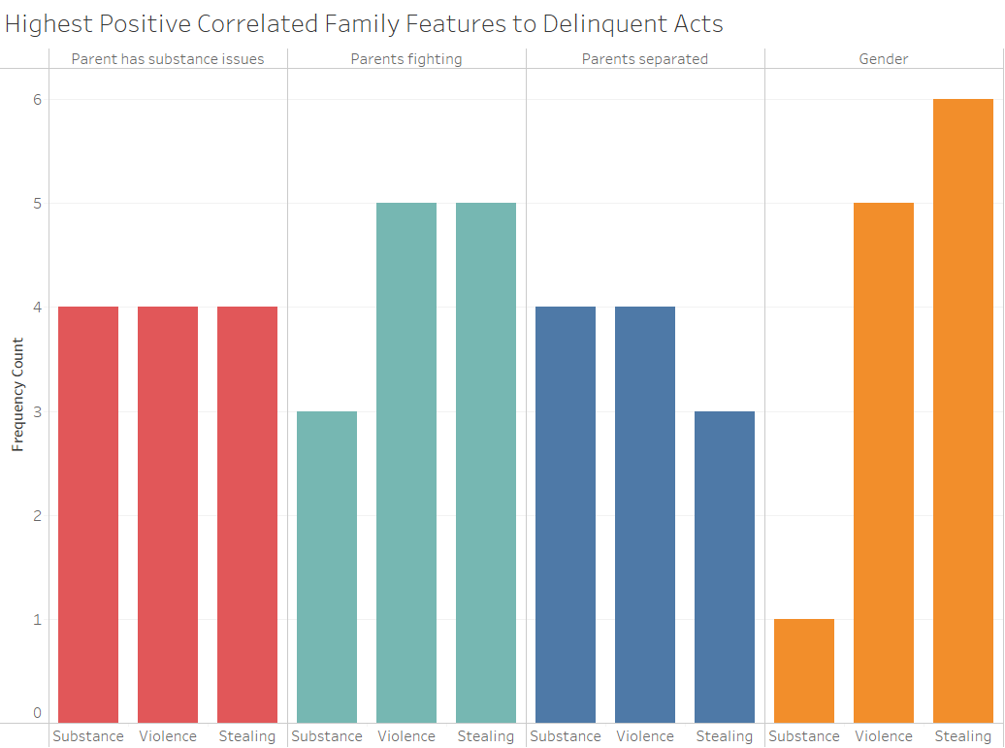
Notes:
(Derived visual)
(This is a frequency counter)
Grouped all 18 delinquent acts into 3 categories
Substance (related) (6 features)
Beer, hard liquor, weed, hash, lsd, mdma
Violence (related) (5 features)
Destroying things, carrying weapons, threatening people, group fighting, and assualting
Stealing (related) (7 features)
Stealing from shops, burglary, stealing bikes, stealing cars, stealing from cars, snatching purses/bags
The visual is depicting 4 family related features with highest positive correlation to delinquent acts
Observations
Substance abuse for parents
You would think that if the child had parents that were abusing substances, then you would see all 6 substances correlated, but only 4.
Parents fighting
As expected, the child is exposed to violence between parents and the frequency count is maxed out 5/5 for correlation to violence
Gender
Interesting that gender has the lowest frequency count for substance, and the highest count for stealing
Requires more research for understanding.
LIFEEV06 Substance abuse (parent)
You would think that if the child had parents that were abusing substances, then you would see all 6 substances correlated, but only 4.
LIFEEV07 Repeated serious conflicts or physical fights between your parents
As expected, the child is exposed to violence between parents and they are maxed out 5/5 for correlation to violence
LIFEEV08 Parents separated (divorced)
The lowest of the 4 features for stealing…
MALE Gender
Stealing is nearly maxed out 6/7. It’s the highest of the 4 features.
Based on the CodeBOok
Substance - beerltp (drink beer)
Spirltp (drink hard liquor)
Hashltp (weed)
Xtcltp (mdma)
Lhcltp (LSD)
Drudltp (sell drugs)
Violence - vandltp (destroy things)
Weapltp (carry weapons)
Extoltp (threaten people w/ weapon)
Gfigltp (group fighting)
Asltltp (assaulting people)
Stealing - shopltp (stealing from shops)
Burgltp (break into building to steal)
Bictltp (steal bicycles)
Cartltp (steal cars)
Hackltp (hack on computer / to steal?)
Carbltp (steal out of car)
Snatltp (snatch purse / bag from someone)

Slide 10
Conclusion
If children are spending time with family, then they are less likely to do delinquent acts
If parents know where their children are at and with whom, then they are less likely to do delinquent acts.
If the parents are partaking in substance abuse, then their children are more likely to do delinquent acts.
If parents are divorced / separated, it can lead to increase in Juvenile Delinquency.
Notes:
These points all demonstrate // The Importance of Parents Being Involved in Their Children's Lives
It’s important to note that these point are not showing causation, but instead correlation
Our visuals showed things that have a negative correlation to delinquent acts
How often spending time with family
Do your parents know who you’re with when you go out
Our visuals showed things that have positive correlation to delinquent acts
Parents having substance abuse issues
Parents being separated
The conclusion is that it’s Vital that parents are involved with the lives of their children

Slide 11
Thank you!

Slide 12
Questions?

