Slide 1
Connect-The-Dots
DevOps CA-II: case studies and a full DevOps toolchain for a five-service hackathon app
Case studies: Netflix · Capital One Tools: GitHub Actions · Ansible · Docker + Kubernetes · Prometheus + Grafana
4 / 4
0
changed=0
7.73%
pipeline jobs green
(run #5, 4 min 8 s)
failed requests during the
v1 → v2 rolling update
on the second Ansible run
(idempotent playbook)
5xx spike caught by Grafana
when Redis was stopped
github.com/saumya08-07/Connect-The-Dots · 1 October 2026
Notes:
This deck covers two case studies (Netflix and Capital One) and five hands-on tasks applied to Connect-The-Dots, a hackathon app with Nginx/React, Spring Boot, MongoDB, Redis and S3 storage. The four numbers are the headline results, each backed by a screenshot later in the deck.

Slide 2
CASE STUDY Q1
Netflix: from a fragile monolith to designed-for-failure
What the 2008 database corruption exposed
How DevOps solved it
Single point of failure
1
Microservices
1
One shared database; DVD shipping stopped for ~3 days.
Small services with their own data and team; failures stay contained.
2
Cloud migration (AWS)
2
Tight coupling
Elastic, horizontal scaling across regions.
Billing, catalogue, recommendations, shipping in one deployable.
3
You build it, you run it
3
Vertical scaling limits
Teams own their service in production; shorter feedback loops.
Growth meant bigger hardware, not more instances.
4
Automated CI/CD (Spinnaker)
4
Slow, risky releases
Frequent canary and blue-green releases without manual gates.
Any fix meant redeploying the whole application.
5
Design for failure
5
Ownership gaps
Hystrix circuit breakers, fallbacks and Eureka discovery degrade gracefully.
6
Chaos Engineering
One shared codebase; no team owned a capability end to end.
Chaos Monkey and the Simian Army kill instances (even regions) on purpose.
Resilience Failures isolated and rehearsed
Scalability Each service scales on its own
Speed Independent deploys, many a day
2
Notes:
Challenges: the 2008 corruption of a single shared relational database stopped DVD shipping for about three days. Everything was tightly coupled in one codebase and deployment, scaling was vertical, every change meant redeploying the whole app, and ownership was unclear. DevOps response: Netflix split the monolith into hundreds of microservices with their own data stores, moved to AWS for elastic horizontal scaling, adopted 'you build it, you run it', automated CI/CD with Spinnaker (canary and blue-green), designed for failure with Hystrix circuit breakers, fallbacks and Eureka, and pioneered Chaos Engineering with Chaos Monkey and the Simian Army including Chaos Kong for region failures. Impact: failures are isolated and found deliberately, each service scales independently, and teams deploy many times a day. Conclusion: the mindset shifted from preventing failure to expecting and surviving it.

Slide 3
CASE STUDY Q3
Capital One: fast and compliant with DevSecOps
The dual challenge 6–9 month release cycles from manual reviews and end-of-cycle audits · strict regulation (PCI-DSS, SOX, banking regulators) · fintech competitors shipping faster
What they did
1
2
3
4
5
Shift-left security
Automated scanning
Compliance as code
Standard pipelines
IaC + cloud
Threat modelling and checks from design and coding time.
SAST, SCA, DAST, image and secrets scans on every build.
Cloud Custodian enforces encryption, access and tagging.
Pre-approved CI/CD with built-in gates (Hygieia).
Immutable, reproducible, auditable environments.
Why embedding security accelerates innovation
Cheaper fixes: minutes in a pull request vs weeks at the final gate
No end-of-cycle queue: small, frequent releases
Lower risk: small changes are easy to test and roll back
Free audit trail: pipeline logs satisfy regulators
Fewer incidents: guardrails stop known-bad code early
Culture: security team becomes enabler, not gatekeeper
Caveat: the 2019 breach came from a cloud misconfiguration, so continuous config monitoring and least privilege are part of DevSecOps too.
3
Notes:
Capital One faced 6 to 9 month release cycles caused by manual reviews, change-approval boards and security audits at the end, while regulators (PCI-DSS, SOX) demanded strict controls and fintechs moved faster. DevSecOps answered both: shift-left security starts at design and coding; automated SAST, SCA, DAST, image and secrets scanning runs in every pipeline; Cloud Custodian enforces compliance as code; standardised pre-approved pipelines (and the open-sourced Hygieia dashboard) apply the same controls to every release; and infrastructure as code gives auditable environments. Embedding security speeds things up because fixes are cheapest early, there is no end-of-cycle bottleneck, small releases are low risk, pipeline logs are audit evidence, guardrails prevent incidents, and developers own security. Caveat: the 2019 breach shows automation must include configuration monitoring and least privilege. Conclusion: speed and security reinforce each other.

Slide 4
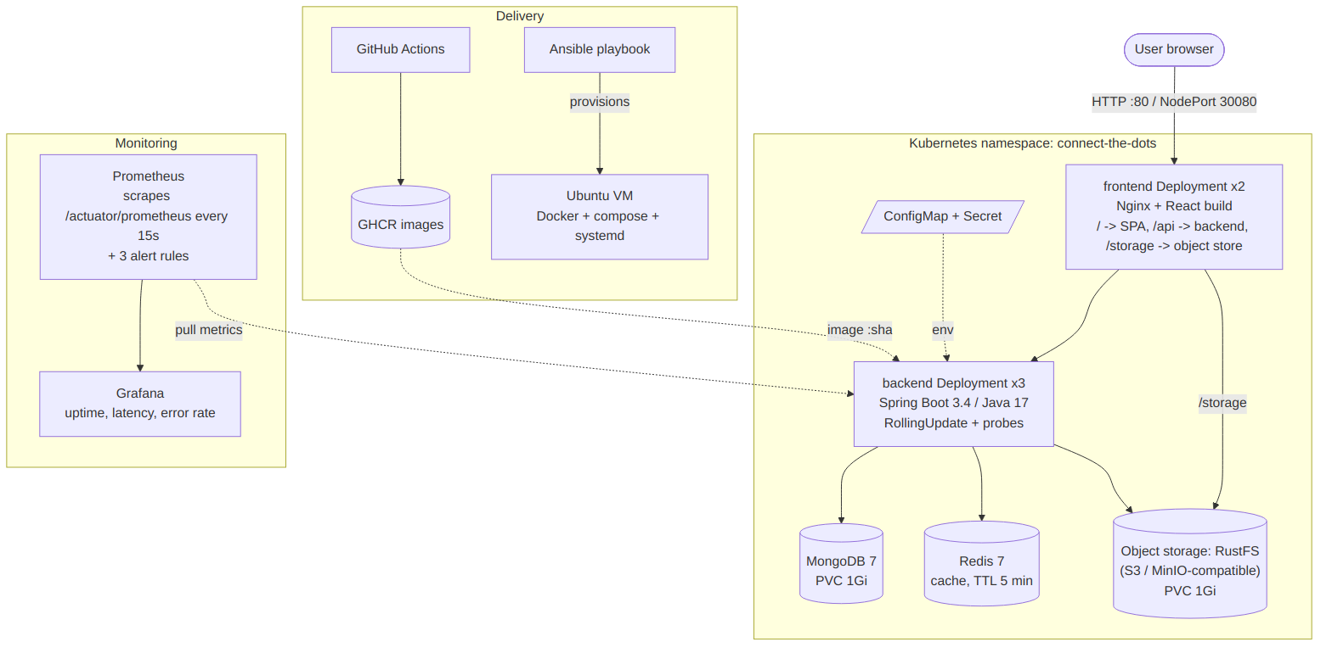
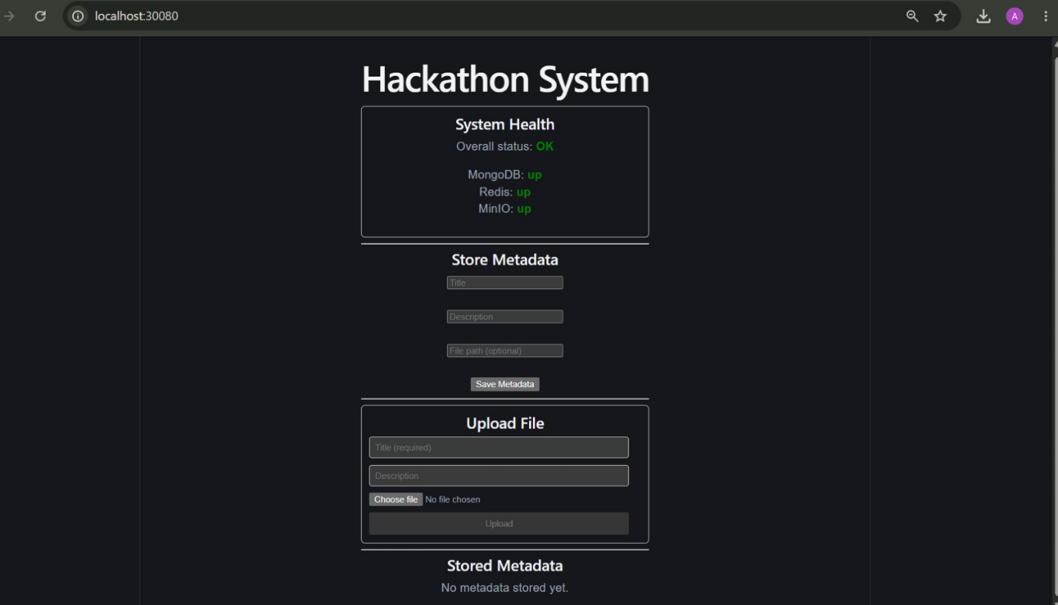
THE PROJECT
Connect-The-Dots: what we deployed
A B.Tech hackathon project: a containerised web system that stores metadata, uploads and downloads files, and checks the health of every service from one dashboard.
Frontend React + Vite, served by Nginx
Backend Spring Boot 3.4, Java 17
Database MongoDB 7 (metadata)
Cache Redis 7 (5-min TTL)
Files S3 storage (RustFS)
Architecture: Nginx is the only entry point; only the backend talks to the data stores. Prometheus scrapes the backend; GitHub Actions and Ansible deliver it.
The running app (served from Kubernetes)
4
Notes:
Connect-The-Dots is a hackathon project that integrates five independent services behind one Nginx reverse proxy. Users can save metadata (title, description, file path), upload and download files, and see a health check that verifies MongoDB, Redis and file storage at once. The backend is Spring Boot; MongoDB stores metadata, Redis caches the metadata list, and S3-compatible storage holds file bytes. Originally the storage was MinIO; it is now RustFS because MinIO's images were deleted, with no code change thanks to the S3 API.

Slide 5
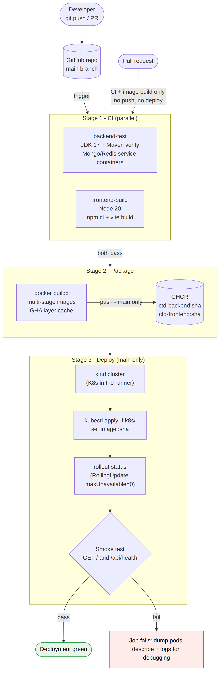
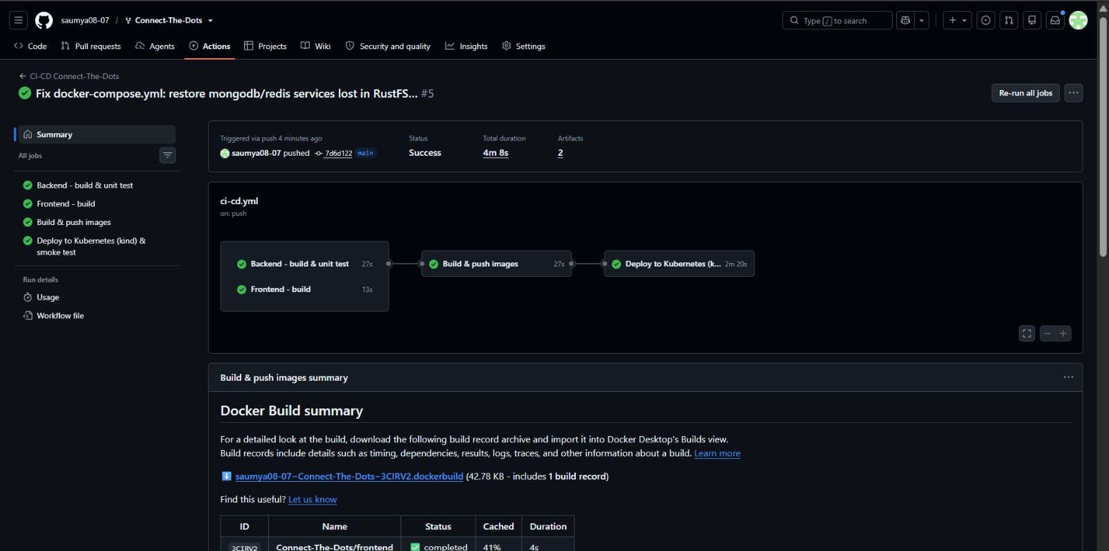
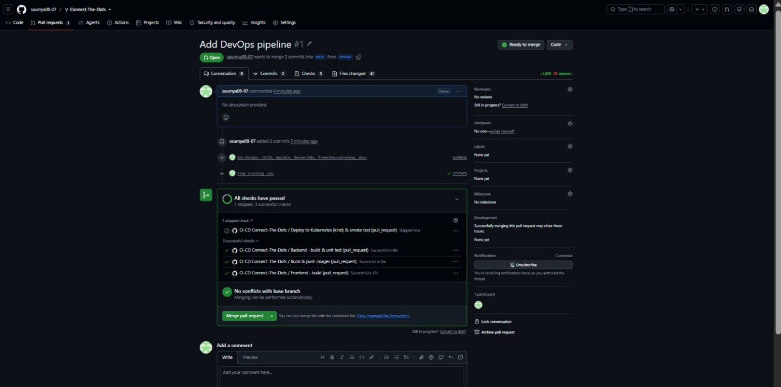
TASK 1 · DEPLOYMENT STRATEGY · GITHUB ACTIONS
Every merge: tested, packaged, deployed, verified
1
CI
Backend + frontend tests in parallel
2
Package
Images to GHCR, tagged by commit
3
Deploy
Kubernetes (kind) in the runner
Run #5 on main: all 4 jobs green in 4 min 8 s.
4
Verify
Health check retried until 200
Files: .github/workflows/ci-cd.yml, docs/diagrams/pipeline.png
Pipeline diagram
Pull request: CI + build pass; deploy skipped by design.
5
Notes:
GitHub Actions was chosen because the code is on GitHub: no server, built-in registry and token. CI runs backend and frontend in parallel; the backend test boots Spring Boot against real MongoDB and Redis. Images are multi-stage and tagged with the commit SHA; the layer cache cut build time from about two minutes to 27 seconds. The deploy job creates a throwaway Kubernetes cluster in the runner, applies the real manifests, waits for every rollout and retries the health check. Pull requests never push or deploy.

Slide 6
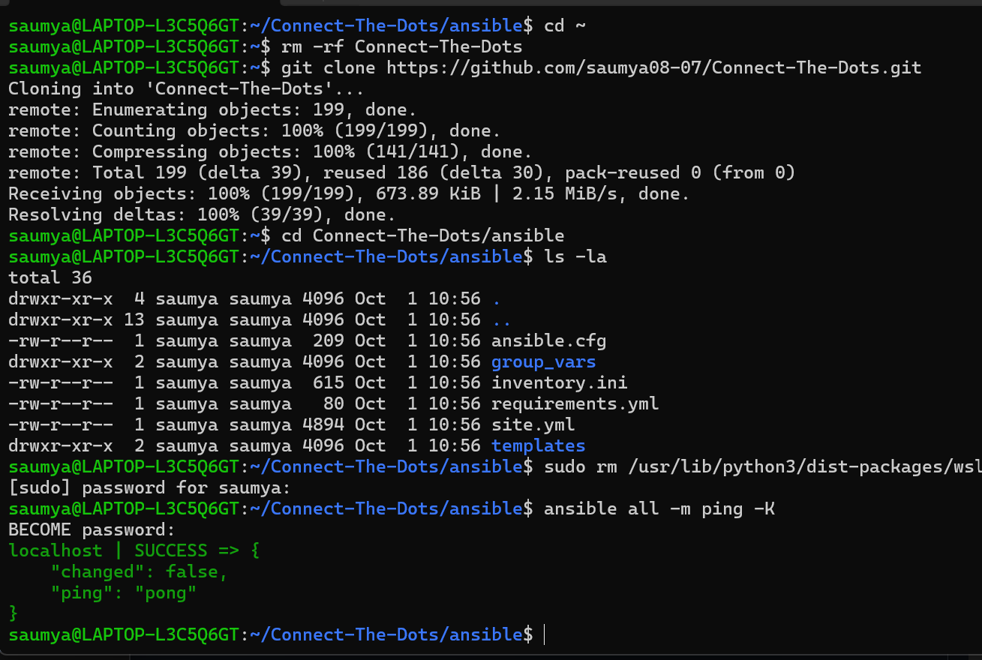
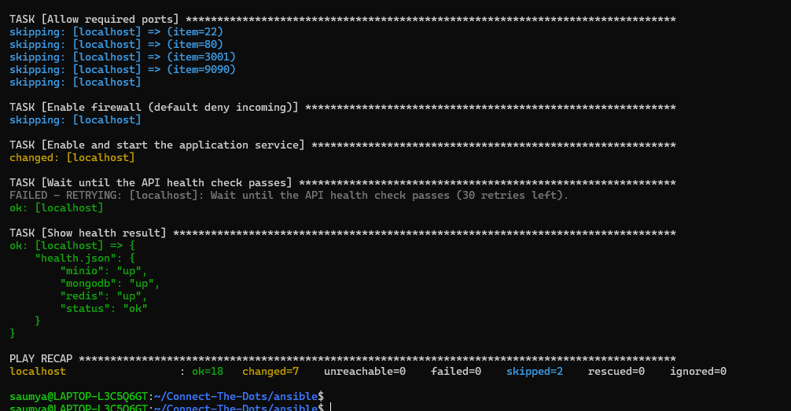
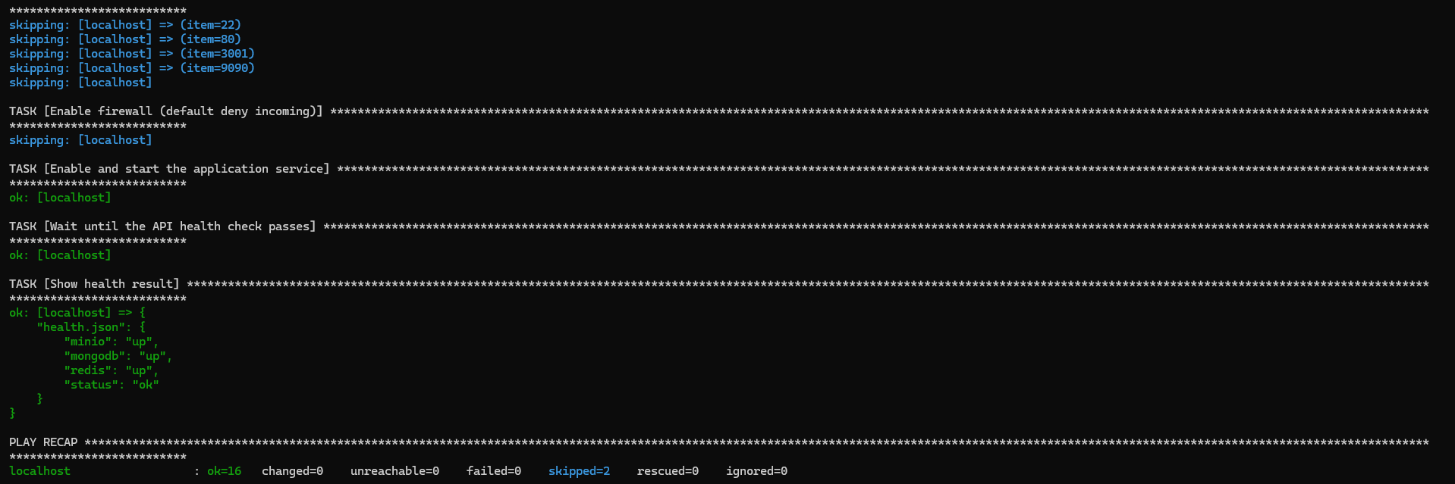
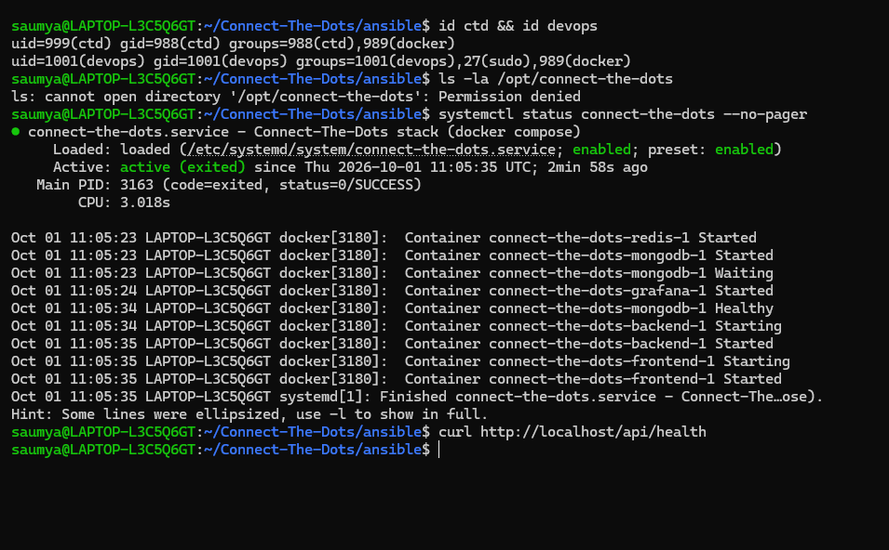
TASK 2 · CONFIGURATION MANAGEMENT · ANSIBLE
One playbook: fresh Ubuntu to running app
Installs Docker and packages · creates users ctd and devops · writes .env (0600), compose file and systemd unit · verifies /api/health
ansible all -m ping → pong (target: WSL Ubuntu 24.04)
First run: all services up · ok=18, changed=7, failed=0
Second run: changed=0, so the playbook is idempotent
Verified: users, 0750 app folder, systemd service active
6
Notes:
Ansible was chosen over Puppet because it is agentless. The playbook installs packages and Docker from its official repository, creates a no-login service account and an operator account, writes the app directory with 0750 permissions and the secrets file with 0600, installs a systemd unit so the stack starts on boot, then verifies the health endpoint. The second run changed nothing, which proves idempotency. Files: ansible/site.yml, inventory.ini, group_vars, templates.

Slide 7
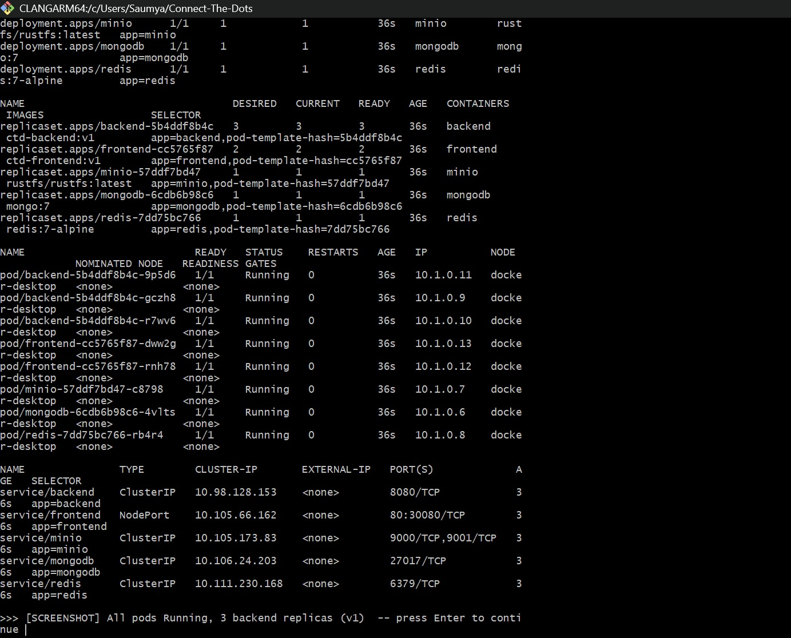
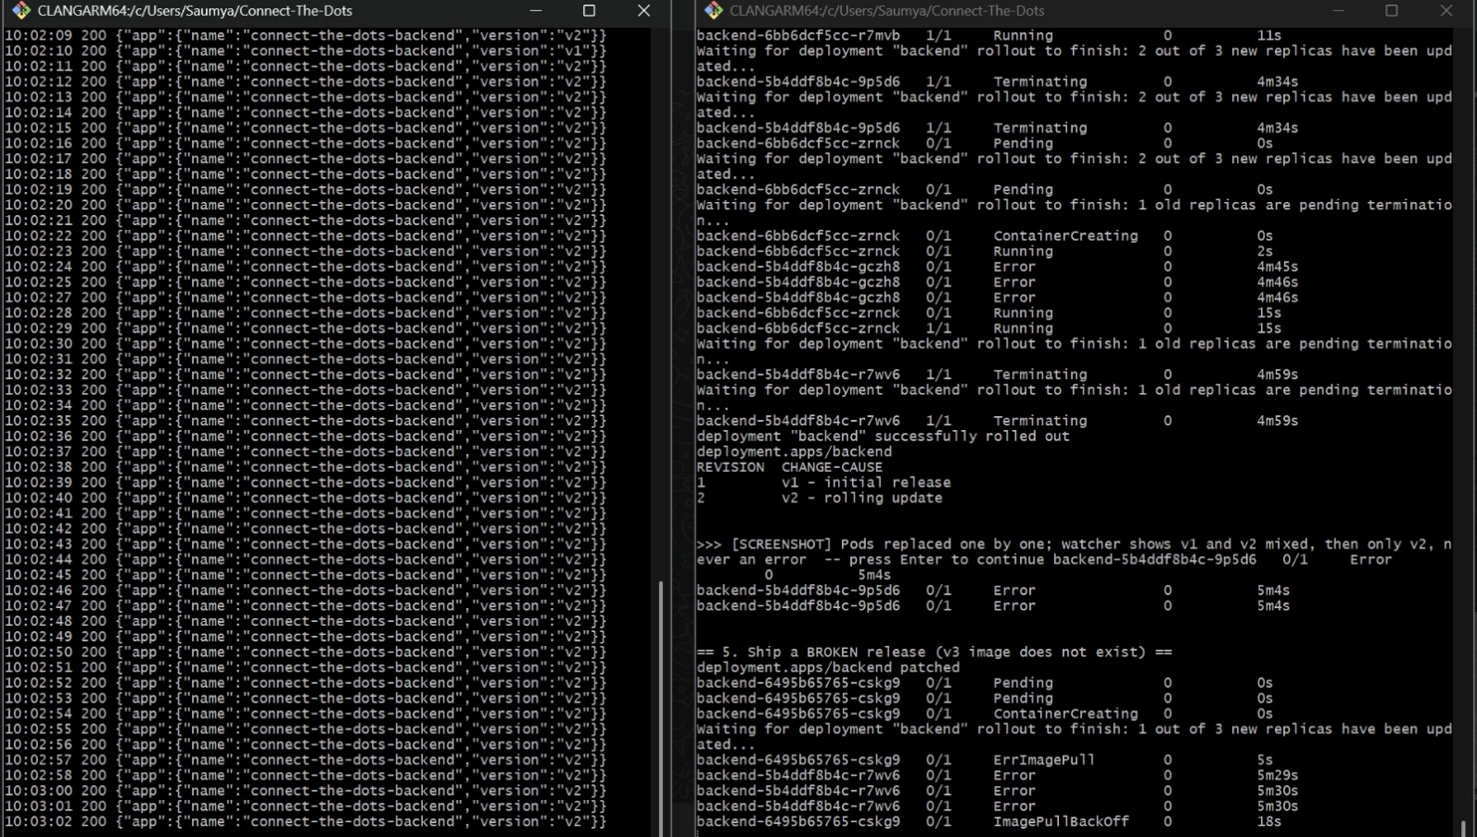
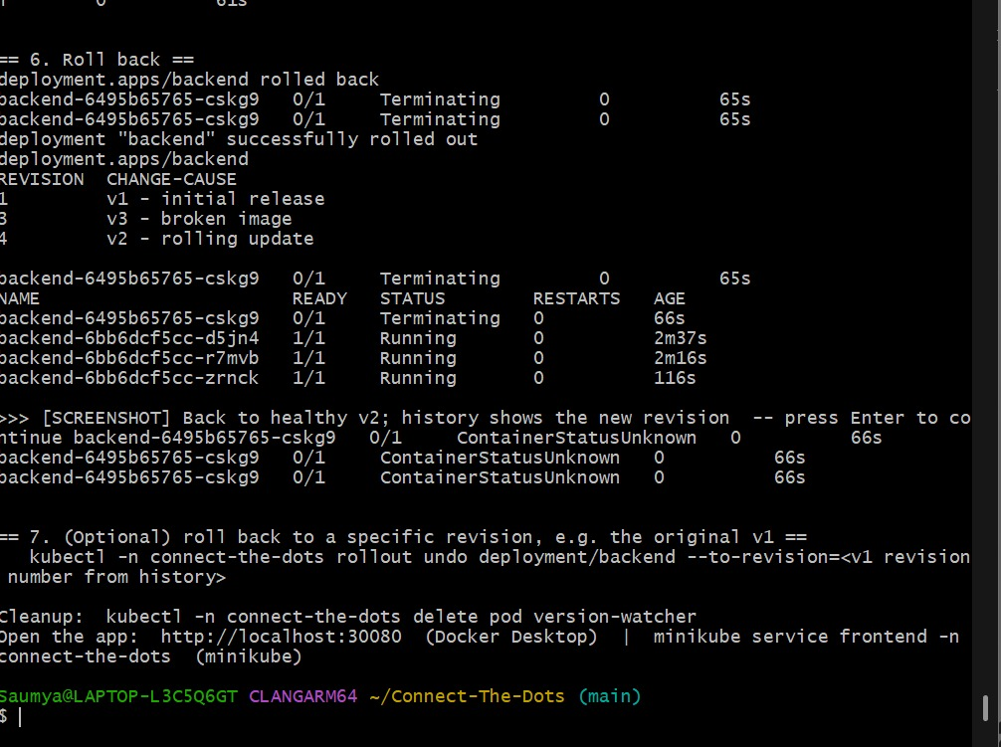
TASK 3 · CONTAINERIZATION & ORCHESTRATION · DOCKER + KUBERNETES
Zero-downtime rolling update, one-command rollback
Multi-stage Dockerfiles · 3 replicas · maxSurge 1, maxUnavailable 0 · readiness, liveness and startup probes · YAMLs in k8s/
v1 deployed: 3 backend replicas, all pods Running
v1 → v2 with only HTTP 200; broken v3 stuck, v2 keeps serving
kubectl rollout undo: back to healthy v2 in seconds
The app running on Kubernetes at localhost:30080
7
Notes:
Both images are multi-stage, so build tools never ship. The backend Deployment runs three replicas with maxSurge 1 and maxUnavailable 0: Kubernetes adds one new pod, waits until it is ready for 10 seconds, then removes one old pod, so capacity never drops. A watcher pod called the API every second and saw only HTTP 200 while versions switched. A deliberately broken v3 could not pull its image, but the old pods kept serving. kubectl rollout undo restored v2 instantly by reusing the old ReplicaSet; the history shows revisions 1, 3 and 4.

Slide 8
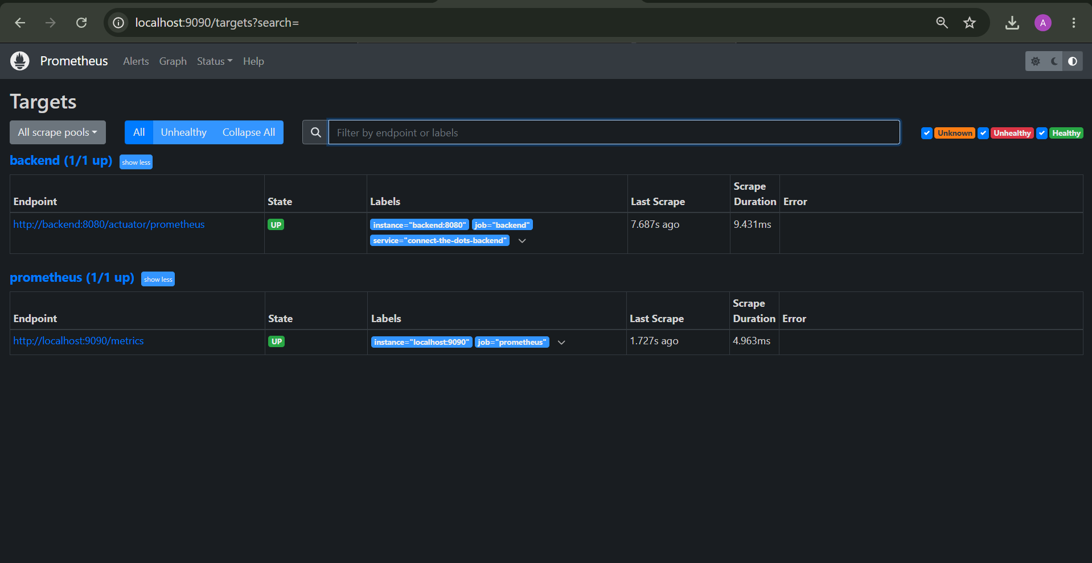
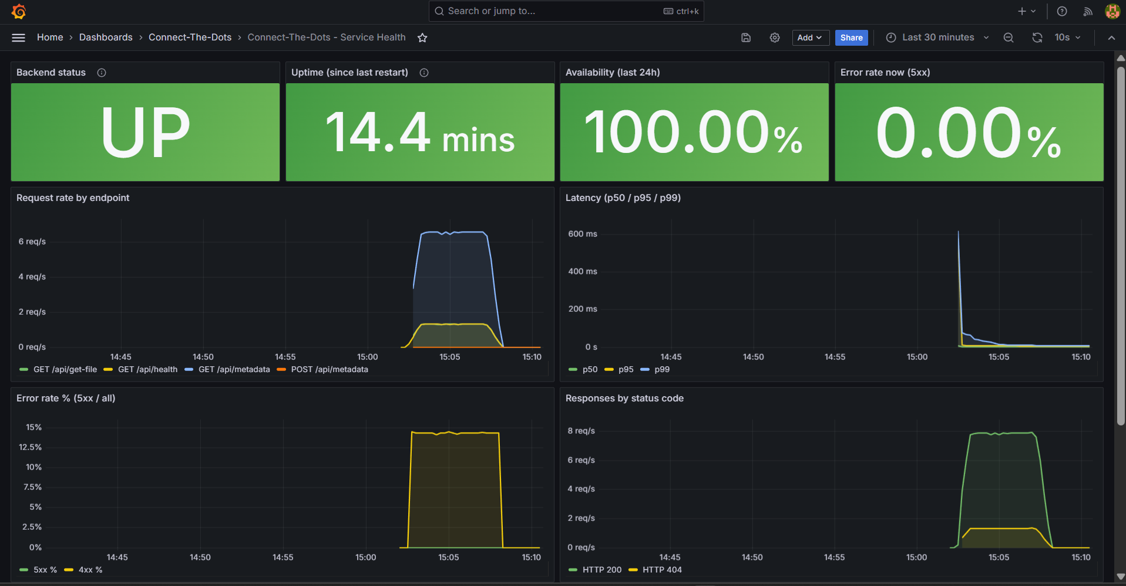
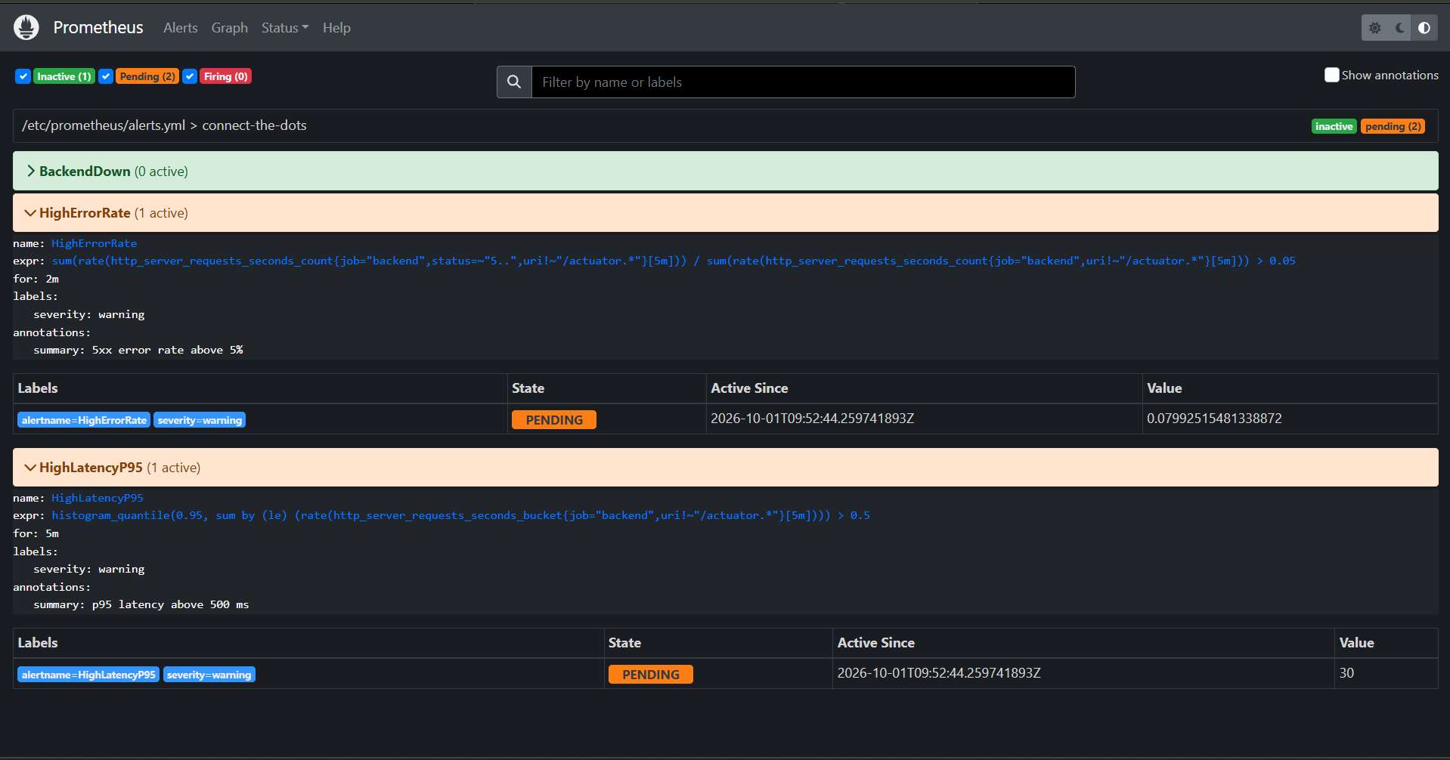
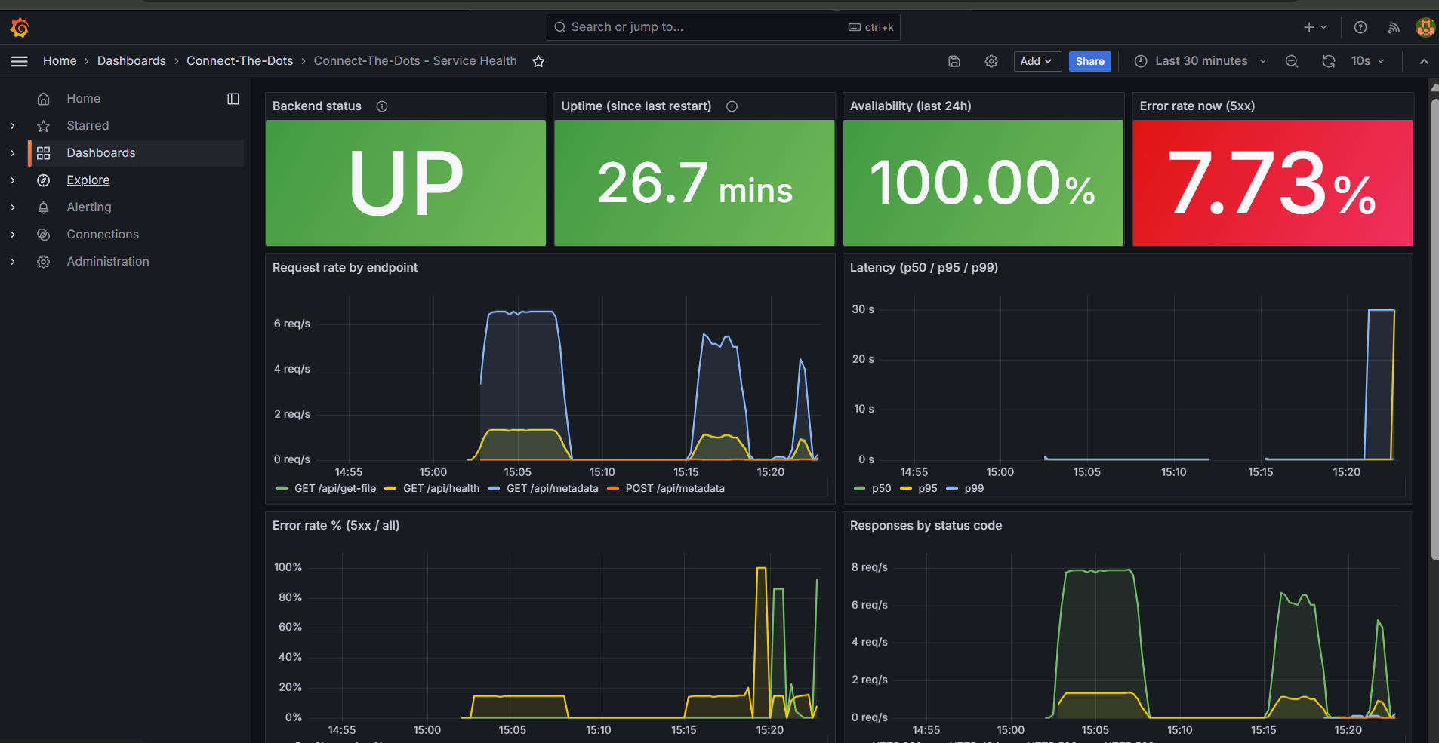
TASK 4 · MONITORING & LOGGING · PROMETHEUS + GRAFANA
Uptime, latency and error rate, and an outage caught live
Actuator + Micrometer expose /actuator/prometheus · scraped every 15 s · 10-panel Grafana dashboard · 3 alert rules
Prometheus: backend target UP
Grafana baseline: UP, 100% availability, 0% 5xx
Redis stopped: HighErrorRate and HighLatencyP95 alerts Pending
Grafana: 5xx error rate jumps to 7.73%, latency ~30 s
8
Notes:
The backend gained Spring Boot Actuator and the Micrometer Prometheus registry; Prometheus scrapes it every 15 seconds and the target shows UP. Grafana's dashboard is provisioned from the repo and shows uptime, availability, p50/p95/p99 latency, and 4xx vs 5xx error rate. The 4xx line around 14% is by design: test requests for a missing file. When Redis was stopped, the 5xx rate rose to 7.73% and latency to about 30 seconds, and two alert rules went Pending. Alerts: BackendDown 1 min, HighErrorRate over 5% for 2 min, HighLatencyP95 over 500 ms for 5 min.

Slide 9
TASK 5 · CHALLENGES
Six real problems, each caught by the system and fixed
1
MinIO images deleted upstream
2
Smoke-test race (HTTP 503)
3
No ARM64 Java runtime image
Deploy timed out; pull access denied.
Fix: RustFS, same S3 API, no code change.
Health checked before storage was up.
Fix: wait for all rollouts, retry for 2 min.
Alpine JRE is x86-only.
Fix: multi-arch eclipse-temurin:17-jre.
4
Frontend tied to host disk
5
WSL hang, then 0-byte files
6
Ansible become_user failed
Compose mounted dist/ from the laptop.
Fix: React build baked into an Nginx image.
Stuck VM froze Ansible; forced stop lost writes.
Fix: restart, re-clone, sync.
chmod 'A+user:ctd' error.
Fix: add the acl package (setfacl) to the playbook.
9
Notes:
One: MinIO deleted its public images, breaking the original compose file for everyone; RustFS speaks the same S3 API. Two: the first post-merge run failed its smoke test because health was checked once before storage was ready. Three: the original Java base image has no ARM build. Four: the frontend relied on a host folder that Kubernetes pods can't see. Five: WSL got stuck after the laptop slept; I isolated it layer by layer, and the forced restart left files at zero bytes. Six: Ansible needs setfacl to hand files to an unprivileged user.

Slide 10
TASK 5 · LESSONS LEARNED
What this project taught
1
Build once, deploy everywhere
2
Safe rollouts are configuration
The SHA-tagged image CI tests is the one Kubernetes runs and rolls back to.
maxUnavailable 0 + readiness probes: a bad release stalls instead of causing an outage.
3
Ready ≠ dependencies ready
4
Idempotency is proof
Wait for every service and retry health checks instead of checking once.
changed=0 makes the playbook both documentation and drift correction.
5
Measure the right thing
6
Standards over vendors
Percentiles, and 4xx split from 5xx; a dead dependency showed up as 30 s latency.
The S3 API made the MinIO swap trivial. Pin and mirror third-party images.
Link to the case studies: our Redis outage is the Netflix lesson (design for failure); the next step, security scans in CI, is the Capital One lesson (shift left).
10
Notes:
Automation is only as good as its checks: every failure here was caught by a health check, a rollout wait or a metric. The Redis test showed that outages appear as latency, which is why Netflix uses circuit breakers. The obvious next step for this pipeline is the Capital One idea: add SAST, dependency and image scans so security shifts left. Other next steps: Ansible Vault for secrets, Alertmanager routing, and pinning image versions.

