Slide 1

Improving Spectral Clustering Scalability Through Intelligent Sampling Methods
Saumya Thakor (20BCP103)
Bhumika Rupchandani (20BCP247)

Slide 2
CONTENTS
Problem Statement
Motivation
Objectives
Literature Review
Method Adopted
Results
Conclusion
Future Scope of Work
Outcomes
References

Slide 3
Problem Statement
Spectral clustering has emerged as a powerful technique for uncovering complex structures and detecting patterns within various types of datasets, including image segmentation, community detection in social networks, and gene expression analysis. This method leverages the eigenstructure of affinity matrices to group similar data points into coherent clusters. However, spectral clustering faces significant challenges in terms of scalability, particularly when dealing with large-scale and high-dimensional datasets.
These limitations highlight the urgent need for innovative techniques that can enhance the scalability of spectral clustering without compromising clustering quality. Specifically, there is a need for methods that can effectively handle large datasets while preserving the meaningful structure and insights within the data. This research aims to address these challenges by developing an ensemble approach that integrates intelligent sampling strategies, thereby improving both the scalability and quality of spectral clustering for modern data analytics.

Slide 4
Problem Statement
Computational Complexity
Sensitivity to Noise and Outliers
Scalability Constraints
Memory Constraints
Quality of Clustering
Sampling Bias
Computational Complexity
Sensitivity to Noise and Outliers
Scalability Constraints
Memory Constraints
Quality of Clustering
Sampling Bias

Slide 5
Motivation
The motivation behind this research stems from the growing demand for efficient and scalable clustering algorithms in the era of big data. As data continues to proliferate across various domains such as social media, healthcare, finance, and scientific research, there is an increasing need to analyze and extract meaningful patterns from massive and complex datasets. Traditional spectral clustering techniques, while powerful in identifying intricate data structures, are often rendered impractical due to their high computational requirements and scalability issues.
The motivation behind this research lies in the pressing need for scalable clustering algorithms that can efficiently process large and complex datasets. Traditional spectral clustering methods, while effective in revealing underlying data structures, often struggle to handle the scale and complexity of modern datasets. By introducing intelligent sampling methods and an ensemble approach, we aim to not only improve the scalability of spectral clustering but also enhance the quality of clustering results. This research is driven by the desire to overcome the limitations of existing methods and provide data analysts and researchers with a powerful tool for extracting meaningful insights from massive datasets.
This research aims to leverage these motivations by developing an ensemble approach that integrates cluster-based and density-based sampling methods to improve the scalability and quality of spectral clustering. By addressing the critical limitations of traditional methods, this work aspires to contribute to the advancement of data clustering techniques, making them more applicable and effective in the context of modern big data challenges.

Slide 6
Objective
Develop an Ensemble Sampling Method
Improve Scalability of Spectral Clustering
Comprehensive Methodology Implementation
Maintain or Enhance Clustering Quality
Conduct Extensive Experiments and Analysis
Provide Visualization and Spatial Analysis
Evaluate Performance and Scalability Metrics
Offer Practical Insights and Recommendations

Slide 7
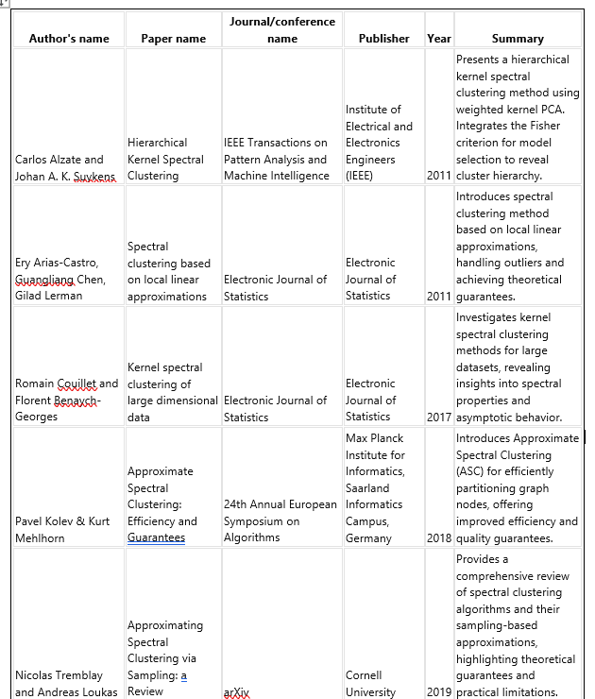
Literature review

Slide 8
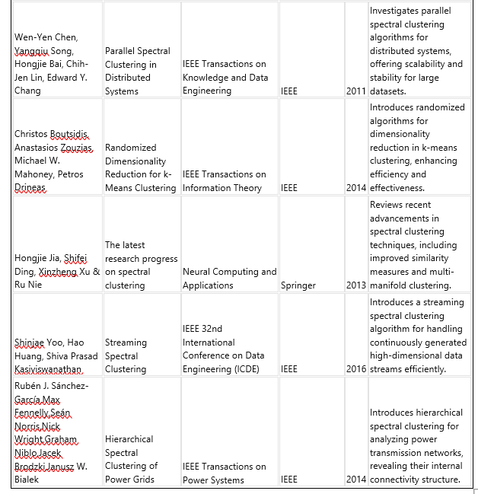
Literature review

Slide 9
Method Adopted
Data Collection and Preprocessing :Data Loading
Preprocessing Pipeline
Sampling Techniques Implementation
Cluster-Based Sampling (CBS)
Density-Based Sampling (DBS)
Ensamble of Both Techniques
Clustering Pipeline Setup : Pipeline Configuration
Hyperparameter Tuning
Optimization

Slide 10
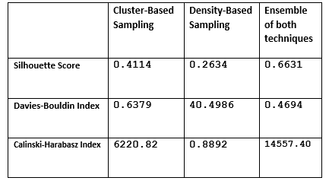
Results
The proposed ensemble method was evaluated using real-world datasets to assess its effectiveness in improving the scalability and quality of spectral clustering. The results demonstrate significant improvements in both clustering quality metrics and scalability.
The results validate the effectiveness of the proposed ensemble approach in addressing the scalability issues of traditional spectral clustering methods. By combining cluster-based and density-based sampling techniques, the ensemble method enhances both the quality and efficiency of clustering, making it a valuable tool for modern data analytics.

Slide 11
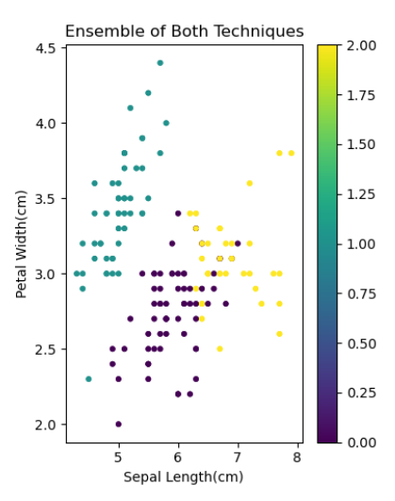
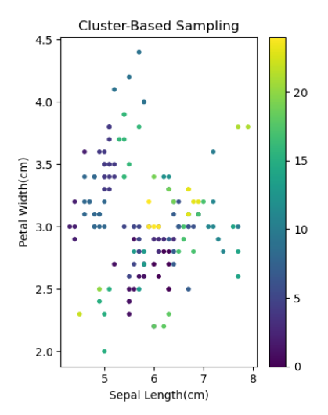
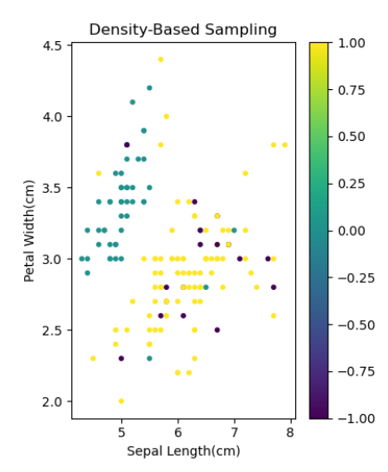
Results
Overall Performance: The ensemble method outperformed individual sampling techniques in all evaluated metrics, demonstrating superior clustering quality and scalability.
Scalability: The ensemble method maintained high performance on larger datasets, validating its effectiveness for real-world applications requiring fast and efficient data analysis.

Slide 12
Conclusion
In conclusion, our research presents an innovative ensemble approach aimed at addressing the scalability and quality limitations of spectral clustering algorithms. By integrating intelligent sampling methods, we achieve notable enhancements in clustering quality, interpretability of results, and robustness to noise and outliers. This ensemble method offers practical utility in real-time applications and facilitates informed decision-making across diverse domains, spanning from image processing to social network analysis. Our study underscores the importance of ongoing innovation in scalable data analytics methodologies to meet the challenges posed by increasingly large and complex datasets. The demonstrated improvements in spectral clustering scalability and quality highlight the potential of our approach to advance data-driven decision-making and knowledge discovery. Looking ahead, further research and development in this area hold the promise of even greater advancements in scalable data analytics and decision support systems, enabling more efficient and effective analysis of complex datasets in various domains.

Slide 13
future work of scope
Develop an Ensemble Sampling Method
Improve Scalability of Spectral Clustering
Comprehensive Methodology Implementation
Maintain or Enhance Clustering Quality
Conduct Extensive ExpOptimization of Sampling Methods
Integration with Deep Learning Techniques
Exploration of Hybrid Approaches
Evaluation on Benchmark Datasets
Investigation of Scalability Limitseriments and Analysis
Provide Visualization and Spatial Analysis
Evaluate Performance and Scalability Metrics
Development of Distributed Algorithms

Slide 14
Outcomes
Understand spectral clustering, sampling, scalability
Identify gaps, challenges, opportunities.
Inform research objectives, solutions.
Guide methodology selection, innovation.
Contribute to advancements, knowledge.
Synthesize existing knowledge, findings.
Evaluate methodologies, approaches, limitations.
Illuminate areas for innovation, exploration.
Provide context, background for research.
Analyze literature for critical insights.
Recognize shortcomings, potential improvements.
Direct research focus, methodology development.
Enhance understanding, inform decisions.
Drive progress, contribute to field.
Provide context, background for research.
Foster interdisciplinary understanding, collaboration.
Inspire novel research directions.
Strengthen theoretical underpinnings.

Slide 15
References
[1] C. ALZATE AND J. A. K. SUYKENS, "HIERARCHICAL KERNEL SPECTRAL CLUSTERING," IEEE TRANS. PATTERN ANAL. MACH. INTELL., VOL. 33, NO. 8, PP. 1521-1532, OCT. 2011, IEEE.
[2] E. ARIAS-CASTRO, G. CHEN, AND G. LERMAN, "SPECTRAL CLUSTERING BASED ON LOCAL LINEAR APPROXIMATIONS," ELECTRON. J. STATIST., VOL. 5, PP. 1558-1583, 2011, ELECTRONIC JOURNAL OF STATISTICS.
[3] R. COUILLET AND F. BENAYCH-GEORGES, "KERNEL SPECTRAL CLUSTERING OF LARGE DIMENSIONAL DATA," ELECTRON. J. STATIST., VOL. 11, NO. 2, PP. 4011-4049, 2017, ELECTRONIC JOURNAL OF STATISTICS.
[4] J. E. CAMPOS, C. DE JESUS, H. OMBAO, AND J. ORTEGA, "THE HIERARCHICAL SPECTRAL MERGER ALGORITHM: A NEW TIME SERIES CLUSTERING PROCEDURE," J. CLASSIFICATION, VOL. 33, NO. 1, PP. 139-166, 2016, SPRINGER NATURE.
[5] W.-Y. CHEN ET AL., "PARALLEL SPECTRAL CLUSTERING IN DISTRIBUTED SYSTEMS," IEEE TRANS. KNOWL. DATA ENG., VOL. 23, NO. 3, PP. 419-431, MAR. 2011, IEEE.
[6]C. BOUTSIDIS ET AL.,"RANDOMIZED DIMENSIONALITY REDUCTION FOR KMEANS CLUSTERING," IEEE TRANS. INF. THEORY, VOL. 60, NO. 9, PP. 4710- 4724, SEP. 2014, IEEE.
[7] R. J. SÁNCHEZ-GARCÍA ET AL., "HIERARCHICAL SPECTRAL CLUSTERING OF POWER GRIDS," IEEE TRANS. POWER SYST., VOL. 29, NO. 5, PP. 2501-2511, SEP. 2014, IEEE.
[8] H. JIA ET AL., "THE LATEST RESEARCH PROGRESS ON SPECTRAL CLUSTERING," NEURAL COMPUT. APPL., VOL. 23, NO. 7-8, PP. 2039-2050, NOV. 2013, SPRINGER
[9] O. BACHEM ET AL., "PRACTICAL CORESET CONSTRUCTIONS FOR MACHINE LEARNING," ARXIV:1703.06476 [STAT], MAR. 2017, ARXIV: 1703.06476.
[10] B. BAHMANI ET AL., "SCALABLE K-MEANS++," PROC. VLDB ENDOW., VOL. 5, NO. 7, PP. 622–633, MAR. 2012.
[11] Z. BAI ET AL., "TEMPLATES FOR THE SOLUTION OF ALGEBRAIC EIGENVALUE PROBLEMS: A PRACTICAL GUIDE," SIAM, 2000.

