Slide 1
Automatic number plate recognition system
A Presentation by:
Bhumika Rupchandani (20BCP247)
Saumya Thakor (20BCP103)
Harsh Chahwala (20BCP107)

Slide 2
INTRODUCTION
Automatic Number Plate Recognition (or 'number plate recognition') is a special form of optical character recognition (OCR).
It enables computer systems to read automatically the registration number (license number) of vehicles from digital pictures.
Reading automatically the registration number means transforming the pixels of the digital image into the ASCII text of the number plate.
OCR technology scans paper documents and turn them into electronic, editable files.
Capturing of fast moving vehicles needs special technique to avoid motion blur . To ensure the right image quality short shutter time is used with high-power illumination.

Slide 3
The best illumination is the IR, because the retro-reflective plates reflect this kind of light and it is undetectable for the human eye.
This combination works fine during day and night and provides constant good image quality.
Only dedicated ANPR cameras meet these requirements, which provide flexible shutter control with built-in IR flash and able to catch the vehicles up to 250km/h which is suitable for all kind of license plate reading applications.

Slide 4
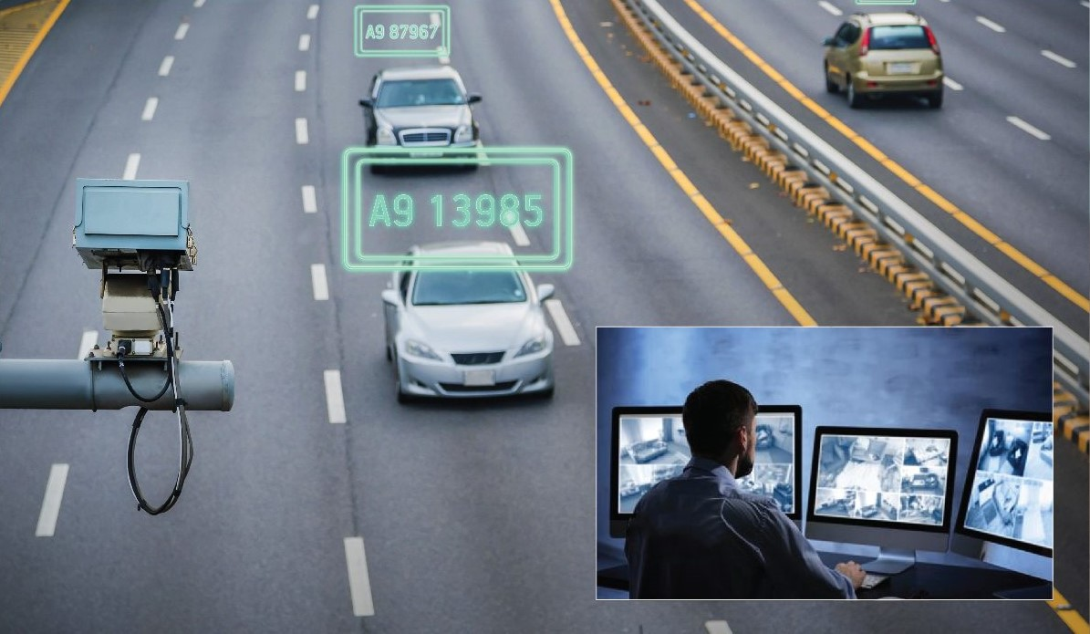

Slide 5
HOW TO BUILD ANPR SYSTEMS ?
ANPR has two technological issues:
The quality of license plate recognition software with its applied recognition algorithms, and
The quality of image acquisition technology, the camera and the illumination.
The very key factor is the number plate recognition software.
A sophistication recognition software should have following features
the highest recognition accuracy
the fastest processing speed
the most type of number plates it can handle,
the widest range of picture quality it can handle.

Slide 6
The key technological parts of an ANPR system:
high accuracy Optical Character Recognition (OCR) – is an essential requirement
technology image acquisition technology - determines the average image quality the number plate recognition algorithm has to work on.

Slide 7
Techniques involved
There are several techniques for automatic number plate detection, including template matching, edge detection, and feature-based methods.
Template matching involves comparing the captured image with a pre-defined template of the number plate.
Edge detection involves detecting the edges of the number plate using techniques such as Canny edge detection.
Feature-based methods involve extracting features such as color, texture, and shape for recognition.
The recognition can also be done using optical character recognition (OCR) techniques which involves the use of machine learning algorithms to recognize characters based on their features.

Slide 8
APPLICATIONS OF ANPR
Parking management
Access Control
Motorway Road Tolling
Border Control
Journey Time Measurement
Law Enforcement

Slide 9
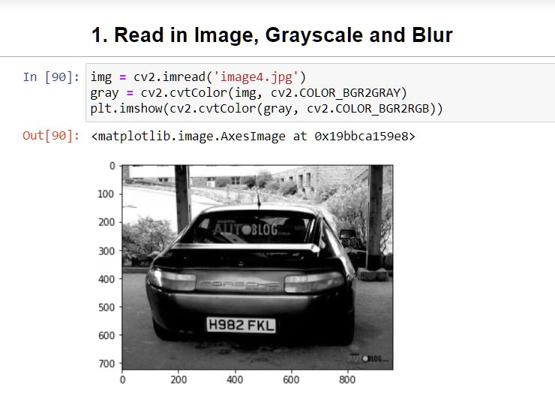
Implementation

Slide 10
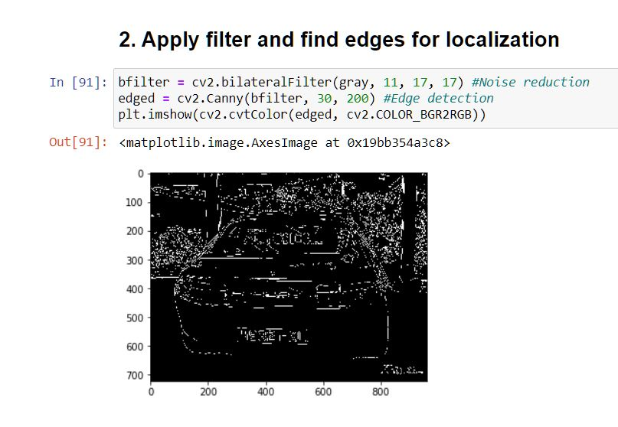

Slide 11
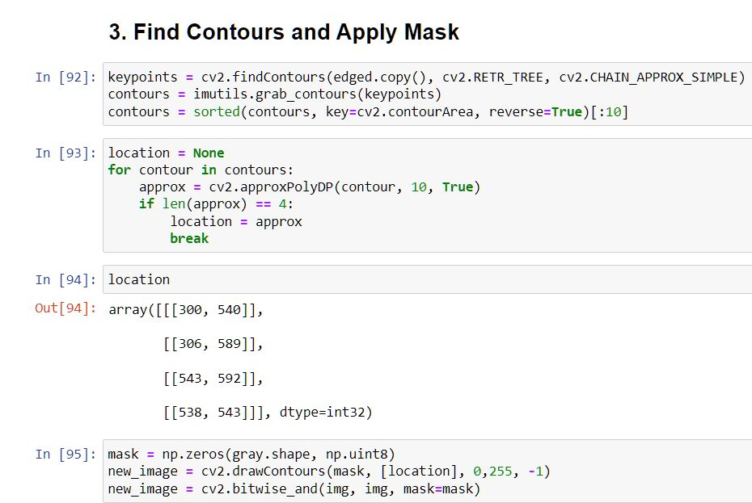

Slide 12
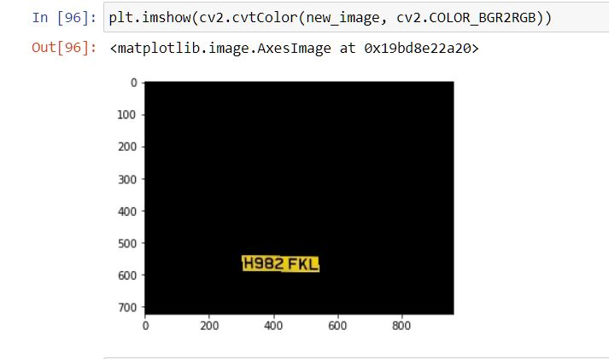
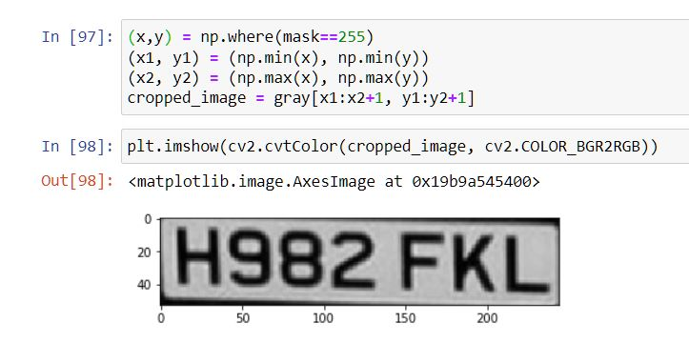

Slide 13
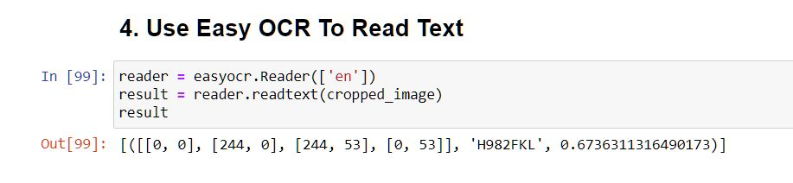
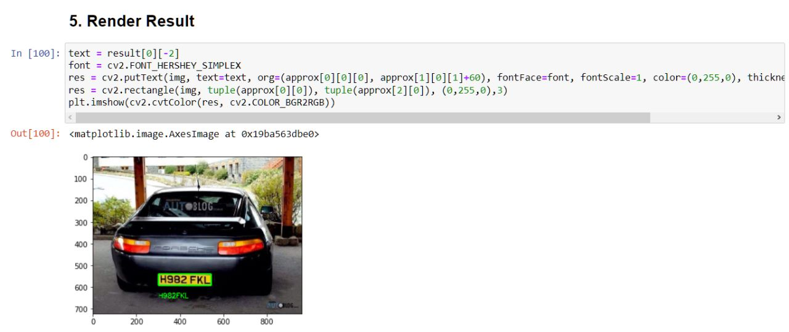

Slide 14
THANK YOU

