Slide 1
Restaurant Rating Prediction
- SAUMYA MISHRA
1

Slide 2
Introduction
2
Bengaluru Whenever we go for a food application to order some the 1st thing that comes to our mind is that we order food where we get quality food. To accomplish that, whether the restaurant can provide quality food or not, is we first look for the restaurant rating and what other customers have mentioned about the restaurant food. Bengaluru is the IT capital of India. Most of the people here are dependent mainly on the restaurant food as they don’t have time to cook for themselves. With such an overwhelming demand for restaurants, studying the demography of a location has become important. In the world of rising new technology and innovation, the industry is advancing with the role of Artificial Intelligence. Machine learning algorithms can help early detection of the disease and improve the quality of life. This study demonstrates how different Regression algorithms can forecast the rating of restaurants so that one user can make a real decision whether to buy food from the restaurant or not as per their ratings. Different regression algorithms such as Decision Tree, Linear Regression, Random forest, etc have been tested and compared to predict the better outcome of the model.

Slide 3
Objective
3
The Restaurant Rating Prediction is a machine learning based model which will help us to predict the rating of the restaurant in Bangalore. The dataset also contains reviews for each of the restaurant which will help in finding overall rating for the place.
The main goal of this project is to perform exploratory data analysis and later predict the rating of the restaurant.

Slide 4
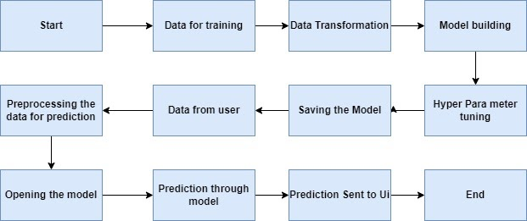
Architecture
4

Slide 5
Dataset
5
url
listed_in(type)
book_table
menu_item
Address
reviews
listed_in(city)
name
approx._cost(for two people
Restaurant Rating Prediction
Online Order
cuisines
rate
phone
dished_liked
votes:
Location
Rest_type

Slide 6
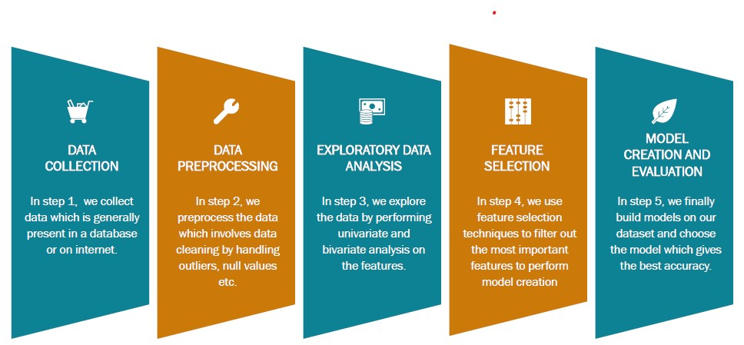
Data Analysis
6

Slide 7
Random Forest Regressor
7
INTRODUCTION
◆ A random forest is a meta estimator that fits a number of classifying decision trees on various sub-samples of the dataset and uses averaging to improve the predictive accuracy and control over-fitting.
◆ Random Forest is an ensemble technique capable of performing both regression and classification tasks with the use of multiple decision trees and a technique called Bootstrap and Aggregation, commonly known as bagging.
◆ Random Forest has multiple decision trees as base learning models. We randomly perform row sampling and feature sampling from the dataset forming sample datasets for every model. This part is called Bootstrap..
It gives us high accuracy as 90%.

Slide 8
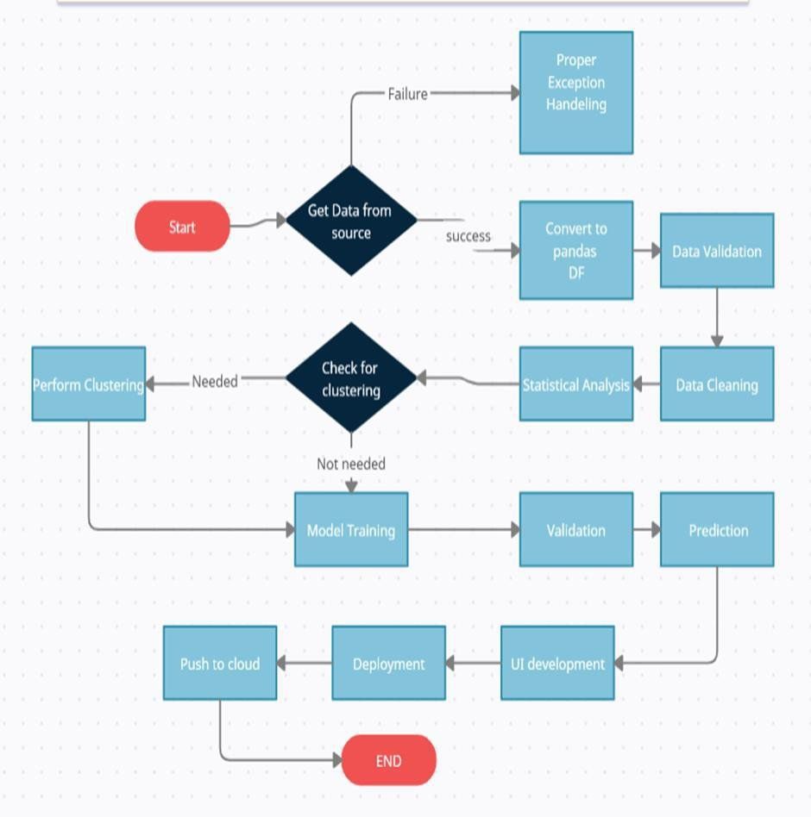
MODEL TRAINING AND VALIDATION WORKFLOW
8

Slide 9
MODEL TRAINING AND VALIDATION WORKFLOW
9
Data Collection
◆ Zomato Restaurant Data Set from Kaggle.
Data Pre-processing
◆ Missing values handling by Simple imputation (median strategy)
◆ Outliers' detection and removal by boxplot and percentile methods
◆ Categorical features handling by ordinal encoding and label
encoding

Slide 10
MODEL TRAINING AND VALIDATION WORKFLOW
10
Model Creation and Evaluation
◆ Various classification algorithms like Linear Regression, Random Forest, Decision Tree tested.
◆ Random Forest, Decision Tree and Linear regression were given less results as comparison to Extra tree regressor that what it has been chosen for the final model training and testing.
◆ Hyper parameter tuning was performed.
◆ Model performance evaluated based on r2 Score using Cross validation technique.

Slide 11

DEPLOYMENT
11
Model Deployment
◆ The final model is deployed using on AWS using Flask framework

Slide 12
FAQs
12
Q1. What was type of data?
◆ It was a combination of numerical and categorical data.
Q2. How did you manage the null values in the dataset?
◆ Used dropna() attribute. Refer to code for better understanding.
Q3. What was the complete flow you followed in this project?
◆ Please refer to slide 4 for better understanding.
Q4. What were the techniques used for data pre-processing?
◆ Removing unwanted attributes.

Slide 13
◆ Dropping null values.
13
◆ Removing outliers.
◆ Visualizing relation between independent variables and dependent variables.
◆ Converting categorical data into numeric values.
Q5. How did you train your model?
◆ Firstly, correlation was found among different variables.
◆ Then dataset was split into training and test size and different ML algorithms were used.
◆ Linear Regression, Decision Tree, Random Forest , Extra tree regressor were used among which Extra tree regressor gave the highest accuracy.

Slide 14
Q6. What was the accuracy of the best model observed?
14
◆ Random Forest Regressor showed the highest accuracy of 90% approx.
Q7. What challenges came up during the deployment of the model?
◆ An error in requirements.txt file can cause deployment failure.
◆ Requirement of correct and compatible versions of certain python libraries should be met.
◆ Cloning of Git repository should be done carefully. Use Git-LFS for files greater than 100mb.

Slide 15

Thank You
15

