Slide 1

MFAI PROJECT_PPT FOR END SEMESTER ASSESSMENT- APRIL-26
NeuroScan AI – Brain Tumour Detection System
Div:- AIDS B EDAI_GROUP No:- 07 Day:-Monday Date:- 18/5/26
Presented By :
1) Teesha Madan (12411254)
2) Satyam Kumar(12413236)
3) Saumya Dhorje(12414484)
4) Ananya Gaikwad (12414480)
Project Guide :
Prof. Shital Dongre
DEPARTMENT OF ARTIFICIAL INTELLIGENCE AND DATA SCIENCE (AIDS)
VISHWAKARMA INSTITUTE OF TECHNOLOGY, PUNE

Slide 2
PROBLEM STATEMENT
Brain tumor detection through MRI analysis is complex and time-consuming.
Manual diagnosis depends heavily on radiologist expertise.
MRI scans often contain noise and low contrast, making tumor identification difficult.
There is a need for an automated system that can:
enhance MRI images
detect tumor regions
and classify scans accurately using AI and image processing
Notes:
“When we looked at existing research, we found that most work depends on large models or focuses on just one technique at a time.
Very little research explores small-model pipelines, even though they are more practical for real-world deployment.
And structured JSON extraction from varied resumes — especially medical resumes — is still an underexplored area.
So the key gap we address is this:
How can we achieve accurate, consistent, and valid JSON extraction using a small, domain-specific language model across highly varied resume formats?
Our project attempts to fill exactly this gap.”

Slide 3
INTRODUCTION
NeuroScan AI is an intelligent MRI-based brain tumour detection system.
Uses image processing and machine learning for accurate diagnosis.
Enhances MRI scans to improve tumour visibility.
Detects suspicious tumour regions automatically.
Provides real-time prediction through a Flask-based web application.
Designed to support radiologists with faster and more reliable analysis.
Notes:
Resumes come in all kinds of formats — neat, messy, creative, or completely unstructured. A recruiter still needs to extract the same key details: name, email, skills, and experience. Our goal is to build a model that acts like a smart recruiter and converts any resume into a clean JSON format.
Instead of relying on a massive LLM, we trained a Small Language Model (SLM) specifically for this extraction task. SLMs are faster, cheaper, and much easier to deploy while still achieving high accuracy on domain-focused tasks when trained properly.
To understand this fully, we evaluated six techniques — Few-shot Prompting, LoRA Fine-tuning, Curriculum Learning, Constraint Decoding, Synthetic Augmentation, and our proposed Hybrid ERR method — on both general and medical resumes.

Slide 4
OBJECTIVES
Enhance MRI image quality using image processing techniques.
Remove noise and improve tumor visibility.
Segment suspicious tumor regions accurately.
Extract statistical and texture-based features.
Classify MRI scans as Tumor / No Tumor using Machine Learning.
Develop an interactive web-based detection system.
Notes:
The main problem we identified is that resumes are highly unstructured, and extracting clean, consistent JSON information is very difficult for small language models.They struggle with:
Inconsistent formatting – sometimes skills come before experience, sometimes after.
2. Broken JSON outputs – brackets missing, quotes missing, structure incorrect.
3. Domain-specific resumes – especially medical resumes with technical terms.
4. Few-shot prompting inconsistency – outputs change every time, not reliable.
5. Lack of a model that works well on CPU with low resources.So the main challenge becomes:👉 How do we convert messy, unstructured resume text into accurate structured JSON using a small model, without relying on expensive large language models?This challenge motivated our entire study.

Slide 5
METHODOLOGY
MRI image acquisition
2. Grayscale conversion & resizing
3. Histogram Equalization & Contrast Stretching
4. Median Filter & Gaussian Blur
5. Image Sharpening
6. Tumour Segmentation
7. Feature Extraction (GLCM + Statistical Features)
8. Random Forest Classification9. Result Visualization on Web Interface

Slide 6
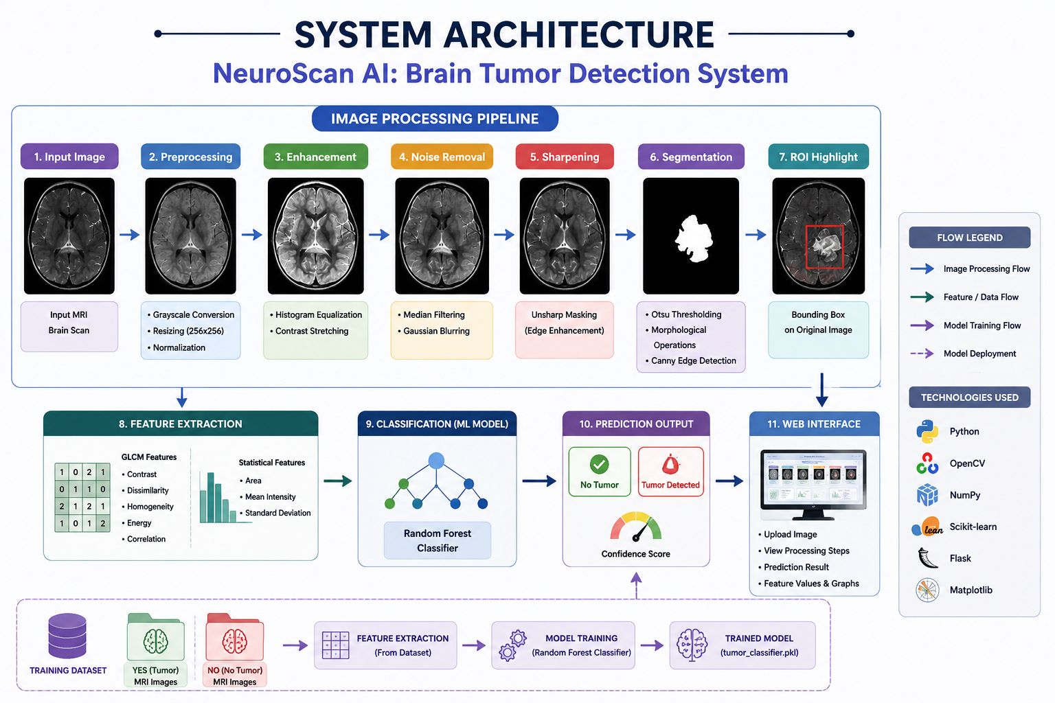
SYSTEM ARCHITECTURE

Slide 7
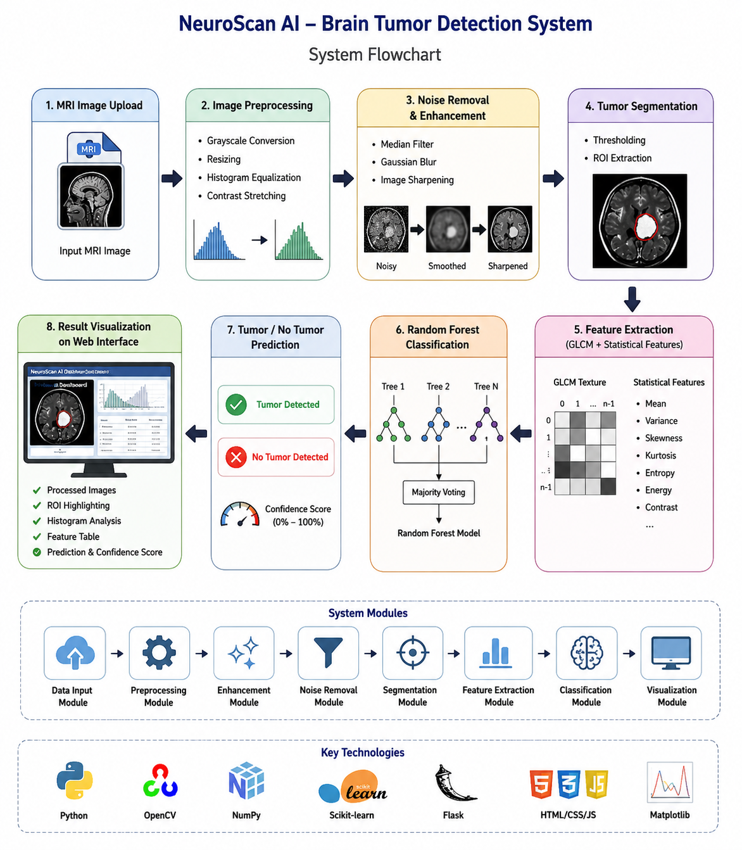
FLOWCHART

Slide 8
FUTURE SCOPE
Integration of Deep Learning models (CNN/U-Net)
Multi-class tumor classification
3D MRI analysis
Cloud deployment for hospitals
Real-time diagnostic assistance
Larger medical datasets for improved accuracy

Slide 9
Research Gap
Limitations of Existing Systems
Manual MRI analysis is time-consuming.
Requires highly experienced radiologists.
Many systems have high computational complexity.
Existing methods often lack visualization and explainability.
Some models focus only on classification without proper image enhancement.
Proposed Improvement
Lightweight and interactive detection system.
Combines image enhancement, segmentation, and ML classification.
Provides visual outputs and ROI highlighting.
Faster and more explainable predictions through Flask dashboard.

Slide 10
TECHNOLOGY STACK
Technology Purpose
Python Core development
OpenCV Image processing
NumPy Numerical operations
Scikit-learn Machine learning
Flask Web framework
HTML/CSS/JS Frontend UI
Matplotlib Graphs & histograms
Notes:
Few-Shot Prompting - this works on the prompting
LoRA - it trains small extra layers of model
Curriculum Learning - in this we increase difficulty level gradually
Constraints-Based Decoding - in this we give constraints to output
Synthetic Data Augmentation - in this we provide extra training data Last one is Hybrid-

Slide 11
CONCLUSION
Developed an AI-based brain tumor detection system using MRI scans.
Applied image enhancement, segmentation, and feature extraction techniques.
Used Random Forest classifier for accurate prediction.
Achieved approximately 94% classification accuracy.
Successfully deployed an interactive Flask-based web application for visualization and analysis.
Notes:
This project compared five techniques—Few-shot prompting, LoRA fine-tuning, Curriculum Learning, Constraint-based Decoding, and Synthetic Data Augmentation—using accuracy and Levenshtein distance on both general and medical resume datasets. Results showed that each method performs differently depending on data complexity and domain. We then proposed a Hybrid approach that combines candidate generation, JSON repair, schema normalization, and signal-guided reranking. Although not always the top performer, the Hybrid method improves reliability and consistency, especially for noisy or domain-specific resumes. Overall, this study highlights key trade-offs across methods and demonstrates how a multi-step pipeline can enhance resume parsing robustness.

Slide 12
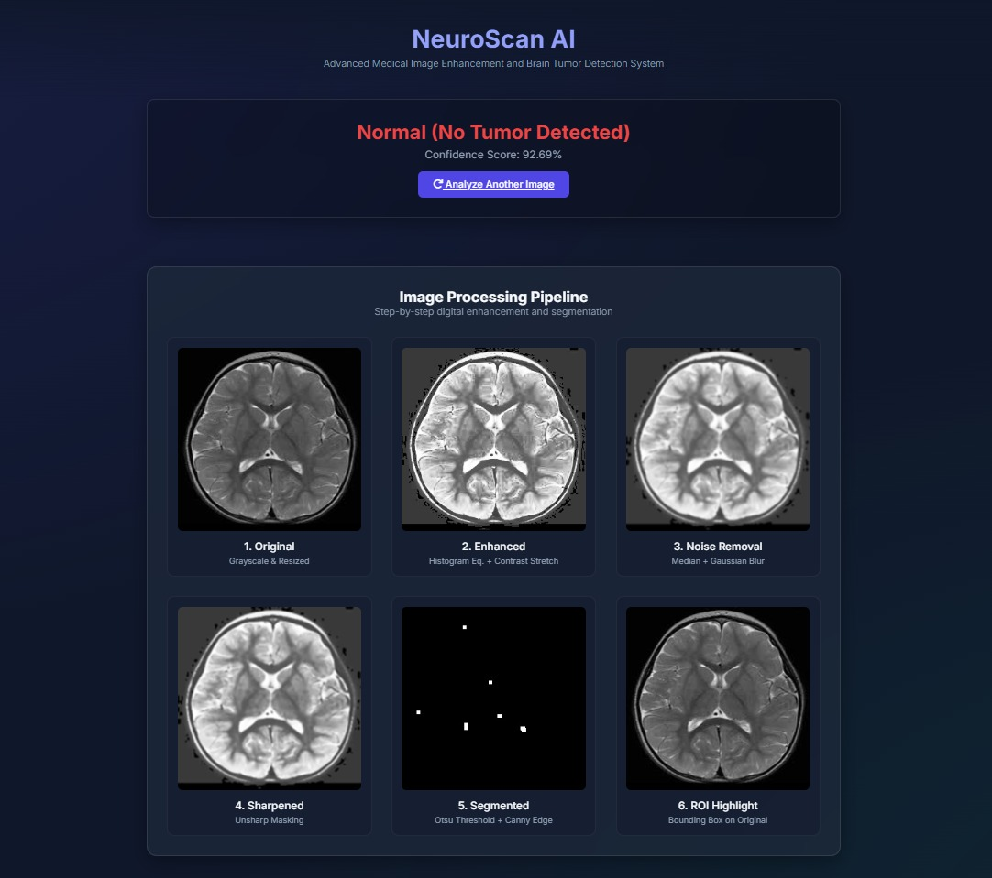
Screenshots of the project

Slide 13
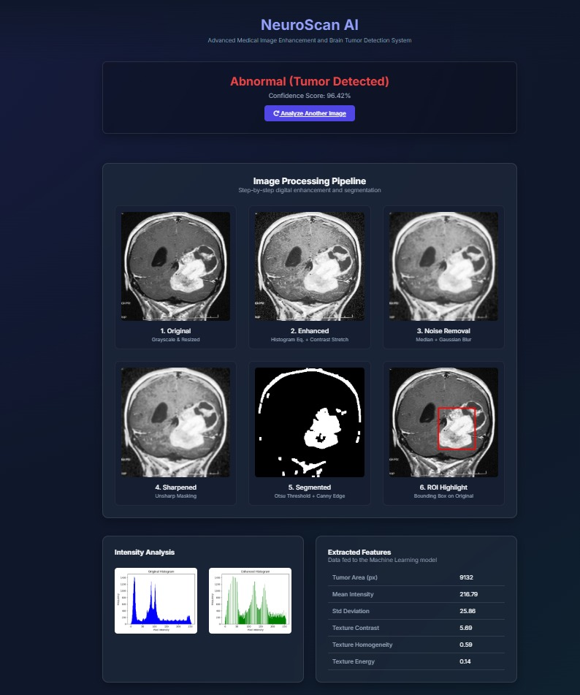
Results:
Metric | Score |
Accuracy | 94% |
Precision | 94% |
Recall | 94% |
F1-Score | 94% |
Outputs:
Successful tumor segmentation Accurate ROI detection
Real-time visualization through Flask dashboard

Slide 14
Thank You

