Slide 1
Graphs
Definitions
Examples
The Graph ADT
PVD
LAX
LAX
STL
HNL
DFW
FTL
Graphs

Slide 2
What is a Graph?
A graph G = (V,E) is composed of:
V: set of vertices
E: set of edges connecting the vertices in V
An edge e = (u,v) is a pair of vertices
Example:
a
b
V= {a,b,c,d,e}
E= {(a,b),(a,c),(a,d),
(b,e),(c,d),(c,e),
(d,e)}
c
d
e
Graphs

Slide 3
Applications
CS16
electronic circuits
find the path of least resistance to CS16
networks (roads, flights, communications)
start
PVD
LAX
LAX
STL
HNL
DFW
Graphs
FTL

Slide 4
A Spike Lee Joint Production
scheduling (project planning)
wake up
A
typical student day
eat
cs16 meditation
work
more cs16
play
cs16 program
battletris
make cookies
for cs16 HT
A
sleep
Graphs
dream of cs16

Slide 5
Graph Terminology
adjacent vertices: vertices connected by an edge
degree (of a vertex): # of adjacent vertices
NOTE: The sum of the degrees of all vertices is twice the number of edges. Why?
Since adjacent vertices each count the adjoining edge, it will be counted twice
path: sequence of vertices
v₁,v₂,. . .v_{k} such that consecutive
vertices v_{i} and v_{i+1} are adjacent.
3
2
3
3
3
a
b
a
b
c
c
d
e
d
e
a b e d c
b e d c

Slide 6
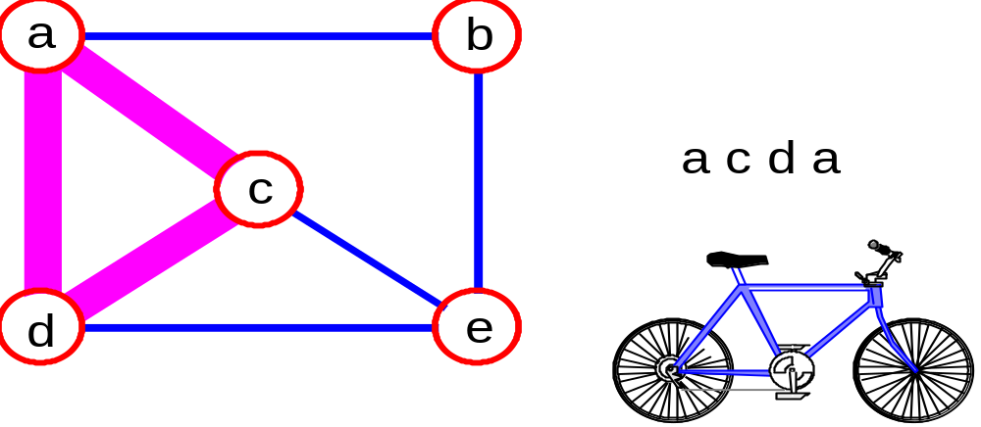
More Graph Terminology
simple path: no repeated vertices
cycle: simple path, except that the last vertex is the same as the first vertex
a
b
b e c
c
d
e
Graphs

Slide 7
Even More Terminology
connected graph: any two vertices are connected by some path
subgraph: subset of vertices and edges forming a graph
connected component: maximal connected subgraph. E.g., the graph below has 3 connected components.
connected
not connected
Graphs

Slide 8
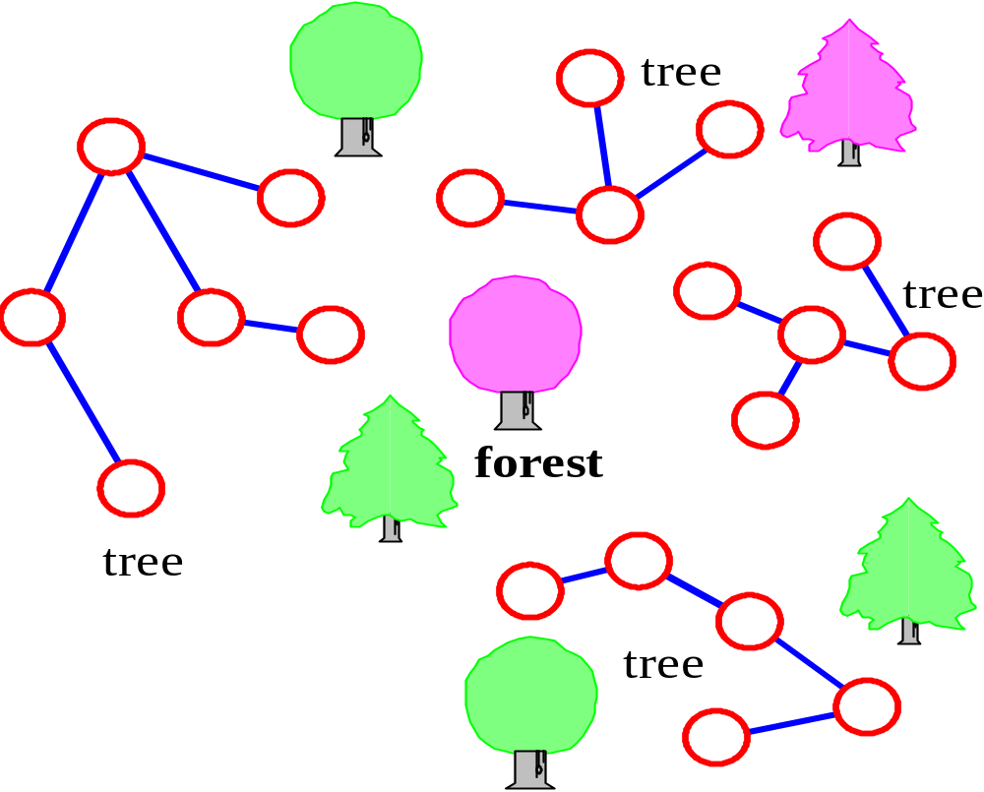
(free) tree - connected graph without cycles
forest - collection of trees
Graphs

Slide 9
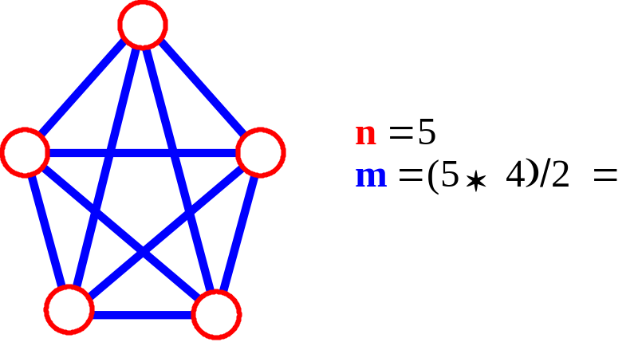
Connectivity
Let n = #vertices, and m = #edges
A complete graph: one in which all pairs of vertices are adjacent
How many total edges in a complete graph?
  Each of the n vertices is incident to n-1 edges, however, we would have counted each edge twice!!! Therefore, intuitively, m = n(n -1)/2.
Therefore, if a graph is not complete, m < n(n -1)/2
Graphs

Slide 10
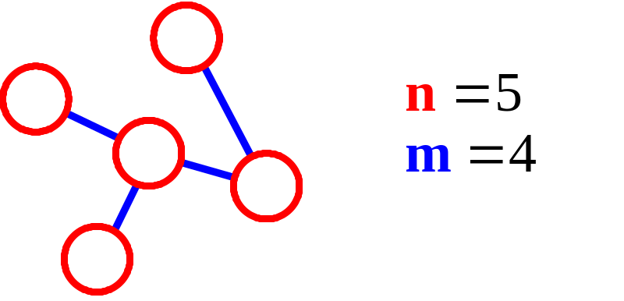
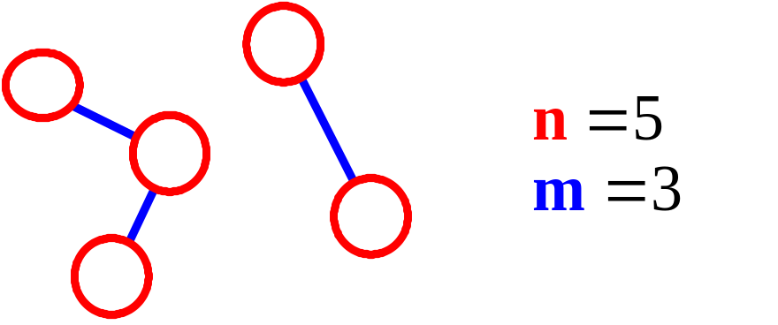
More Connectivity
n = #vertices
m = #edges
For a tree m = n - 1
If m < n - 1, G is not connected
Graphs

Slide 11
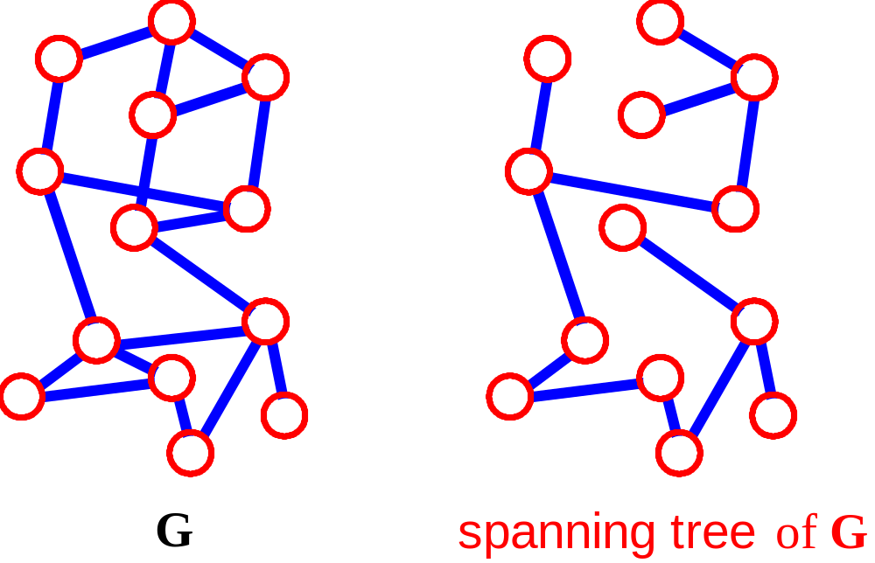
Spanning Tree
A spanning tree of G is a subgraph which is a tree and which contains all vertices of G
Failure on any edge disconnects system (least fault tolerant)
Graphs

Slide 12
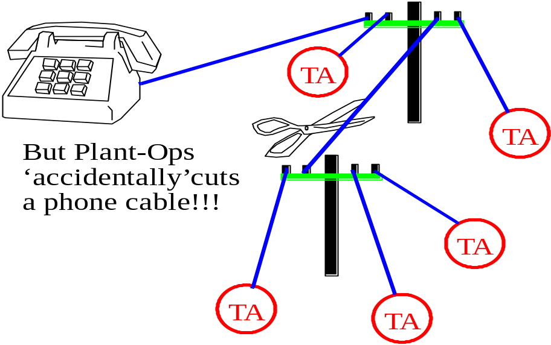
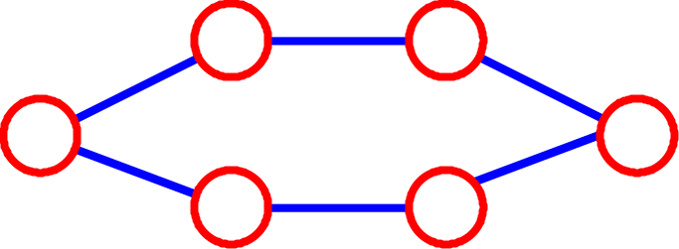
AT&T vs. RT&T
(Roberto Tamassia & Telephone)
Roberto wants to call the TA’s to suggest an extension for the next program...
In the previous graph, one fault will disconnect part of graph!!
A cycle would be more fault tolerant and only requires n edges
Graphs

Slide 13
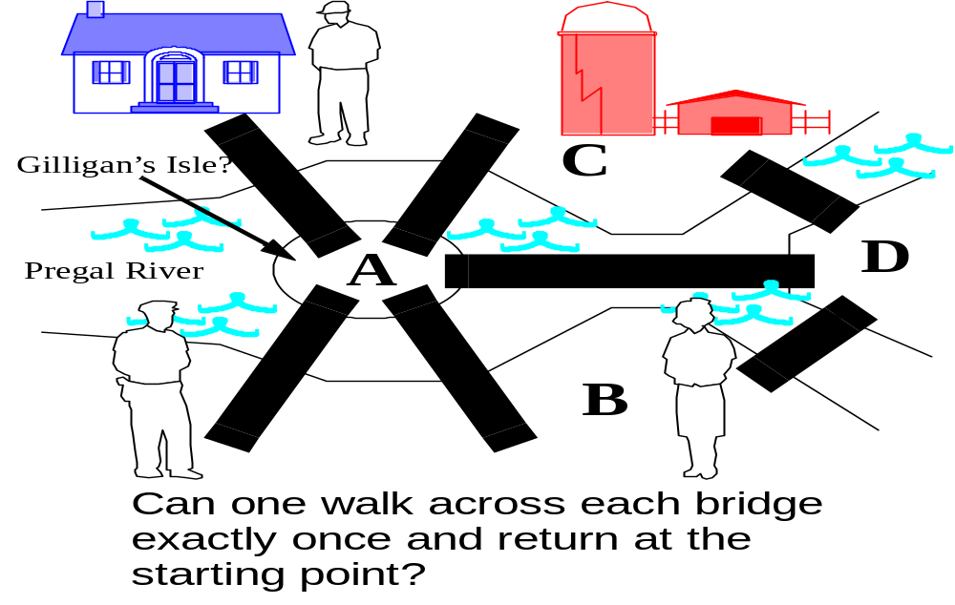
Euler and the Bridges of Koenigsberg
Consider if you were a UPS driver, and you didn’t want to retrace your steps.
In 1736, Euler proved that this is not possible
Graphs

Slide 14
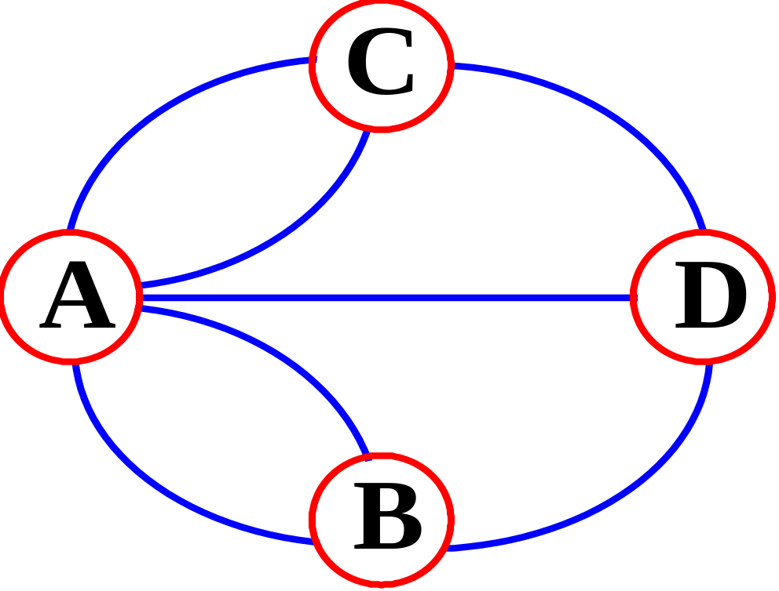
Graph Model(with parallel edges)
Eulerian Tour: path that traverses every edge exactly once and returns to the first vertex
Euler’s Theorem: A graph has a Eulerian Tour if and only if all vertices have even degree
Graphs

Slide 15
The Graph ADT
The Graph ADT is a positional container whose positions are the vertices and the edges of the graph.
  -size() Return the number of vertices plus the number of edges of G.
  -isEmpty()
  -elements()
  -positions()
  -swap()
  -replaceElement()
Notation: Graph G; Vertices v, w; Edge e; Object o
  -numVertices() Return the number of vertices of G.
  -numEdges() Return the number of edges of G.
  -vertices() Return an enumeration of the vertices of G.
  -edges() Return an enumeration of the edges of G.
Graphs

Slide 16
The Graph ADT (contd.)
-directedEdges() Return an enumeration of all directed edges in G.
-undirectedEdges() Return an enumeration of all undirected edges in G.
-incidentEdges(v) Return an enumeration of all edges incident on v.
-inIncidentEdges(v) Return an enumeration of all the incoming edges to v.
-outIncidentEdges(v) Return an enumeration of all the outgoing edges from v.
-opposite(v, e) Return an endpoint of e distinct from v
-degree(v) Return the degree of v.
-inDegree(v) Return the in-degree of v.
-outDegree(v) Return the out-degree of v.
Graphs

Slide 17
More Methods ...
-adjacentVertices(v) Return an enumeration of the vertices adjacent to v.
-inAdjacentVertices(v) Return an enumeration of the vertices adjacent to v along incoming edges.
-outAdjacentVertices(v) Return an enumeration of the vertices adjacent to v along outgoing edges.
-areAdjacent(v,w) Return whether vertices v and w are adjacent.
-endVertices(e) Return an array of size 2 storing the end vertices of e.
-origin(e) Return the end vertex from which e leaves.
-destination(e) Return the end vertex at which e arrives.
-isDirected(e) Return true iff e is directed.
Graphs

Slide 18
Update Methods
-makeUndirected(e) Set e to be an undirected edge.
-reverseDirection(e) Switch the origin and destination vertices of e.
-setDirectionFrom(e, v) Sets the direction of e away from v, one of its end vertices.
-setDirectionTo(e, v) Sets the direction of e toward v, one of its end vertices.
-insertEdge(v, w, o) Insert and return an undirected edge between v and w, storing o at this position.
-insertDirectedEdge(v, w, o) Insert and return a directed edge between v and w, storing o at this position.
-insertVertex(o) Insert and return a new (isolated) vertex storing o at this position.
-removeEdge(e) Remove edge e.

