Slide 1

Linked Lists
Linked Lists
Notes:
Sequences

Slide 2
Arrays: pluses and minuses
+ Fast element access.
-- Impossible to resize.
Many applications require resizing!
Required size not always immediately available.
Linked Lists

Slide 3
Singly Linked Lists
A singly linked list is a concrete data structure consisting of a sequence of nodes
Each node stores
  element
  link to the next node
next
elem
node
∅
A
B
C
D
Linked Lists

Slide 4
Recursive Node Class
public class Node {
// Instance variables:
private Object element;
private Node next;
/** Creates a node with null references to its element and next node. */
public Node() {
this(null, null);
}
/** Creates a node with the given element and next node. */
public Node(Object e, Node n) {
element = e;
next = n;
}
// Accessor methods:
public Object getElement() {
return element;
}
public Node getNext() {
return next;
}
// Modifier methods:
public void setElement(Object newElem) {
element = newElem;
}
public void setNext(Node newNext) {
next = newNext;
}
}
Linked Lists

Slide 5
Singly linked list
public class SLinkedList {
protected Node head; // head node of the list
/** Default constructor that creates an empty list */
public SLinkedList() {
head = null;
}
// ... update and search methods would go here ...
}
Linked Lists

Slide 6
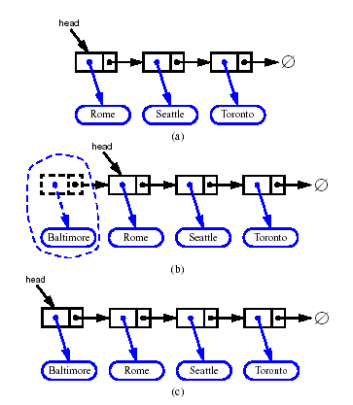
Inserting at the Head
Allocate a new node
Insert new element
Make new node point to old head
Update head to point to new node
Linked Lists

Slide 7
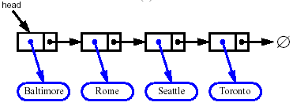


Removing at the Head
Update head to point to next node in the list
Allow garbage collector to reclaim the former first node
Linked Lists

Slide 8
Singly linked list with ‘tail’ sentinel
public class SLinkedListWithTail {
protected Node head; // head node of the list
protected Node tail; // tail node of the list
/** Default constructor that creates an empty list */
public SLinkedListWithTail() {
head = null;
tail = null;
}
// ... update and search methods would go here ...
}
Linked Lists

Slide 9
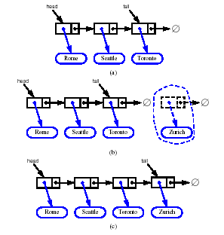
Inserting at the Tail
Allocate a new node
Insert new element
Have new node point to null
Have old last node point to new node
Update tail to point to new node
Linked Lists

Slide 10
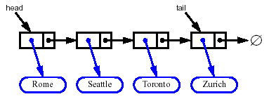
Removing at the Tail
Removing at the tail of a singly linked list cannot be efficient!
There is no constant-time way to update the tail to point to the previous node
Linked Lists

Slide 11




Doubly Linked List
A doubly linked list is often more convenient!
Nodes store:
  element
  link to the previous node
  link to the next node
Special trailer and header nodes
prev
next
elem
node
header
nodes/positions
trailer
elements
Linked Lists

Slide 12
Insertion
We visualize operation insertAfter(p, X), which returns position q
p
A
B
C
p
A
B
q
C
X
p
q
A
B
X
C
Linked Lists

Slide 13
Insertion Algorithm
Algorithm insertAfter(p,e):
Create a new node v
v.setElement(e)
v.setPrev(p) {link v to its predecessor}
v.setNext(p.getNext()) {link v to its successor}
(p.getNext()).setPrev(v) {link p’s old successor to v}
p.setNext(v) {link p to its new successor, v}
return v {the position for the element e}
Linked Lists

Slide 14
Deletion
We visualize remove(p), where p == last()
p
A
B
C
D
A
B
C
p
D
A
B
C
Linked Lists

Slide 15
Deletion Algorithm
Algorithm remove(p):
t = p.element {a temporary variable to hold the return value}
(p.getPrev()).setNext(p.getNext()) {linking out p}
(p.getNext()).setPrev(p.getPrev())
p.setPrev(null) {invalidating the position p}
p.setNext(null)
return t
Linked Lists

Slide 16
Worst-cast running time
In a doubly linked list
  + insertion at head or tail is in O(1)
  + deletion at either end is on O(1)
  -- element access is still in O(n)
Linked Lists

