Slide 1
DATAVIZ IN R | CASE STUDY
Intermediate Submission, 6. Dec 2020
Group 48
Nadija Borovina
Nedžad Hadžiosmanović
Saumya Goyal
Felix Eschmann

Slide 2
OUR APPROACH
1 | Tidying the data
split datasets between group members
created master-script with all adaptations
2 | Merging the data
merged various tables to create new ones
discussed possible relations between data
3 | Making claims
set up separate claims with diagrams
aligned claims to common thread
Github Repo
Weekly meetings
Chat Group
Dataviz in R WiSe 2020 - Case Study - Group 48
Notes:
add timeline with per week actions
communication & collaboration github...

Slide 3
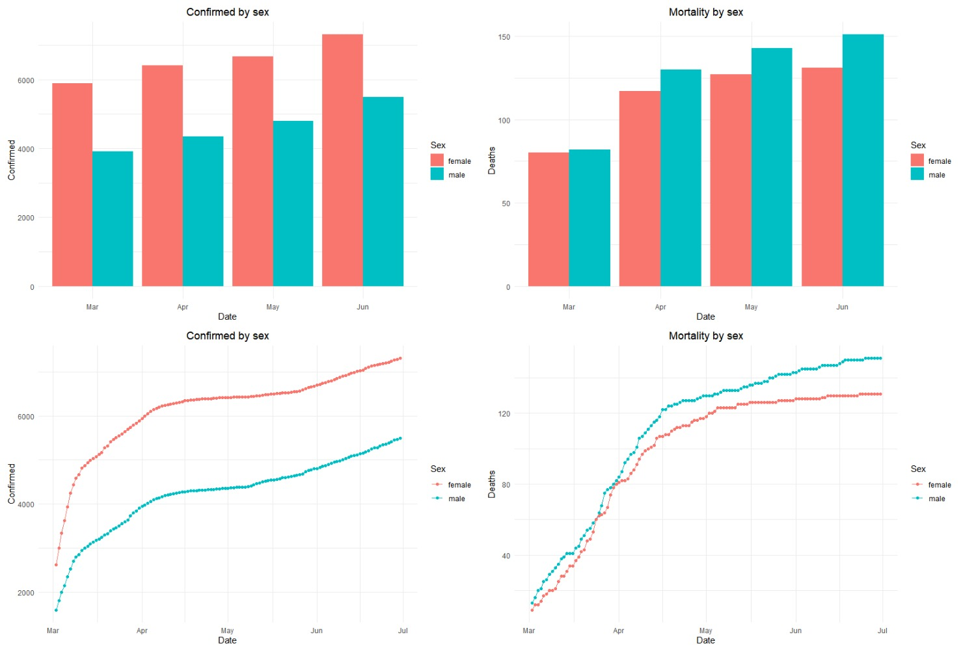
Dataviz in R WiSe 2020 - Case Study - Group 48
Notes:
data deep dive slide

Slide 4
CASES RISE EXPONENTIALLY &
MALE AND FEMALE CASE CHARACTERISTICS DIVERGE
until flattening, case numbers rise exponentially
total infection cases are higher for females, while men show a higher mortality rate
Before looking into the reasons of growth and decline of infection cases, we examine who is most affected by the virus.
Dataviz in R WiSe 2020 - Case Study - Group 48
Notes:
data deep dive slide

Slide 5
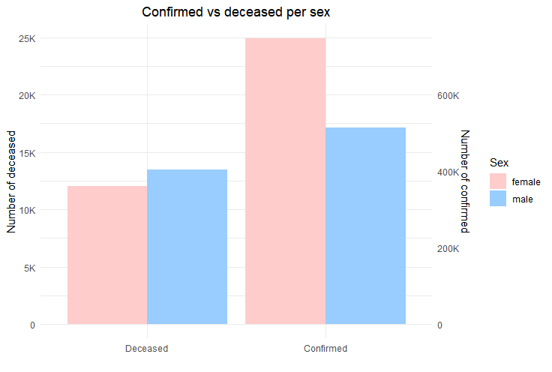
WOMEN ARE MORE OFTEN INFECTED, WHILE MEN ARE HIT HARDER.
approx. mortality for women: 1.6%
vs.
approx. mortality for men: 2.6%
diagram is scaled to give a graphic representation of confirmed vs. deceased shares between male and female
Dataviz in R WiSe 2020 - Case Study - Group 48
Notes:
data deep dive slide

Slide 6
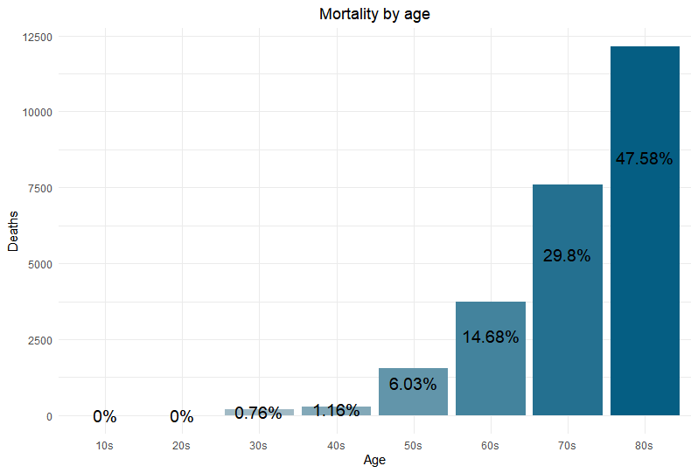
WITH GROWING AGE, MORTALITY INCREASES DRAMATICALLY.
almost 50% of deceased are 80 or above
possible explanation: severe deficiency in certain classes of immune cells that fight off infections and decline over time
Dataviz in R WiSe 2020 - Case Study - Group 48
Notes:
data deep dive slide

Slide 7
“Flatten the curve”: which factors influence infection rates?
Government policies
Weather
Population movement
Dataviz in R WiSe 2020 - Case Study - Group 48
Notes:
data deep dive slide

Slide 8
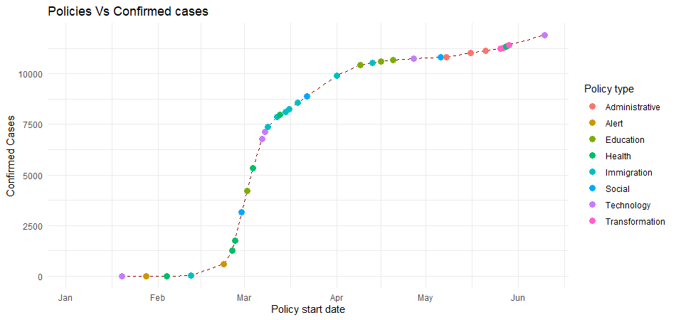
INCREASED GOVERNMENT EFFORTS SLOWED DOWN INFECTION RATES.
Education, Health, Immigration, Social and Technology policies are at the turning point of the curve, implying the strongest effects on reducing infection cases.
Dataviz in R WiSe 2020 - Case Study - Group 48
Notes:
data deep dive slide

Slide 9
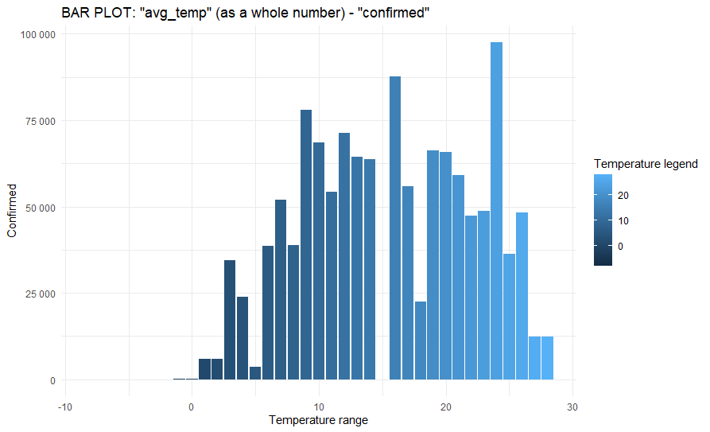
THE INFECTION GROWTH RATE SEEMS TO DECREASE WITH RISING TEMPERATURES.
temperature and number of cases seems to be correlated; however, this could be due to other third factors too
no definitive statement possible on exact influence of weather on case numbers
Dataviz in R WiSe 2020 - Case Study - Group 48
Notes:
data deep dive slide

Slide 10
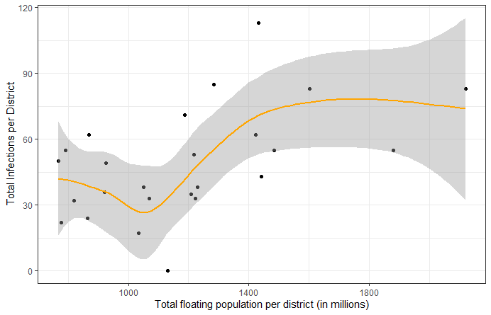
THE HIGHER THE FLOATING POPULATION, THE MORE INFECTIONS SEEM TO OCCUR.
Comparison of total infected patients per city (district) in Seoul from PatientInfo with total number of floating population from SeoulFloating
cor = 0.5 indicates that other factors influence the infection count too
Point: district of Seoul
Floating population: amount of people who spent time in a district they are not registered in
Dataviz in R WiSe 2020 - Case Study - Group 48

Slide 11
Thanks for taking part!

