Slide 1
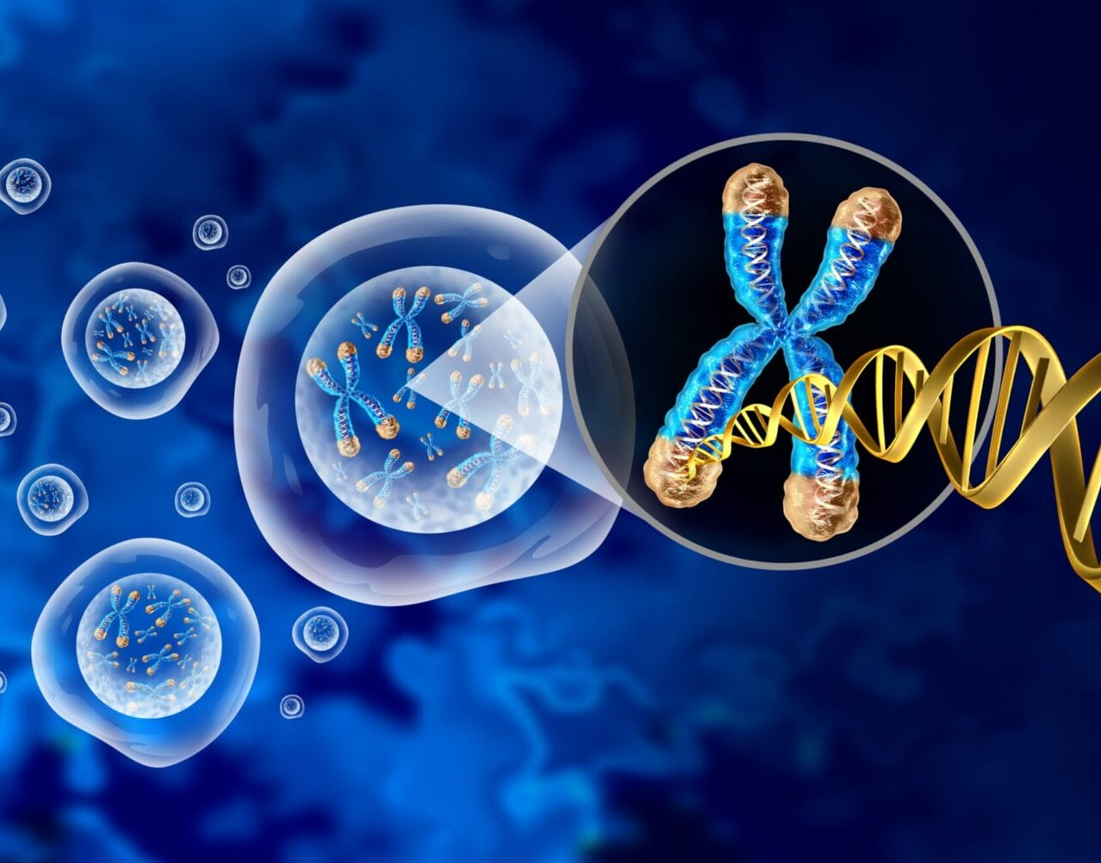
Genome Classification by ML-DSP
Submitted by:
Saumya Kumar
Ishan Sharma
Saurav Sharma
Vivek Singh Yadav
Abhay Pratap Singh
Submitted to:
Prof. Sanjeev Narayan Sharma

Slide 2
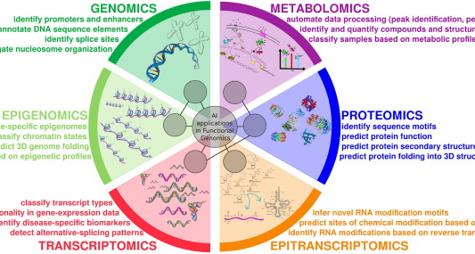
Introduction
This project investigates machine learning classification techniques by integrating traditional algorithms with advanced signal processing methods.
Genome classification is crucial for understanding biodiversity, identifying new species, and exploring evolutionary relationships.
Existing alignment-based methods are computationally expensive, especially for large datasets, and rely on homologous sequences.
ML-DSP was developed to overcome these limitations and provide a fast, scalable, and alignment-free genome classification approach.

Slide 3
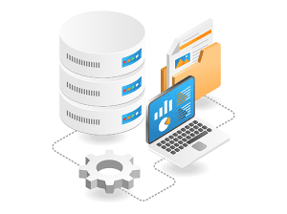
Data Collection
The datasets utilized in this project were obtained from two primary sources:
Dr. Gurjit S. Randhawa's GitHub Repository.
National Center for Biotechnology Information (NCBI):

Slide 4
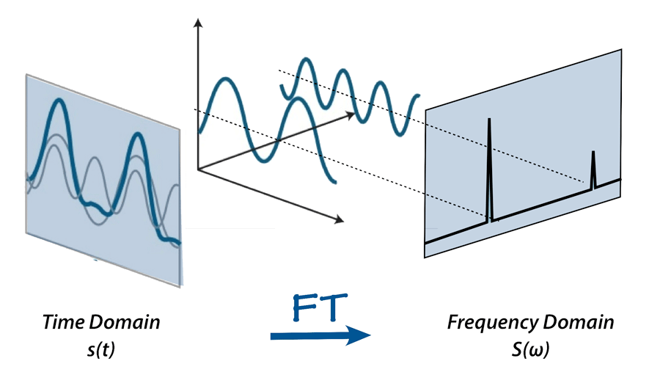
Methodology
Data Preprocessing
Efficient preprocessing ensures that the data is clean, normalized, and ready for machine learning algorithms. Key steps include:
Data Import:
Feature Scaling and Normalization
Numerical Representations of DNA:
Signal Processing with FFT

Slide 5
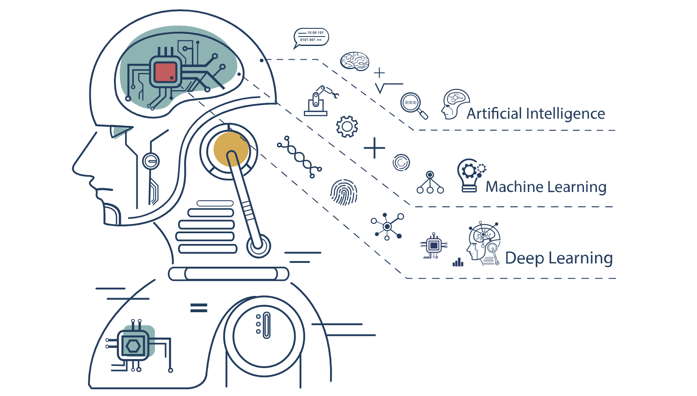
Methodology
Data Splitting
To evaluate the model's generalizability, the dataset was split into training and testing subsets:
Training Set: 80% of the data
Testing Set: 20% of the data

Slide 6
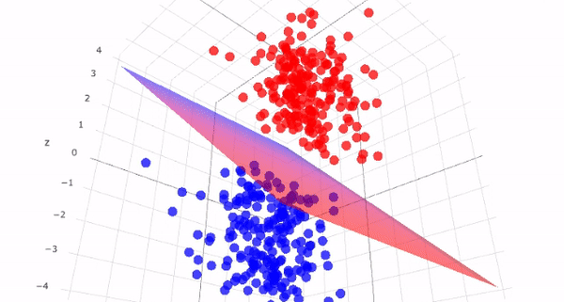
Methodology
Model Selection and Training
Logistic Regression
Support Vector Machines (SVM)

Slide 7
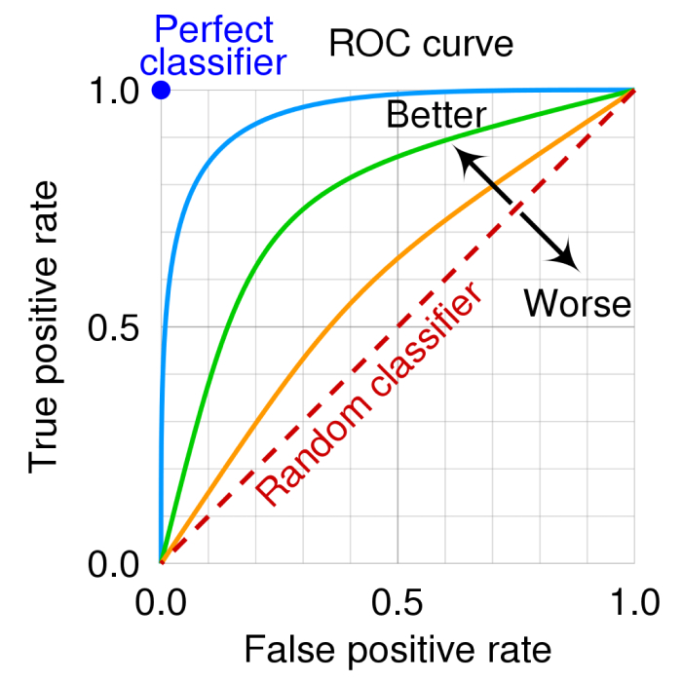
Methodology
Model Evaluation
F1-Score
Confusion Matrix
Recall
Roc Curve
Precession

Slide 8
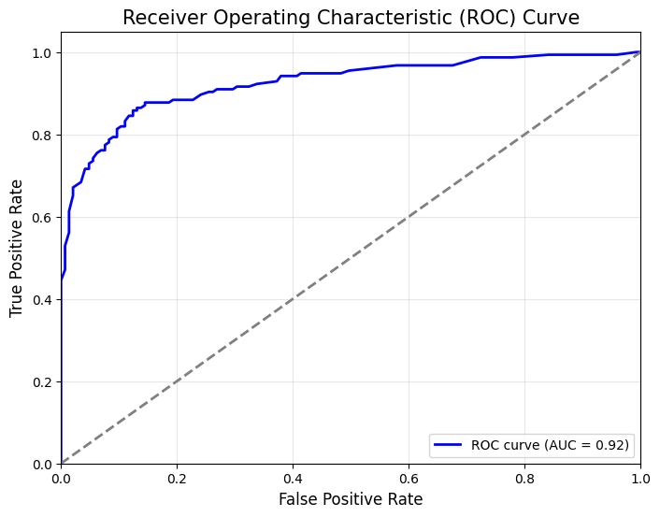
Methodology
Visualization and Analysis
Data and results were visualized using advanced plotting techniques to interpret model performance:
Matplotlib
Seaborn

Slide 9
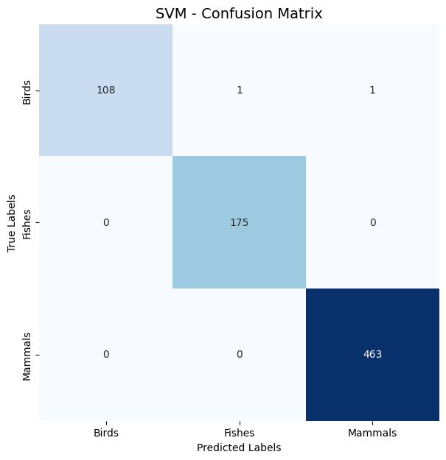
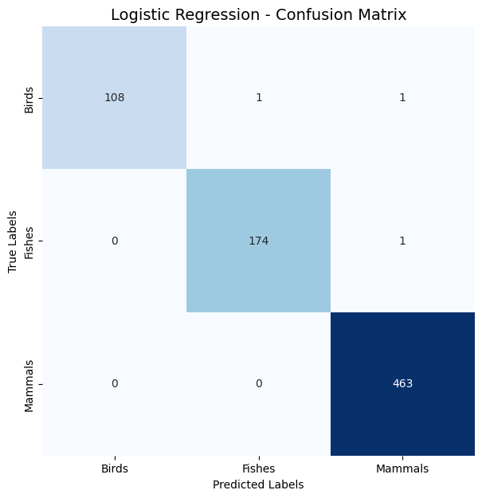
Results

Slide 10
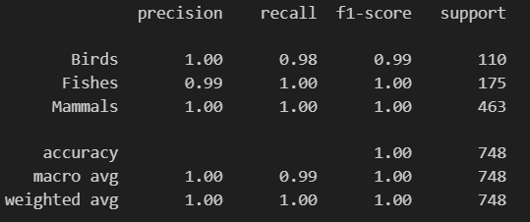
Results

Slide 11
Conclusion
SVM and Logistic Regression showed significant improvements with FFT features, while Decision Trees and KNN benefited less. This underscores the importance of choosing the right algorithm for data transformation, as some models are more sensitive to frequency-domain features than others.

Slide 12
THANK YOU!

