Slide 1

Smart City Traffic Management System
Shortest Route Finding and Interactive Traffic Navigation
Project Presentation
Presented By: Naureen, Shubham Yadav and Saumya Mihir |
Registration No.: 12502577, 12500406, 12503940 |
Submitted To: Mahipal Singh Papola, Deepak Kumar

Slide 2

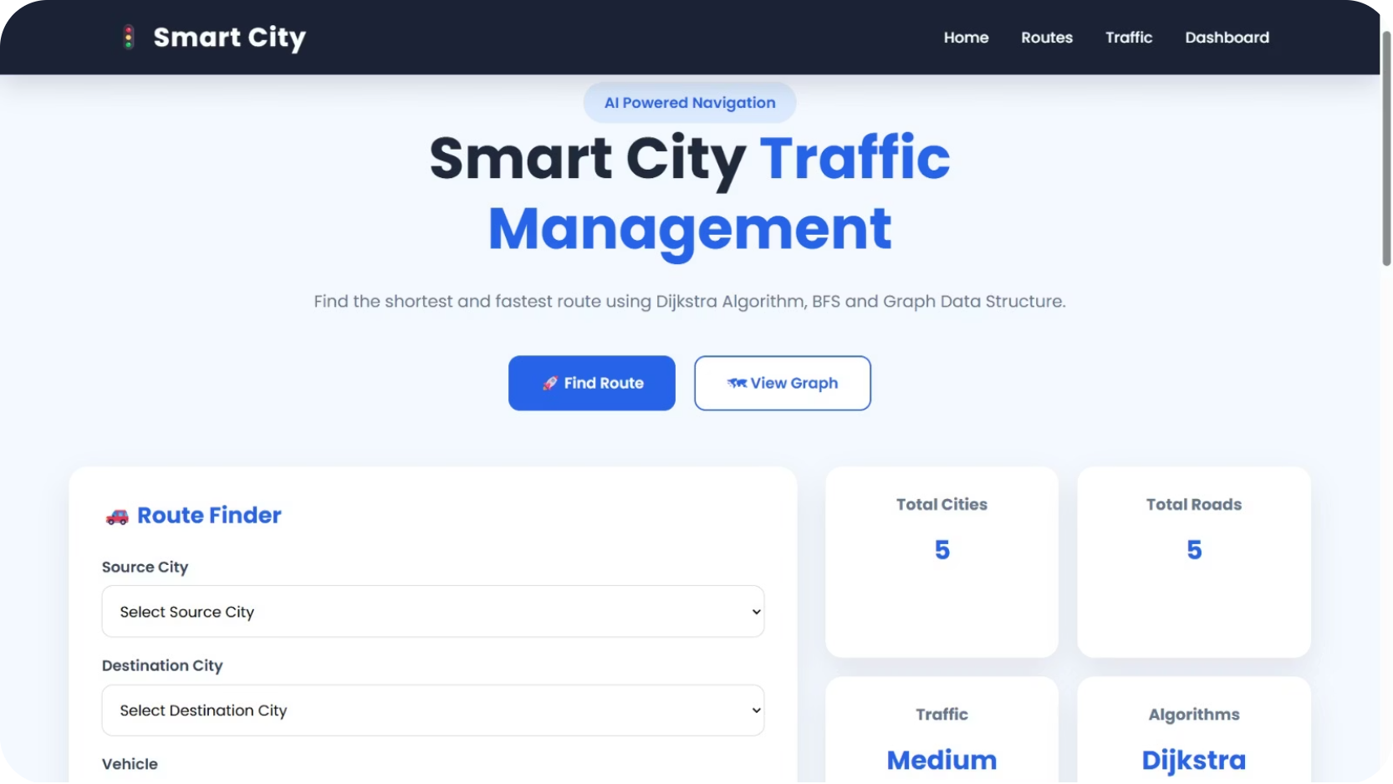
Project Overview
The Smart City Traffic Management System is a web-based application designed to find the shortest and most efficient route between cities.
It provides information about distance, traffic, estimated travel time, fuel cost, and nearby places.
The System Uses
A practical, algorithm-driven solution for real-world urban navigation challenges.
Graph Data Structure
Dijkstra's Algorithm
BFS Algorithm
Interactive Map

Slide 3
Problem Statement
Finding an efficient route is important for reducing travel time and distance. The main problem addressed by this project is to provide users with a simple system that can:
Find the Shortest Route
Display Traffic Conditions
Estimate Travel Time
Identify the optimal path between any two cities in the network.
Show real-time or simulated traffic status along the route.
Calculate how long the journey will take based on distance and traffic.
Calculate Fuel Cost
Show Route Visually on a Map
Provide an estimated fuel expenditure for the selected vehicle.
Render the calculated route on an interactive map interface.

Slide 4
Objectives
01
02
Shortest Route
Dijkstra's Algorithm
Find the shortest route between two cities.
Implement Dijkstra's shortest path algorithm.
03
04
Graph Data Structure
BFS Traversal
Use Graph Data Structure for representing the city network.
Use BFS for graph traversal and exploring connected nodes.
05
06
Time & Cost
Route Visualization
Calculate estimated travel time and fuel cost.
Provide route visualization using an interactive map.

Slide 5

Technologies Used
Frontend
Backend
Algorithms
HTML · CSS · JavaScript
Node.js · Express.js
Dijkstra's Algorithm · BFS · Graph Data Structure
Map
Deployment
Version Control
Leaflet.js · OpenStreetMap
Netlify (Frontend) · Render (Backend)
Git · GitHub

Slide 6
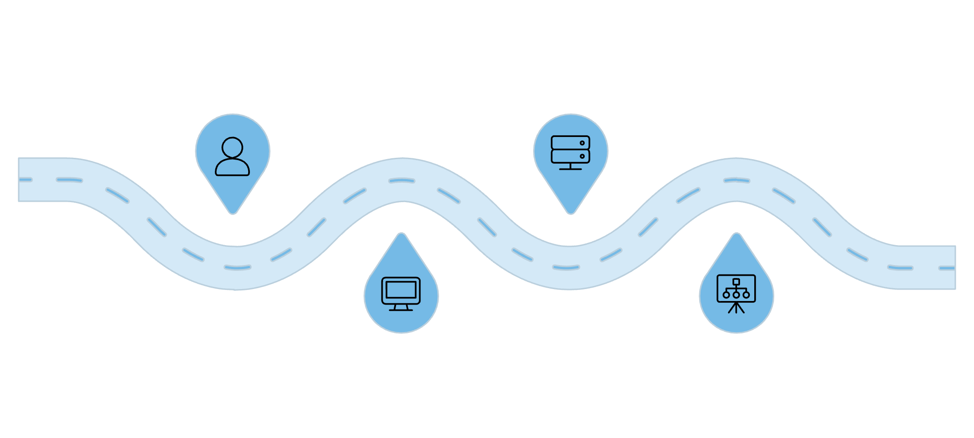
System Architecture
User
Backend API
Enter source and destination
Node.js + Express handles calls
How It Works
The frontend collects user input and sends a request to the backend. The backend processes the city graph using shortest path algorithms and returns the optimized route to the frontend.
Frontend
Graph & Algorithms
HTML, CSS, JavaScript send request
Dijkstra and BFS compute route
1
2
3
4
User Input
API Request
Algorithm
Result
Source, destination, vehicle
Frontend → Backend
Dijkstra + BFS processing
Route, map, summary

Slide 7

Algorithms Used
Graph Data Structure
Dijkstra's Algorithm
Cities are represented as nodes and roads are represented as edges.
Used to find the shortest path between the selected source and destination.
BFS (Breadth-First Search)
Used for graph traversal and exploring connected nodes.

Slide 8

System Workflow
Select Vehicle
Start
Select Cities
Find Route
Run Dijkstra
The system follows a structured pipeline — from user input through algorithmic processing to visual output — ensuring accurate and efficient route computation every time.

Slide 9
Main Features
Shortest Route Finder
Traffic & Time
Source & destination selection with vehicle type input.
Traffic status display and estimated travel time calculation.
Fuel Cost Estimation
Nearby Places & Live Map
Distance calculation with fuel cost estimation per vehicle.
Nearby places, live city map, and city network graph visualization.

Slide 10
Results
The developed system successfully finds and displays the best route between the selected cities. Example output:
Route
Distance
Traffic
Estimated Time
Patna → Samastipur
85 KM · Vehicle: Car
Medium
1 Hour 51 Min
Fuel Cost
₹425
The system also displays nearby places such as hospitals, ATMs, petrol pumps, and restaurants.
Screenshot: Add your Route Summary + Nearby Places screenshot here.
85
₹425
111
KM Distance
Fuel Cost
Minutes Travel
Patna to Samastipur
Estimated for Car
Estimated journey time

Slide 11
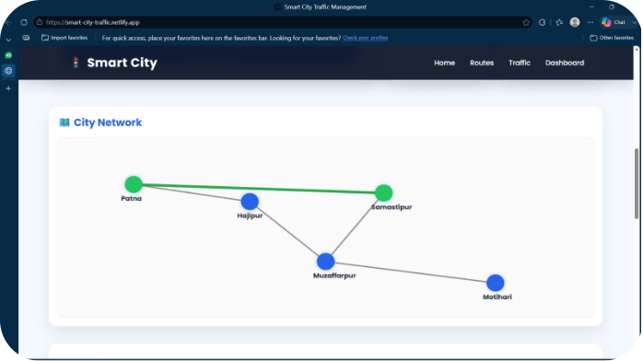
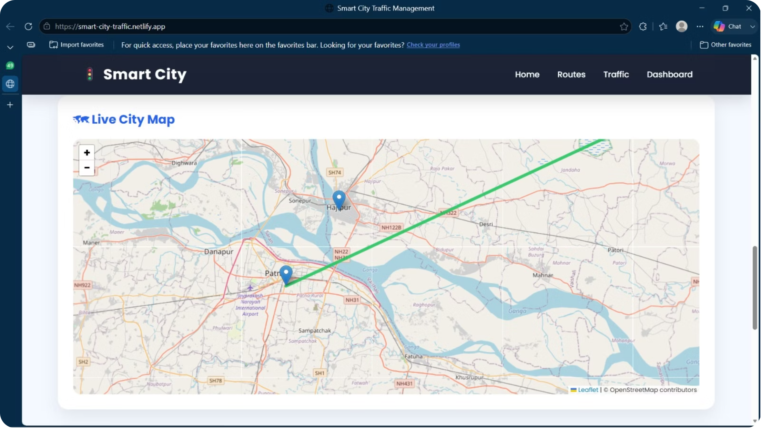
Route Visualization
The calculated route is visually displayed using two complementary views:
Live City Map
Shows city locations
Displays source and destination
Visualizes the calculated route
City Network Graph
Represents cities as nodes
Represents roads as edges
Highlights the selected route

