Slide 1
Data Storage and Indexing

Slide 2


Slide 3
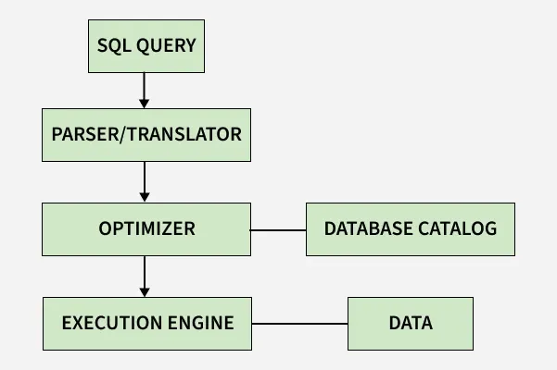
SQL Query Processing

Slide 4
Steps
The Query Arrives — Connection and Authentication
As soon as the query reaches the database server (for example, SELECT name, age FROM users WHERE city = ‘New York’;), it hits the connection manager — essentially the database’s front door
Authentication
Parsing the SQL — Understanding the Request
SQL query goes to the query parser - breaks the query text into parts; checks the SQL syntax; verifies that all referenced tables and columns actually exist; and there is access to them
Optimization — Planning the Best Route
Most efficient way to execute it - optimizer considers different strategies to get data and decides on the fastest one using statistics about the data
Execution plan — a blueprint of the steps the database will take to get your results
Execution Engine — Carrying Out the Plan

Slide 5
Execution Engine
If the plan says “fetch all users from New York via an index,” - the execution engine will ask the storage engine to do that, then take those results and maybe filter out just the name and age fields
Storage Engine — Retrieving Data and Ensuring Integrity
The storage engine is responsible for the actual data retrieval
The storage engine interacts with the disk and memory, and also makes sure that the database’s integrity is maintained while the query runs
Ensures that query runs safely by using transactions (all-or-nothing execution) and applying locks to prevent conflicts with other queries
The storage engine also checks its in-memory cache for the required data (for speed) and goes to disk if needed, logging any changes along the way for recovery

Slide 6
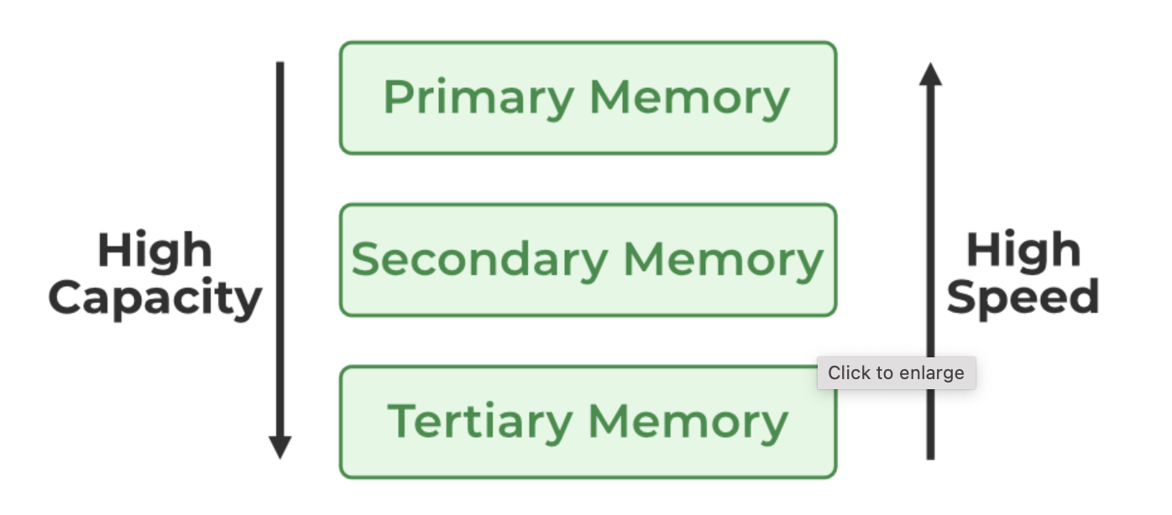
The records in databases are stored in file formats
Physically, the data is stored in electromagnetic format on a device

Slide 7
Primary Memory
This is directly accessible by the central processing unit
According to performance and speed, the primary memory devices are the fastest devices, and this feature is in direct correlation with their capacity
The size of these devices is considerably smaller and they are volatile.
Usually more expensive due to their increased speed and performance.
Cache Memory: Cache Memory is a special very high-speed memory. It is used to speed up and synchronize with a high-speed CPU

Slide 8
Secondary Memory
Devices that can be accessed for storing data that will be needed at a later point in time for various purposes or database actions
The size of this group of devices is noticeably larger than the primary devices and smaller than the tertiary devices.
Flash memory, also known as flash storage, is a type of nonvolatile memory that erases data in units called blocks and rewrites data at the byte level
Flash memory is widely used for storage and data transfer in consumer devices, enterprise systems, and industrial applications
Unlike traditional hard drives, flash memories are able to retain data even after the power has been turned off
Magnetic Disk Storage: A Magnetic Disk is a type of secondary memory that is a flat disc covered with a magnetic coating to hold information

Slide 9
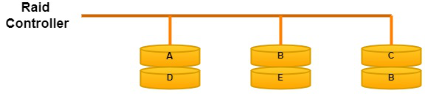
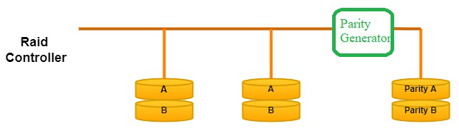
Redundant Array of Independent Disks
In the Redundant Array of Independent Disks technology, two or more secondary storage devices are connected so that the devices operate as one st

Slide 10
Tertiary Memory
Tertiary Memory refers to devices that can hold a large amount of data without being constantly connected to the server or the peripherals
The cost of tertiary storage is lower than primary and secondary
Means to make a backup of data, this type of storage is commonly used for making copies from servers and databases
Optical Storage: It is a type of storage where reading and writing are to be performed with the help of a laser
Tape Storage: Tape Storage is a type of storage data where we use magnetic tape to store data

Slide 11


Slide 12
Accessing Data
Access Types: This refers to the type of access, such as value-based search, range access, etc.
Access Time: It refers to the time needed to find a particular data element or set of elements.
Insertion Time: It refers to the time taken to find the appropriate space and insert new data.
Deletion Time: Time taken to find an item and delete it as well as update the index structure.
Space Overhead: It refers to the additional space required by the index.

Slide 13
File Organization
The database is stored as a collection of files. Each file is a sequence of records. A record is a sequence of fields.
One approach
Assume record size is fixed
Each file has records of one particular type only
Different files are used for different relations
This case is easiest to implement
We assume that records are smaller than a disk block

Slide 14
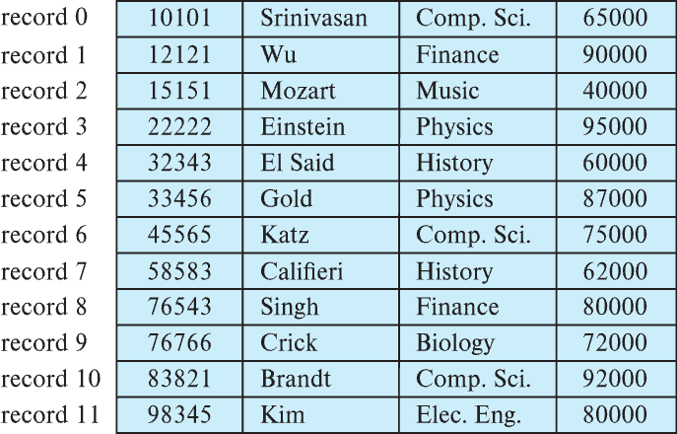
Fixed-Length Records
Simple approach:
Store record i starting from byte n ∗ (i – 1), where n is the size of each record.
Record access is simple but records may cross blocks
Modification: do not allow records to cross block boundaries

Slide 15
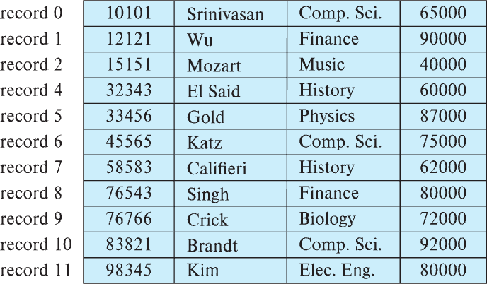
Fixed-Length Records
Deletion of record i: alternatives:
move records i + 1, . . ., n to i, . . . , n – 1
move record n to i
do not move records, but link all free records on a free list
Record 3 deleted

Slide 16
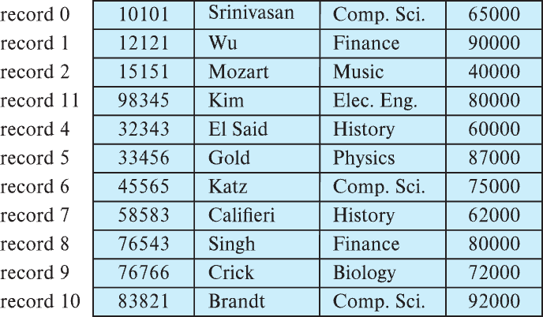
Fixed-Length Records
Deletion of record i: alternatives:
move records i + 1, . . ., n to i, . . . , n – 1
move record n to i
do not move records, but link all free records on a free list
Record 3 deleted and replaced by record 11

Slide 17
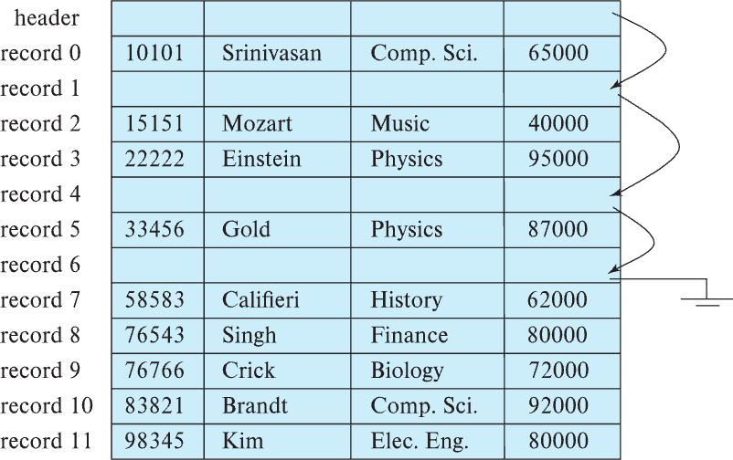
Fixed-Length Records
Deletion of record i: alternatives:
move records i + 1, . . ., n to i, . . . , n – 1
move record n to i
do not move records, but link all free records on a free list

Slide 18
Organization of Records in Files
Heap – record can be placed anywhere in the file where there is space
Sequential – store records in sequential order, based on the value of the search key of each record
In a multitable clustering file organization records of several different relations can be stored in the same file
Motivation: store related records on the same block to minimize I/O
B⁺-tree file organization
Ordered storage even with inserts/deletes
More on this in Chapter 14
Hashing – a hash function computed on search key; the result specifies in which block of the file the record should be placed
More on this in Chapter 14

Slide 19
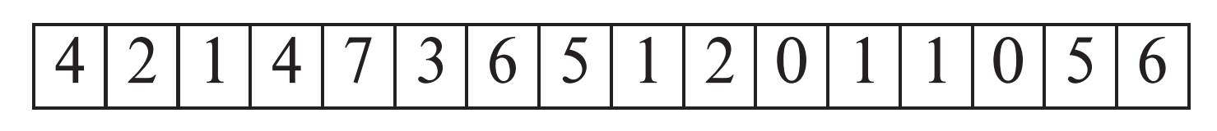
Heap File Organization
Records can be placed anywhere in the file where there is free space
Records usually do not move once allocated
Important to be able to efficiently find free space within file
Free-space map
Array with 1 entry per block. Each entry is a few bits to a byte, and records fraction of block that is free
In example below, 3 bits per block, value divided by 8 indicates fraction of block that is free

Slide 20
Sequential File Organization
Suitable for applications that require sequential processing of the entire file
The records in the file are ordered by a search-key

Slide 21
Sequential File Organization (Cont.)
Deletion – use pointer chains
Insertion –locate the position where the record is to be inserted
if there is free space insert there
if no free space, insert the record in an overflow block
In either case, pointer chain must be updated
Need to reorganize the file from time to time to restore sequential order

Slide 22
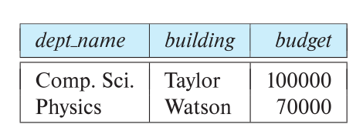
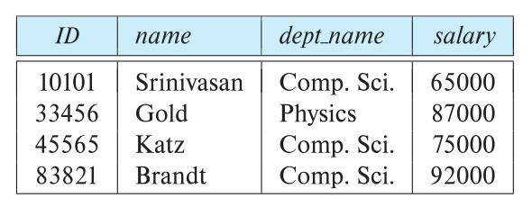
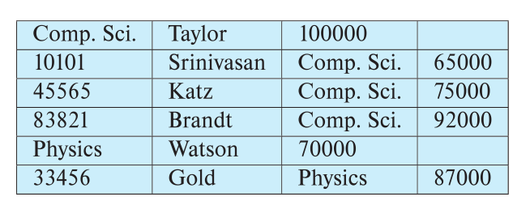
Multitable Clustering File Organization
Store several relations in one file using a multitable clustering file organization
department
instructor
multitable clustering
of department and
instructor

Slide 23
Multitable Clustering File Organization (cont.)
Good for queries involving department ⨝ instructor, and for queries involving one single department and its instructors
bad for queries involving only department
results in variable size records
Can add pointer chains to link records of a particular relation

Slide 24
Partitioning
Table partitioning: Records in a relation can be partitioned into smaller relations that are stored separately
E.g., transaction relation may be partitioned into transaction_2018, transaction_2019, etc.
Queries written on transaction must access records in all partitions
Unless query has a selection such as year=2019, in which case only one partition in needed
Partitioning
Reduces costs of some operations such as free space management
Allows different partitions to be stored on different storage devices
E.g., transaction partition for current year on SSD, for older years on magnetic disk

Slide 25
Data Dictionary Storage
The Data dictionary (also called system catalog) stores metadata; that is, data about data, such as
Information about relations
names of relations
names, types and lengths of attributes of each relation
names and definitions of views
integrity constraints
User and accounting information, including passwords
Statistical and descriptive data
number of tuples in each relation
Physical file organization information
How relation is stored (sequential/hash/…)
Physical location of relation

Slide 26
Relational Representation of System Metadata
Relational representation on disk
Specialized data structures designed for efficient access, in memory

Slide 27
Indexing
Many / Most queries reference only a small portion of the records in a file
Example –
Find all instructors in Physics Department
Find courses registered by student ID – 21200
Inefficient for the system to read every record to check the department value
An Index in a DBMS works the same way as an index of words work for books – - To look up a word - find it in the index – go to the page number
Words are in sorted order
DBMS would look up an index to find the block in which the record is stored

Slide 28
Basic Concepts
Indexing mechanisms used to speed up access to desired data.
E.g., author catalog in library
Search Key - attribute to set of attributes used to look up records in a file.
An index file consists of records (called index entries) of the form
Index files are typically much smaller than the original file
Two basic kinds of indices:
Ordered indices: search keys are stored in sorted order
Hash indices: search keys are distributed uniformly across “buckets” using a “hash function”.
search-key
pointer

Slide 29
Ordered Indices
In an ordered index, index entries are stored sorted on the search key value.
Clustering index: in a sequentially ordered file, the index whose search key specifies the sequential order of the file.
Also called primary index
The search key of a primary index is usually but not necessarily the primary key.
Secondary index: an index whose search key specifies an order different from the sequential order of the file. Also called nonclustering index.
Index-sequential file: sequential file ordered on a search key, with a clustering index on the search key.

Slide 30
Dense Index Files
Dense index — Index record appears for every search-key value in the file.
E.g. index on ID attribute of instructor relation

Slide 31
Dense Index Files (Cont.)
Dense index on dept_name, with instructor file sorted on dept_name

Slide 32
Sparse Index Files
Sparse Index: contains index records for only some search-key values.
Applicable when records are sequentially ordered on search-key
To locate a record with search-key value K we:
Find index record with largest search-key value < K
Search file sequentially starting at the record to which the index record points

Slide 33
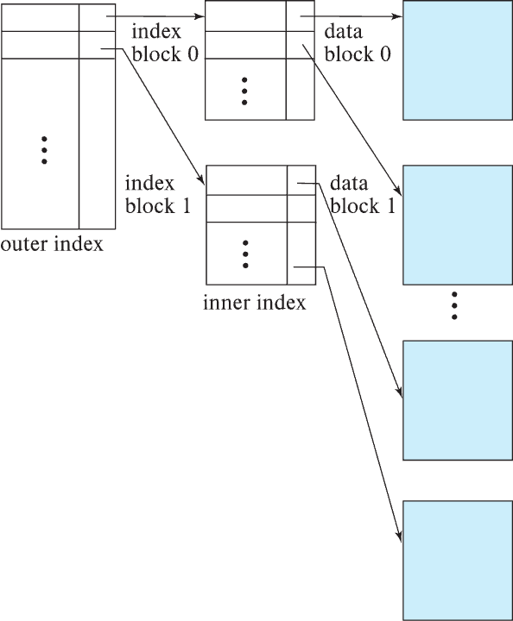
Sparse Index Files (Cont.)
Compared to dense indices:
Less space and less maintenance overhead for insertions and deletions.
Generally slower than dense index for locating records.
Good tradeoff:
for clustered index: sparse index with an index entry for every block in file, corresponding to least search-key value in the block.
For unclustered index: sparse index on top of dense index (multilevel index)

Slide 34
Secondary Indices Example
Secondary index on salary field of instructor
Index record points to a bucket that contains pointers to all the actual records with that particular search-key value.
Secondary indices have to be dense

Slide 35
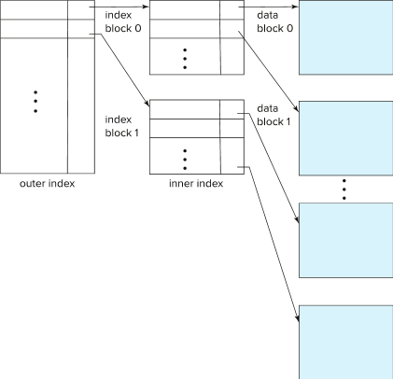
Multilevel Index
If index does not fit in memory, access becomes expensive.
Solution: treat index kept on disk as a sequential file and construct a sparse index on it.
outer index – a sparse index of the basic index
inner index – the basic index file
If even outer index is too large to fit in main memory, yet another level of index can be created, and so on.
Indices at all levels must be updated on insertion or deletion from the file.

Slide 36
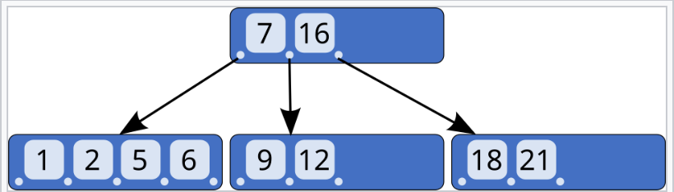
B-Tree
B-tree is a self-balancing tree that maintains sorted data and allows searches, sequential access, insertions, and deletions in logarithmic time

Slide 37
B⁺-Tree Index Files
A B+ Tree is a self-balancing multi-level index tree structure used in database indexing and file systems.
Purpose: Helps in fast searching, insertion, deletion, and efficient range queries.
In the B+ tree, the internal nodes do not store any pointers to records
Overall fewer pointers - each node can hold more keys - the trees are shallower and thus faster to search.
All pointers to records are stored in the leaf nodes
In addition, a leaf node may include a pointer to the next leaf node to speed up sequential access

Slide 38
Structure of a B+ Tree
Properties:
Order (d): Maximum number of children per node = d.
Balanced Structure: All leaf nodes are at the same level.
Internal Nodes: Store keys but no actual data.
Leaf Nodes:
Store actual records (or pointers).
Connected as a linked list (useful for range queries).
Root Node: Can have 2 to d children (except for the first root).

Slide 39
B⁺-Tree Index Files (Cont.)
A B⁺-tree is a rooted tree satisfying the following properties:
All paths from root to leaf are of the same length
Each node that is not a root or a leaf has between ⎡n/2⎤ and n children – Order d can be defined
A leaf node has between ⎡(n–1)/2⎤ and n–1 values
Special cases:
If the root is not a leaf, it has at least 2 children.
If the root is a leaf (that is, there are no other nodes in the tree), it can have between 0 and (n–1) values.

Slide 40
Let’s use a B+ tree where:
Each internal node can have up to 3 keys (i.e., up to 4 children)
Each leaf node can have up to 3 keys
[ 6 | 12 | 21 ]
[1, 2, 5] [6, 7, 9] [12, 16, 18] [21] ↔ ↔ ↔

Slide 41
Example of B⁺-Tree

Slide 42
B⁺-Tree Node Structure
Typical node
K_{i} are the search-key values
P_{i} are pointers to children (for non-leaf nodes) or pointers to records or buckets of records (for leaf nodes).
The search-keys in a node are ordered
K₁ < K₂ < K₃ < . . . < K_{n–1}
(Initially assume no duplicate keys, address duplicates later)

Slide 43
Non-Leaf Nodes in B⁺-Trees
Non leaf nodes form a multi-level sparse index on the leaf nodes.
For a non-leaf node with m pointers:
All the search-keys in the subtree to which P₁ points are less than K₁
For 2 ≤ i ≤ n – 1, all the search-keys in the subtree to which P_{i} points have values greater than or equal to K_{i–1} and less than K_{i}
All the search-keys in the subtree to which P_{n} points have values greater than or equal to K_{n–1}
General structure

Slide 44
Index Evaluation Metrics
Access types supported efficiently. E.g.,
Records with a specified value in the attribute
Records with an attribute value falling in a specified range of values.
Access time
Insertion time
Deletion time
Space overhead

Slide 45
Leaf Nodes in B⁺-Trees
For i = 1, 2, . . ., n–1, pointer P_{i} points to a file record with search-key value K_{i},
If L_{i}, L_{j} are leaf nodes and i < j, L_{i}’s search-key values are less than or equal to L_{j}’s search-key values
P_{n} points to next leaf node in search-key order

Slide 46
Operations on B+ Trees
(a) Searching
Start from the root.
Compare key with internal node values.
Follow the appropriate child pointer.
Once at the leaf node, perform a linear search.
Time Complexity: O(log_{d}N)
(b) Insertion
Find the correct leaf node.
Insert the key in sorted order.
If the leaf node overflows, split it.
Propagate the split upward if needed.

Slide 47
Operations
(c) Deletion
Find the leaf node containing the key.
Remove the key.
If the node underflows, borrow from sibling or merge nodes.
Adjust internal nodes if needed.

Slide 48


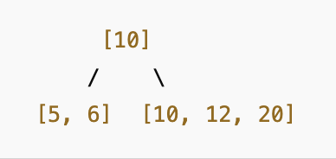
Example
Construct a B+ Tree of order 4 and insert the keys: 10, 20, 5, 6, 12, 30, 7, 17
Maximum number of children per node = 4
Insert 12 - Node Split! - Left Leaf: [5, 6] - Right Leaf: [10, 12, 20] - middle key (10) moves up to the root node.
.
.
.

Slide 49
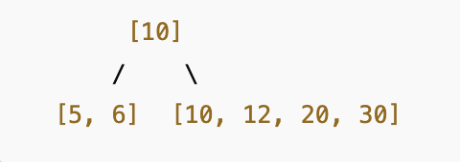
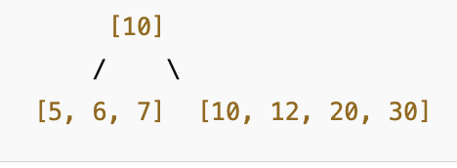
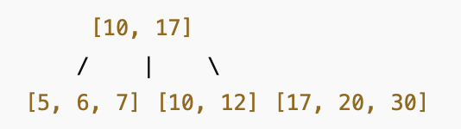
10, 20, 5, 6, 12, 30, 7, 17
Insert 17 – needs second Node Split!
The right leaf node [10, 12, 20, 30] is full, so it splits:
Left Leaf: [10, 12]
Right Leaf: [17, 20, 30]
The middle key (17) moves up to the root.

Slide 50
Example of B⁺-tree
B⁺-tree for instructor file (n = 6)
Leaf nodes must have between 3 and 5 values
(⎡(n–1)/2⎤ and n –1, with n = 6).
Non-leaf nodes other than root must have between 3 and 6 children (⎡(n/2⎤ and n with n =6).
Root must have at least 2 children.

Slide 51
Observations about B⁺-trees
Since the inter-node connections are done by pointers, “logically” close blocks need not be “physically” close.
The non-leaf levels of the B⁺-tree form a hierarchy of sparse indices.
The B⁺-tree contains a relatively small number of levels
Level below root has at least 2* ⎡n/2⎤ values
Next level has at least 2* ⎡n/2⎤ * ⎡n/2⎤ values
If there are K search-key values in the file, the tree height is no more than ⎡ log_{⎡n/2⎤}(K)⎤
thus searches can be conducted efficiently.
Insertions and deletions to the main file can be handled efficiently, as the index can be restructured in logarithmic time

