Slide 1
END-TO-END ANALYTICS PROJECT
Customer shopping behavior,
from raw data to action
Transactions → preparation → analysis → recommendations

Slide 2



What the dataset can answer
THE OPPORTUNITY
3,900 purchases reveal a retention opportunity
Dataset
3,900 transactions across 4 product categories and 25 items
Headline
Loyal customers dominate the base, while subscriptions reach only 27% of customers
Business question
Where should marketing, merchandising, and loyalty efforts focus?
27%
of customers have subscriptions

Slide 3
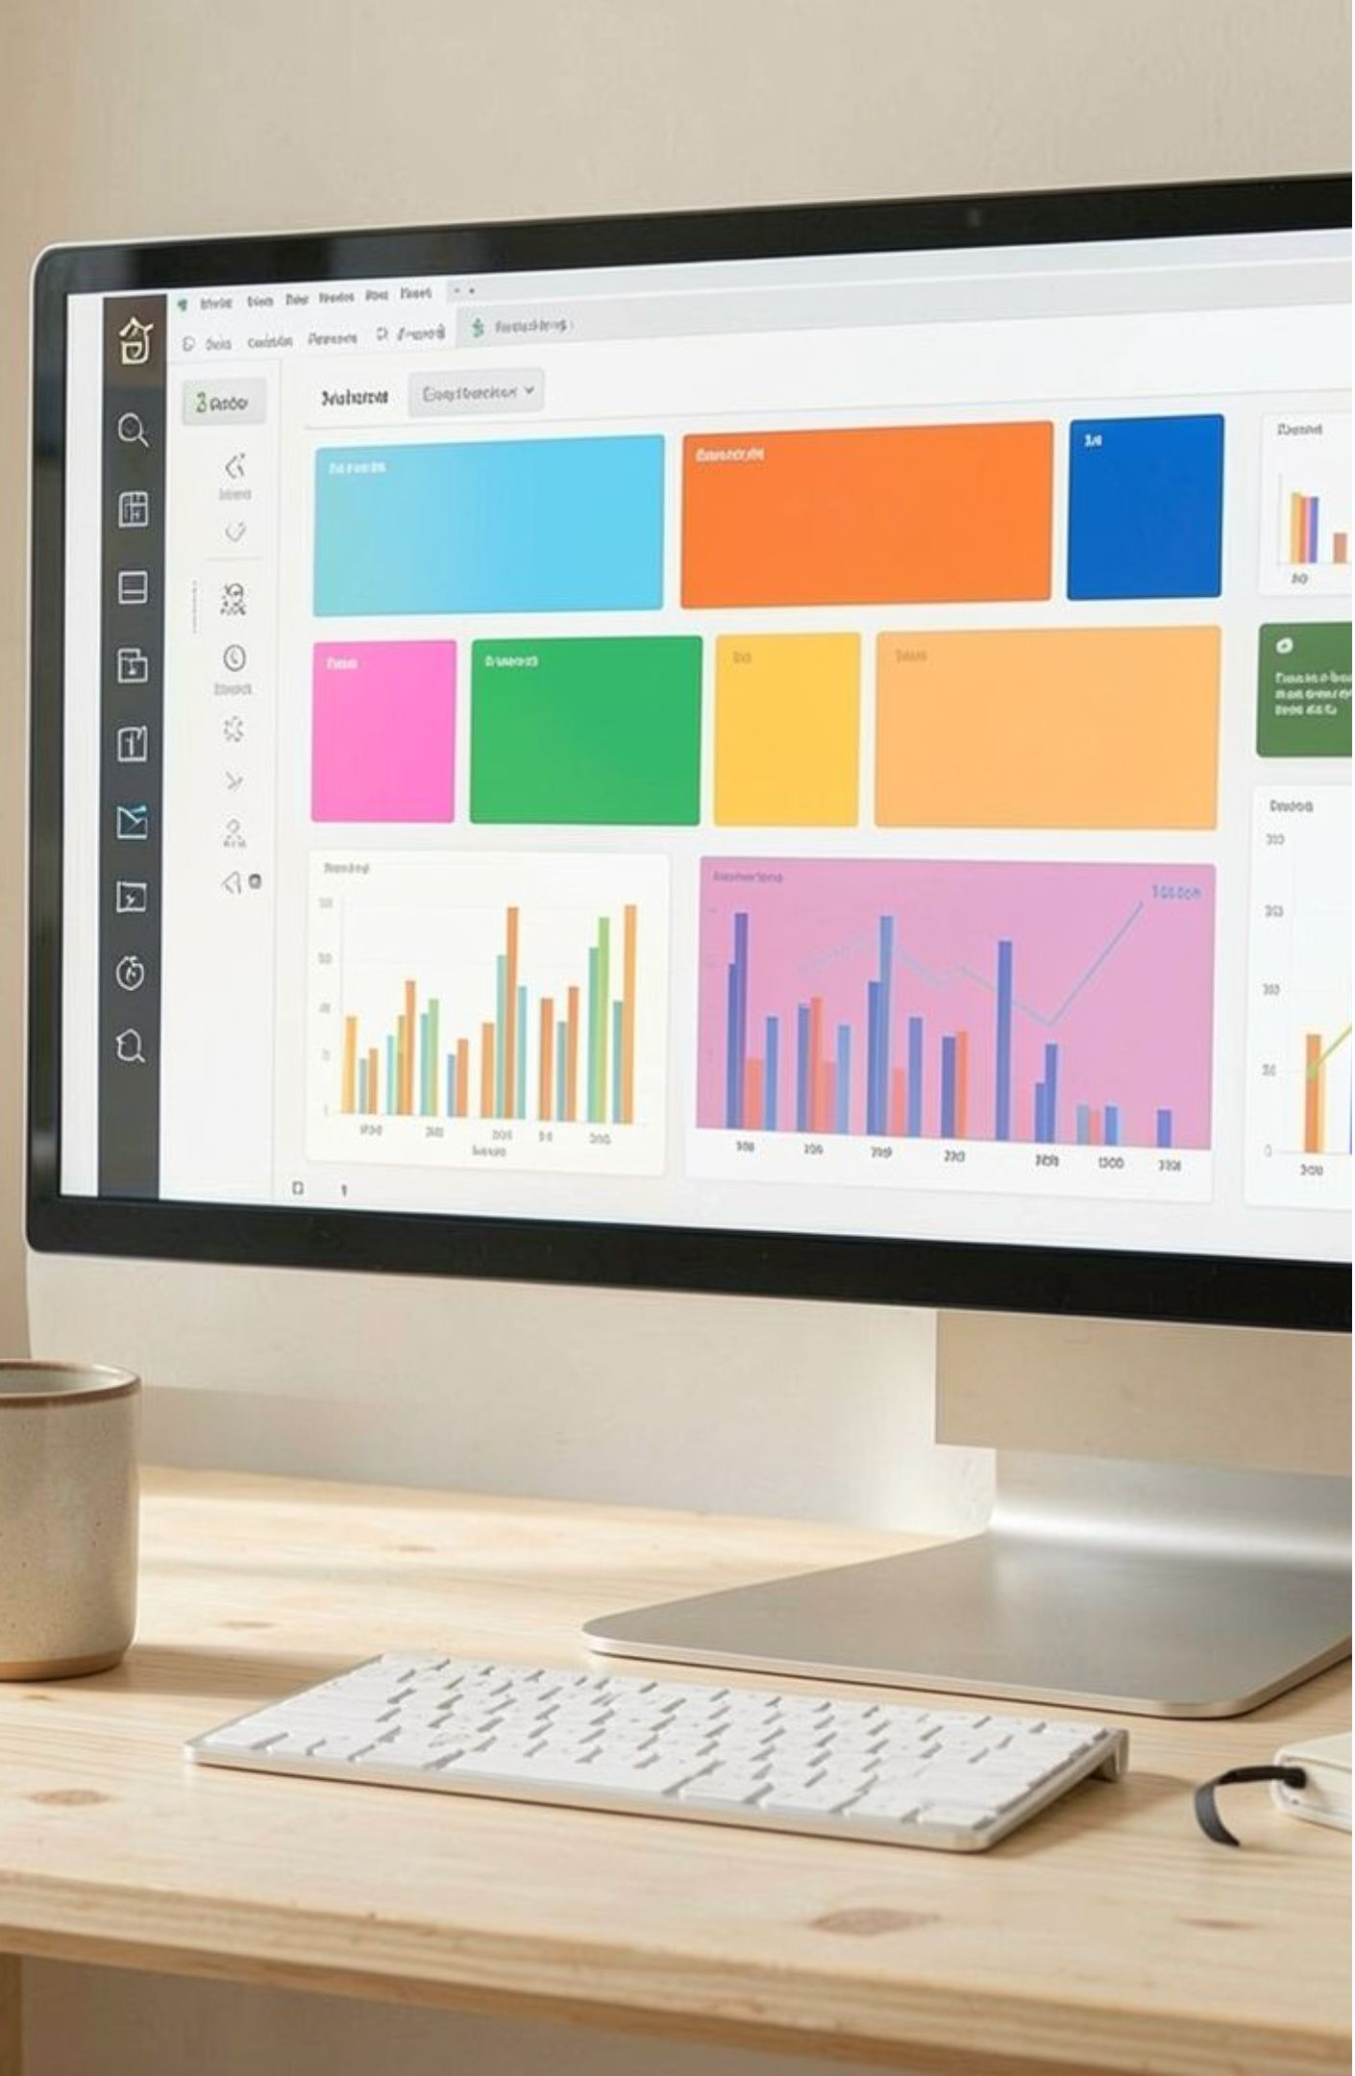
THE ANALYTICS STACK
The project connects three layers of analysis
01
02
03
Python
PostgreSQL
Power BI
Clean, standardize, and engineer features
Answer business questions with transaction-level SQL
Turn findings into an interactive dashboard

Slide 4
DATA PREPARATION
Data preparation made the analysis reliable
01
02
03
Quality check
Imputation
Feature engineering
37 review ratings were missing
Missing ratings were filled with the median for each product category
Age groups and purchase-frequency days were created; redundant promo-code data was removed

Slide 5
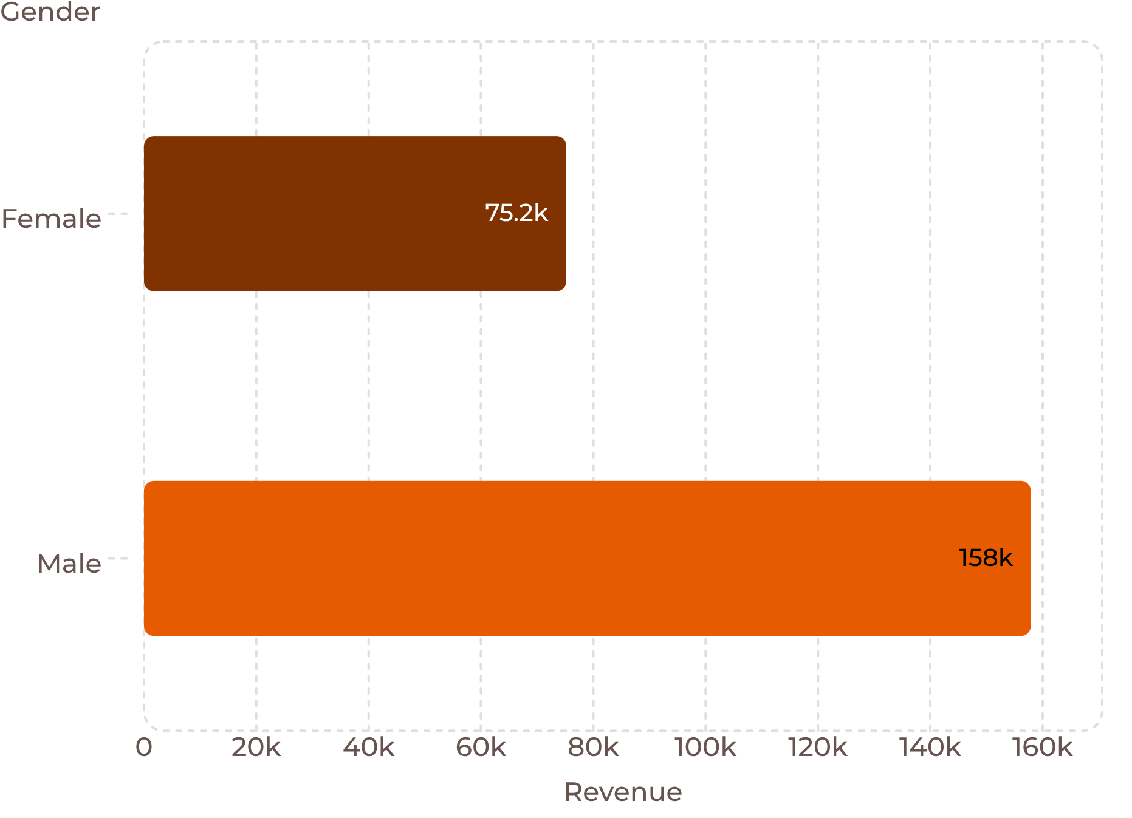
CUSTOMER ECONOMICS
Revenue by gender
The customer base is broad, but spending is concentrated
$59.76
3.75
Average rating out of 5
Average purchase
Male customers generated $157,890 versus $75,191 from female customers

Slide 6
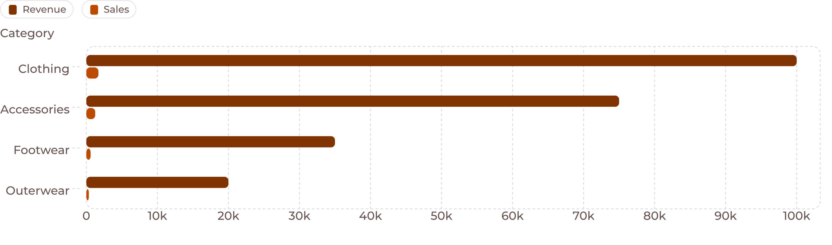
MERCHANDISING
Clothing is the commercial center of gravity
Clothing leads both revenue and sales volume. Top products: jewelry, sunglasses, belts, blouses, pants, and shirts.

Slide 7
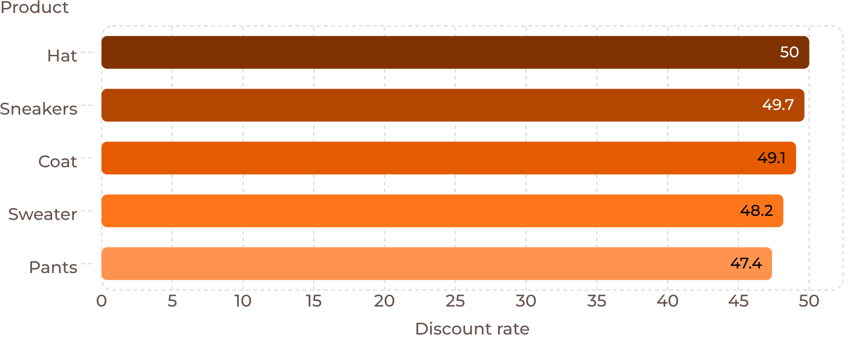
PROMOTION SIGNAL
Discounts attract high-value purchases, but may pressure margin
Most discount-dependent products
Optimize discount depth and targeting rather than treating every product the same.
839
customers spent above the average purchase amount while using discounts

Slide 8
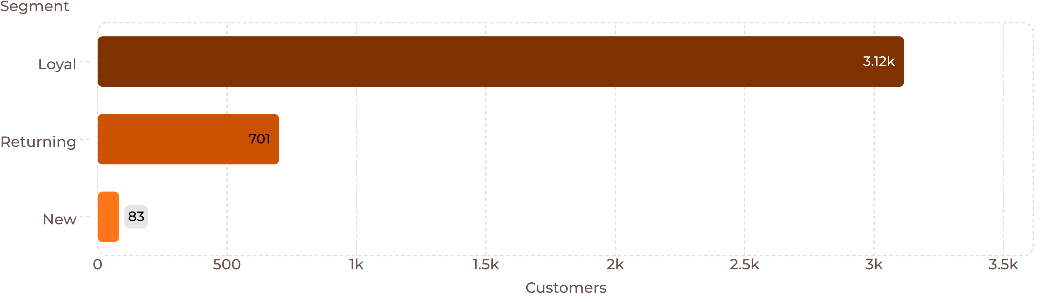
CUSTOMER SEGMENTS
Loyal customers are the largest segment to develop
Convert returning customers into loyal advocates while protecting the new-customer pipeline.

Slide 9
SUBSCRIPTION SIGNAL
Subscriptions are underpenetrated and not yet driving higher spend
27%
Average spend
$59.49 for subscribers
$59.87 for non-subscribers
Subscribers
73% are non-subscribers
Revenue
$62,645 from subscribers
$170,436 from non-subscribers

Slide 10
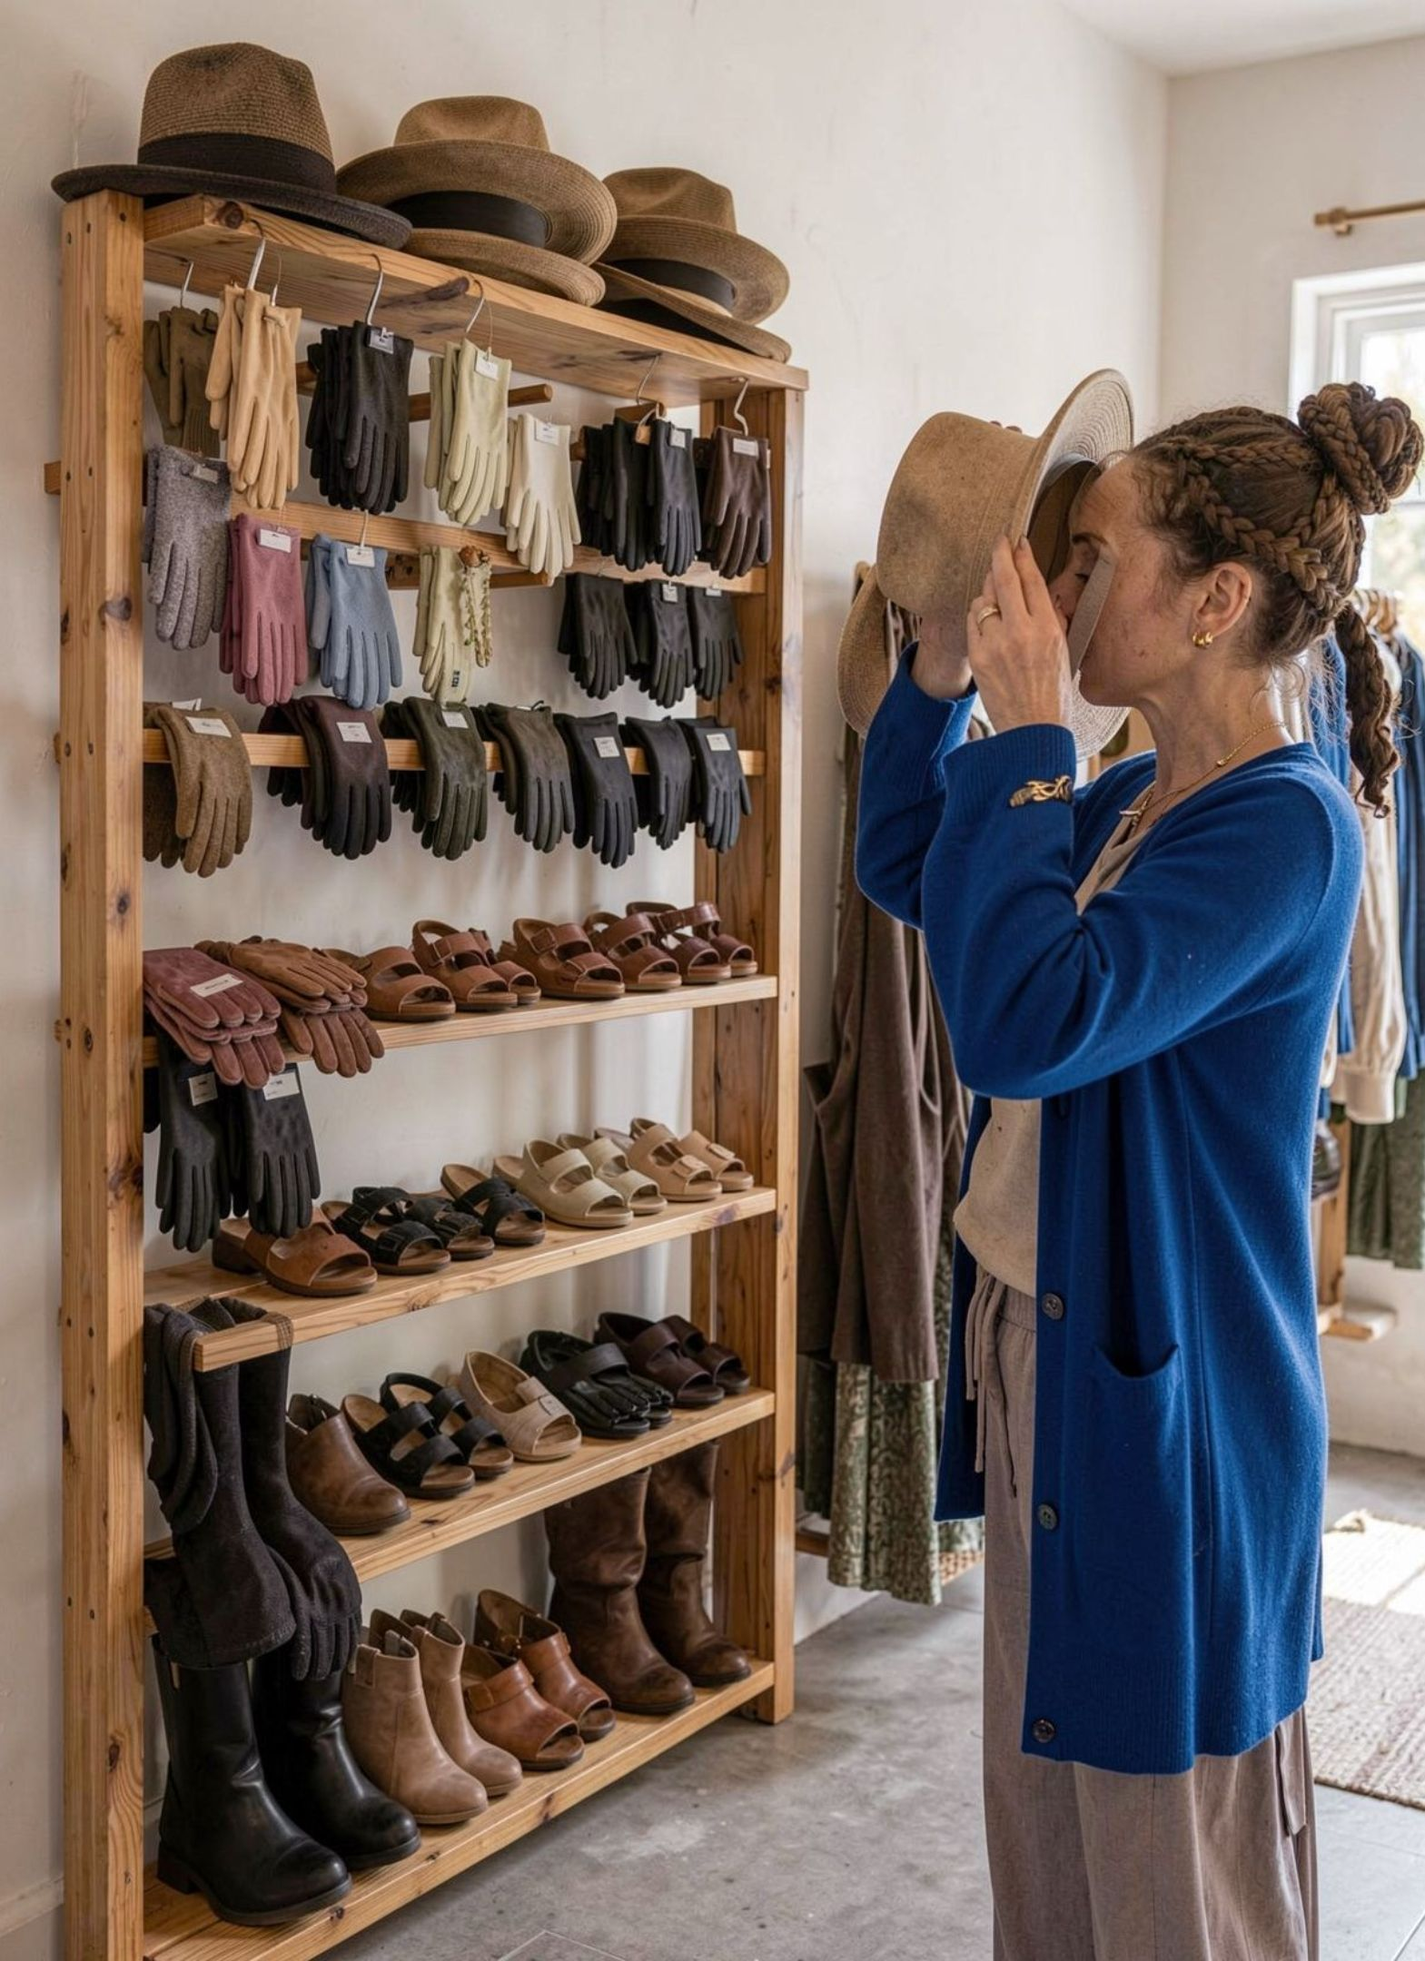
RECOMMENDATIONS
Product ratings point to merchandising wins
Top-rated products
Gloves 3.86, sandals 3.84, boots 3.82, hats 3.80, and skirts 3.78
Shipping: average purchase value is $60.48 for express versus $58.46 for standard shipping
Implication: feature trusted products and test premium fulfillment messaging

