Slide 1
HR ANALYTICS DASHBOARD
01
16.1%
HR attrition across 1.47K employees
A concentrated signal, with the clearest pressure in early tenure, lower salary bands, and high-volume roles.
Executive readout
HR leadership

Slide 2
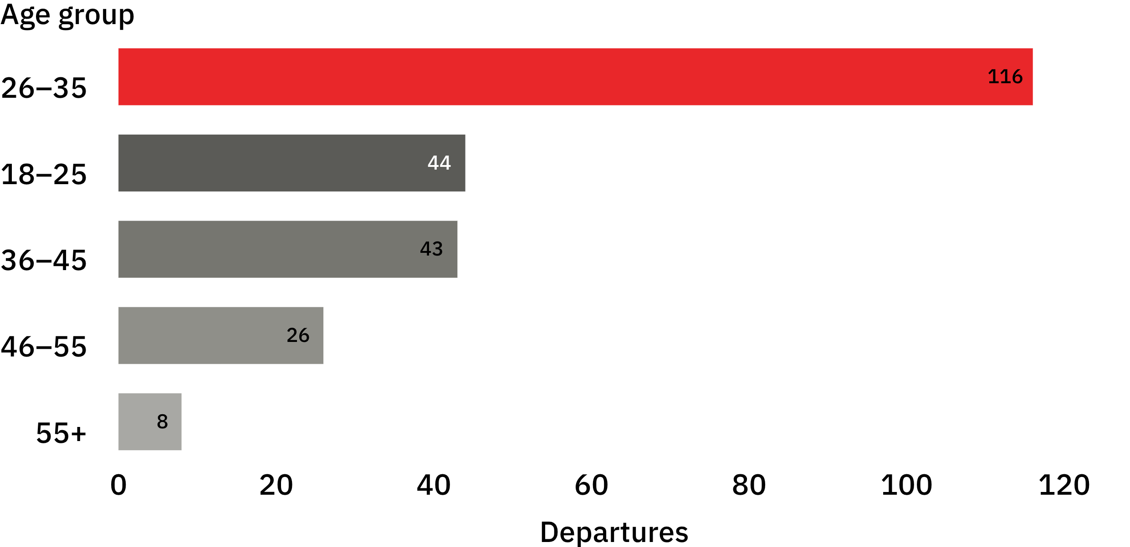
Age profile · departures
Largest cohort
Attrition is concentrated in the 26–35 age group
116
departures in the 26–35 age group.
Source: HR Analytics Dashboard.

Slide 3
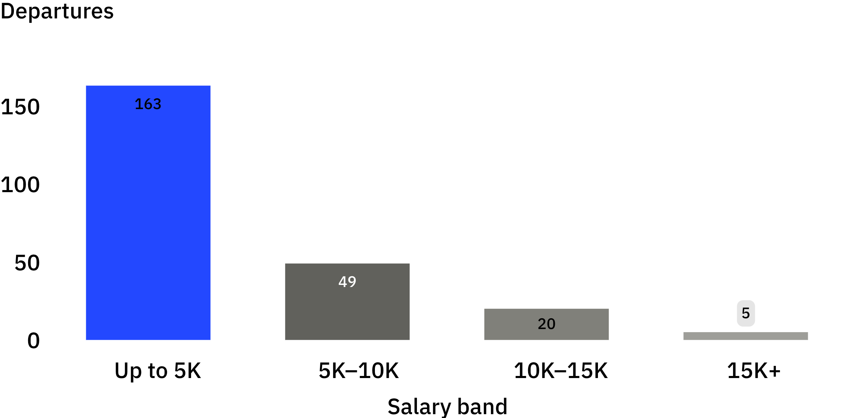
Salary profile
Departures by salary band
163
Lower salary bands account for most attrition
departures in the Up to 5K band.
Lower bands carry most of the observed attrition.

Slide 4
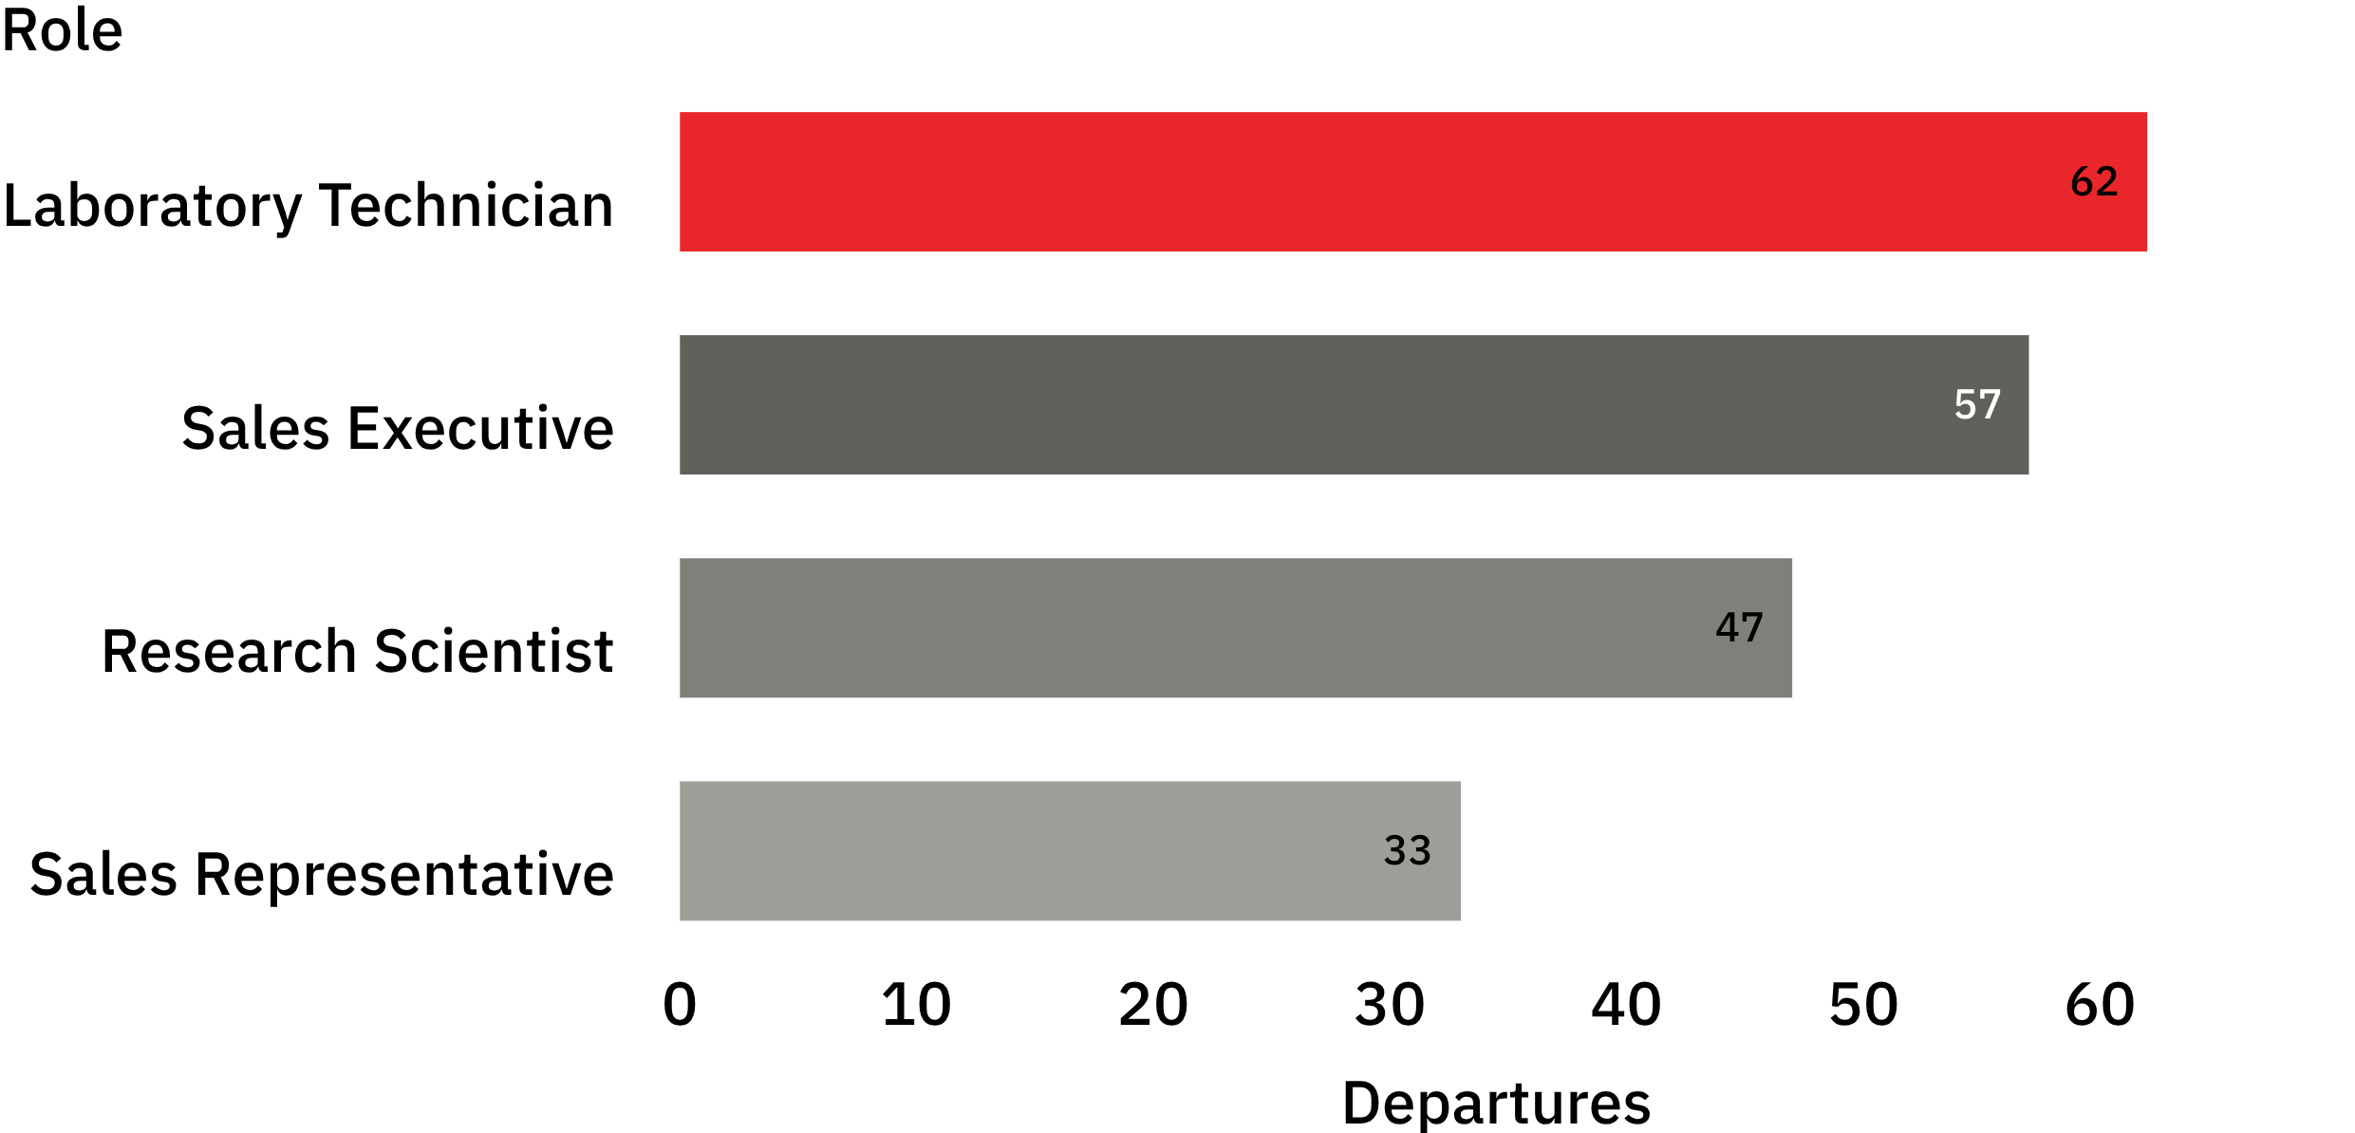
Role profile · departures
Leading roles
Role-level risk is led by frontline and technical jobs
Laboratory Technician
62
departures
Sales Executive · 57
Research Scientist · 47
Sales Representative · 33

Slide 5
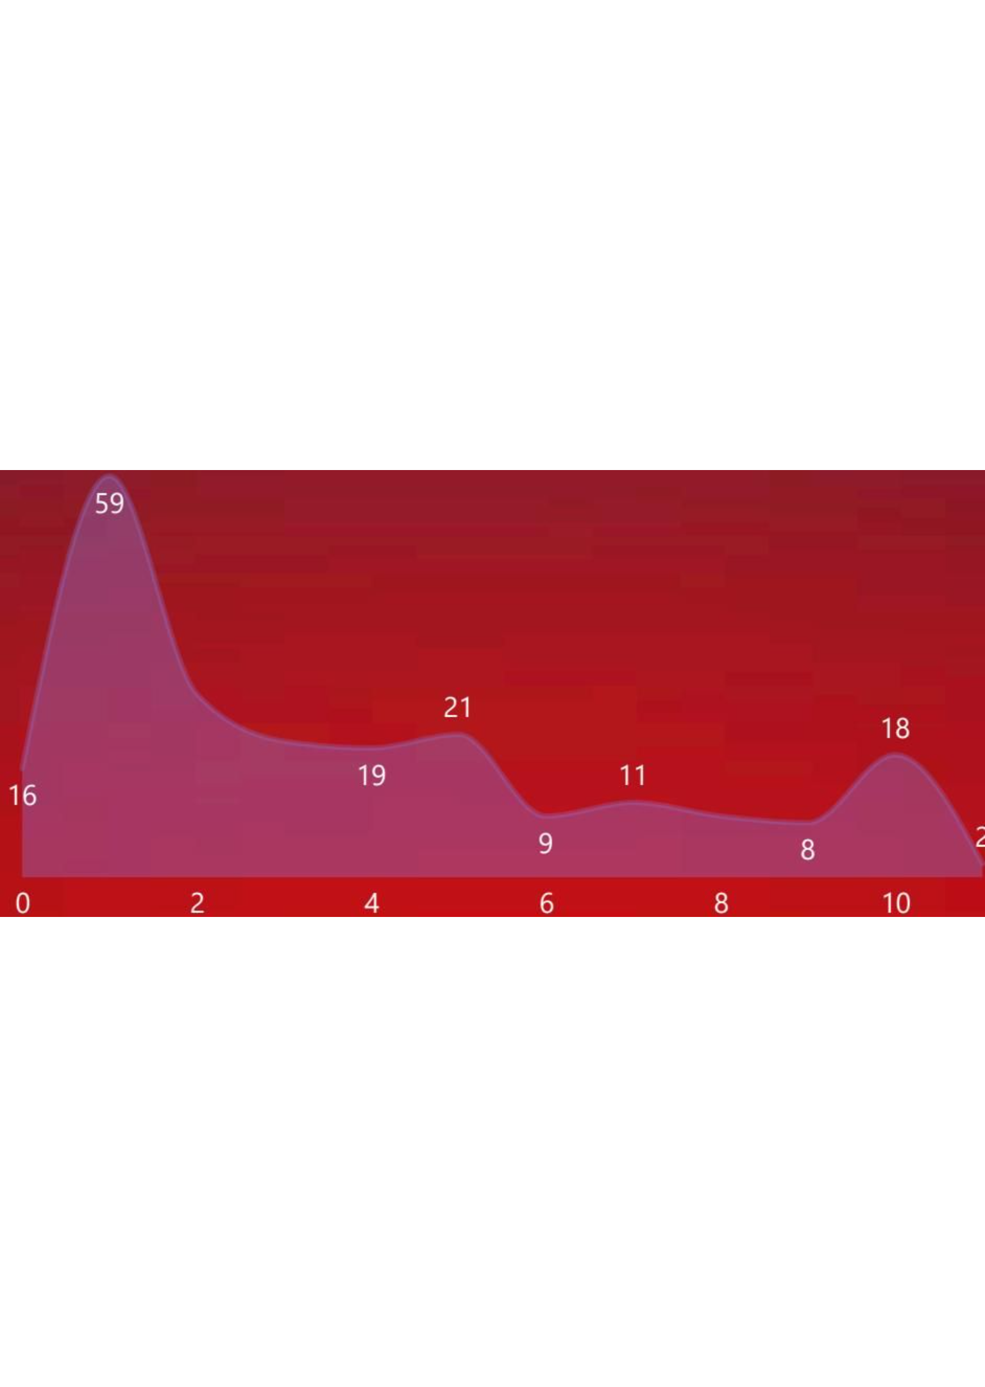
Tenure profile
Early-tenure attrition is the sharpest signal
The distribution peaks around year 1.
7.0
37
Average years
Average age
Average salary · 6.5K
Use onboarding, first-year manager support, and pay progression as the first diagnostic lenses.

Slide 6
Next analysis
What leadership should investigate next
01
Compare first-year attrition
By role, manager, and salary band.
02
Test pay compression
Is it strongest in the highest-volume roles?
03
Pair the next dashboard cut
With exit reasons and hiring cohorts.

