Slide 1
Predicting Patient Readmission Risk using Machine Learning
Course: MGT-665 Solve Problems with Machine Learning
Team: Saumya Padhi, Surendar Reddy, Vignesh Nagarajan
Instructor: Dr. Mighty Itauma Itauma
Presentation Date: July 10th, 2025

Slide 2
Problem Statement
Unplanned hospital readmissions are costly in both financially and clinically.
Can we identify high-risk patients in advance using machine learning?

Slide 3
The Goal
Predict 30-day readmission & uncover wellness-based patient clusters
Classification + Clustering
=
Predictive + Strategic insights

Slide 4
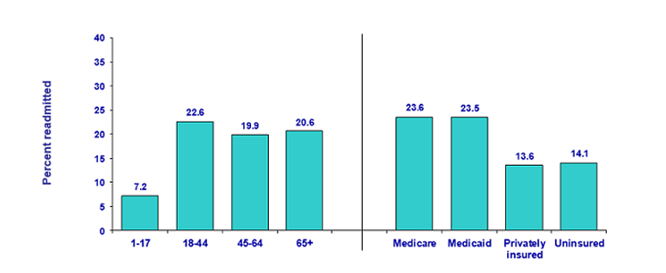
Background & Motivation
Diabetes → One of major cause Readmission → Costly, avoidable
ML → Proactive decision-making
Sources: Agency for Healthcare Research and Quality (AHRQ), https://hcup-us.ahrq.gov/reports/statbriefs/sb153.jsp

Slide 5
Dataset Overview
UCI Diabetes Dataset
101,766 records | 10 years
Features: age, gender, diagnoses, labs, meds, readmitted (Target)

Slide 6
Literature Review
Author(s) | ML Models Used | Key Findings
Rajkomar et al., 2019 | DNN, Logistic Regression, GBT | Deep models outperformed traditional ML models in predicting readmission, mortality, and length of stay using EHRs.
Zhou et al., 2020 | Random Forest, SVM, k-NN | Classical ML models showed strong performance on large-scale healthcare datasets.
Chen et al., 2021 | Tree-based Models, Neural Networks, SVM, Logistic Regression | Most reviewed studies used tree-based and neural models; many reported AUC > 0.70 in readmission prediction.
Interpretable ML Study, 2023 | Random Forest, Neural Network, Regression Tree Surrogates | Regression tree surrogates were used to replicate black-box models like RF and NN, ensuring model interpretability with minimal accuracy loss.

Slide 7
Data Preprocessing
Missing Value Handling.
Dropped Columns with > 50% missing
One-Hot Encoding.
Target binarization: Readmitted = Yes/No
Pipeline includes preprocessing, clustering, train-test split (80/20).

Slide 8
Machine Learning Pipeline
Split data - (train/test: 80/20)
Models - KNN, Decision Tree, Naive Bayes, Random Forest, MLP (Multi-layer Perceptron neural network )
Evaluation metrics - Accuracy, Precision, Recall, F1, ROC-AUC
Preprocessing
Clustering
Train-Test-Split
Model Training
Model Evaluation

Slide 9
Evaluation Metrics
Random Forest: 88.8% accuracy, F1: 0.836
KNN: 88% accuracy, F1: 0.835
Note: Class imbalance → minority class prediction poor
Model | Precision | Recall | F1-Score | Accuracy
KNN | 0.810 | 0.880 | 0.835 | 0.880
Decision Tree | 0.814 | 0.823 | 0.818 | 0.823
Naive Bayes | 0.837 | 0.150 | 0.100 | 0.150
Random Forest | 0.850 | 0.888 | 0.836 | 0.888
MLP (Neural Net) | 0.812 | 0.837 | 0.824 | 0.837

Slide 10
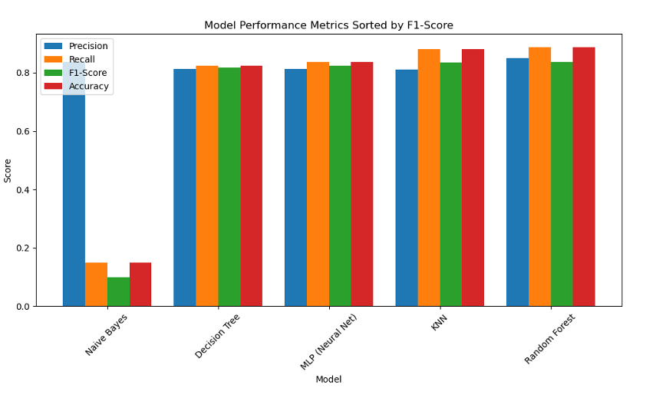
Classification Results

Slide 11
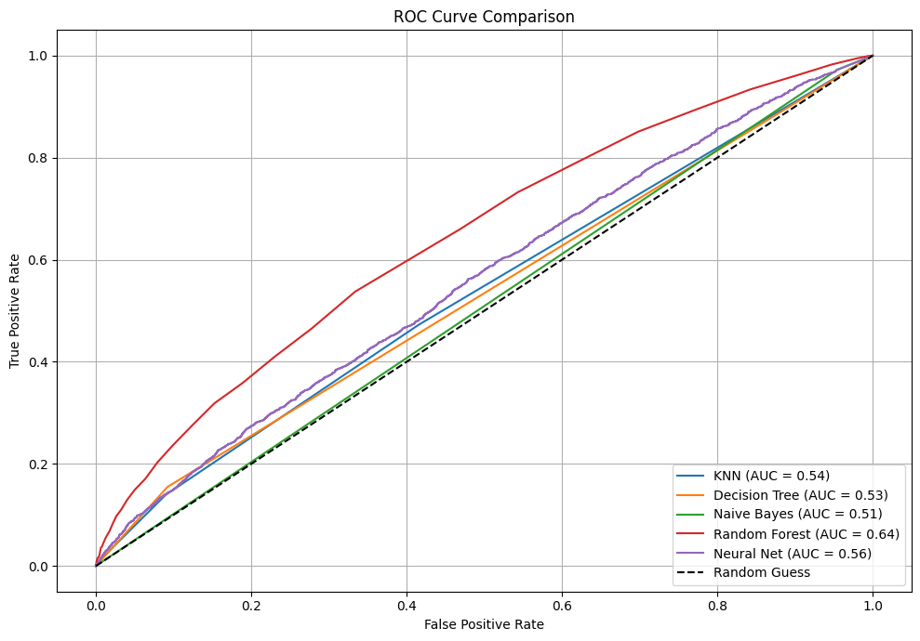
ROC Curve
ROC curves show Random Forest had highest AUC, indicating strong predictive power.

Slide 12
Unsupervised Learning
Applied KMeans and Agglomerative Clustering for patients natural grouping.
To visualize clusters, we used Principal Component Analysis (PCA) to reduce high-dimensional data into 2D.
Clusters reflect differing wellness profiles among patients, helping in care personalization.

Slide 13
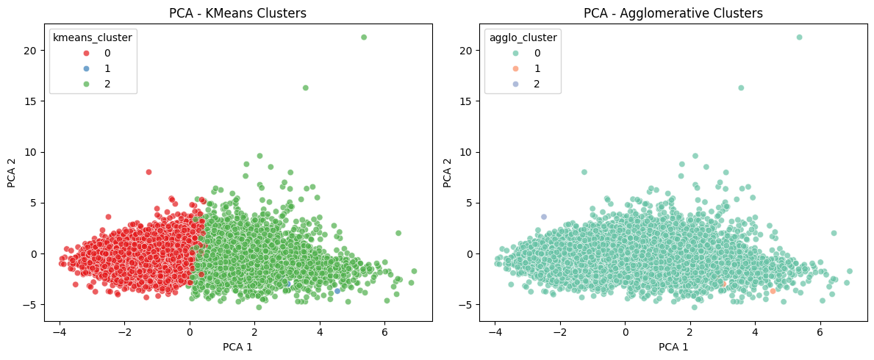
Cluster Analysis Insight
Identification of High-Risk Clusters
Overall, Class Imbalance Confirmation

Slide 14
Key Findings
Random Forest and KNN performed well on predicting readmission.
Clusters can assist in segmenting patients by risk or care pathway.
All models struggled with class imbalance on the minority class.

Slide 15
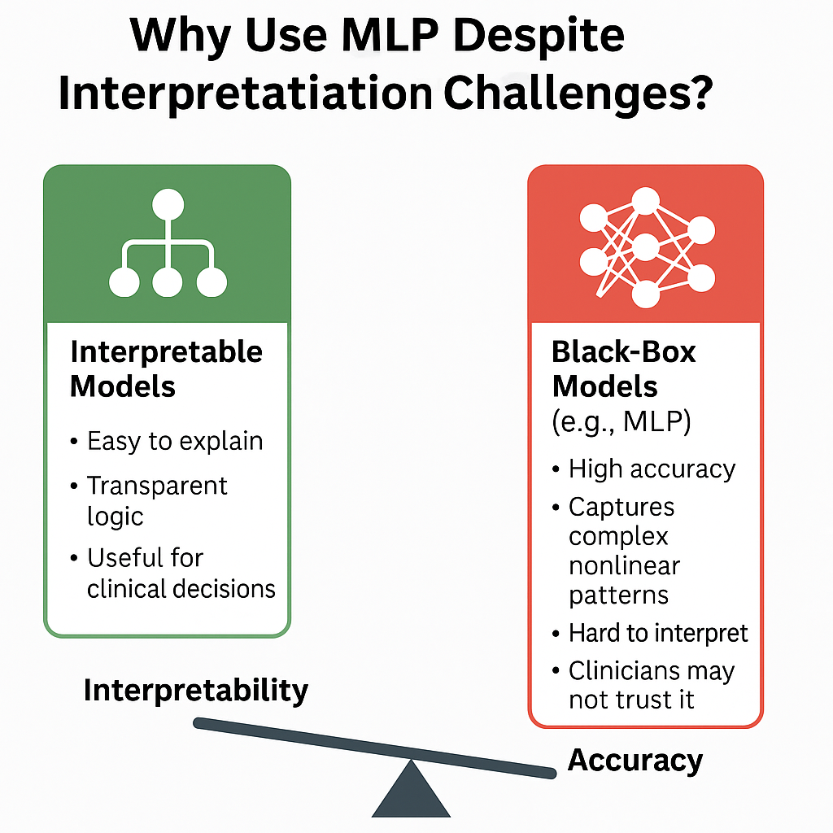
Challenges
MLP is accurate but hard to interpret. Clinicians need transparent Explainable Models.
Association Rules – Missing features related to Frequent Procedures on the Dataset

Slide 16
FUTURE WORK / IMPROVEMENTs
Use SMOTE or cost-sensitive learning to address class imbalance.
Explore rule-based models + ML hybrid.
Incorporate clinical features like severity or procedure types more directly

Slide 17
Conclusion
ML can predict readmissions with high accuracy.
Random Forest is promising
Clustering reveals meaningful patient segments
Next step: Improve interpretability & clinical adoption

Slide 18
References
Rajkomar, A., Dean, J., & Kohane, I. (2019). Machine learning in medicine. New England Journal of Medicine, 380(14), 1347–1358. https://doi.org/10.1056/NEJMra1814259
Zhou, L., Pan, S., Wang, J., & Vasilakos, A. V. (2020). Machine learning on big data: Opportunities and challenges. Neurocomputing, 237, 350–361. https://doi.org/10.1016/j.neucom.2017.01.026
Elixhauser A (AHRQ), Steiner C (AHRQ). Readmissions to U.S. Hospitals by Diagnosis, 2010. HCUP Statistical Brief #153. April 2013. Agency for Healthcare Research and Quality, Rockville, MD. http://www.hcup-us.ahrq.gov/reports/statbriefs/sb153.pdf.

Slide 19
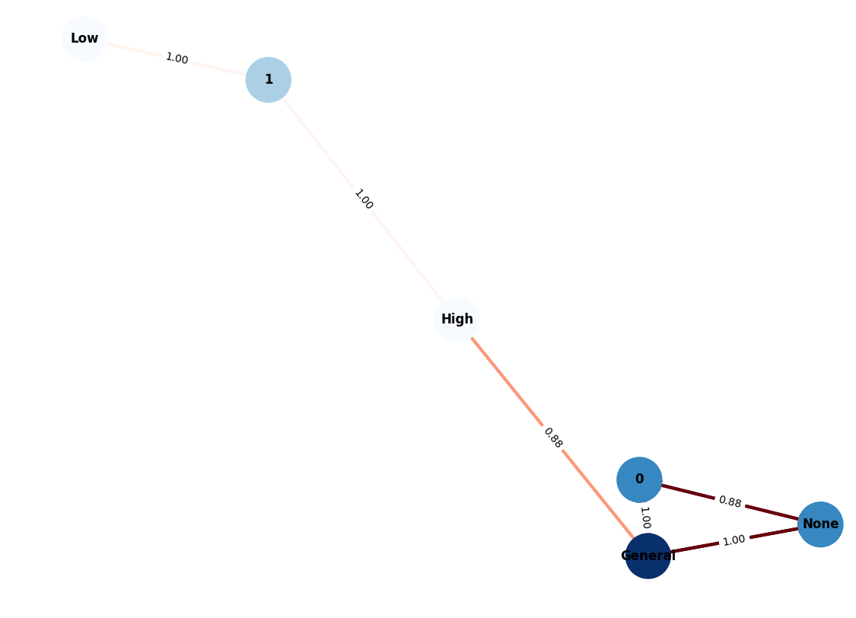
Q&A
Thank you!

