Slide 1

ML Model analysis for CAN Bus Intrusion Detection Systems – Cybersecurity
DR. MIGHTY ITAUMA ITAUMA.
RICHARD DEVOS Graduate school, NORTHWOOD UNIVERSITY
Contributors:
Saumya Padhi,
https://github.com/saumyasam/analytics_papers/tree/main/Can_BUS​

Slide 2
Abstract
Overview of cybersecurity threats to CAN bus systems.
Use of ML models for intrusion detection.
Dataset: CAN MIRGU dataset with normal and attack data.
Key findings: Random Forest, XGBoost, and LSTM perform best.

Slide 3


What is the CAN bus and why is it important?
Increasing cybersecurity threats in automotive systems.
Traditional IDS vs. ML-based IDS.
Introduction

Slide 4
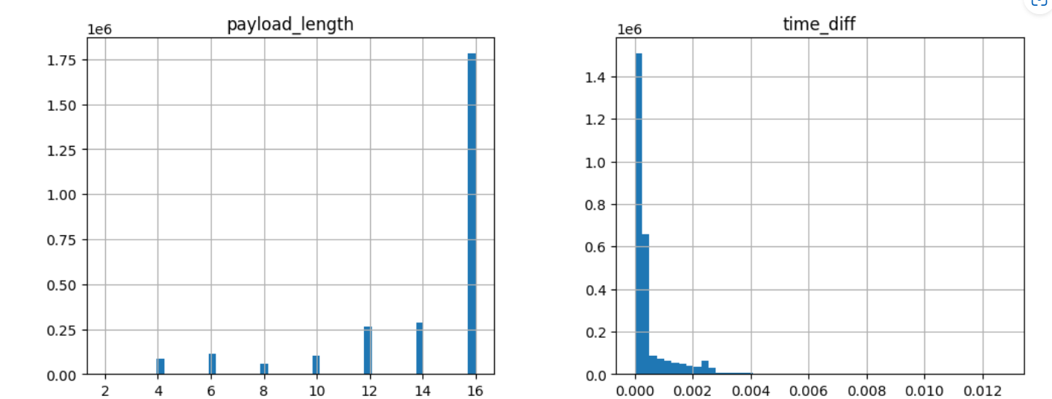
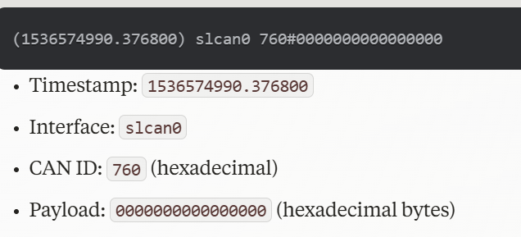
Dataset
CAN Bus Log Structure:
The dataset contains timestamps, CAN IDs, and payloads from the CAN bus logs.
The timestamps are in epoch format but have been successfully converted to a readable datetime format (e.g., 2018-09-10 10:06:04.242068).
CAN IDs (e.g., 1C8, 1E9, 232, etc.) represent unique message identifiers sent over the CAN bus.
Payload contains hexadecimal data representing actual message contents.
Payload Length Analysis:
The payload_length column indicates the size of each CAN message in bytes.
The first three messages have 16-byte payloads, while the next two have 10-byte payloads.

Slide 5
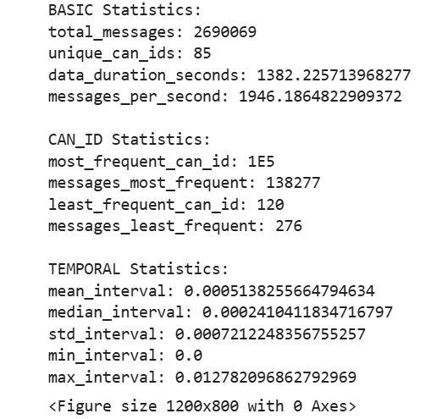
EDA & Descriptive Analysis
BASIC Statistics:
total_messages: 2690069: This indicates the total number of CAN frames captured in the dataset. A large number suggests a substantial recording period.
unique_can_ids: 85: There are 85 distinct CAN IDs present in the dataset, meaning there are 85 different types of messages being transmitted on the CAN bus.
CAN_ID Statistics:
most_frequent_can_id: 1E5: The CAN ID "1E5" (hexadecimal) is the most frequently occurring message type in the dataset.
messages_most_frequent: 138277: The CAN ID "1E5" appears 138,277 times in the dataset.
messages_least_frequent: 276: The CAN ID "120" appears 276 times in the dataset.

Slide 6
Literature Review
Early rule-based IDS and their limitations.
Emergence of ML-based intrusion detection.
Effectiveness of Random Forest, XGBoost, and LSTM.
Challenges in dataset availability, feature selection, and model interpretability.

Slide 7
Methodology
Problem formulation: Identifying anomalies in CAN bus traffic.
Dataset: CAN MIRGU dataset with normal and attack data.
Data preprocessing: Timestamp conversion, feature extraction, and normalization.
ML models used: Logistic Regression, SVM, KNN, Random Forest, XGBoost, LSTM.

Slide 8
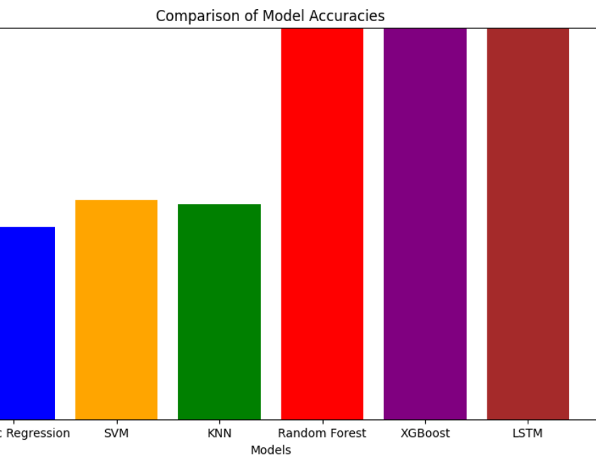
Model comparison
Performance Discrepancy: The chart clearly demonstrates a substantial performance difference between the first three models (Logistic Regression, SVM, KNN) versus the last three (Random Forest, XGBoost, LSTM).
Perfect Accuracy: Random Forest, XGBoost, and LSTM all achieve perfect accuracy, which is highly unusual and warrants further investigation.
Model Selection: Based on this chart, Random Forest, XGBoost, or LSTM would be the preferred models due to their significantly higher accuracy.

Slide 9
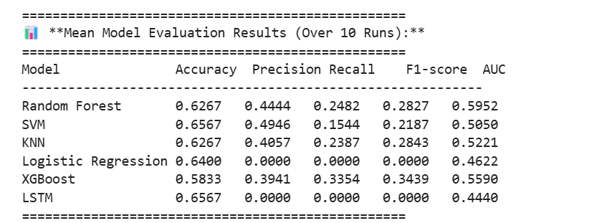
Model Evaluation
Metrics Explained:
Accuracy: The proportion of correctly classified instances.
Precision: The proportion of correctly predicted positive instances out of all instances predicted as positive.
Recall: The proportion of correctly predicted positive instances out of all actual positive instances.
F1-score: The harmonic means of precision and ¹ recall, providing a balance between the two.
AUC (Area Under the ROC Curve): A measure of the model's ability to distinguish between positive and negative classes.

Slide 10
Linear models (Logistic Regression, SVM, KNN) performed poorly, highlighting their limitations in capturing complex attack patterns.
Ensemble and deep learning models (Random Forest, XGBoost, LSTM) achieved perfect accuracy, suggesting their robustness in intrusion detection. However, overfitting concerns necessitate further validation.
Conclusion

Slide 11
SUMMARY & CHALLENGES
ML-based IDS are effective but require further refinement.
Future research areas:
Addressing overfitting.
Enhancing real-time deployment.
Improving interpretability of deep learning models.

Slide 12
Thank you
RICHARD DEVOS Graduate school, NORTHWOOD UNIVERSITY
PRESENTED BY:
Saumya Padhi.

