Slide 1

ANALYSING heart disease through analytics
DR. MIGHTY ITAUMA.
RICHARD DEVOS Graduate school, NORTHWOOD UNIVERSITY
Contributors:
Saumya Padhi,
Imran Shaik,
Srinivas Bhootam
Pooja Shinde
https://github.com/saumyasam/casestudy_heart

Slide 2
Background
Problem Definition:
How can we predict whether a person has heart disease based on their health and demographic information?
In the dataset provided, the target variable defines whether a person has heart disease Specifically,
0=Indicates no heart disease [Negative Case] 1=Indicates the presence of Heart disease[Positive Case]
This binary variable Target is the dependent variable in your analysis, and the goal of a logistic regression model is to predict this target based on the other independent variables, such as age, sex, cholesterol, and blood pressure.

Slide 3
Variables
In your dataset, the variables can be categorized as follows:
Dependent Variable (Target):
target: A binary variable where:
0: No heart disease.
1: Presence of heart disease.
Independent Variables (Predictors):
age: Age of the patient.
sex: Gender of the patient (Male/Female).
chest_pain_type: Type of chest pain experienced (e.g., Typical angina).
resting_blood_pressure: Resting blood pressure in mm Hg.
cholestoral: Serum cholesterol in mg/dl.
fasting_blood_sugar: Indicates if fasting blood sugar is greater than 120 mg/dl.
thalassemia: Type of blood disorder (e.g., Fixed Defect, Reversable Defect).
The above image provides the results of a binomial logistic regression model. The model aims to predict a binary outcome variable (target) based on several predictor variables.

Slide 4
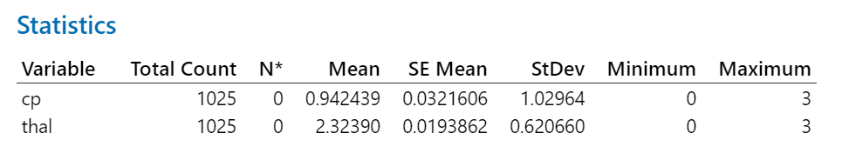
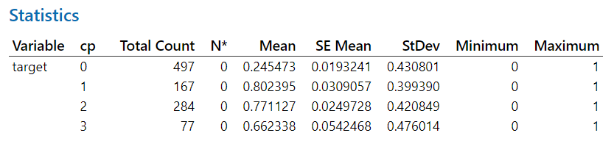
DISCRIPTIVE STATISTICS
Cp = chest pain
Thal= Thallium Stress Test

Slide 5
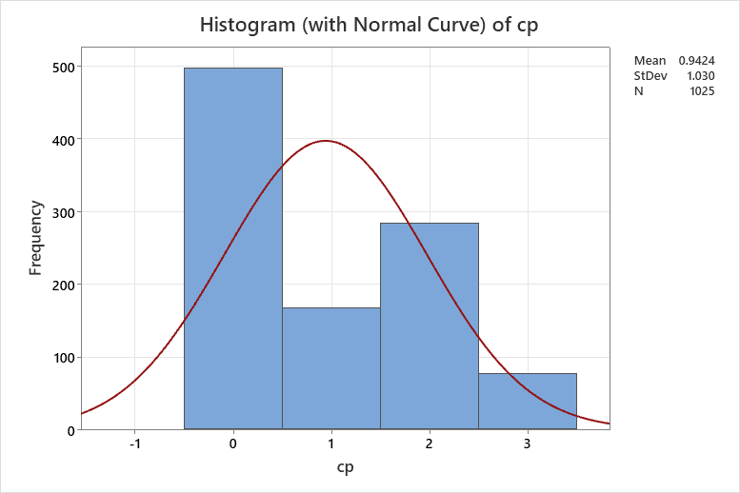
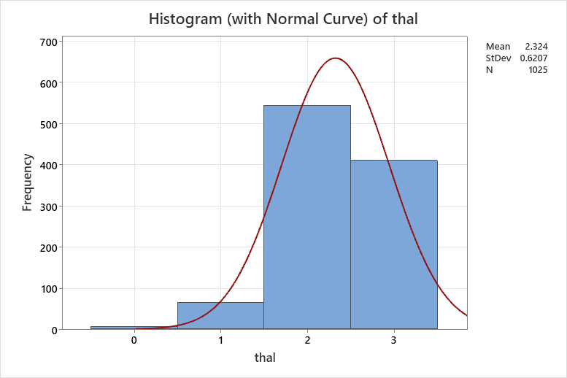
DISCRIPTIVE STATISTICS
Cp = chest pain
Thal= Thallium Stress Test

Slide 6
exploratory Data Analysis
Effect of Chest Pain Type (cp): The data suggest that different chest pain types may have varying associations with heart disease. Individuals with "cp" = 2 appear to have the highest risk, while those with "cp" = 0 have the lowest risk.
Effect of Thal (Thallium Stress Test): The "thal" variable also seems to be associated with heart disease risk. Individuals with "thal" = 2 have the highest proportion of heart disease, followed by those with "thal" = 3.
Prevalence of Heart Disease: The "target" variable indicates the presence or absence of heart disease.
The proportion of individuals with heart disease (target = 1) varies across the different "cp" categories.
For example, individuals with "cp" = 2 have the highest proportion of heart disease (77.11%).
Cp = chest pain
Thal= Thallium Stress Test

Slide 7
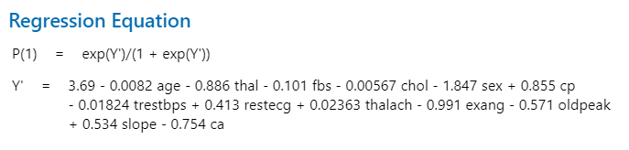
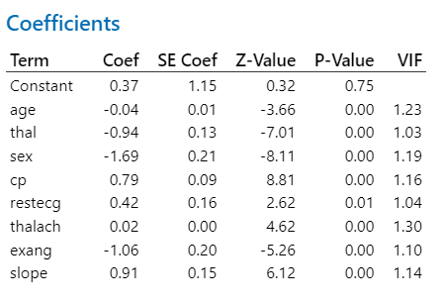
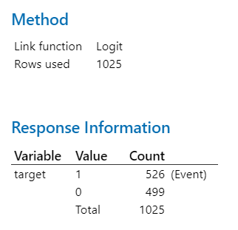
Logistic regression

Slide 8
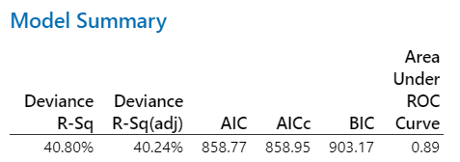
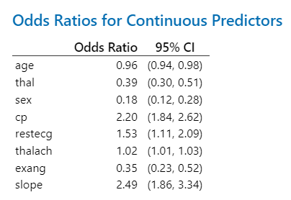
Logistic regression
Predictors:
thal: A decrease in thal is associated with a significant decrease in the odds of the outcome.
sex: Being female (compared to male) is associated with a significantly lower odds of the outcome.
cp: Chest pain type is significantly associated with the outcome. Individuals with a certain type of chest pain have over twice the odds of the outcome compared to those with the baseline chest pain type.
restecg: Resting electrocardiographic results are associated with an increased odds of the outcome.
thalach: Maximum heart rate achieved has a weak positive association with the outcome.
slope: The slope of the peak exercise ST segment is associated with an increased odds of the outcome.

Slide 9
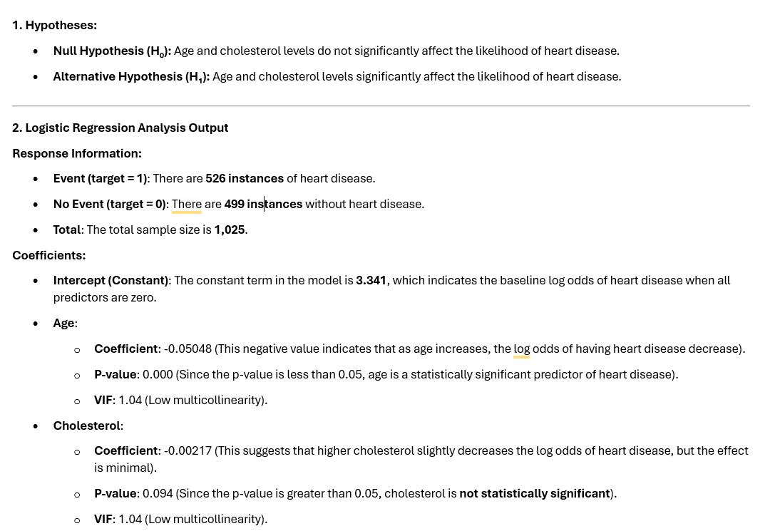

Slide 10
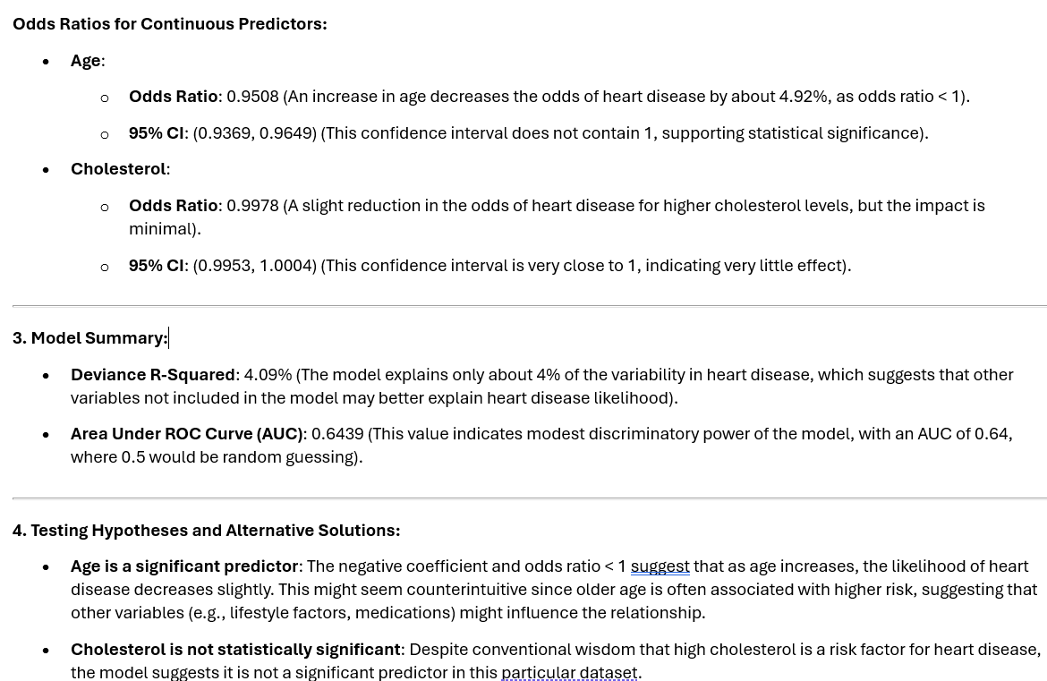

Slide 11
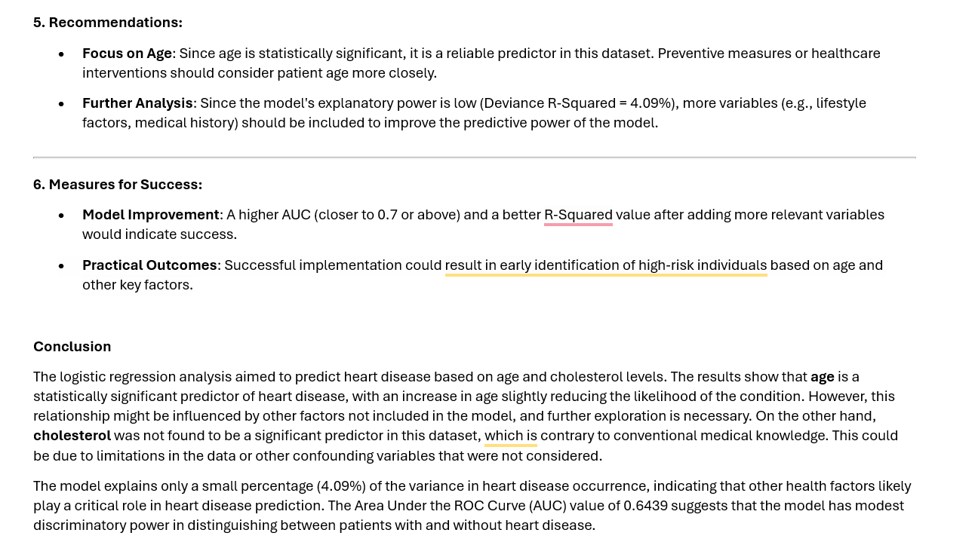

Slide 12
Thank you
RICHARD DEVOS Graduate school, NORTHWOOD UNIVERSITY
PRESENTED BY:
Saumya Padhi,
Imran Shaik,
Srinivas Bhootam
Pooja Shinde

