Slide 1

ANALYSING heart disease through analytics
DR. MIGHTY ITAUMA ITAUMA.
RICHARD DEVOS Graduate school, NORTHWOOD UNIVERSITY
Contributors:
Saumya Padhi,
Imran Shaik,
Srinivas Bhootam
Pooja Shinde
https://github.com/saumyasam/casestudy_heart

Slide 2
Background
Problem Definition:
How can we predict whether a person has heart disease based on their health and demographic information?
In the dataset provided, the target variable defines whether a person has heart disease Specifically,
0=Indicates no heart disease [Negative Case] 1=Indicates the presence of Heart disease[Positive Case]
This binary variable Target is the dependent variable in your analysis, and the goal of a logistic regression model is to predict this target based on the other independent variables, such as age, sex, cholesterol, and blood pressure.

Slide 3
Variables
Dependent Variable:
target: This variable indicates the presence or absence of heart disease. Our aim here is to predict heart disease, "target" is the dependent variable.
Independent Variables:
age
sex
cp: chest pain type (categorical)
trestbps: resting blood pressure
chol: serum cholesterol in mg/dl
fbs: fasting blood sugar > 120 mg/dl (yes/no)
restecg: resting electrocardiographic results (categorical)
thalach: maximum heart rate achieved
exang: exercise induced angina (yes/no)
oldpeak: ST depression induced by exercise relative to rest
slope: the slope of the peak exercise ST segment (categorical)
ca: number of major vessels (0-3) colored by flourosopy
thal: Thallium stress test results (categorical)
The above detail used for a binomial logistic regression model.

Slide 4
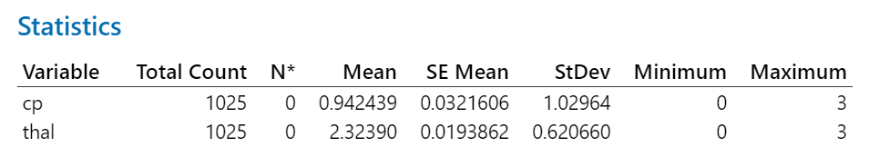
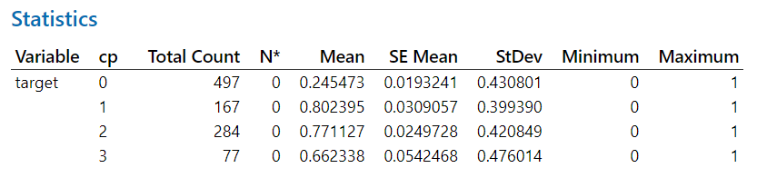
DISCRIPTIVE STATISTICS
Cp = chest pain
Thal= Thallium Stress Test

Slide 5
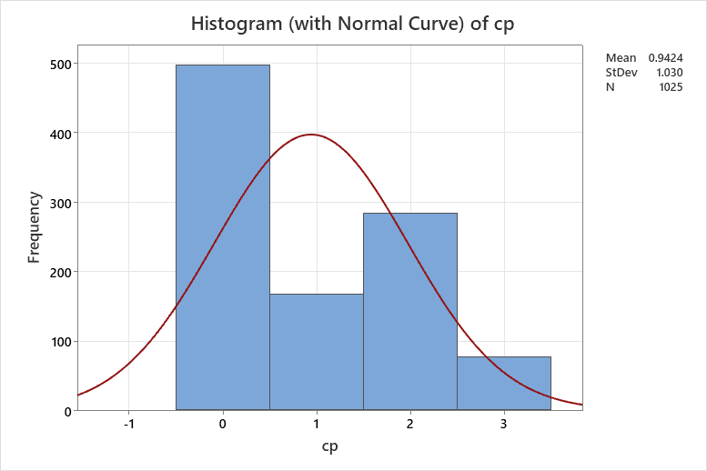
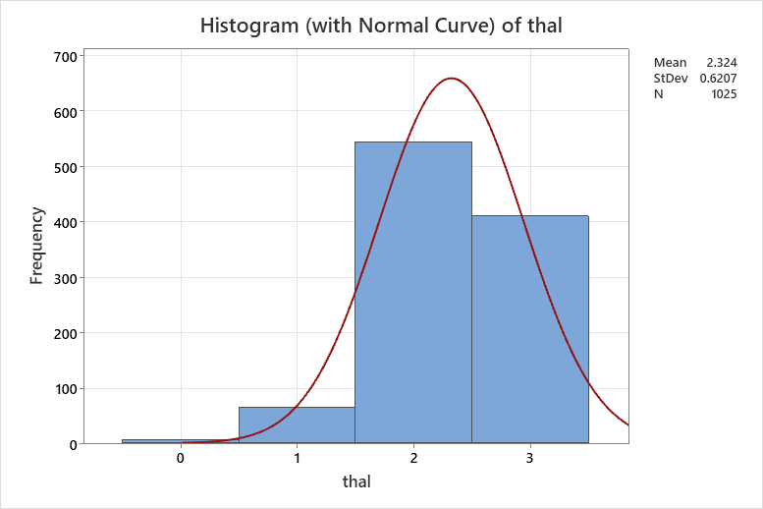
DISCRIPTIVE STATISTICS
Cp = chest pain
Thal= Thallium Stress Test

Slide 6
exploratory Data Analysis
Effect of Chest Pain Type (cp): The data suggest that different chest pain types may have varying associations with heart disease. Individuals with "cp" = 2 appear to have the highest risk, while those with "cp" = 0 have the lowest risk.
Effect of Thal (Thallium Stress Test): The "thal" variable also seems to be associated with heart disease risk. Individuals with "thal" = 2 have the highest proportion of heart disease, followed by those with "thal" = 3.
Prevalence of Heart Disease: The "target" variable indicates the presence or absence of heart disease.
The proportion of individuals with heart disease (target = 1) varies across the different "cp" categories.
For example, individuals with "cp" = 2 have the highest proportion of heart disease (77.11%).
Cp = chest pain
Thal= Thallium Stress Test

Slide 7
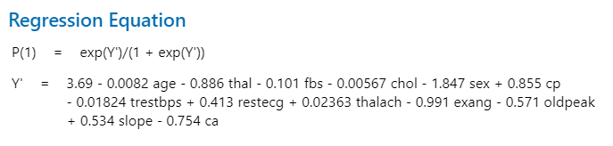
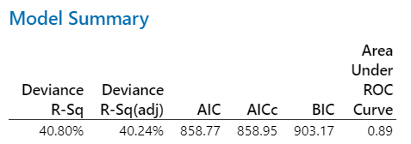
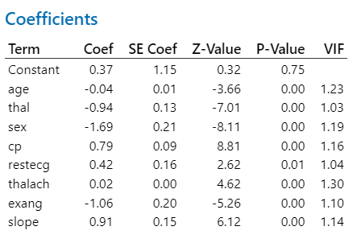
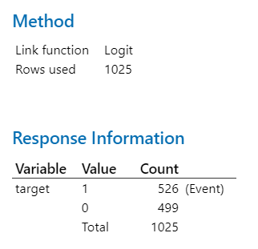
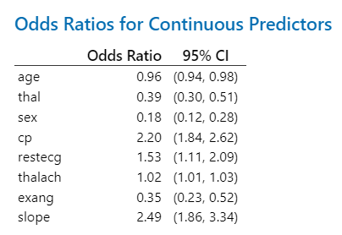
Binary Logistic regression

Slide 8
Logistic regression - Interpretation
thal: OR = 0.39 (95% CI: 0.30, 0.51). A higher thal value reduces the odds by 61% i.e. A decrease in thal is associated with a significant decrease in the odds of the outcome. i.e.
sex: OR = 0.18 (95% CI: 0.12, 0.28), Being female (compared to male) is associated with a significantly lower odds of the outcome.
cp: OR = 2.20 (95% CI: 1.84, 2.62). Chest pain type is significantly associated with the outcome. Individuals with a certain type of chest pain have over twice the odds of the outcome compared to those with the baseline chest pain type.
restecg: OR = 1.53 (95% CI: 1.11, 2.09) Resting electrocardiographic results are associated with an increased odds of the outcome.
thalach: OR = 1.02 (95% CI: 1.01, 1.03). Maximum heart rate achieved has a weak positive association with the outcome.
slope: OR = 2.49 (95% CI: 1.86, 3.34) The slope of the peak exercise ST segment is associated with an increased odds of the outcome.

Slide 9
Summary
Significant predictors (p < 0.05) include: age, thal, sex, cp, restecg, thalach, exang, and slope.
Predictors such as age and exang decrease the odds of the outcome, while cp and slope increase it.
No multicollinearity issues were detected (VIF < 5).

Slide 10
Thank you
RICHARD DEVOS Graduate school, NORTHWOOD UNIVERSITY
PRESENTED BY:
Saumya Padhi,
Imran Shaik,
Srinivas Bhootam
Pooja Shinde

