Slide 1
The Stagnation Crisis:
Why Our Top Talent is Preparing to Leave
A Predictive Audit of the 6-Year Turnover Cliff
Saumya Singhani
MGMT 595: Advanced HR Analytics
Professor Dr. Angela Grotto
Montclair State University

Slide 2
Our Biggest Assumption is Wrong: Pay is Not the Problem
The Noise
The Signal
  Annual Salary: No statistical impact on retention.
  Compa-Ratio: Market-competitive pay is not stopping exits.
  Finding: We cannot "buy" our way out of this crisis.
  Job Tenure: Risk increases every year in the same role.
  Travel Time: Long commutes are a primary trigger for leaving.
  Promotion Speed: Lack of movement is our strongest predictor of loss.
vs
We are treating a stagnation problem with salary solutions. The data proves movement matters more than money.

Slide 3
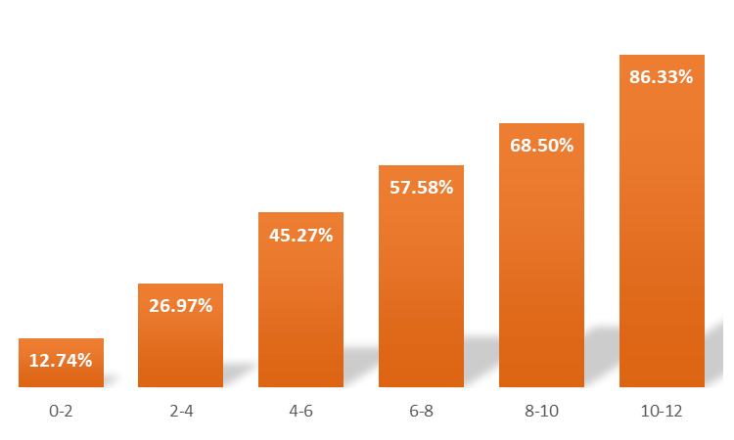
The 6-Year Cliff: Where Loyalty Ends
Critical Findings:
  The Stability Phase (0–4 Years): Risk remains manageable under 30%.
  The Crisis Point (6 Years): Probability of turnover doubles to 58%.
  The Point of No Return: By year 10, the probability of an exit hits 86%.
We aren't just losing "employees" - we are losing our subject matter experts and institutional memory because they feel trapped in their roles.

Slide 4
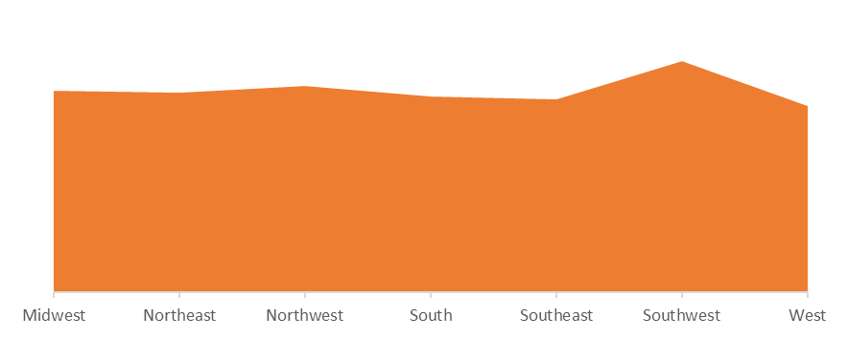
The Southwest Crisis: Geography as a Predictor of Loss
  51% Risk: Highest turnover probability in the company.
  Logistical Friction: Travel Time is the primary statistical driver.
  The "Perfect Storm": Commute stress + role stagnation in the Products Unit.
Our retention pilot cannot be "one-size-fits-all." We must prioritize the Southwest and address the travel-related friction before the talent drain worsens.

Slide 5
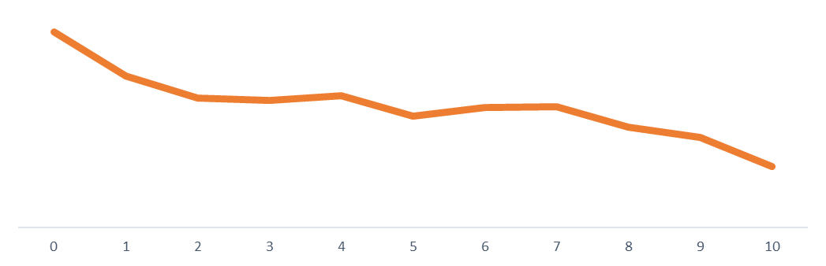
Movement Resets the Risk Clock
The Power of Internal Mobility
  The Danger Zone: Employees with 0–2 promotions are most vulnerable to the "6-Year Cliff."
  The Retention Anchor: 5+ promotions drops risk below 30%, regardless of total tenure.
  The "Reset" Effect: Every move serves as a psychological "reset," dramatically lowering exit probability.
We don't necessarily need more headcount or higher salaries; we need a more fluid internal market. To keep our best people, we must move them before they move on.

Slide 6
The Path Forward: Pilot Retention Program
3-Year "Stay" Interviews
  Goal: Intervene before the 6-Year Cliff.
  Action: HR will conduct mandatory career-mapping sessions for all employees hitting their 3rd anniversary to prevent the stagnation spike.
Southwest Hybrid-Flex Pilot
  Goal: Neutralize "Travel Time" friction.
  Action: Implement a 2-day remote work option specifically for the Southwest region to reduce the logistical burden identified in the regression.
Products Unit" Lateral Rotations
  Goal: Reset the stagnation clock for subject matter experts.
  Action: Launch a mobility program allowing veterans in the Products Unit to rotate into new job functions, providing a psychological "reset" without requiring a promotion.

