Slide 1

Analysis of Branch Predictor Choices and their impact on Performance of X86 Processors using Gem5 Simulator
Team Members:
Saumya Shah (sxs220366)
Deep Padmani (dmp210005)

Slide 2
Initial Set-up
For this project we have utilized the Gem5 simulator installed on the UTD server.
Copied the Gem5 on the local directory using the command:
“cp –rf /usr/local/gem5 /home/eng/s/sxs220366/CA/”
Compiled using the command:
“scons build/X86/gem5.opt”
After compilation we cloned the benchmark files to our local directory using the command:
“git clone https://github.com/timberjack/Project1_SPEC”

Slide 3
Branch Predictors
A branch predictor is a crucial component of a pipelined CPU that helps improve its performance.
It works by attempting to anticipate the address of a branch instruction well in advance and with limited context, organizing the most likely outcome.
Despite having access to only the current instruction's address and a limited history, the predictor operates before the decoder pipeline phase.

Slide 4
Type of Branch Predictors
Tournament Predictor
Local Predictor
Bi-mode Predictor

Slide 5
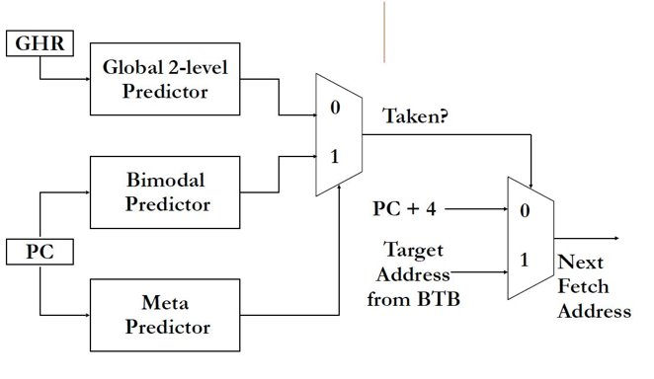
Tournament Predictor
It improves the accuracy of predictions by using a combination of two or more other branch predictors.
Uses a meta-predictor to determine which of the branch predictors should be used for each branch instruction. The meta-predictor compares the accuracy of the predictions made by the different predictors and selects the one with the highest accuracy for each branch.
This approach can provide higher prediction accuracy than any individual predictor alone.

Slide 6
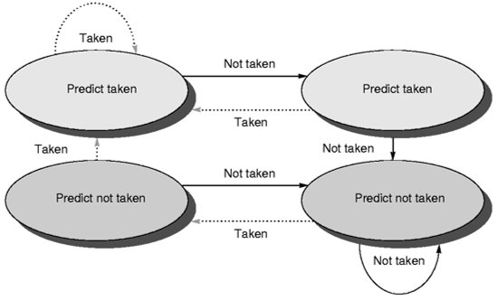
Local Predictor
Makes a prediction depending on the outcome of a branch for its last ten executions.
Stores a table of the history of branches at each location and uses this information to make predictions.
Local predictors work well when a program has repeating patterns of branches at specific locations.

Slide 7
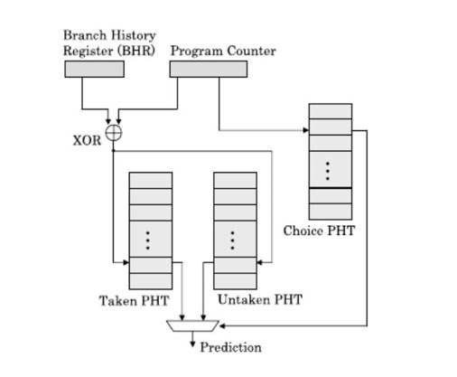
Bi-mode Predictor
It is a hybrid of local and global predictor. The bi-mode predictor uses a local predictor to predict the outcome of branches at specific locations in the program and a global predictor to predict branches that do not have a history at the current location.
The global predictor uses a history buffer to store the history of recent branches in the program and uses this information to make predictions.
The bi-mode predictor selects either the local or global predictor based on the history of recent branches at the current location in the program.

Slide 8
Project Requirements and Specifications
Objective
To Simulate different branch predictors over different benchmarks and observing their behavior hierarchy in X86 architecture on Gem5 simulator .
Tools Used
Gem5 simulator on the university server
MobaXterm: For remote SSH extension to access Gem5 over university server
Benchmarks: (1) 456.hmmer (2) 458.sjeng
Branch Predictors: (1) LocalBP( ) (2) TournamentBP ( ) (3) BiModeBP( )
Python Script: Created a Python script for the Project

Slide 9
Deliverables

Slide 10
Changes made to source files.
Observing the changes made.
Generating the BTBMissPct and BranchMispredPercent for all Benchmarks
Varying the sizes of predictor and calculating the same for TournamentBP, LocalBP and BimodeBP
Graphs of each benchmark for each Branch Predictor
Observations from the graphs.

Slide 11
Change in Gem5

Slide 12
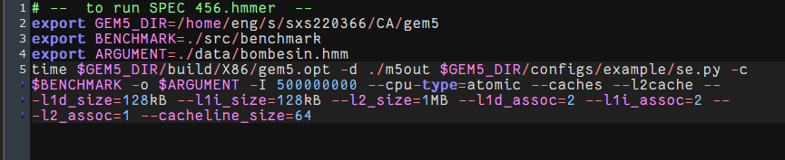
We made the following changes to the respective “runGem5.sh” files for the Benchmarks 456.hmmer, 458.sjeng
Change the path of the gem5 directory
Change the Argument path in every benchmark

Slide 13
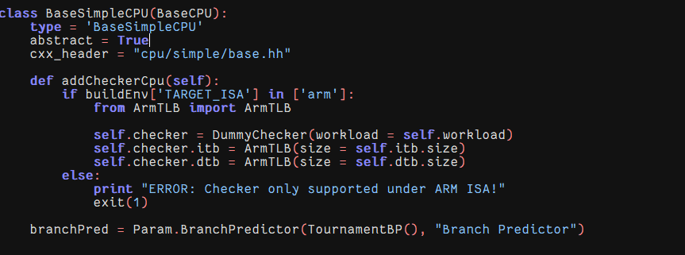
In the Gem5 folder, to change the branch predictor type
Go to cd gem5/src/cpu/simple .
Edit the file named “BaseSimpleCPU.py” and at the bottom we find the line: branchPred = Param.BranchPredictor (NULL, “Branch Predictor”)
In place of null we put the branch predictor types given: 1. LocalBP 2. BimodeBP 3. TournamentBP.
After changing each BP, delete all the files gem5/build/X86 first and then use the scons (% scons build/X86/gem5.opt) command to recompile in order to reflect the changes.

Slide 14
Changes in source files

Slide 15
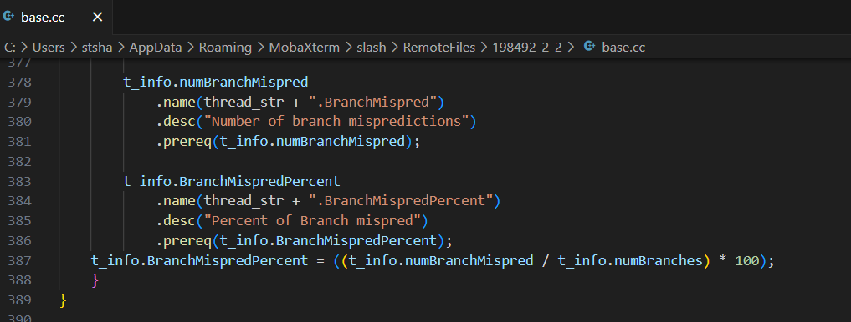
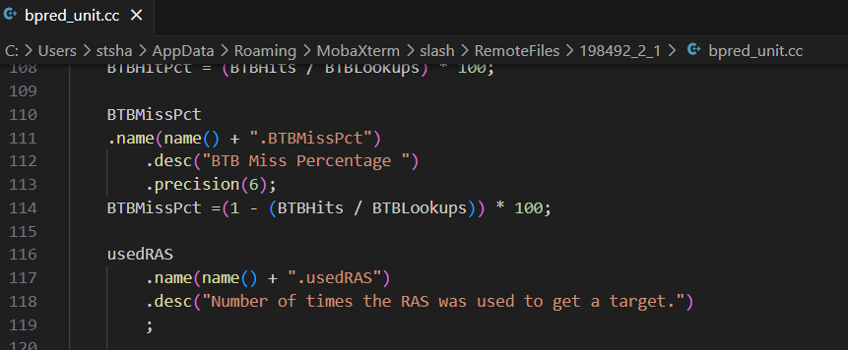
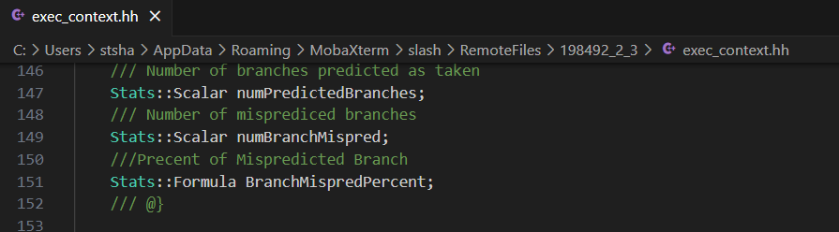
Changes in base.cc file for definition of BranchMispredPercent
Changes in bpred_unit.cc file for adding the definition of BTBMissPct
Changes in exec_context.hh file

Slide 16
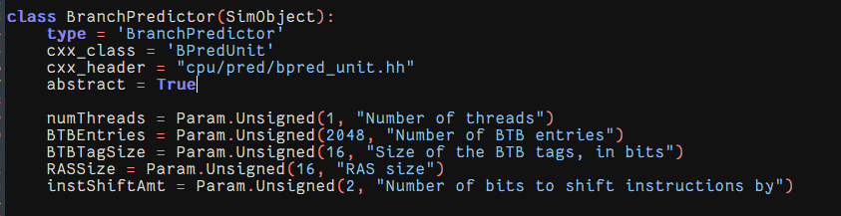
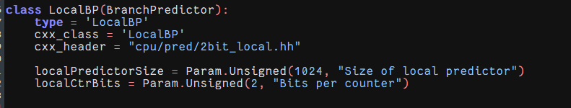
We make following changes in sizes of the predictor in gem5 in file: gem5/src/cpu/pred/Branchpredictor.py The changes in the files are done using a custom python script: run_project1.py
In class BranchPredictor : Number of BTB entries is changed .
In class LocalBP: Size of local predictor is changed

Slide 17
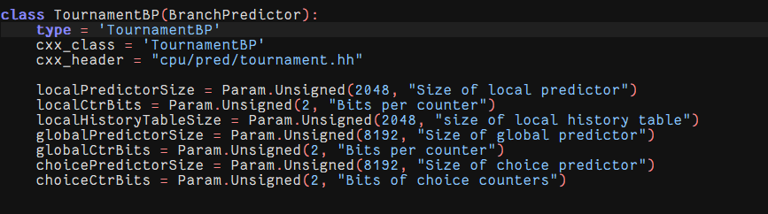
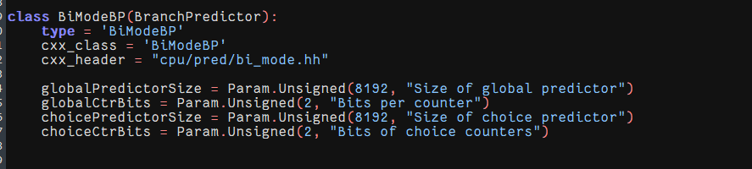
We make following changes in sizes of the predictor in gem5 in file: gem5/src/cpu/pred/Branchpredictor.py
In class TournamentBP: localPredictorSize, globalPredictorSize and choicePredictorSize are changed
In class BiModeBP: globalPredictorSize and choicePredictorSize are changed

Slide 18
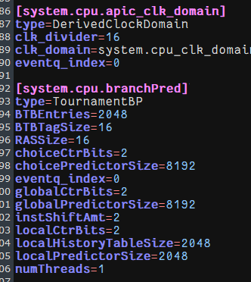
Output to be observed after compiling
After making the necessary changes we run the script for all the benchmarks, for all the three Branch Predictors separately and compare the results for different Branch Predictors.
Then in m5out/config.ini file of every benchmark, we observe if the type of system.cpu.pred is the same as the predictor we have changed.

Slide 19
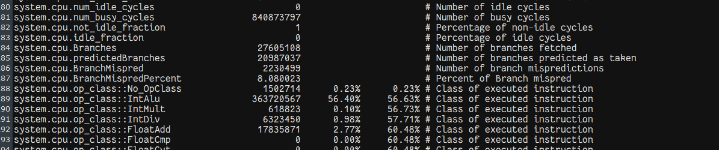
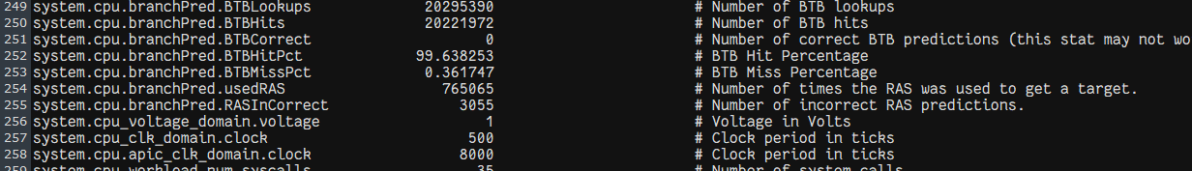
The results are present in the m5out/stats.txt file of each benchmark

Slide 20
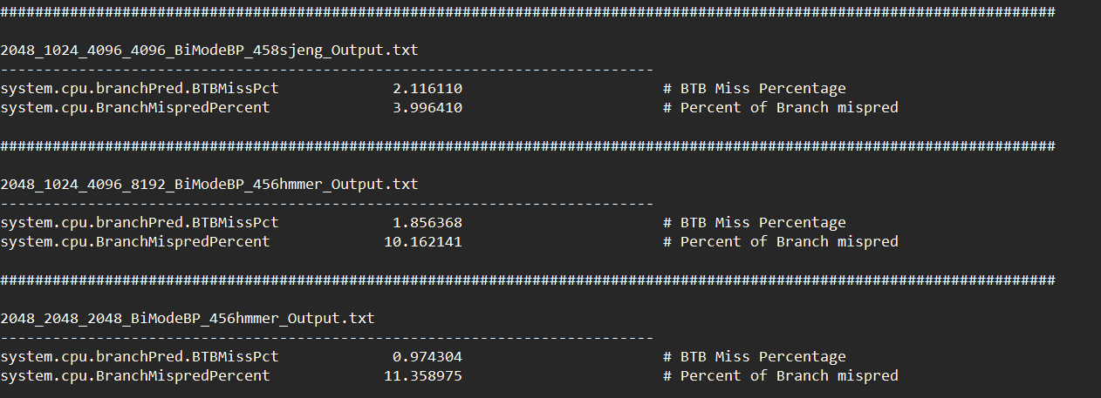
We made a separate .txt file for each predictor

Slide 21
BTB Miss Pct of all Benchmarks for all types o Predictors

Slide 22
Branch Miss Percentage for 456.hmmer

Slide 23
Branch Miss Percentage for 458.sjeng

Slide 24
Branch MisPredPercent of all Benchmarks for all types o Predictors

Slide 25
Branch Miss prediction percentage for 456.hmmer

Slide 26
Branch Miss prediction percentage for 458.sjeng

Slide 27
Observations and Conclusions
From the graphs obtained we can say that for the given combination of branch predictor sizes the BiMode BP is giving the least BTB miss percentage for benchmarks 456.hmmer and Tournament BP is giving least BTB miss percentage for 458.sjeng.
The best result we obtained for benchmark 456.hmmer : Branch Predictor-BiMode BP, BTB miss percent = 0.994386, BTB Entry = 4096 and Predictor size = 2048.
The Tournament BP is giving the least branch miss prediction percentage for 456.hmmer it is 458.sjeng for BiMode BP and it is 458.sjeng for Local BP.
The best result we obtained for benchmark 458.sjeng : Branch Predictor-Local BP, Branch miss percent = 0.5808048, BTB Entry = 4096 and Predictor size: Local=2048, Global=4096, Choice = 4096.

Slide 28
We can choose BiMode BP for benchmark 456.hmmer as it is providing the best tradeoff between the BTB miss percentage and Branch Miss percentage when compared to Tournament BP. The BTB miss percentage by BiMode is 0.994386 and the Branch Miss Prediction percent is 11.358833.
For benchmark 458.sjeng the Tournament BP gives the best results with a BTB miss percentage of 4.82227 and Branch Prediction miss percentage of 9.543592.

Slide 29
BTB Miss PCT values for all benchmarks for Tournament Branch Predictors

Slide 30
Keeping the BTBentries value same and changing the sizes of Local Predictor (LP), Global Predictor(GP), Choice Predictor (CP) and observing the changes in BTB Miss percentage for all benchmarks using graphs.
As LP,GP & CP sizes increases, BTB MissPct decreases.

Slide 31
Keeping the BTBentries value same and changing the sizes of Local Predictor (LP), Global Predictor(GP), Choice Predictor (CP) and observing the changes in BTB Miss percentage for all benchmarks using graphs.
As LP,GP & CP sizes increases, BTB MissPct increases.

Slide 32
BTB Miss PCT values for all benchmarks for Tournament Branch Predictors

Slide 33
Branch Mispred Percentage for all Benchmarks for Tournament Branch Predictor

Slide 34
Keeping the BTB value same and changing the sizes of Local Predictor (LP), Global Predictor (GP), Choice Predictor (CP) and observing the changes in Percentage of Branch Miss Prediction for all benchmarks using graphs.

Slide 35
Keeping the BTB value same and changing the sizes of Local Predictor (LP), Global Predictor (GP), Choice Predictor (CP) and observing the changes in Percentage of Branch Miss Prediction for all benchmarks using graphs.
As LP, GP & CP size increases, Percentage of Branch Miss prediction decreases.

Slide 36
Keeping the BTB value same and changing the sizes of Local Predictor (LP), Global Predictor (GP), Choice Predictor (CP) and observing the changes in Percentage of Branch Miss Prediction for all benchmarks using graphs.
As LP, GP & CP size increases, Percentage of Branch Miss prediction increases.

Slide 37
Observations and Conclusions
For the Tournament BP
We observe that as the sizes of the 3 predictors increase the BTB Miss percentage decrease for benchmarks 456.hmmer and increases for 458.sjeng if we keep the BTB Entries constant. Branch prediction miss percentage decrease if we keep the BTB Entries constant for both benchmarks.
If we change the BTB Entries and vary the 3 predictors sizes as well, we observe that as the BTB Entries size and the predictor sizes increase the BTB Miss percentage and the Branch Miss Prediction Percentage decreases.

Slide 38
Thank You

