Slide 1
EEDG 6306 – Application Specific Integrated Circuit Design
Submitted by:-
Saumya Shah (sxs220366)
Rutvikk Kharod (rxk220021)

Slide 2
Mini Stereo Digital Audio Processor
The MSDAP is implemented by a Digital Finite Impulse Response (FIR) Filter
Its main aim is to increase performance by reducing Power Consumption and increasing the efficiency through Lower cost as well
Two Channels (Left and Right) are used to bring in the input data.
It has its main applications in the Multimedia systems such as Hearing aids, speakers, home entertainment audio systems.

Slide 3

Algorithm Description
The FIR Digital filter is implemented based on the linear convolution given by:
$$y\left(n\right)=\sum_{k=0}^{N}{h\left(k\right).x(n−k)}$$
MSDAP performs only linear convolution, therefore a simpler hardware architecture is employed which avoids multiplication and addition
The coefficients are coded using minimum-number power-of-two digits, thus replacing multiplication with shifting and addition
To avoid the cons of a programmable shifter, an FIR filtering structure using only one-bit shifters is utilized as shown below:
$y\left(n\right)=2^{−1}(…$ $2^{−1}$($2^{−1}(2^{−1}\text{u}\text{1}$ + u₂) + u₃) +…) + u₁₆)

Slide 4
So Far…
Clock Frequency Calculation
State Diagram
Behavioral Design
Simulation

Slide 5
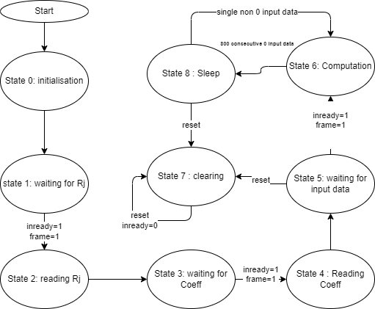
State Diagram

Slide 6
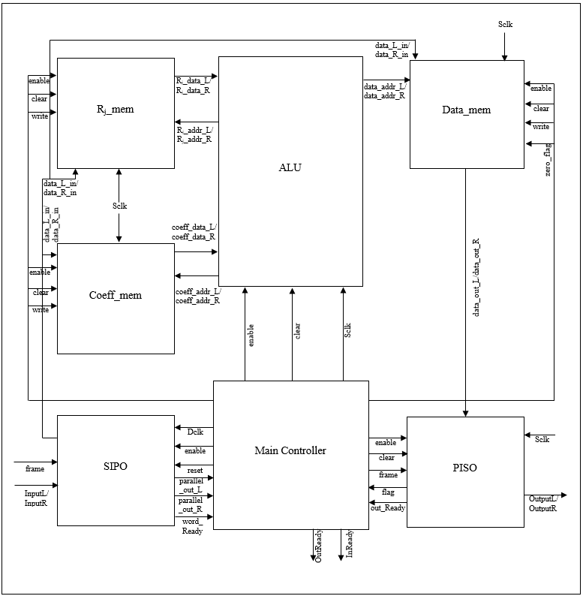
MSDAP Design

Slide 7
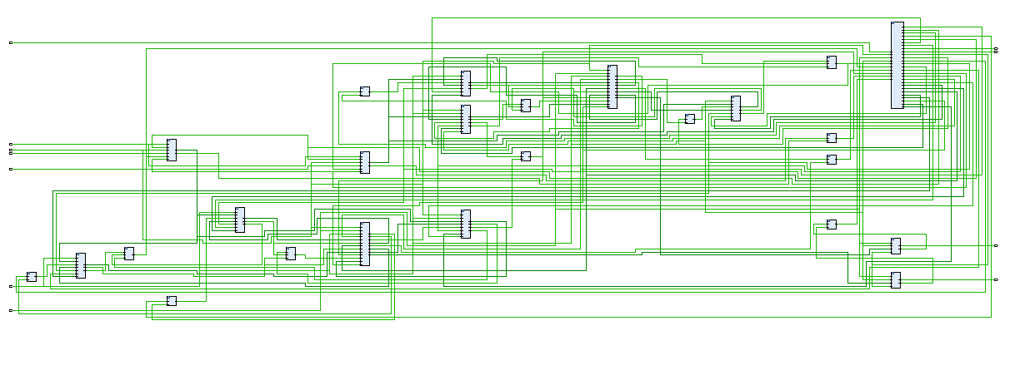
MSDAP Schematic

Slide 8

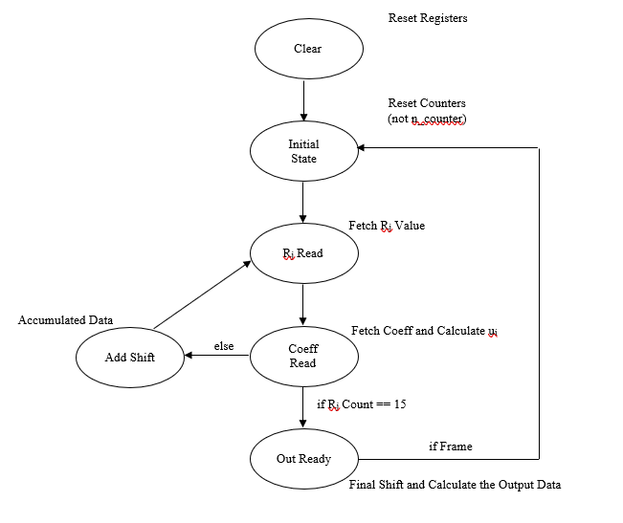
Finite State Machine ALU

Slide 9
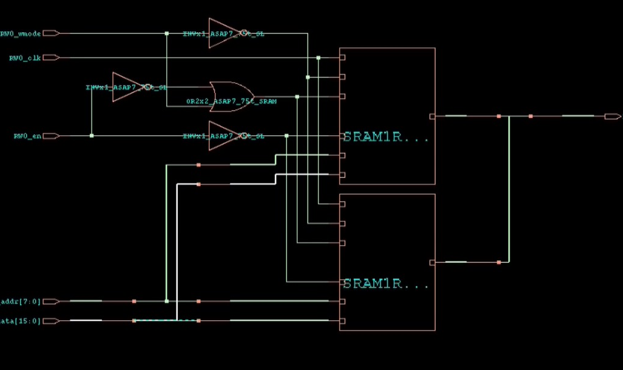
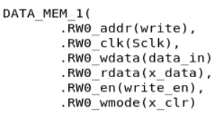
Integrating SRAM blocks to the design

Slide 10
Steps for Genus
Set root attributes
Define corners
Read libraries and SRAM macros
Read your Verilog files
Set design attributes
Exclude standard cells that may cause error
Synthesize the MSDAP design
Save design

Slide 11
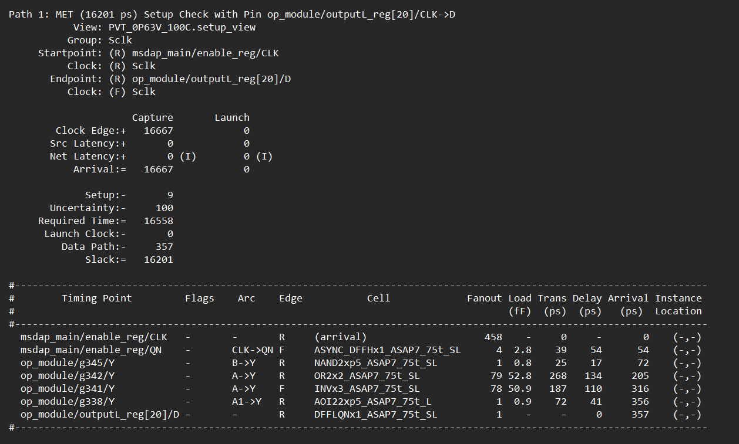
Power and Timing Reports

Slide 12
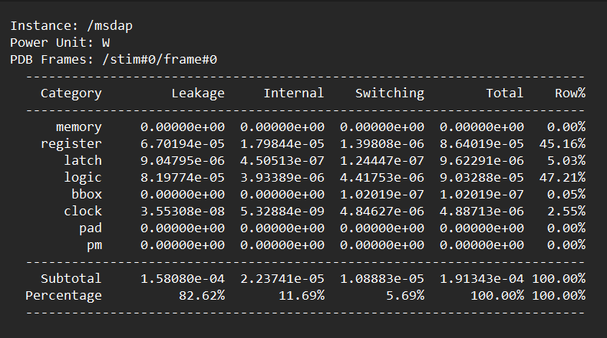
Power and Timing Reports

Slide 13
Steps for Innovus
Set root attributes
Read libraries and SRAM macros
Define corners
Read netlist
Setup power intent
Set other attributes
Read floorplan
Create routing tracks
Create place blockage on top & bottom row
Set I/O pin locations
Place cells
Synthesize clock tree
Route your design

Slide 14
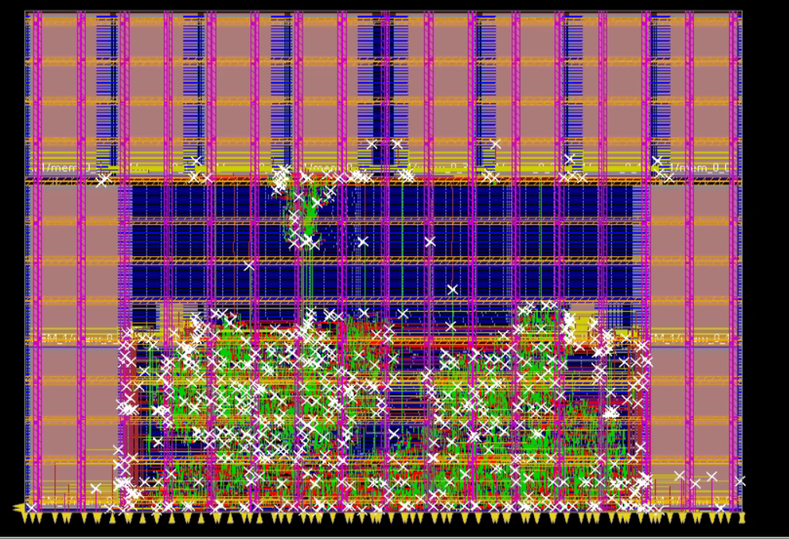
Innovus Layout

Slide 15
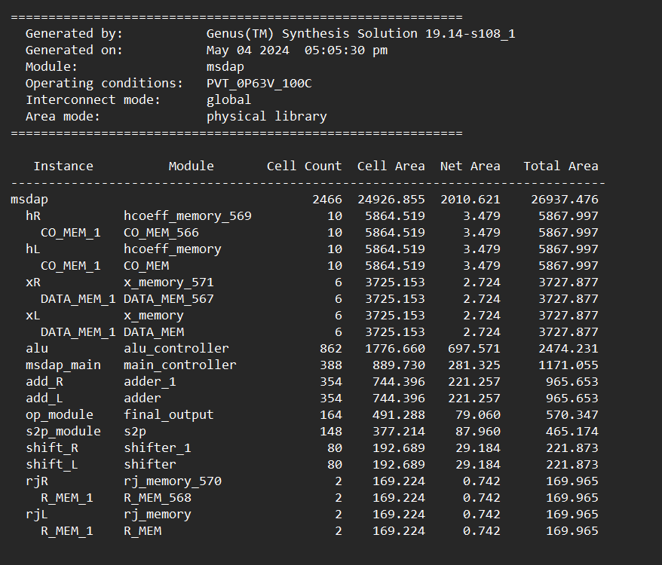
Area Utilization

Slide 16
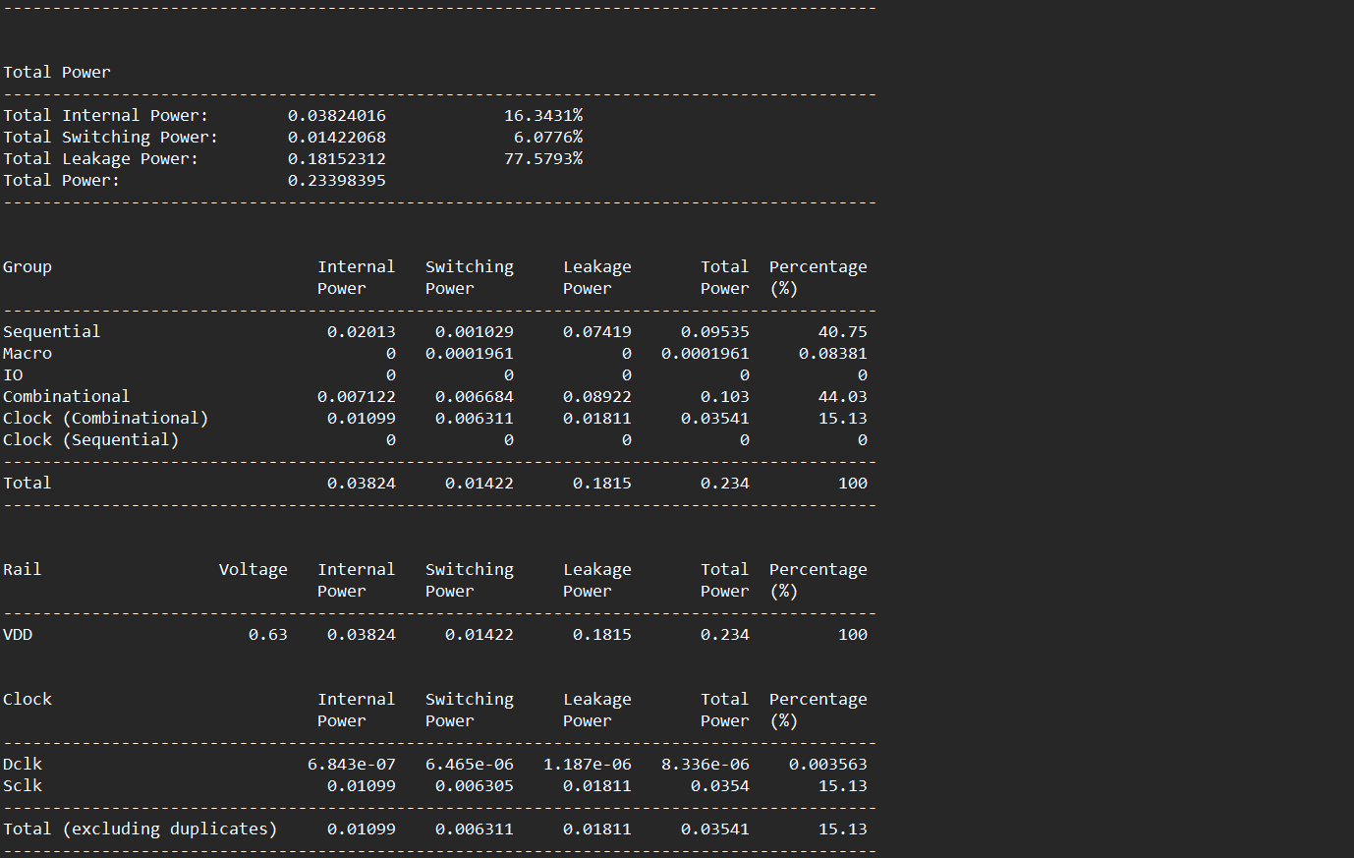
Power and Timing reports

Slide 17
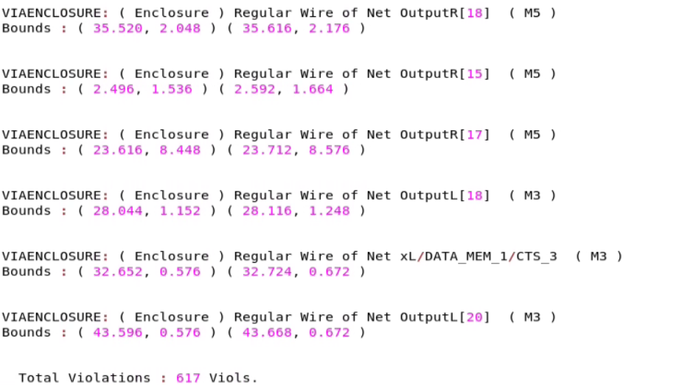
DRC

Slide 18
Conclusions

