Slide 1
American Community Survey (ACS) data 2019

Slide 2
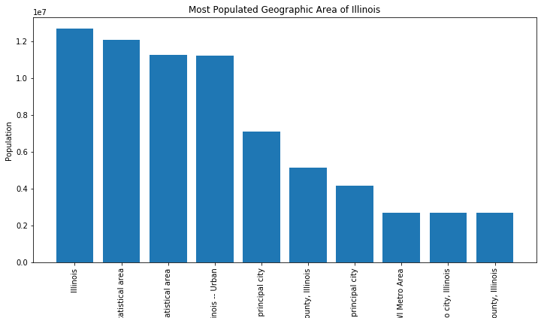
Geographic Area wise Population
Finding out the locations to focus with Number of people as constraint.

Slide 3
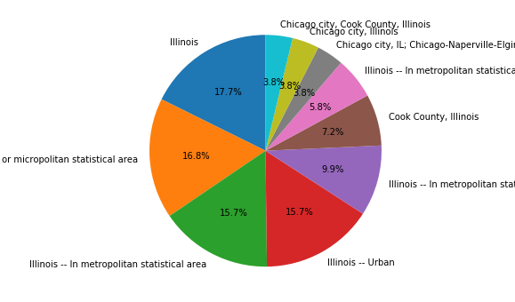
Percentage wise Population
These all geographic locations are the major contenders to focus for selling Insurance.
These locations have the largest population of Illinois

Slide 4
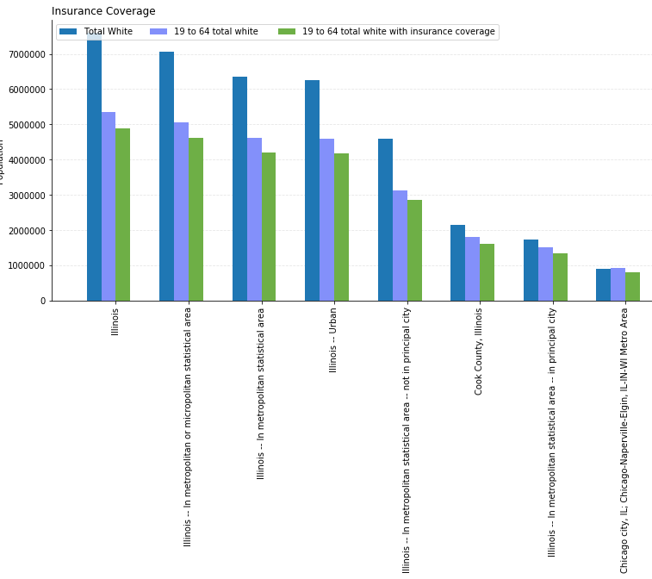
Comparison between
Total White Population
19 to 64 age White Population
19 to 64 age White Population with Insurance
1. White population is the largest in number. So, we choose them as prime customers.
2. We see that in all the locations
the difference between total number of white people (19to 64) and people with insurance coverage is very less, which means These people believe in purchasing Insurance.

Slide 5
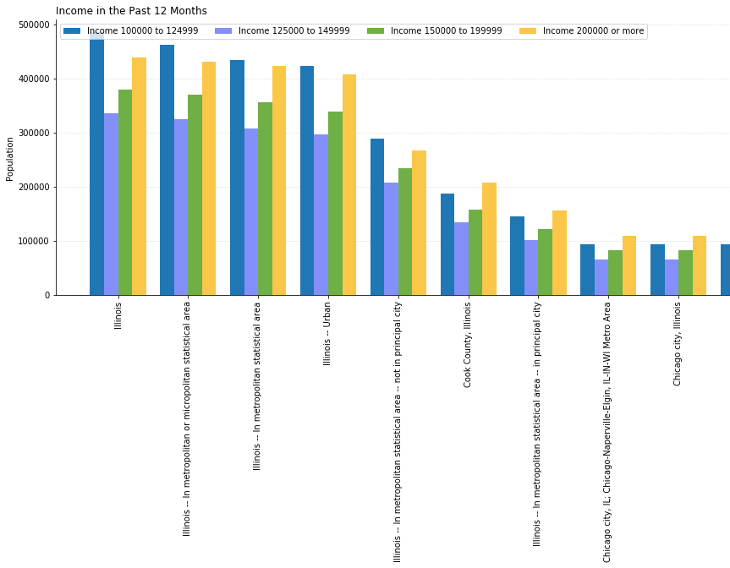
Household Income data
Targeting population having Income 100000 to 200000 to sell expensive/ premium private health insurance.

Slide 6
Target Customers
From the above analysis I would recommend one of the targeted customer’s criteria
People in all the 10 following geographical location shown above
Sex by age - 25- 29
Race - White Race and having Income more than
Median Household Income – 100000 to 200000

