Slide 1

B.Tech Project External Evaluation, VIIIth Sem
A Novel CV Based Candidate Suitability Assessment
Presented by :-
Saumy Raj, 2018010226 (Leader)
Kartik Rathi, 2018008330
YashVardhan Singh, 2018010015
Muskan Vashishtha, 2018011522
Under the Supervision of:-
Assoc. Prof. Sudhir Mohan
Sharda University, Gr. Noida
DEPARTMENT OF COMPUTER SCIENCE & ENGINEERING,
SCHOOL OF ENGINEERING AND TECHNOLOGY
10 May 2022
1

Slide 2
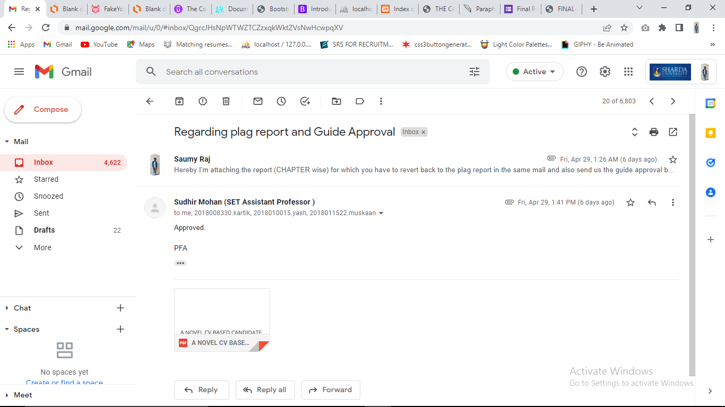
Approval from guide for the evaluation

Slide 3
Contents of the Presentation:
Introduction to the project
Project Overview
Solution to the problem
Improvement and Work done from previous semester
Future Scope Discussed
References

Slide 4
Work load distribution and Project planning
1. Saumy Raj – Problem identification & research / code development.
2. Kartik Rathi – Frontend / Code development
3. Yashvardhan Singh – deployment / testing
4. Muskan Vashishtha -

Slide 5
Introduction to the Project
A lot of CVs at your desk and no idea how to choose the best candidate for the position?
Taking time and labor more than required ?
Potential and deserving candidates are not getting chance they deserve ?
All these problems faced , helped us realize this and led us to discover a solution for it.
This will enable a more effective way to short list the submitted candidate CVs from the large number of applicants providing a consistent and fair CV ranking policy, which can be legally justified. System will rank the experience and key skills required for particular-job position. Then system will rank the CV’s based on the experience and other key skills which are required for particular-job profile. This system will help the HR department to easily shortlist the candidate based on the CV ranking policy.

Slide 6
Project Overview
As far as employment is considered, selecting the right candidate from a vast pool of candidates has been a fundamental issue. Conducting personality and various technical eligibility evaluation tests, interviews, and group discussions have been traditional techniques.
As compared to traditional recruitment process, if an online selection process is conducted, then a fair selection of the candidate is possible and will also be a time saving.
In this project, we propose a machine learning based method to check a candidate’s resume matching score. The matching score of the candidate would be identified by using two metrics, first is job description provided by the company and second by analyzing and matching the CV to the given JD.

Slide 7
Solution to the problem :
All the problems faced by HRs motivated us to find an effective solution to this.
Our CV analysis module helps us to do the same.
This system will help the human resources department to select right candidate for the particular job position, which in turn provide expert workforce for the organization.
This system will help to get shortlisted CV’s according to their ranking. Ranking is based on their experience, qualification etc.
This system will reduce the work of the human resource department.

Slide 8
Improvement/Work done from the last evaluation
Designing the work-flow & diagrams for the project : Designed different SDLC models required for the project designing.
Literature Survey : Compared 8-9 different review papers and made a proper literature survey.
Code development : Developed full length code for both frontend/backend and the ML code.
Testing : Testing is done by using the ROUGE evaluation metric.
Review paper writing : Different techniques and methods were written and compared in the published paper.
Report & Documentation work : full report with suitable diagrams and information is written and submitted.

Slide 9
Future Scope Discussed :
We are trying to predict the personality of the candidate using it’s submitted resume and by having the test (questions related to moral values, work ethics and sentiment based).
Uploading the whole code & data of resume and JD onto the cloud-based server and database.
Providing the candidate better resume templates according to the JD of the company.

Slide 10
References :
https://www.analyticsvidhya.com/blog/2021/06/resume-screening-with-natural-language-processing-in-python/
https://www.kaggle.com/code/gauravduttakiit/resume-screening-using-machine-learning/notebook
https://analyticsindiamag.com/top-ai-tools-for-resume-screening/

Slide 11
THANK YOU !!!

