Slide 1
SIGN LANGUAGE TRANSLATOR
Corrina Marieanne Barnabas 16BCE0754
Saunak Sahoo 16BCE2167

Slide 2
OBJECTIVES
We plan to make a system that is based on gesture translation for the dumb and deaf.
The letters encoded in the system will be those used by the American Sign Language.
When we will make specific gestures towards the computer screen, the computer which letter our fingers specify and it will display that letter on the screen, hence making it easy for people who don’t know the sign language.

Slide 3
MOTIVATION
The American Sign Language (ASL) is the most highly used sign language in the world with over 250,000 to 500,000 users in the world
Deaf people continue to face problems in communicating with other non-deaf people. Only a handful of us take the effort to learn sign language to talk to or understand such people.
These people often need interpreters

Slide 4
LITERATURE SURVERY
1ST paper referred Emphasizes that along with recognition of fingers and the wrists, sign language also depends heavily on the facial expression of the communicator.
This system used 2 different sensors to map the hand gestures and the face. They trained their model with 51 different words and used Independent Bayesian Classification Combination (IBCC) to recognize the various gestures.

Slide 5
LITERATURE SURVERY
2nd paper referred uses 3D modelling techniques to train the application on sign language and recognize it.
Uses Graph Matching techniques
The main advantages are that the model is able to distinguish similar looking sign languages because it makes a complete 3D model of each word.
Also, when an invalid sign language is made, it will make no attempt to match it to something close to it, hence greatly reducing errors.

Slide 6
LITERATURE SURVERY
3rd paper referred uses the entire features of the body to interpret what the speaker is trying to say.
The model is trained to work with orange gloves and the camera keeps track of the entire outline of the body using the Gaussian skin color model.

Slide 7
LITERATURE SURVERY
4th paper referred instead of using cameras, this model uses sensors to understand sign language
It trained the model on over 7500 instances of sign language words to make the model work accurately.

Slide 8
LITERATURE SURVERY
5th paper referred uses wavelet technology along with neural networks to recognize sign language
Instead of live tracking, the application takes an image of your hand and converts it into gray-scale to try and figure out the contours of the hand. This contour is then matched to outline images of sign languages to produce the output.

Slide 9
ISSUES IN EXISTING SYSTEM
Not real-time
Most system utilize a complex system to identify gestures (such as multiple sensors, data glove etc)
Some systems require gloves to be worn
Resource intensive, not portable
Inaccurate

Slide 10
LANGUAGE AND LIBRARY
The language we will be using to write our code will be Python
We will also be using Open CV. It is a library of programming functions which are mainly aimed at real time computer vision.

Slide 11
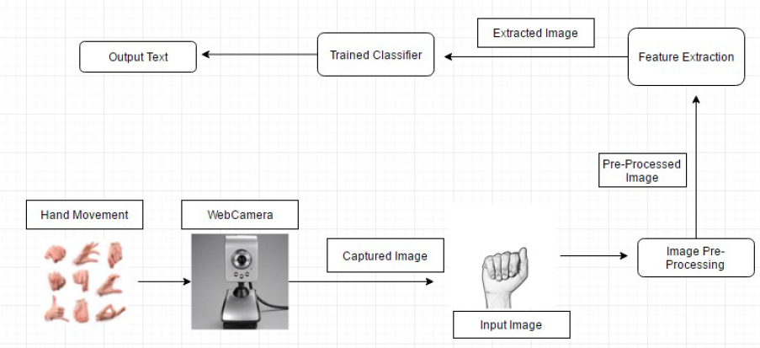
FUNCTIONAL ARCHITECTURE

Slide 12
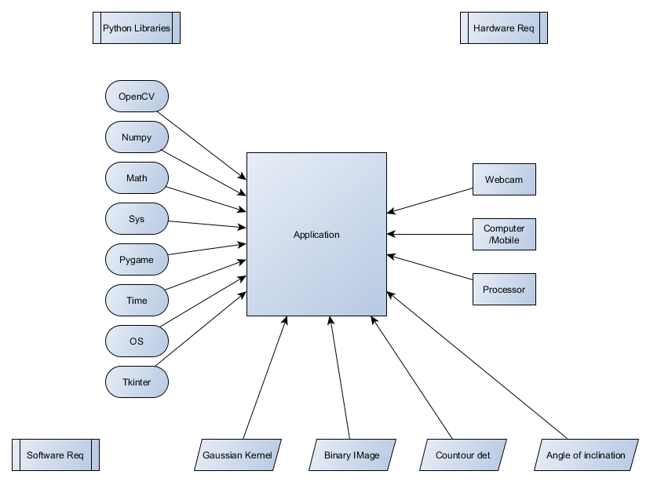
SYSTEM ARCHITECTURE

Slide 13
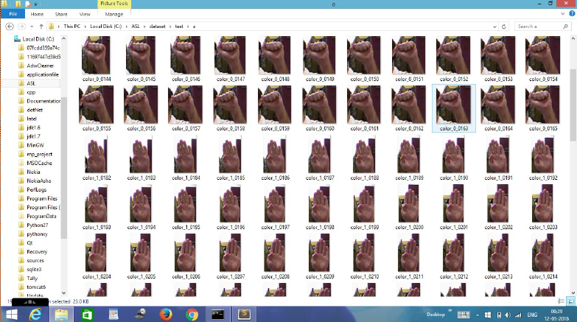
DATASET

Slide 14
IMPLEMENTATION STEPS
Step 1: User takes a real time image of the hand to be tested through the webcam
Step 2: The image is converted into gray scale and smoothed using a Gaussian kernel.
Step 3: Convert the gray scale image into a binary image. Set a threshold so that the pixels that are above a certain intensity are set to white and those below are set to black

Slide 15
IMPLEMENTATION STEPS
Step 4: Find contours, then remove noise and smooth the edges to smooth big contours and melt numerous small contours.
Step 5: The largest contour is selected as a target.
Step 6: The angles of inclination of the contours and also the location of the center of the contour with respect to the center of the image are obtained through the bounding box information around the contour.

Slide 16
IMPLEMENTATION STEPS
Step 7: The hand contours inside the bounding boxes are extracted and rotated in such a way that the bounding boxes are made upright (inclination angle is 0) so that matching becomes easy.
Step 8: Both the images are scaled so that their widths are set to the greater of the two widths and their heights are set to the greater of the two heights. This is done so that the images are the same size.
Step 9: The distance transform of both the query image and the candidate images are computed and the best match is returned.

Slide 17
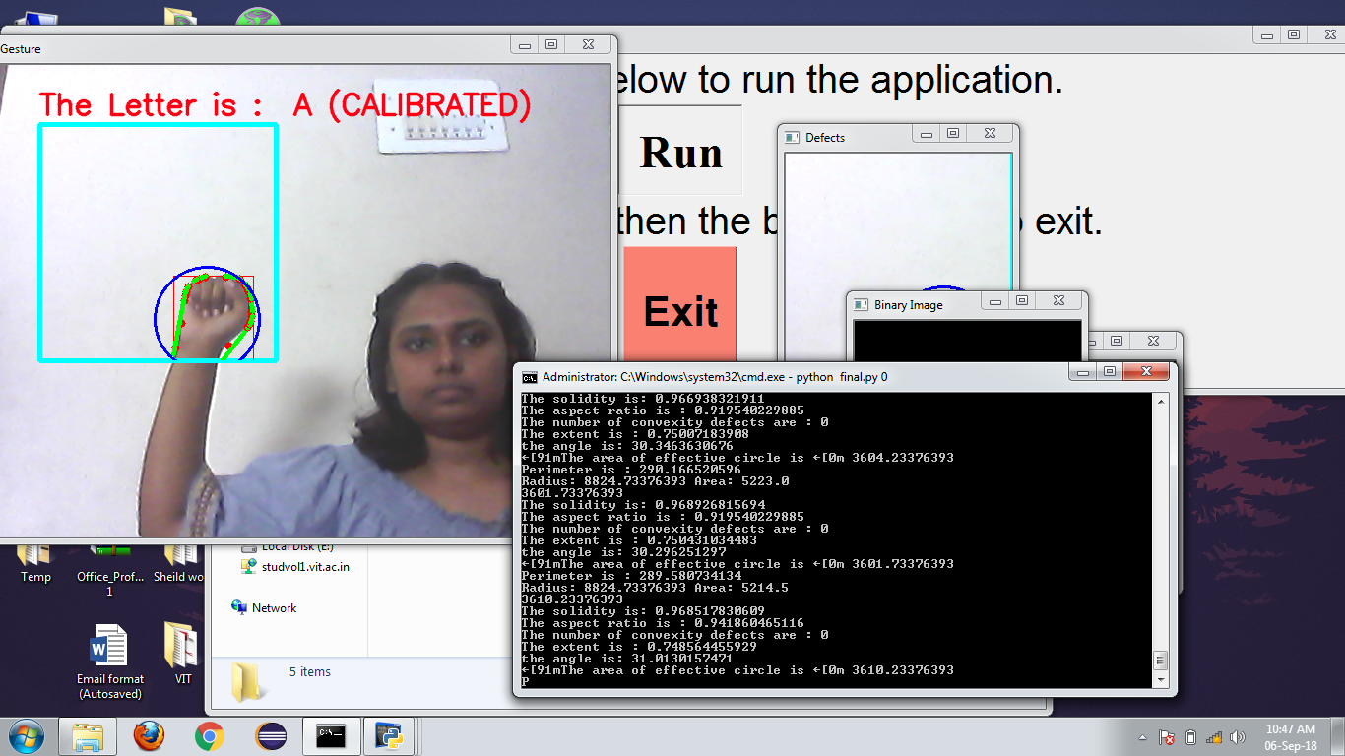
SCREENSHOTS

Slide 18
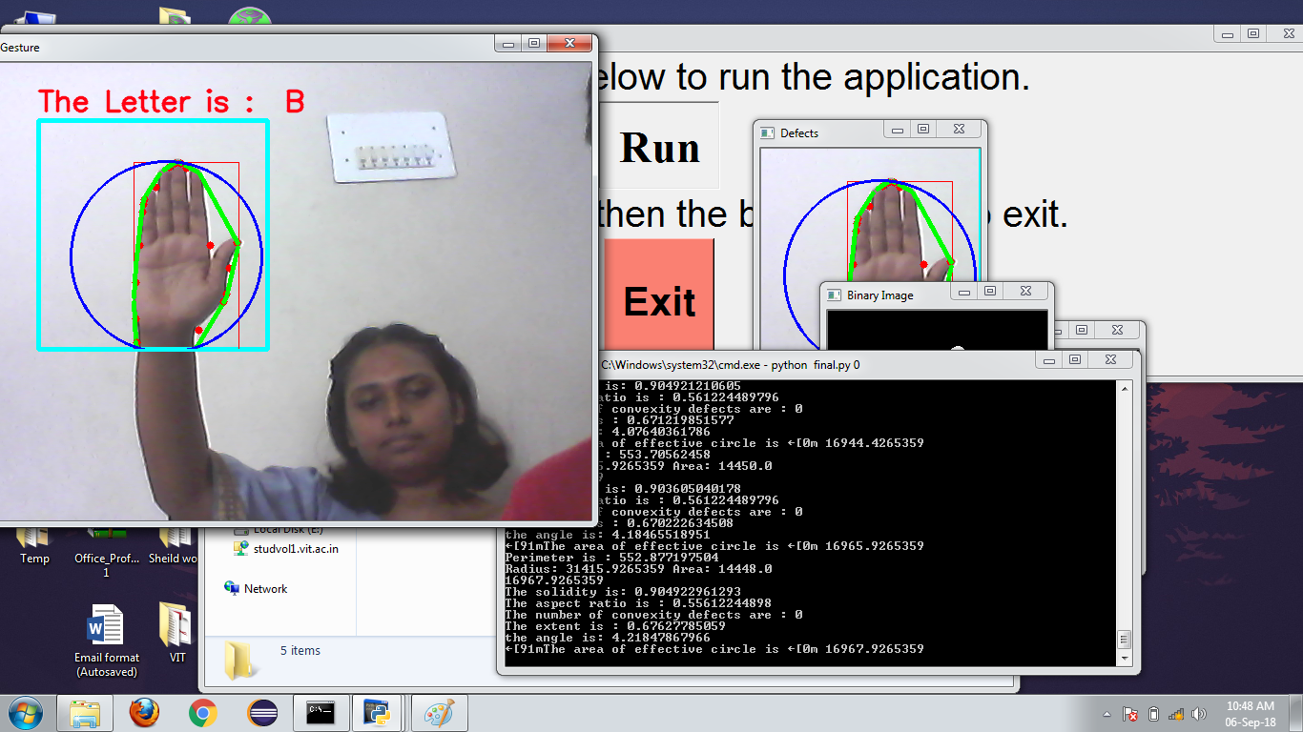
SCREENSHOTS

Slide 19
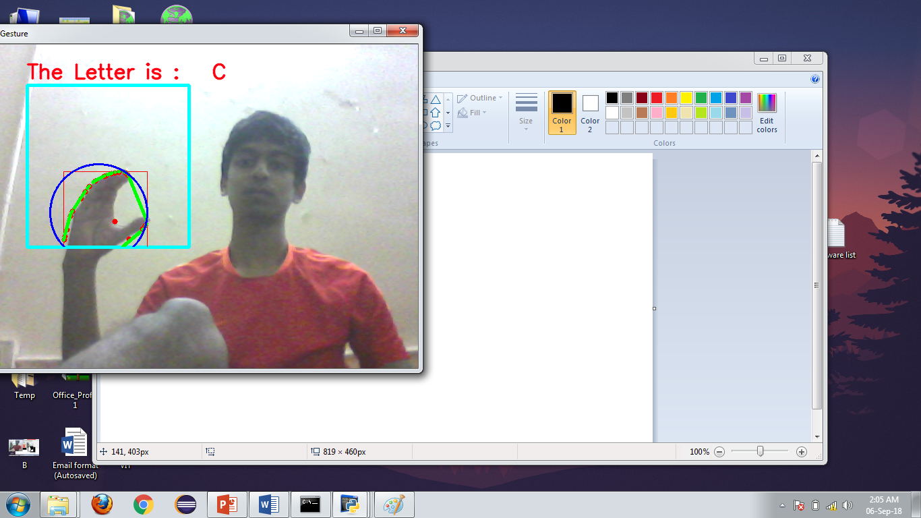
SCREENSHOTS

Slide 20
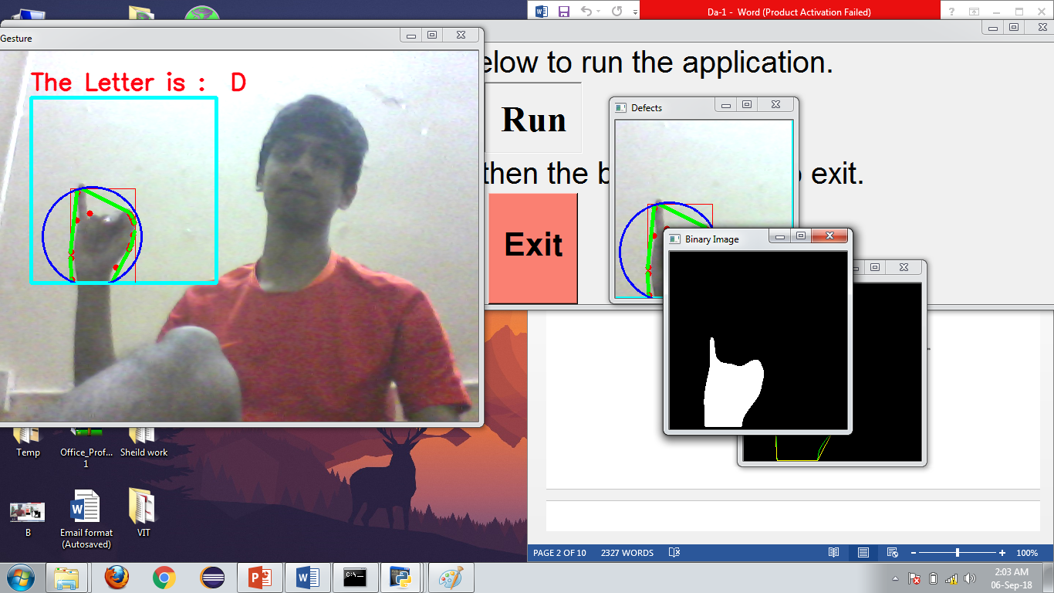
SCREENSHOTS

Slide 21
APPLICATIONS
Perfect for deaf and dumb people who don’t want to depend on an interpreter to communicate with others.
Portable (OpenCV is available for platforms like Android and iOS also)
ASL is one of the largest sign languages used, hence many people can understand it.
Can be used to teach sign language
Increase of acceptance of deaf and dumb people in society
Other sign languages and translated languages can be included

Slide 22
NOVELTY
Real time identification of sign language
Simple system relying on primary camera instead of complex system of sensors or data gloves
No gloves need to be worn to use object detection
Portable system (can be used on a mobile phone as OpenCV is supported on many platforms including Andoird and iOS)

Slide 23
REFERENCES
Independent Bayesian classifier combination based sign language recognition using facial expression, Information Sciences, Volume 428, 2018
Early estimation model for 3D-discrete indian sign language recognition using graph matching, Journal of King Saud University - Computer and Information Sciences, 2018
A signer-independent Arabic Sign Language recognition system using face detection, geometric features, and a Hidden Markov Model, Computers & Electrical Engineering, Volume 38, Issue 2, 2012
A multimodal framework for sensor based sign language recognition, Neurocomputing, Volume 259, 2017
Persian sign language (PSL) recognition using wavelet transform and neural networks, Expert Systems with Applications, Volume 38, Issue 3, 2018

