Slide 1

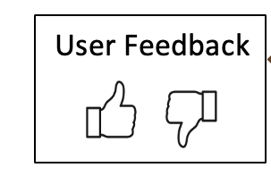
Continuous Answer Quality Improvement
Improve knowledge
Knowledge
Automated
Answer
Evaluation
Answer quality
assessment &
attribution
Questions
Answers
Answer Engine
Improve answer engine

