Slide 1
RAG Context Refinement Agent
Make prompt context smarter by re-visiting the source docs
Eric Saund
Mohit Shankarvelu
Tico Ballagas

Slide 2


Application: Tech Support
How do I ...?
Why does this...?
Question
What is the...?
Tech Support Engineer
Engineering Customer
RAG !
Examples
Source code
API Spec
Release Notes
Repo
Knowledge Source Docs

Slide 3
Standard RAG Workflow
source docs
Knowledge
Preparation
indexed chunks
system
prompt
User Query
Query
Elaboration
query
embedding
retrieved
chunks
Full LLM prompt
LLM response
re-ranking
context prompt
LLM
call

Slide 4
RAG with Context Refinement
source docs
Context Refinement Agent
Knowledge
Preparation
indexed chunks
system
prompt
refined
knowledge
context
User Query
Query
Elaboration
query
embedding
retrieved
chunks
Full LLM prompt
LLM response
context prompt
LLM
call

Slide 5
Context Refinement Agent
Repo chooser
RC Event
Examples
Source code
FF Event
File fetcher
API Spec
Release Notes
Tool Selector
Repo
Sum Event
Summarizer
DCF Event
Distractor chunk filer
Refinement Event
Evaluator
Evaluate Event
Context Good Event
user question
refined knowledge context
focus repo
Assemble
Final
Prompt
retrieved chunks
Scratchpad (ctx)

Slide 6
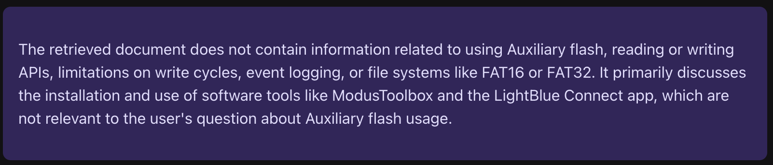
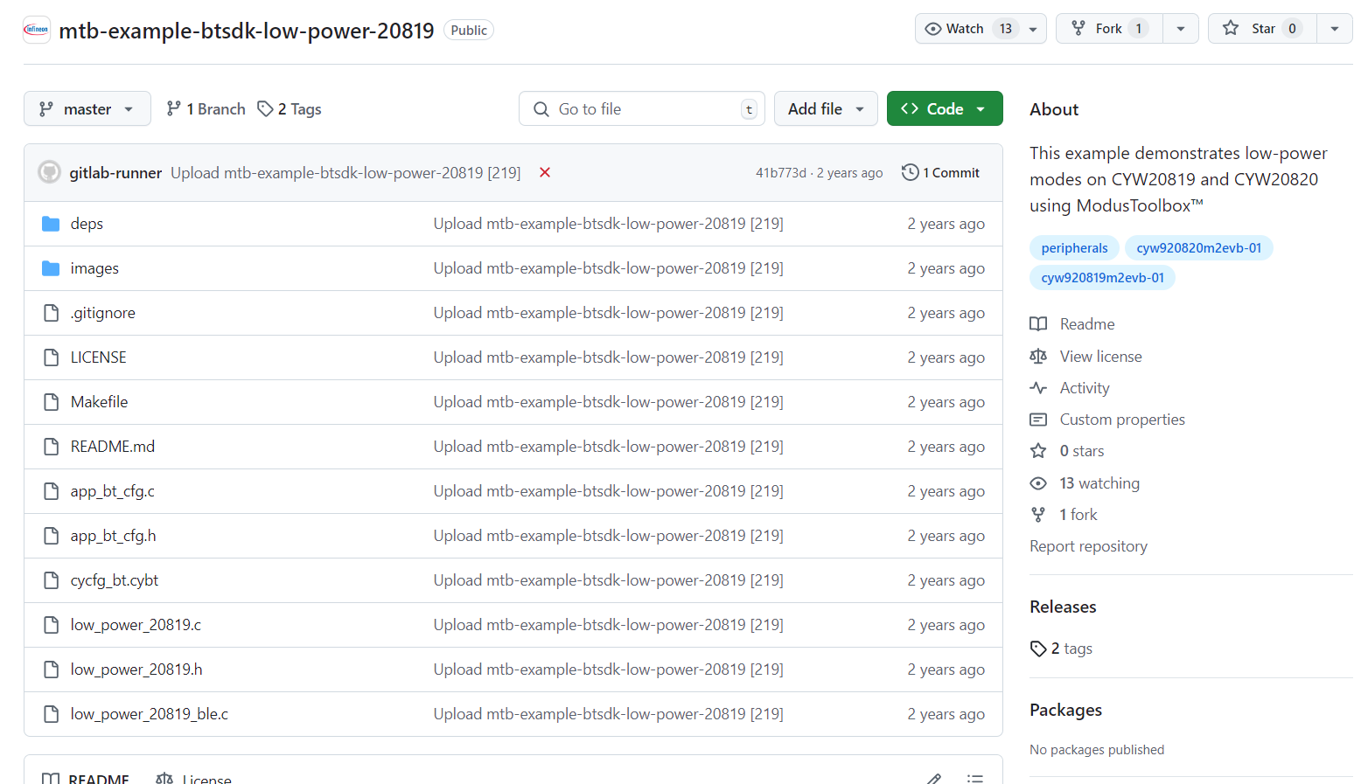
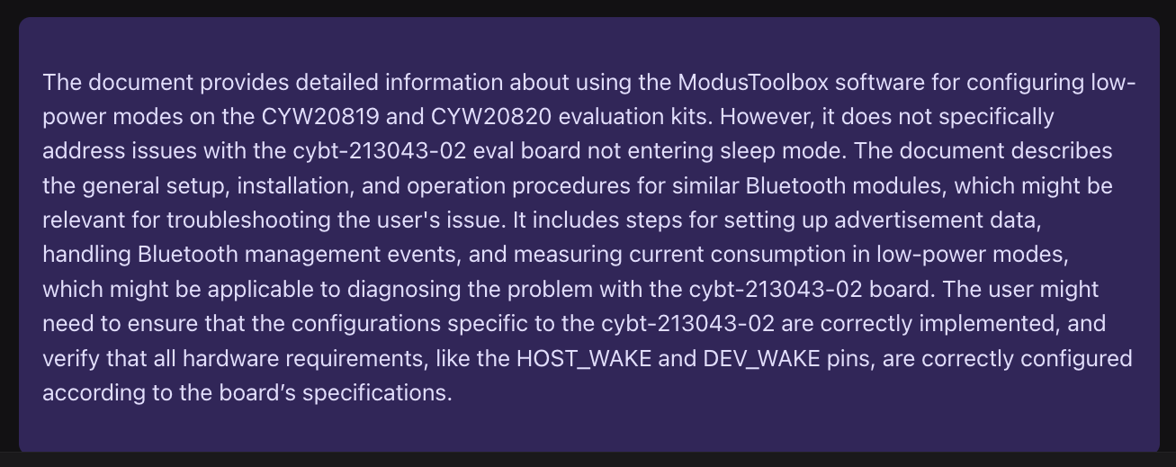
Working Example
Question URL:
https://community.infineon.com/t5/AIROC-Bluetooth/cybt-213043-02-not-entering-sleep-mode/td-p/643512
Community Forum Developer question:
Group: Home/Forums/WirelessConnectivity/AIROC Bluetooth
Topic: cybt-213043-02 not entering sleep mode
Hi,
I am using cybt-213043-02 eval board. I am running
https://github.com/Infineon/mtb-example-btsdk-low-power-20819
example with a tweak that changes the eval board to cybt-213043-eval.
I can see the output on the PUART when I press the user button and
the ble works ok.
However the board never enters sleep mode. I see a constant ~2.5mA
usage and the sleep permit handler is never called. Also sleep callback is never called.
The HOST_WAKE and DEV_WAKE pins are floating. I have tried tying
them to either VCC or GND without effect. Is there some additional
configuration or hw requirement to trigger sleep mode.
Thank you for response.
Basic RAG answer
Relevant repo
Answer with RAG context refinement
Question

Slide 7
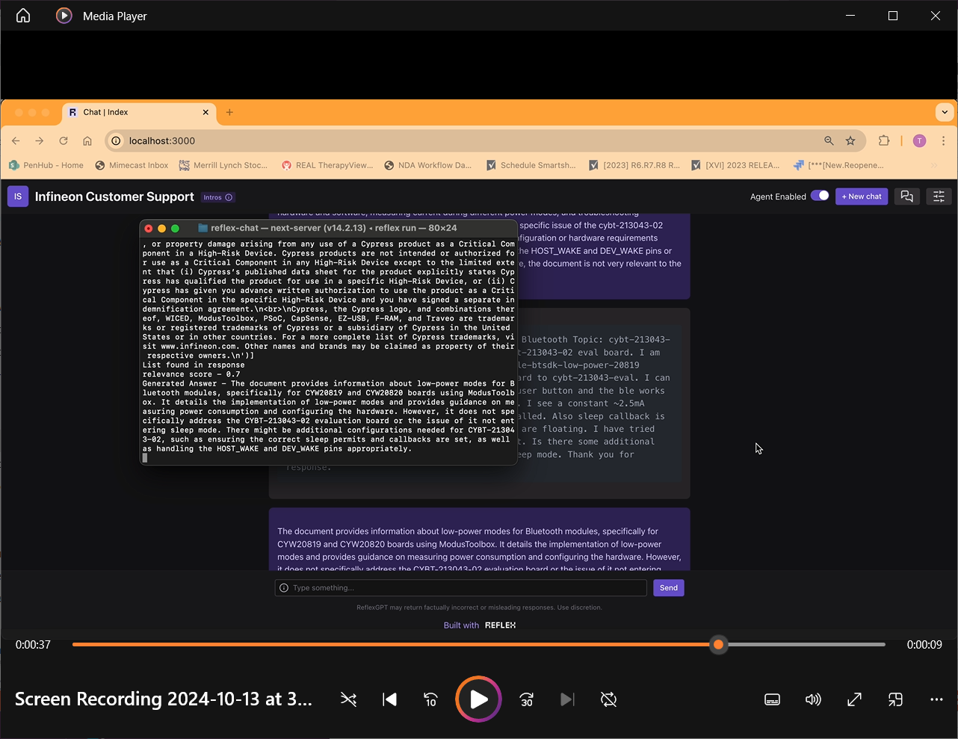
Demo - Video

Slide 8
RAG with Agent Context Refinement
source docs
Context Refinement Agent
Knowledge
Preparation
indexed chunks
refined
knowledge
context
app system
prompt
User Query
Query
Elaboration
query
embedding
retrieved
chunks
LLM prompt
LLM response

