Slide 1

Using Generative AI at Westminster
Why it matters and what the University expects
AI is part of your future
The University’s position
Student guidance exists
Employers expect graduates who can use AI effectively and responsibly. AI literacy is a core skill in every sector.
The University Executive Board has approved Generative AI Principles that apply to all colleagues and students.
A practical Student Guidance document sets out exactly what is and is not permitted, including in assessed work.
Three values underpin everything the University asks of you:
1. Genuine purpose
2. Honesty, transparency
3. Responsibility
Use AI to deepen your learning not to do your learning for you.
Declare any meaningful AI involvement in your assessed work.
You remain fully accountable for everything you submit.
Notes:
Speaker notes: Slide 1 — Why AI matters at Westminster • AI literacy is now a graduate employability expectation — this is not just about academic policy • The Principles were approved by UEB — this is an institutional position • Stress that the three values describe HOW to use AI, not whether students can use it • The student guidance document has the practical detail — point to the QR code / link

Slide 2
Your Responsibilities as a Student
What you can do, what you must do, and what is never permitted
✔ YOU CAN
! YOU MUST
✕ YOU MUST NOT
Use AI freely for non-assessed work revision, exploring ideas.
Declare any meaningful AI use; tool name and purpose.
Submit AI-generated work as your own work.
Plan and outline assessed work with AI support.
Critically evaluate all AI output; verify facts and references.
Conceal AI involvement in your assessed submissions.
Use AI to check grammar and expression.
Be able to explain everything in your submission.
Use AI in exams or any prohibited assessment.
Understand concepts using AI before working independently.
Check your module handbook and school guidance.
Submit AI-generated content without declaring it.
The AI declaration
Not sure what applies?
"I used [tool] to [use]. I remain fully responsible for all ideas, analysis and conclusions in this submission."
Ask your module leader before you submit - not after.
Notes:
Speaker notes: Slide 2 — Your responsibilities as a student • YOU CAN: AI is not banned — many uses are legitimate. The key is purpose and transparency. • YOU MUST: stress the declaration requirement — students often ask what they need to write. The abbreviated template is shown at the bottom of the slide. • YOU MUST NOT: these are clear-cut. Submitting AI-generated work as your own is academic misconduct. • Note that school-level guidance may add requirements on top — particularly relevant for Law students. • End message: if in doubt, ask before you submit, not after.

Slide 3
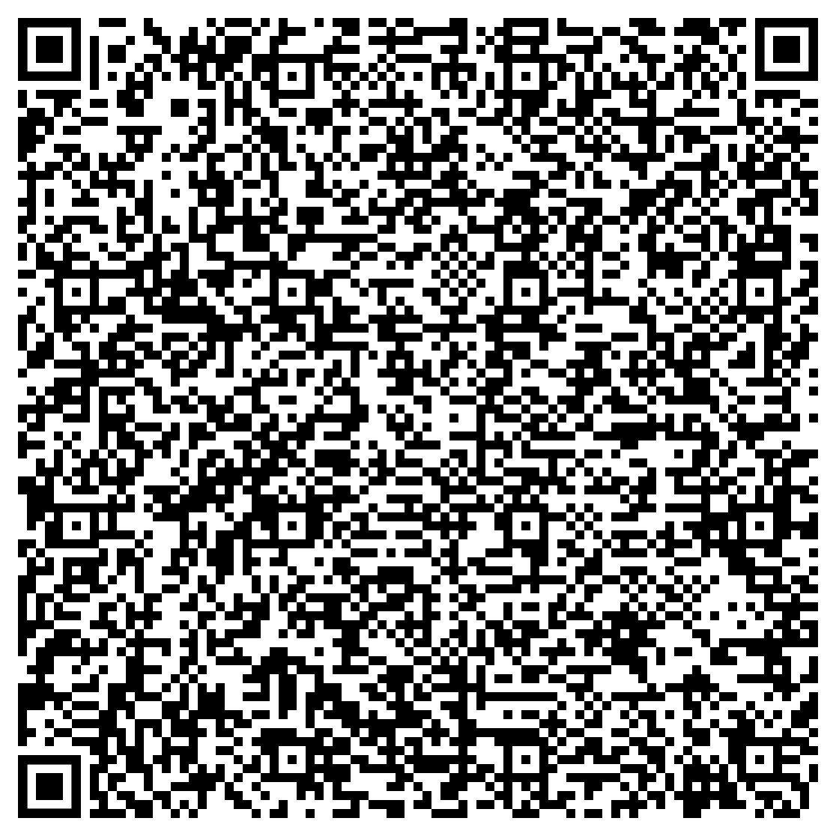
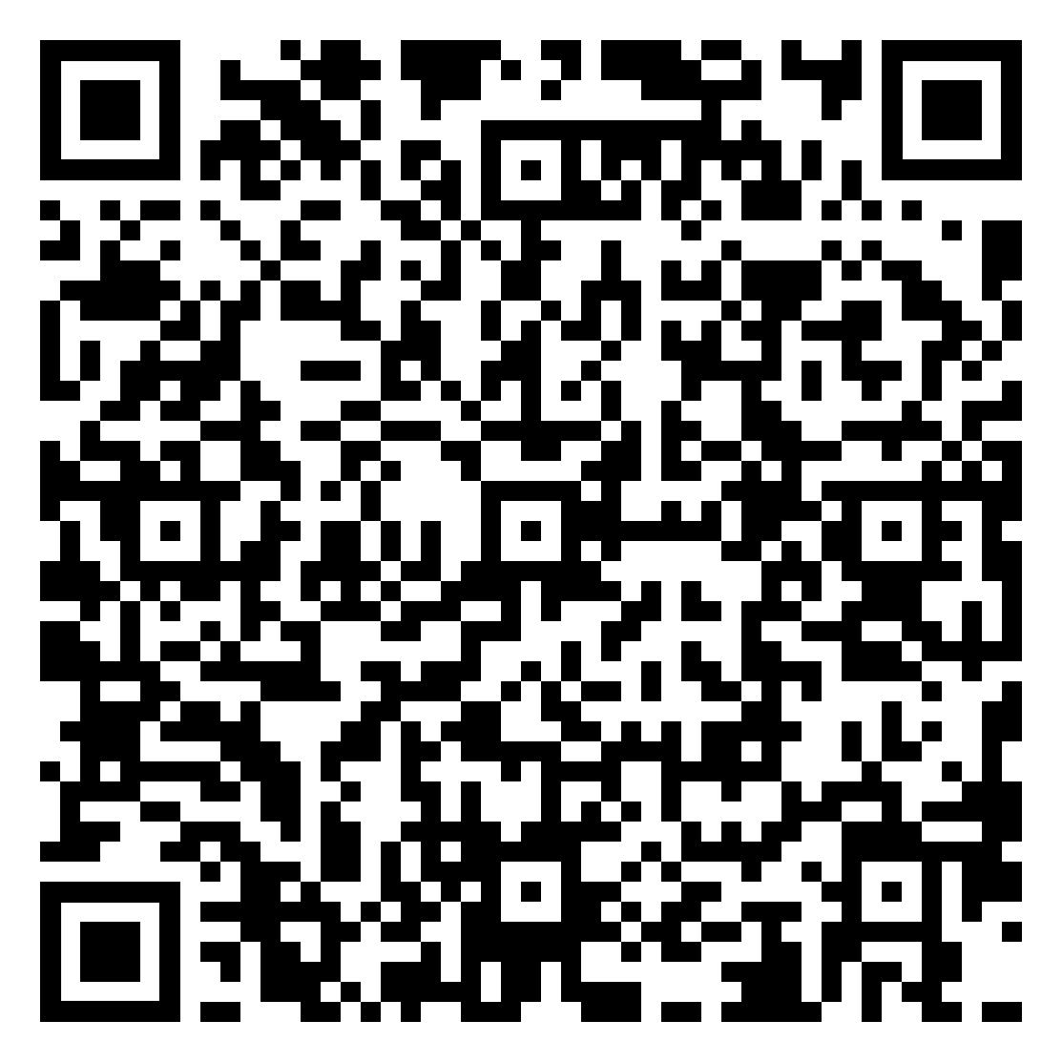
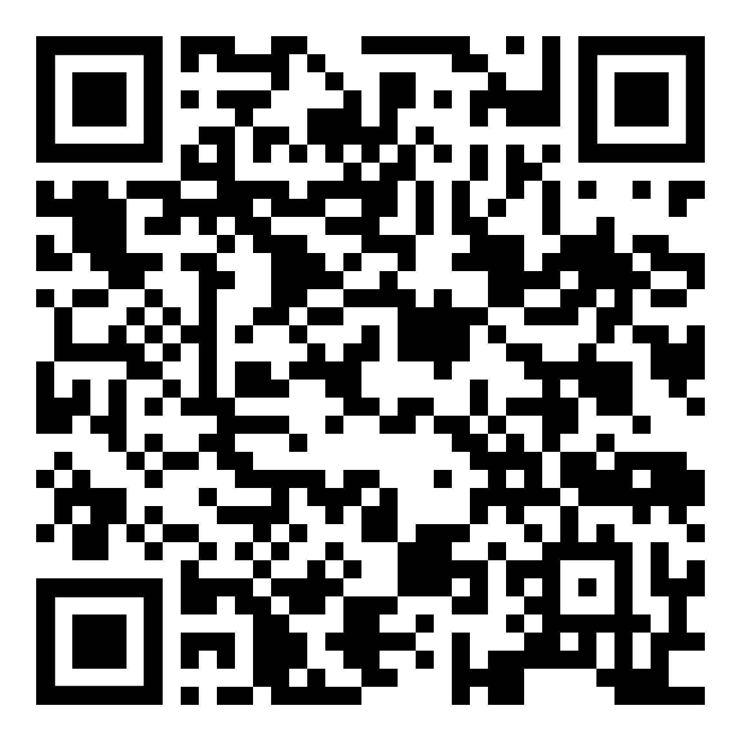
Further Information and Resources
GUIDANCE TO STUDENTS ON THE USE OF GENERATIVE AI
WESTMINSTER’S PRINCIPLES FOR THE USE OF GENERATIVE AI
GRAMMARLY FOR EDUCATION

