Slide 1
Core Java
Week 1 java fundamentals

Slide 2
What is java
Programming Platform for creating
Web Applications/Enterprise Applications
Standalone applications
Create by Sun Microsystems in 1995
Java is fast, reliable, and secure
Java is used by millions of devices
Computers
Phones
Televisions
Smart Watches
Etc..

Slide 3
Benefits of java
Compile once run any where
JVM (Java Virtual Machine)
Different implementations for each separate host platform. (Windows, Linux, MacOS, …)
Built in memory management
Garbage collector for the removal of unreferenced objects
Large support community
Regular updates and releases
99% Object Oriented Programming Language
Easy to use and Easy Learn

Slide 4
Object oriented programming
Polymorphism
Method Overloading
Method Overriding
Covariance
Encapsulation
Abstraction
Inheritance

Slide 5
polymorphism
Objects and methods in Java can take different forms during different stages of execution
interface Runnable{}
class Job implements Runnable{}
Job j = new Job();
Runnable r = new Job();

Slide 6
encapsulation
Typically referred to as data hiding
Private or protected data fields
Public getters/setters to retrieve or modify intrinsic data

Slide 7
abstraction
The practice of hiding complexity through a public api
Public API exposure through
Interface
Abstract Class

Slide 8
inheritance
The means of gaining state and or behavior from
Super class
Interface
Inherited state
Used carte blanche
Shadowed by declaring variables in the subclass with the same name
Inherited behavior
Used carte blanche (if not abstract)
Overridden by redefining the implementation in the subclass

Slide 9
Class vs. object
Class
Blueprint of objects that will have a defined state and behavior
Classes are instantiated using constructors
Classes can be an outer or inner class
Outer classes are default or public
Inner classes can have any access modifier
Can contain state and behavior that is accessible to all instances of the class (static)

Slide 10
Class vs. object
Object
Instance of a class
Contains the state and behavior for its own instance
Unlike classes, state and behavior can be invoked on objects
Created using a constructor invoked with the new keyword

Slide 11
Programming examples
Anatomy of a Java Application
Class Structure
Constructors
Hello World
Methods and parameters
Variables and scopes
Control Statements

Slide 12
Arrays
Fixed-size sequential collection of elements of the same type
Indexed access starting at 0 and going to n – 1 (where n = number of elements)
Can store primitives or objects
Int[] nums = new int[5];
Int nums[] = new int[]{1,2,3,4,5};

Slide 13
varargs
An array of unknown size that can be declared in a method’s arguments list
Must be the last argument in the list
Can be treated like an array in the method body
public static void main(String… args){}
public float avg(float… nums){}
public Batch createBatch(String name, String… studentNames){}

Slide 14
Programming examples
Creating arrays
Iterating over an array
Passing varargs to methods
Iterating over varargs

Slide 15
String API
Java object that represents a collection of characters usually read as words
Strings are immutable (once created they can not be modified)
Any changes to a string must be captured to keep its effects
Strings created by literals are stored in the string pool
Strings created using the new keyword are stored in the normal heap segment

Slide 16
String pool
String x = “cat”;
String y = new String(“dog”);
String Pool
“CAT”
“DOG”
Java Heap

Slide 17
String API methods
charAt
Concat
Equals
equalsIgnoreCase
indexOf (overloaded)
Intern
Length
Split
Substring
toLowerCase (overloaded)
toUpperCase (overloaded)

Slide 18
Stringbuilder and stringbuffer
Mutable strings
Stringbuffer is synchronized
Add new methods to the string api

Slide 19
Programming examples
Using strings
Using stringbuilder/stringbuffer

Slide 20
Wrapper classes
Classes in Java meant to encapsulate primitive data types
One class for each primitive
Integer
Float
Double
Character
Byte
Short
Long
Boolean
Autoboxing
Primitive to Object
Unboxing
Object to primitve

Slide 21
exceptions
Events in execution which deviate or interrupt from normal execution
Java has three major types of exceptions
Exception (checked)
RuntimeException (unchecked)
Error (unchecked, unrecoverable)

Slide 22
Exceptions hierarchy
Throwable
Error
Exception
RuntimeException
IOException
SQLException
…
NullPointerException
ClassCastException
IndexOutOfBoundsException
…

Slide 23
Exceptions handling
Java checked exceptions
Must be handled
Try/Catch
Throws
Usually arise from dependency on outside resources
Java unchecked exceptions
Don’t need to be handled by a Try/Catch or Throws
Can be avoided using logic
Usually arise from dependency on user input

Slide 24
Programming examples
Working with exceptions
Handling exceptions
Throwing exceptions
multicatch

Slide 25
Garbage collection
Remove objects from the heap that no longer have any stack references
Long Running Process (Daemon Thread)
Starts when the first user thread is started by the JVM
Terminated when the last user thread terminates
Periodically scans the heap for unreferenced objects
Can not be forced to scan the heap
System.gc doesn’t guarantee that the garbage collector will run

Slide 26
Types of garbage collector
Serial Garbage Collector
Freezes all user threads during collection
Scans each thread head sequentially
Not suitable for server environments
Suitable for simple command-line applications
-XX:+UserSerialGC

Slide 27
Types of garbage collector
Parallel Garbage Collector
Freezes all user threads during collection
Scans user thread heaps in multiple threads
Default Garbage Collector

Slide 28
Types of garbage collector
Concurrent Mark Sweep (CMS) Garbage Collector
Uses multiple threads to scan heap memory
Marks instances for eviction
Sweeps the marked instances
Uses more CPU than parallel to ensure maximum throughput
Ideal when more CPU can be allocated
-XX:+UseParNewGC

Slide 29
Types of garbage collector
G1 Garbage Collector
Used for large heap memory areas
Separates the heap into regions
Prioritizes regions by “Most Garbage”
Does collection in parallel
Compacts memory on the go
-XX:+UseG1GC

Slide 30
Oop programming examples
Inheritance
Polymorphism
Overriding
Overloading
Covariance
Abstraction
Interfaces
Abstract classes

Slide 31
File i/o
Java uses the concept of a stream to speed i/o
Streams can be used to read/write from and to the console, files, and more
Streams come in 2 types
Input
output
Java contains 3 automatically created streams
System.out
System.in
System.err

Slide 32
Outputstream

Slide 33
inputstream

Slide 34
Programming examples
Writing to stream
Reading from a stream

Slide 35
serialization
Java mechanism for writing object state to a byte stream
Used in many advance java frameworks
Used for transferring objects from java application to java Application
Serialization comes in 2 forms
Serialization (object to stream)
Deserialization (stream to object)
Objects must be marked for serialization by implementing the Serializable interface
Serializable is a marker interface (has no methods simply meant for marking objects as something)
ObjectInputStream
ObjectOutputStream

Slide 36
Serialization problems
InvalidClassException – serialVersionUID mismatch
NotSerialiableException – the class or object reference in the class is not serializable
ClassNotFoundException – When reading in a objectstream a suitable class could not be found for deserialization
When serializing when an exception occurs all serialization is rolled back and the exception is written to the file

Slide 37
Programming examples
Write an object to stream
Read an object from a stream

Slide 38
Collections framework
Generic framework added to Java in version 1.5
Collection of classes and interfaces used to represent groups of similar objects
All the collections are Generic and can only store object types not primitives

Slide 39
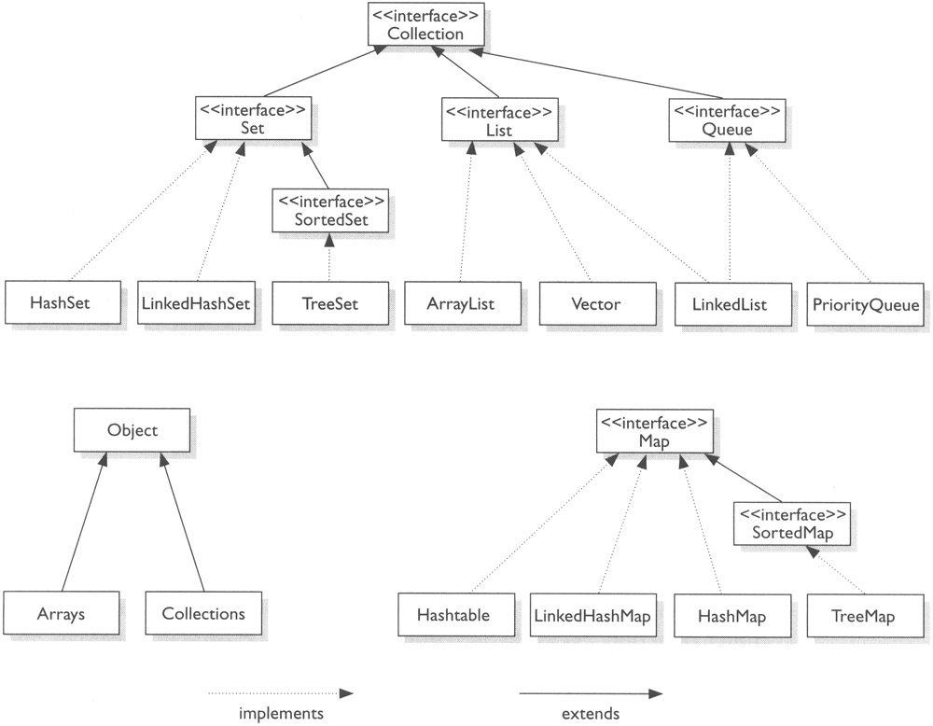
Collections framework

Slide 40
Programming examples
Creating different collections
Iterating over collections
Modifying Collections

Slide 41
Hashcode and equals
Come from the Object Class
Constitute an object contract for collections
Both methods are used for either inserting, searching, or removing data in collections
Hashcode is used when inserting into collections
Equals is used when searching or removing data in collections
If you override one, you should override both
By default Equals compares the memory locations of two objects
By Default Hashcode maps the memory address of an object to an int

Slide 42
Rules for hashcode and equals
Hashcode invoked n times will return the same value, considering nothing has changed in the object
If two objects are equal they will have the same hashcode
If two objects have the same hashcode, they may not be equal

Slide 43
Programming example
Using a hashset

Slide 44
Threads
Processes created to run concurrently to each other
Each thread run isolated from each other
Each thread has its own stack of execution
All thread share the heap storage of the creating process
Threads can communicate to each other using
Sockets
Signals
Shared memory
Semaphores
files

Slide 45
Threading problems
Shared memory can be come modified during thread execution
Shared memory modification can result in read corruption
deadlock

Slide 46
Thread safety
Immutable objects are thread safe by default
Final Variables are thread safe
Minimize memory sharing of objects
Apply locking
Some classes are designed to be thread safe (String, Hashtable, ConcurrentHashMap, Vector)
Atomic operation are thread safe

Slide 47
Creating threads
Extend Thread
Must override run
Class C extends Thread{}
Thread t = new C();
t.start();
Implement Runnable
Must override run
Class C implements Runnable{}
Thread t = new Thread(new C());
t.start();

Slide 48
Thread states
Runnable
New
Running
Blocked/Waiting
Terminated

Slide 49
Thread methods
From Thread
Start
Join (overloaded)
setDaemon
isDaemon
Stop (don’t use)
isAlive
setPriority
getPriority
Yield
Sleep
currentThread
getName
From Object
Wait (overloaded)
Notify
NotifyAll

Slide 50
Programming examples
Creating Threads
Producer Consumer
Deadlock

