Slide 1
Web Development
Making the web a beautiful place

Slide 2
HTML

Slide 3
Technologies Of The Interactive Web
HTML
CSS
JavaScript
Angular
React
Vue
jQuery

Slide 4
HTML 5
Language specification for defining the structure of a web page
Maintained by W3C
Extension to XML
Contains a set of extendable pre-defined tags
DOES NOT define any particular styling of the web page
Very slow moving specification
HTML 4 -- 1997
HTML 5 -- 2014

Slide 5
Commonly used tags
Html
Head
Body
Div
P
UL/OL/LI
H1-H6
Form/Input
Nav
Article
Aside
Header
Footer
A
Link
Script
https://www.w3schools.com/tags/ref_byfunc.asp

Slide 6
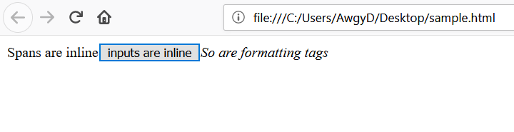
Inline Elements
Elements that are only large enough to wrap its content
span, i, b, button, input…

Slide 7
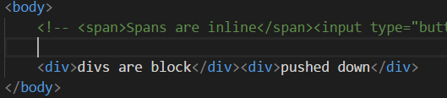
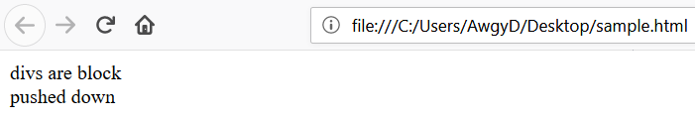
Block Elements
Elements take up all available width of the parent
Div, H1-H6, Nav…

Slide 8
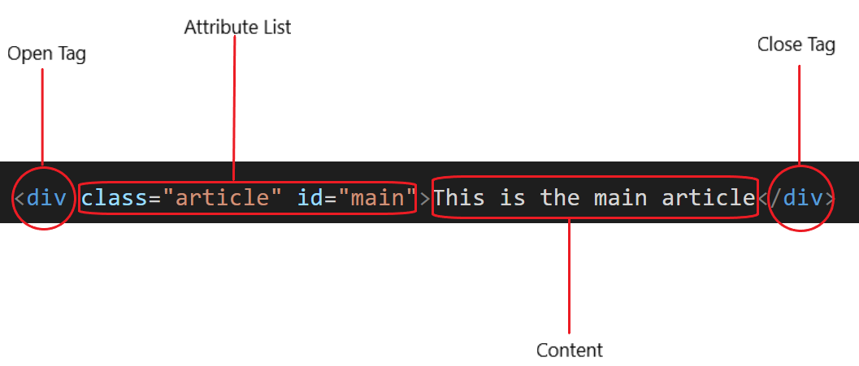
Anatomy of Elements

Slide 9
CSS

Slide 10
Cascading Style Sheets
Adds the styling component missing in the HTML specifications
Rulesets applied to elements that fit a selection criteria
Styles are applied from least specific to most specific
Styles cascade down from browser level to element level.
Thousands of different rules can be combined to style anything about elements

Slide 11
Element Selection
Class
.
ID
#
Element
p
d
ul
Child
div ul
Direct child
div>ul
Multiple Element Selector
div, p, ul
Pseudo-class
a:hover
ul:nth-child(2)
Attribute
input[type=“text”]

Slide 12
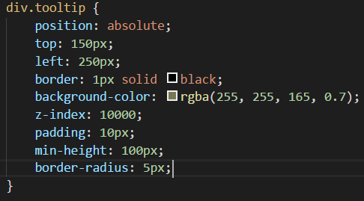

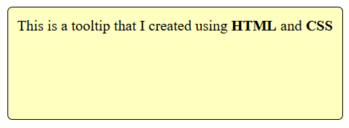
Ruleset

Slide 13
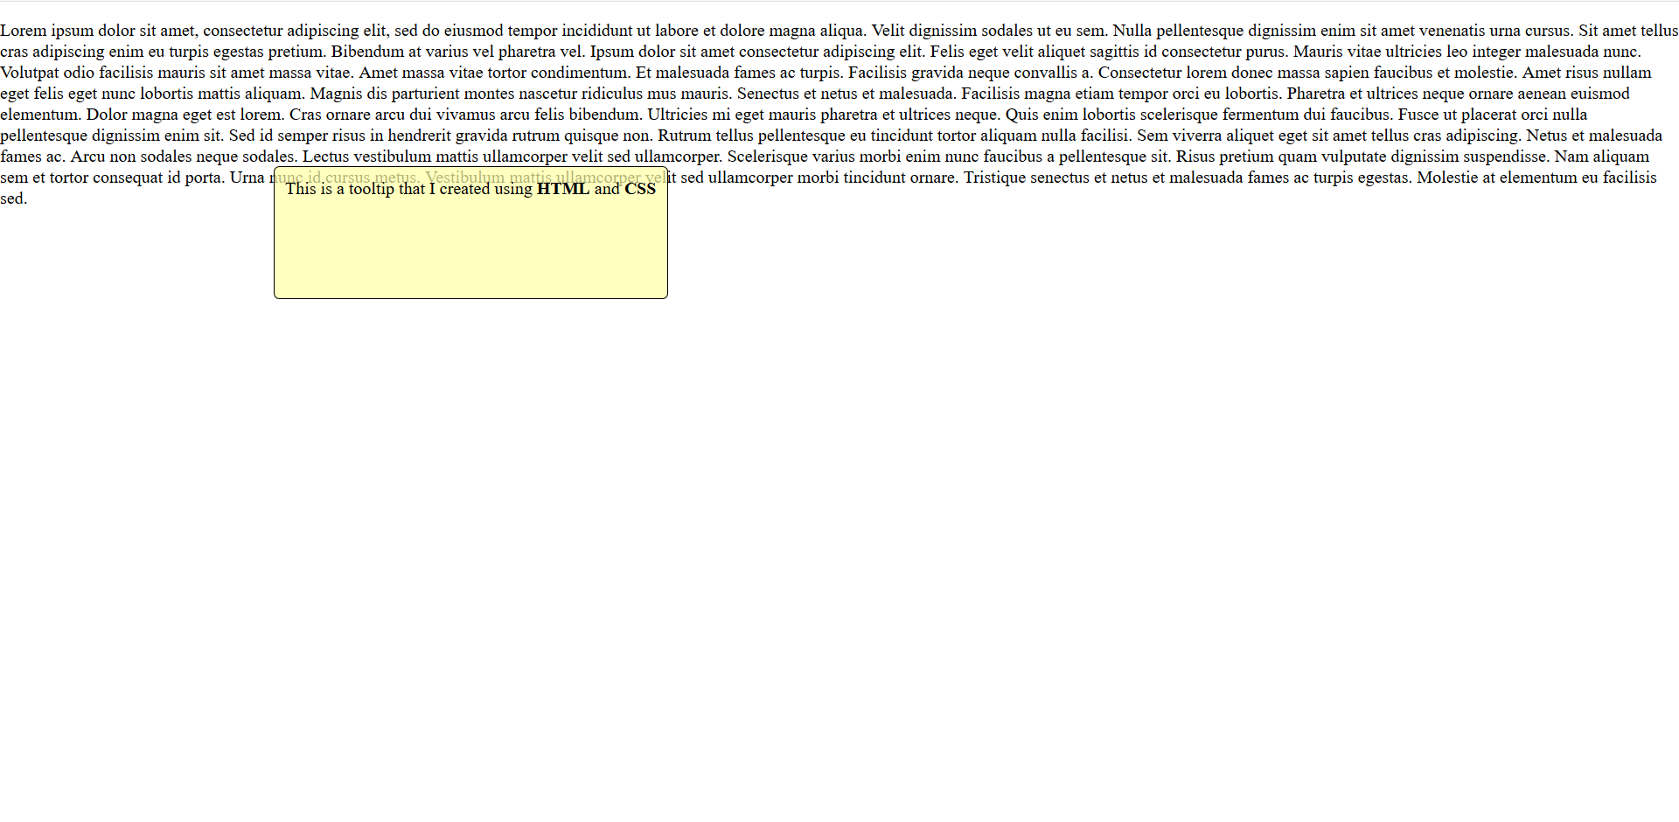
position: absolute;
top: 150px;
z-index: 10000;
padding: 10px;
left: 250px;
Min-height: 100px;
border: 1px solid black;
Background-color: rgba(255,255,165,0.7);
border-radius: 2px;

Slide 14

Box Model

