Slide 1
Spring 2016 Thesis Progress Update
Multi-Target Tracking Problem

Slide 2
Problem Description
T₁
T₂
T₃
T₄

Slide 3
Problem Data
T₁
T₂
T₃
T_{t}

Slide 4
Two Scenarios
Number of targets is known
Detections subject to noise
No errors in detection process
Number of targets is unknown
Detections subject to noise
Detections may be false or missed

Slide 5
Assumptions Common to Both Scenarios
Targets have linear trajectories
Constant velocity
No maneuvering
No outside forces
Number of targets always constant
No birth/death of targets

Slide 6
Scenario # 1 Assumptions
No missed detections
No false alarms
Known/constant number of targets

Slide 7
Objective
Residual Sum of Squares (RSS)
Easy to calculate quickly via matrix multiplication
More suited for an algorithm
Nonlinear
Sums of Absolute Residuals
More difficult to calculate quickly
Linear: more suited for optimization

Slide 8
Mixed Integer Program

Slide 9
Simple Heuristic
Randomly select two data points in a given time step and swap their assignments

Slide 10
Simple Heuristic
Accept the swap if the objective improve; otherwise reject the swap

Slide 11
Simple Heuristic
Repeat for all time steps

Slide 12
Proposed Heuristic

Slide 13
Scenario Complexity Coefficient (ρ)
ρ = 1 when error = noise
Lower ρ → Increasingly difficult scenarios
Higher ρ → Increasingly easy scenarios
For fixed scenario,
Higher σ → Increases difficulty/density
Lower σ → Decreases difficulty/density

Slide 14
Sim #16
ρ | σ
1.0 | 5.28
3.0 | 1.76
5.0 | 1.06
Sim #64
ρ | σ
1.0 | 2.55
3.0 | 0.85
5.0 | 0.51

Slide 15
Performance Metric (δ)
Solve for assignment index that maps solution trajectories to true trajectories
Lower δ → stronger performance
Can be normalized by dividing by σ as well

Slide 16
RESULTS

Slide 17
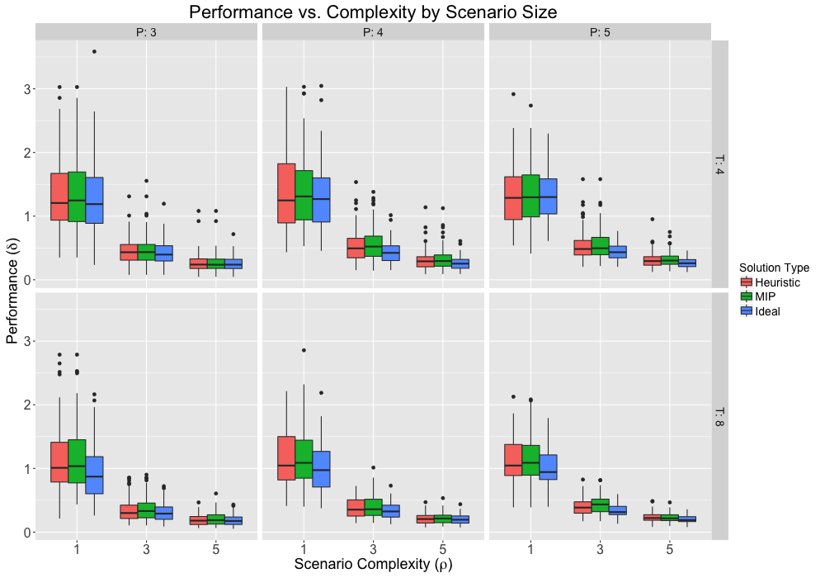

Slide 18
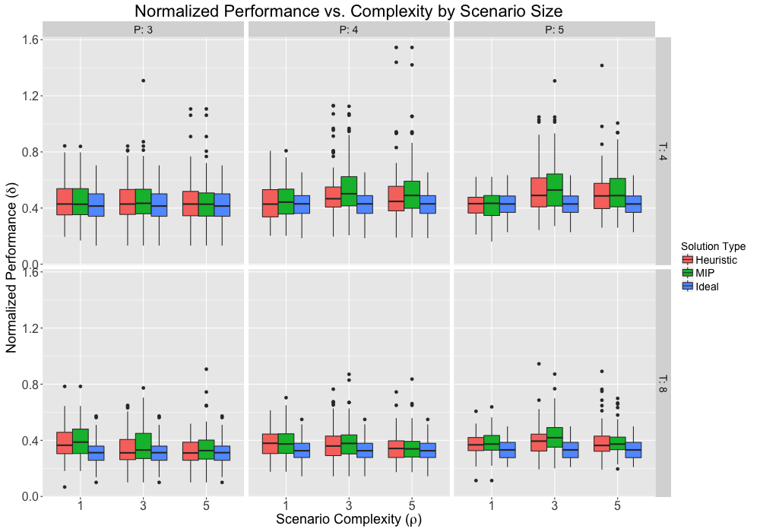

Slide 19
Sim #35
ρ | σ
1.0 | 3.44
3.0 | 1.15
5.0 | 0.69

Slide 20
Sim #35
ρ | σ
1.0 | 3.44
3.0 | 1.15
5.0 | 0.69

Slide 21
Sim #35
ρ | σ
1.0 | 3.44
3.0 | 1.15
5.0 | 0.69

Slide 22
Quadratic vs Abs Value in MIP Objective Function

Slide 23
Quadratic vs Abs Value in MIP Objective Function

Slide 24
Quadratic vs Abs Value in MIP Objective Function

Slide 25
Quadratic vs Abs Value in MIP Objective Function

Slide 26
Quadratic vs Abs Value in MIP Objective Function

Slide 27
Scenario Assumptions
Number of targets is unknown
Remains constant
Missed Detections
Bernoulli distribution with probability ( )
iid detections
False Alarms
Occurrence rate distributed Poisson, parameter ( )
Location uniformly distributed across sensor horizon

Slide 28
Problem Description
T₁
T₂
T₃
T₄
False Alarms

Slide 29
Problem Description
T₁
T₂
T₃
T₄
Missed Detections

Slide 30
Problem Description
T₁
T₂
T₃
T₄
False Alarms
Missed Detections

Slide 31
Problem Data
T₁
T₂
T₃
T₄

Slide 32
MIP with Fixed # Targets (P)

Slide 33
Model Assumptions
Number of existing targets falls between N_0 and N_1
Penalties for false/missed detections accurately reflect reality of scenario
Analysis needed to tune parameters

Slide 35
Modified Algorithm
Switch detection assignments between two existing targets
Switch the detection assignment of an existing target with a false alarm
Switch the detection assignment of an existing target with a missed detection identifier for a different existing target
Move the detection assignment of an existing target to a false alarm and replace with a missed detection identifier
Move a false alarm into the location of a missed detection identifier for an existing target

Slide 36
Switch detection assignments between two existing targets
T₁
T₂
T₃
T₄

Slide 37
Switch detection assignments between two existing targets
T₁
T₂
T₃
T₄

Slide 38
Switch the detection assignment of an existing target with a false alarm
T₁
T₂
T₃
T₄

Slide 39
Switch the detection assignment of an existing target with a false alarm
T₁
T₂
T₃
T₄

Slide 40
Moving Forward
How to modify performance metric to account for:
unknown number of targets
false alarms
missed detections
Other possible performance metrics
Tuning FA and MD penalties
How does objective effect performance?
RSS vs Absolute Sum of Residuals
How does problem scale?
How large to explore?

