Slide 1

Transfer Learning for
Image Classification
Group Project for EE5561 09 Spring
Group No.: 15
Group member : Feng Cai caixx043@umn.edu
Sauptik Dhar dharx007@umn.edu
Jingying Lin linxx634@umn.edu

Slide 2
BRIEF OUTLINE
CURRENT STATE OF ART(SELF TAUGHT LEARNING with SPARSE CODING)
OUR METHODS (UNSUPERVISED TRANSFER LEARNING)
OUR METHODS (SUPERVISED TRANSFER LEARNING)
EXPERIMENTAL SETUP/DATASET
RESULTS
CONCLUSION

Slide 3

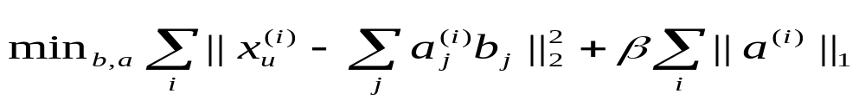
SELF-TAUGHT LEARNING
WHAT IS SPARSE CODING?
Sparse coding is the representation of items by the strong activation of a
relatively small set.
BASIC FORMULATION
WHAT IS SELF-TAUGHT LEARNING? ^{[1]}
Unlike Semi-Supervised classification ;no assumption that unlabeled data follows the same class labels or generative distribution as the labeled data.
WHAT IS TRANSFER LEARNING? ^{[2]}
Involves two interrelated learning problems with the goal of using knowledge about one set of task to improve performance on a related task.
[Details: An extra normalization constraint on b_{j} is required.]

Slide 4
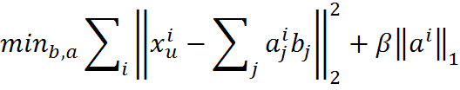


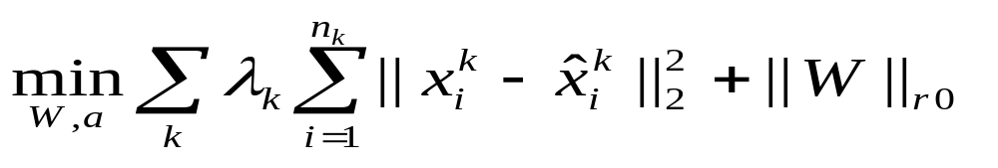



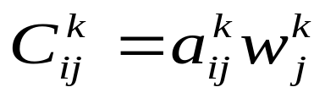
UNSUPERVISED TRANSFER LEARNING
STEP 1: USE SELF LEARNING APPROACH TO OBTAIN THE BASIS VECTORS.[1]
STEP 2: FIND THE COEFFICIENTS C USING FOLLOWING EQUATIONS
Define the estimation of as:
Here is a pseudo-norm that counts the number of non-zero rows in .
The coefficient for example i in group k can be computed as:
STEP3: ARE USED AS NEW FEATURES AND WE TRAIN SVM CLASSIFIERS IN EACH GROUP

Slide 5
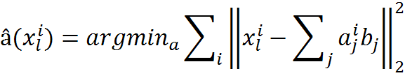




SUPERVISED TRANSFER LEARNING
STEP 1: USE SELF LEARNING APPROACH TO OBTAIN THE BASIS VECTORS.[1]
STEP 2: MAP THE LABLED TRAINING DATA IN THE BASIS SPACE
STEP 3:PERFORM SUPERVISED TRANSFER LEARNING WITH SPARSE CODING.[2]
Let,
STEP 4:COMPUTE THE RELEVANT PROTOTYPE REPRESENTATION
Finally,

Slide 6
EXPERIMENTAL SETUP/DATASET
DATASET
UNLABELED DATASET( The Yale Face Database B )
Contains 5760 single light source images of 10 subjects each seen under 576 viewing
conditions.(http://cvc.yale.edu/projects/yalefacesB/yalefacesB.html)
LABELED DATASET(CMU Face Images Data Set )
This data consists of 640 gray level face images of people taken with varying
pose and expression.(http://archive.ics.uci.edu/ml/datasets/CMU+Face+Images)
EXPERIMENTAL SETUP
Classification of FACIAL EXPRESSION using TRANSFER LEARNING.
CLASS LABELS = Happy(+1) or Sad(-1).
GROUP LABELS = PERSON ID.
SCALED DOWN PROBLEM
Number of Unlabeled samples =15
Number of Basis used =25
Number of Tasks =3
Number of Training samples(Labeled) =56
Number of Test samples(Labeled) =19

Slide 7
RESULTS
TRAINING SET=56 samples TEST SET=19 samples
METHOD USED | PREDICTION ERROR
RAW DATA (dim=256) | 0.421053
SELF-LEARNING (dim=25)⁽¹⁾ | 0.421053
SUPERVISED TRANSFER LEARNING (dim=13) | 0.421053
TABLE 1. PREDICTION ERROR for LINEAR SVM (for different methods)
DOUBLE RESAMPLING (56 samples)
METHOD USED | PREDICTION ERROR [5 5] | PREDICTION ERROR [10 10]
RAW DATA (dim=256) | 0.322727 | 0.306667
SELF-LEARNING (dim=25)⁽¹⁾ | 0.375758 | 0.346667
SUPERVISED TRANSFER LEARNING (dim=13) | 0.322727 | 0.306667
TABLE 2. PREDICTION ERROR for LINEAR SVM (for different methods)
⁽¹⁾ There is a caveat involved in obtaining the results for this method.

Slide 8
CONCLUSION
The feature selection methodology conserves the discriminative patterns with the added advantage of a lower problem dimensionality.
2. The new transfer learning methodology provides better results than the self-learning approach(at least for the current case).
REFERENCE
[1] Self-taught learning: transfer learning from unlabeled data. Rajat Raina, Alexis Battle, Honglak Lee, Benjamin Pacher, Andrew Y. Ng. 24th International Conference on Machine Learning 2007.
[2] Transfer learning for image classification with sparse prototype representations. Ariadna Quattoni, Michael Collins, Trevor Darrell. IEEE CVPR 2008.

