Slide 1

PRACTICAL CONDITIONS FOR EFFECTIVENESS OF THE UNIVERSUM LEARNING
PRESENTED BY: SAUPTIK DHAR

Slide 2
AGENDA
HISTOGRAM OF PROJECTION
UNIVERSUM LEARNING
RESULTS
CONCLUSION
FUTURE IDEAS/REFERENCE

Slide 3
HISTOGRAM OF PROJECTION
MOTIVATION
BASICS FOR HISTOGRAM OF PROJECTION
UTILITY

Slide 4
MOTIVATION FOR UNIVARIATE HISTOGRAM OF PROJECTION
Many applications in Machine Learning involve sparse high-dimensional
data low sample size (HDLSS) where ,n << d
where, n=No. of Samples and d= No. of Dimensions
        Medical imaging (i.e., sMRI, fMRI).
        Object and face recognition
        Text categorization and retrieval
        Web search.
Need a way to visualize the high dimensional data.

Slide 5
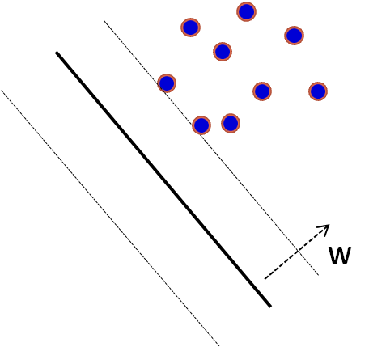

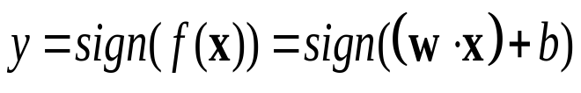

UNIVARIATE HISTOGRAM OF PROJECTIONS
Project training data onto normal vector w of the trained SVM
The projection is , so we can also
have projections for nonlinear SVM.
+1
0
W
-1
-1
0
+1

Slide 6
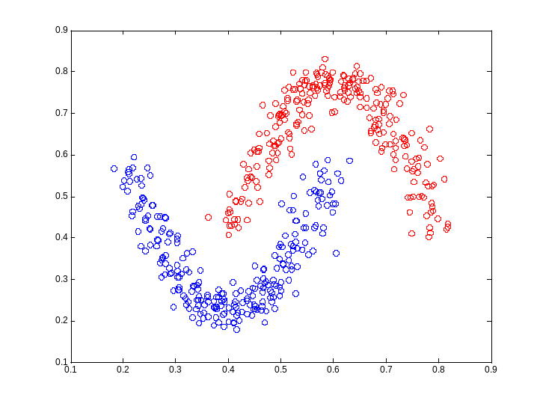


(SYNTHETIC) HYPERBOLA DATA
Coordinate x₁ = ((t-0.4)*3)²+0.225
Coordinate x₂ = 1-((t-0.6)*3)²-0.225.
for class 1. (Uniformly distributed)
for class 2. (Uniformly distributed)
Gaussian noise is added to both x₁ and x₂ co-ordinates, with standard deviation(σ) = 0.025
No. of Training samples = 500. (250 per class).
No. of Validation samples = 500.(This independent validation set is used for Model selection).
Dimension of each sample = 2.

Slide 7
MODEL SELECTION
MODEL SELECTION
[STEP 1] Build the SVM model for each (C, γ) values using the training data samples.
[STEP 2] Select the SVM model parameter (C*, γ*) that provides the smallest classification error on the validation data samples.

Slide 8
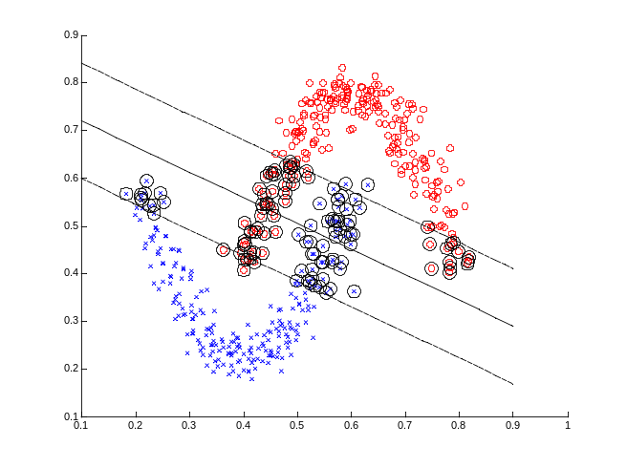
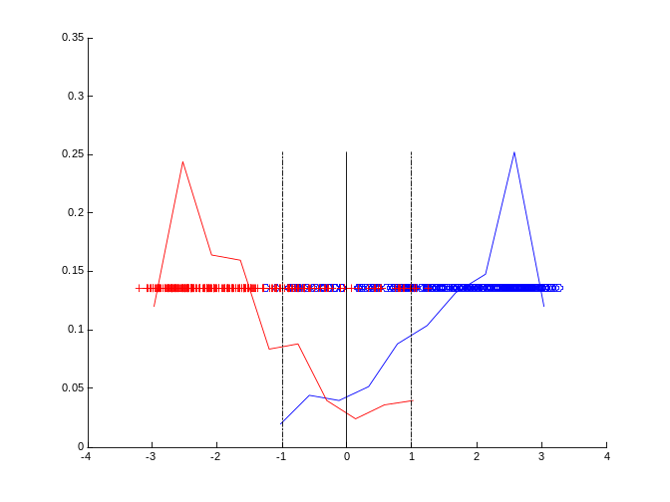


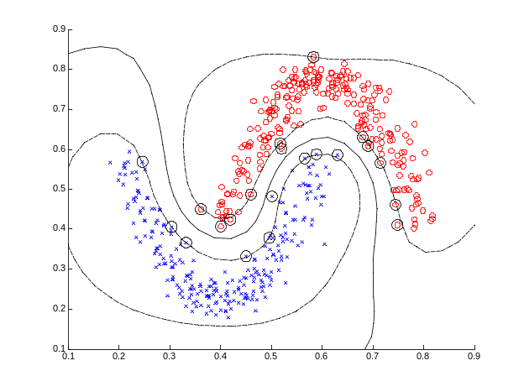
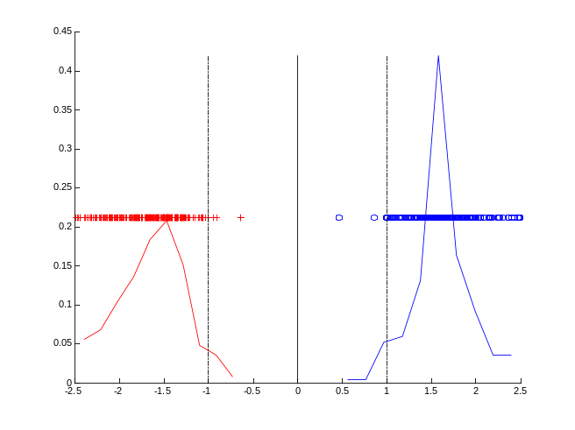

TYPICAL HISTOGRAM OF PROJECTION
Histogram for
Histogram for

Slide 9


MNIST Data (Handwritten 0-9 digit data set)
28 pixel
28 pixel
28 pixel
28 pixel
Digit “5”
Digit “8”
TASK :- Binary classification of digit “5” vs. digit “8”
No. of Training samples = 1000. (500 per class).
No. of Validation samples = 1000.(This independent validation set is used for Model selection).
No. of Test samples = 1866.
Dimension of each sample = 784(28 x 28).

Slide 10
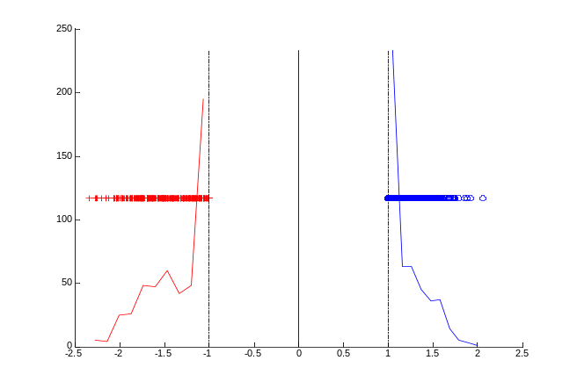
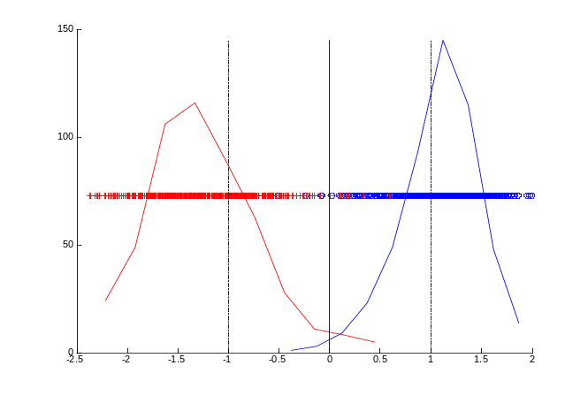
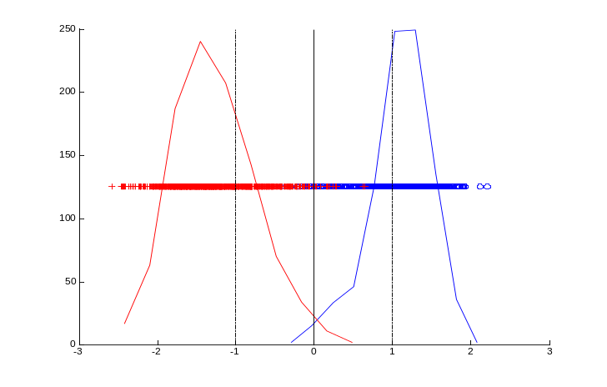
TYPICAL HISTOGRAM OF PROJECTION
(a)Histogram of projections of MNIST training data onto normal direction of RBF SVM decision boundary. Training set size ~ 1,000 samples. Training error(%)=0 (0/1000)
(b)Histogram of projections of MNIST validation data onto normal direction of RBF SVM decision boundary. Validation set size ~ 1,000 samples. Validation error (%)=1.7 (17/1000)
(c)Histogram of projections of MNIST Test data onto normal direction of RBF SVM decision boundary. Test set size ~ 1866 samples. Test error (%)=1.2326(23/1866)

Slide 11
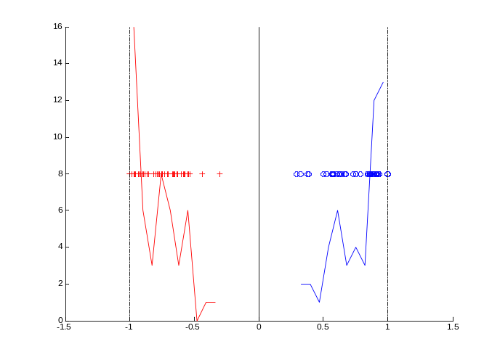
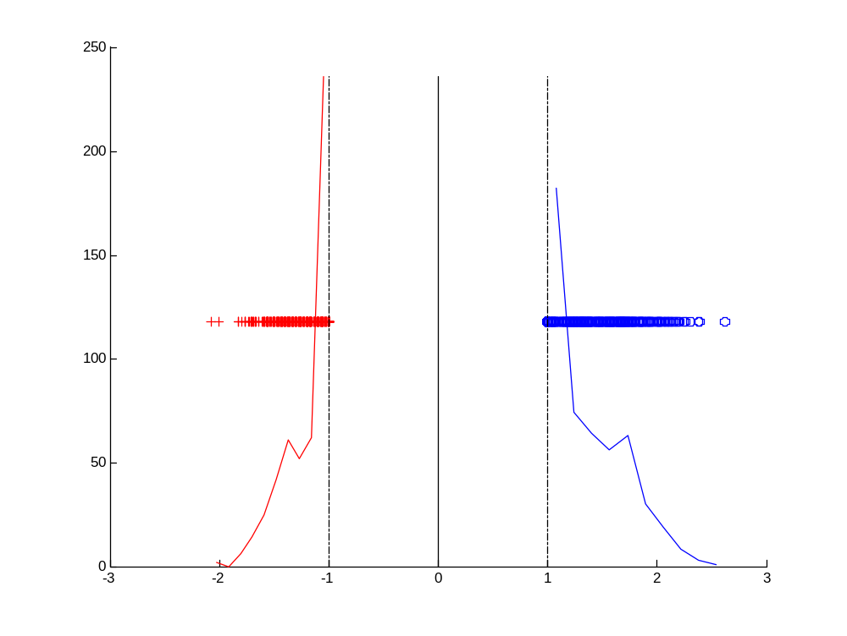
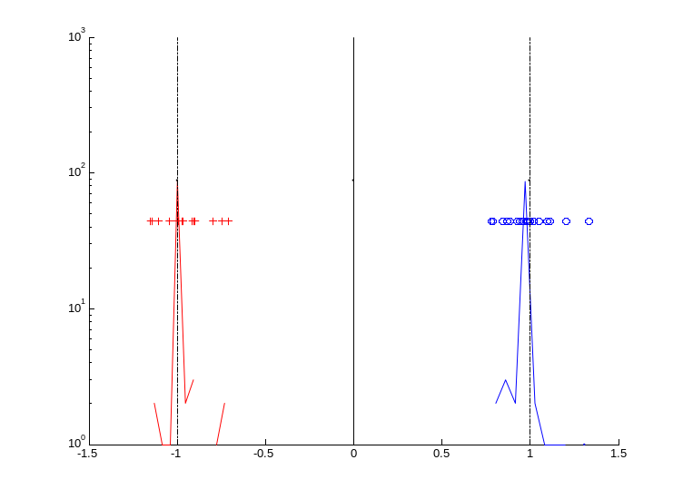
TYPICAL HISTOGRAM FOR HDLSS DATA
CASE 1
CASE 2
CASE 3

Slide 12
UNIVERSUM LEARNING
MOTIVATION OF UNIVERSUM LEARNING
BASICS FOR UNIVERSUM LEARNING
OPTIMIZATION FORMULATION
EFFECTIVENESS FOR UNIVERSUM

Slide 13
MOTIVATION OF UNIVERSUM LEARNING
MOTIVATION
Inductive learning usually fails with high-dimensional, low sample size (HDLSS) data: n << d .
POSSIBLE MODIFICATIONS
  Predict only for given test points → transduction
  A priori knowledge in the form of additional ‘typical’ samples → learning through contradiction
  Additional (group) info about training data → Learning with structured data
  Additional (group) info about training + test data → Multi-task learning

Slide 14



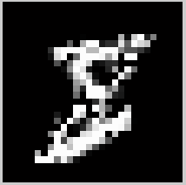

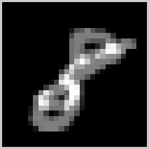

Universum Learning (Vapnik, 1998)
Motivation: include a priori knowledge about the data
Example: Handwritten digit recognition 5 vs. 8 we may Incorporate priori
knowledge about the data space by using:-
  Data samples: digits other than 5 or 8
  Data samples: randomly mixing pixels from images 5 or 8
  Data samples: average of randomly selected examples of 5 and 8

Slide 15
UNIVERSUM LEARNING FOR DUMMIES
Which boundary is better?
CLASS 1
CLASS 2
UNIVERSUM

Slide 16
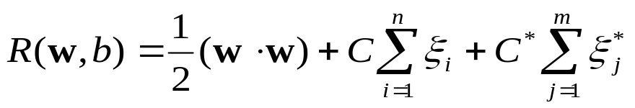












OPTIMIZATION FORMULATION
GIVEN (Labeled samples + unlabeled Universum samples)
Primal Problem
minimize where
subject to
slack variable for Labeled samples
slack variable for Universum samples
NOTE
Universum samples use -insensitive loss
control the trade-off between min error and max
number of contradictions
When → standard soft margin SVM

Slide 17
EFFECTIVENESS OF UNIVERSUM LEARNING
Class 1
Average
Class -1
Hyper-plane
Random Averaging (RA) Universum:
  RA Universum does not depend on application domain
  RA samples expected to fall inside the margin borders
Properties of RA Universum depend on characteristics of labeled training data.
Use the new form of model representation: univariate histograms

Slide 18
CONDITION FOR EFFECTIVENESS OF RA U-SVM
RA U-SVM is effective only for this Type 2 of histogram

Slide 19
EXPERIMENTAL SETUP
DATASETS USED
  Synthetic 1000-dimensional hypercube data set. X~ U[0,1] dimension 1000 of which 200 are significant i.e y=sign(x₁+x₂+…+x₂₀₀ – 100).(We use only Linear SVM)
  No. of Training samples= 1000
  No. of Validation samples = 1000
  No. of Test samples= 5000
  Real-life MNIST handwritten digit data set, where data samples represent handwritten digits 5 and 8. Each sample is represented as a real-valued vector of size 28*28=784.
  No. of Training samples= 1000
  No. of Validation samples = 1000
  No. of Test samples= 1866
  Real-life ABCDETC data set, where data samples represent handwritten lower case letters ‘a’ and ‘b’. Each sample is represented as a real-valued vector of size 100*100=10000.
  No. of Training samples = 150 (75 per class).
  No. of Validation samples = 150 (75 per class).
  No. of Test samples = 209 (105 class ‘a’ , 104 class ‘b’)

Slide 20

MODEL SELECTION
[1]Perform model selection for standard SVM classifier, i.e. choose parameter and kernel parameter. Most practical applications use RBF kernel of the form where possible values of parameter C=[0.01, 0.1, 1, 10, 100, 1000] and γ = [2⁻⁸, 2⁻⁶, …, 2², 2⁴] during model selection.
[2]Using fixed values of and , as selected above, tune additional parameters specific to U-SVM, as follows:
For the ratio C*/C , try all values in the range ~ [0.01, 0.03, 0.1, 0.3, 1, 3, 10] parameter , try all values in the range ε ~ [0,0.02,0.05,0.1,0.2] for the number of Universum, it is suggested to use the number in the range of .If the dimensionality of the data is large, smaller number of samples will be used due to the computational consideration.
where, n= No. of samples in Class 1.
m= No. of samples in Class 2.
Note: steps 1 and 2 above is done by using an independent validation data set.

Slide 21
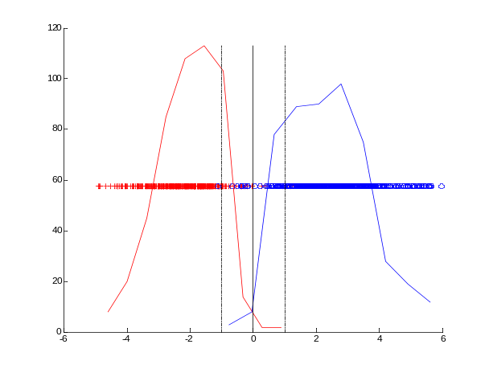
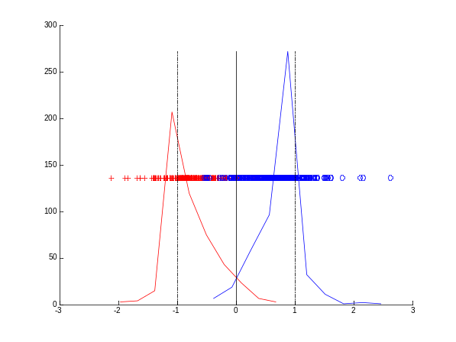
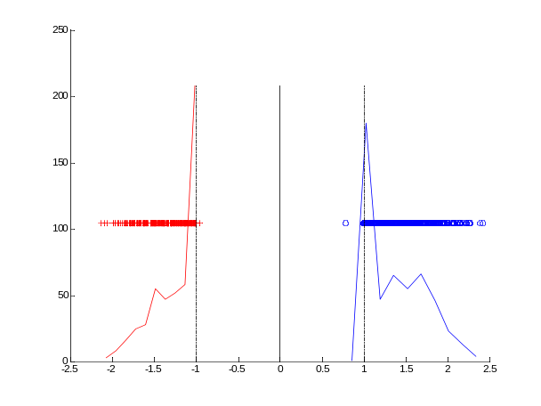
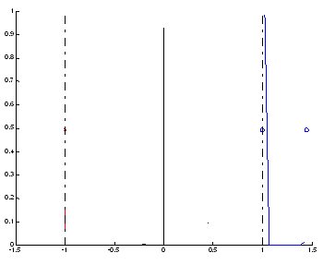
HISTOGRAM OF PROJECTIONS
(a) MNIST data set (b) synthetic data set
Histogram of projections onto normal direction of linear SVM hyperplane.
Histogram of projections of MNIST training data onto normal direction of RBF SVM decision boundary. Training set size ~ 1,000 samples.
Histogram of projections of ABCDETC training data onto normal direction of Polynomial SVM decision boundary with d=3. Training set size ~ 150 samples.

Slide 22
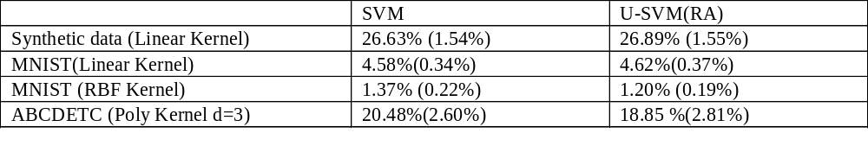
RESULTS
TABLE : Average percent of Test error over 10 partitioning of dataset.(with the standard deviation in parenthesis).

Slide 23
INSIGHTS
FOR EFFECTIVE PERFORMANCE OF RANDOM AVERAGING
Training data is well-separable (in some optimally chosen kernel space).
The fraction of training data samples that project inside the margin borders is small.
QUESTIONS
What are good universum samples?
Can we identify good universum samples using the univariate histogram of projection?

Slide 24
Conditions for Effectiveness of the Universum
The histogram projection of the Universum samples is symmetric relative to (standard) SVM decision boundary.
The histogram projection of the Universum samples has wide distribution between margin borders denoted as points -1/+1 in the projection space.

Slide 25
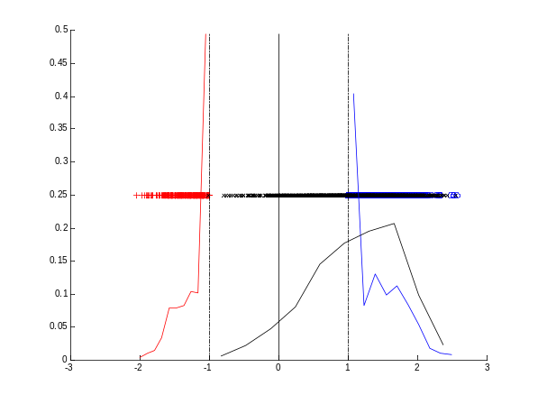
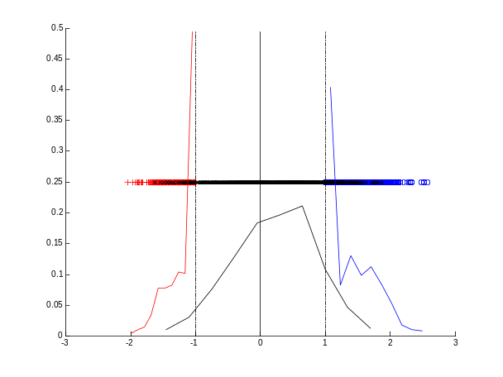

RESULTS
MNIST DATA binary classification ‘5’ vs. ‘8’. UNIVERSUM :- Digit ‘1’, ‘3’ and ‘6’
Digit ‘1’
Digit ‘3’
Digit ‘6’
TABLE : Average percent of Test error over 10 partitioning of dataset.(with the standard deviation in parenthesis). Training /Validation set size is 1000 samples.

Slide 26
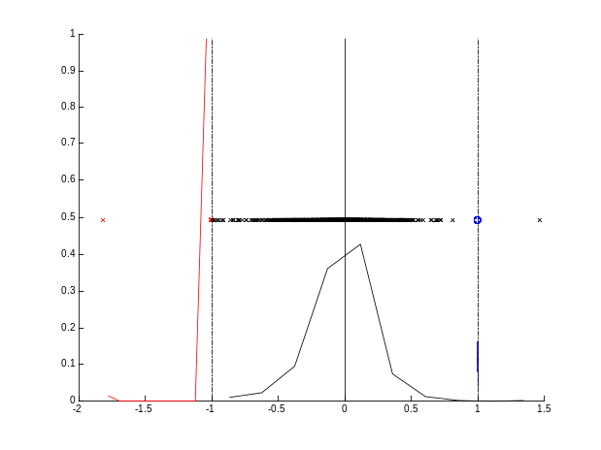
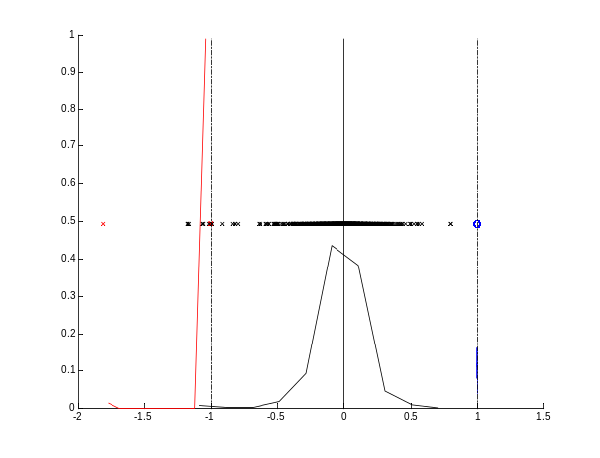
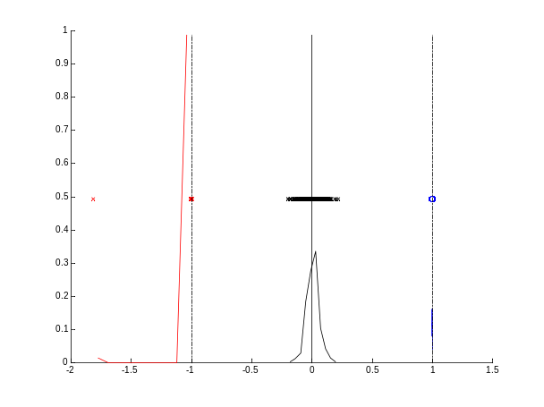
RESULTS
ABCDETC DATA binary classification ‘a’ vs. ‘b’ .UNIVERSUM:- ‘A-Z’ , ‘0-9’, RA Universum samples.
A-Z(uppercase)
0-9(Digits)
Random Averaging
 | SVM | U-SVM (upper case) | U-SVM(all digits) | U-SVM(RA)
Test error | 20.47%( 2.60%) | 18.42 %( 2.97%) | 18.37 %( 3.47%) | 18.85 %( 2.81%)
TABLE : Average percent of Test error over 10 partitioning of dataset.(with the standard deviation in parenthesis). Training /Validation set size is 150 samples.

Slide 27
CONCLUSIONS
PRACTICAL CONDITIONS
Training data is well-separable (in some optimally chosen kernel space).
The histogram projection of the Universum samples is symmetric relative to (standard) SVM decision boundary.
The histogram projection of the Universum samples has wide distribution between margin borders denoted as points -1/+1 in the projection space.
ESSENSE(SIMPLE RULE)
Estimate standard SVM classifier for a given (labeled) training data set
Generate low-dimensional representation of training data by projecting it onto the normal direction vector of the SVM hyper plane estimated in (a);
Project the Universum data onto the normal direction vector of SVM hyper plane, and analyze projected Universum data in relation to projected training data. Specifically, the Universum is expected to yield improved prediction accuracy (over standard SVM) only if the conditions stated above are satisfied.

Slide 28
REFERENCE
FUTURE IDEAS
Devise a scheme to generate the Universum samples that are uniformly spread out within the soft-margin.{-1,+1}
Clever Feature selection using the Universum samples.
Extend Universum for Non Standard Setting.
Extend Universum for Multi-Category case.
[1] Vapnik, V.N., Statistical Learning Theory, Wiley, NY 1998.
[2] Cherkassky, V., and Mulier, F. (2007), Learning from Data Concepts: Theory and Methods, Second Edition, NY: Wiley.
[3] Weston, J., Collobert, R., Sinz, F., Bottou, L. and Vapnik, V., Inference with Universum, Proc. ICML 2006
[4] Vladimir Cherkassky and Wuyang Dai,'Empirical Study of the Universum SVM Learning for High-Dimensional Data',ICANN 2009.
[5] Sinz, F. H., O. Chapelle, A. Agarwal and B. Schölkopf, ‘An Analysis of Inference with the Universum.’ Advances in Neural Information Processing Systems 20: Proceedings of the 2007 Conference, 1369-1376. (Eds.) Platt, J. C., D. Koller, Y. Singer, S. Roweis, Curran, Red Hook, NY, USA (09 2008)
[6] Vladimir Cherkassky , Sauptik Dhar and Wuyang Dai,"Practical Conditions for Effectiveness of the Universum Learning“,IEEE Trans. on Neural Networks,May 2010.(submitted).
[7] Vladimir Cherkassky , Sauptik Dhar,"Simple Method for Interpretation of High-Dimensional Nonlinear SVM Classification Models",The 6th International Conference on Data Mining 2010.(submitted).

Slide 29
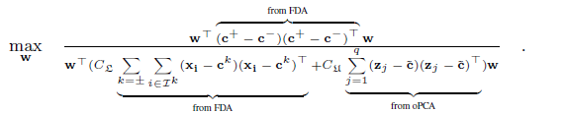
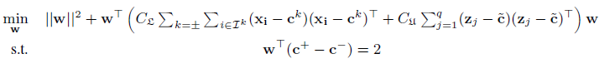
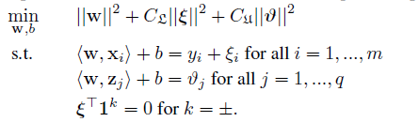
THEORETICAL INSIGHTS
PROBLEM 1
PROBLEM 2

